Slide 1
FGAI4H-M-025-A03
E-meeting, 28-30 September 2021
Source: | TG-Endoscopy Topic Driver
Title: | Att.3 – Presentation (TG-Endoscopy)
Purpose: | Discussion
Contact: | Junbo Li Suzhou Institute of Biomedical Engineering and Technology, Chinese Academy of Sciences China | E-mail: lijb@sibet.ac.cn
Abstract: | This PPT contains brief introduction to ultrasonic endoscopy.

Slide 2
Endoscopic Ultrasound

Slide 3
Endoscopic Ultrasound (EUS) is a minimal invasive procedure in which endoscopy is combined with ultrasound to obtain images of the internal organs.
EUS is most commonly used in the upper digestive tract and the respiratory system for the diagnosis and staging of benign and malignant lesions.
Indications of EUS
staging of GI malignancies
evaluating pancreaticobiliary disease
evaluating subepithelial abnormalities
evaluating extraluminal abnormalities
staging of lung cancer
therapeutic EUS.

Slide 4
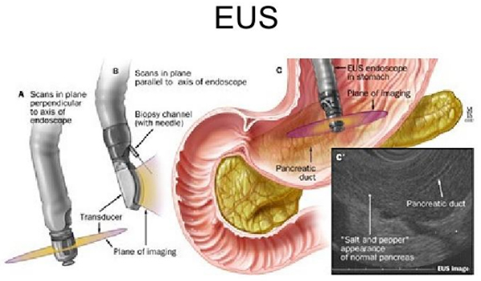
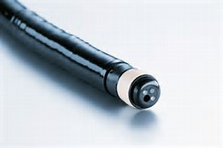
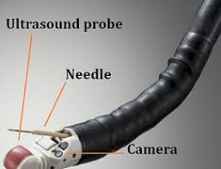
Ultrasound probe
Miniature probe
Working Channel
Camera
Radial scan probe
Ultrasound probe
Working Channel
Camera
Linear array probe

Slide 5
Major players in endoscopic ultrasound
Company | Endoscopic ultrasound |  |  | Clinical application
 | Mini-probe | Radial Scan | Linear Array | GI tract | Respiratory
Olympus | X | X | X | X | X
Pentax |  | X | X | X | X
Fujifilm | X | X | X | X | X
Reports on AI for endoscopic ultrasound are limited
Clinical areas: Pancreatic diseases, neuroendocrine tumor,
Datasets: small, retro 388 cases, pros 167 cases
No commercial product available on the market

