Slide 1
FGAI4H-M-023-A03
E-meeting, 28-30 September 2021
Source: | TG-Radiology Topic Driver
Title: | Att.3 – Presentation (TG-Radiology)
Purpose: | Discussion
Contact: | Darlington Ahiale Akogo minoHealth AI Labs Ghana | Email: darlington@gudra-studio.com
Abstract: | This PPT contains a presentation of M-023-A01.

Slide 2
Topic Group on AI for Radiology
Darlington Akogo Topic Driver
Founder, Executive Director
minoHealth AI Labs
darlington@gudra-studio.com

Slide 3
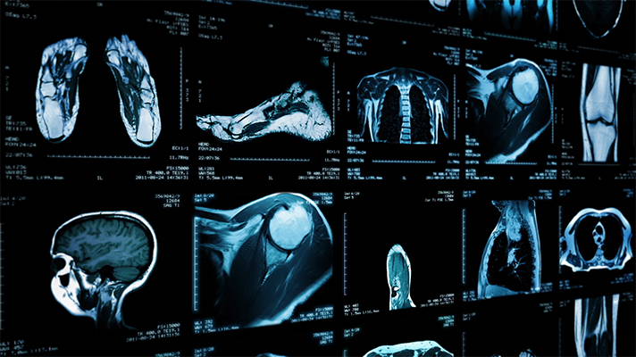
AI in Radiology - Overview
AI systems in radiology have achieved impressive results. They outperformed radiologists in some cases.
Challenge in properly testing AI radiological systems and ensuring they work in all edge and diverse cases radiologists encounter.
Study analysed 31,587 AI healthcare studies, only 69 studies provided enough data enabling calculation of test accuracy. Only 25 studies further did out-of-sample external validations. And further, only 14 of such studies compared the models’ performances to that of radiologists. (Liu et al., 2019)
Standardisation and benchmarking is required.

Slide 4
Objectives
TG-Radiology is dedicated to the development of global standards for the evaluation and benchmarking of AI radiological systems.
We are also collecting diverse data towards the assessment of AI radiological applications.

Slide 5
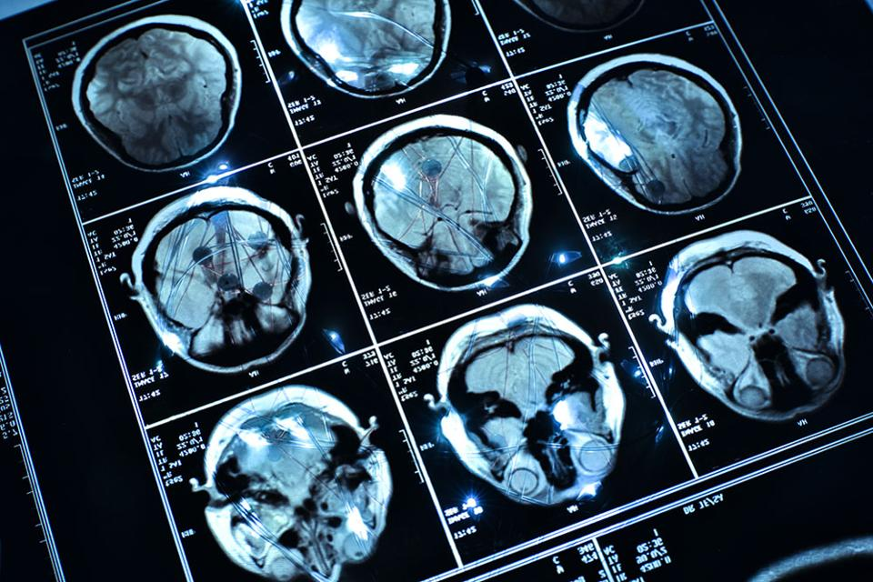
Timeline
21-24​ Jan 2020 - TG-Radiology was officially created at Meeting H, Brasilia
30 Jan 2020 - Call for Participants published
25 Feb 2020 - First Zoom meeting
26 Mar 2020 - First TDD submission (Radiograph-agnostic framework for AI Evaluation)
7-8 May 2020 - 9th FGAI4H Meeting (Use Cases & Existing Solutions)
27 Nov 2020 - TG virtual meeting
16 April 2021 - TG virtual meeting
21 May 2021 - 12th FGAI4H Meeting (Existing work on benchmarking)
Current - Updated TDD for ​​13th Meeting

Slide 6
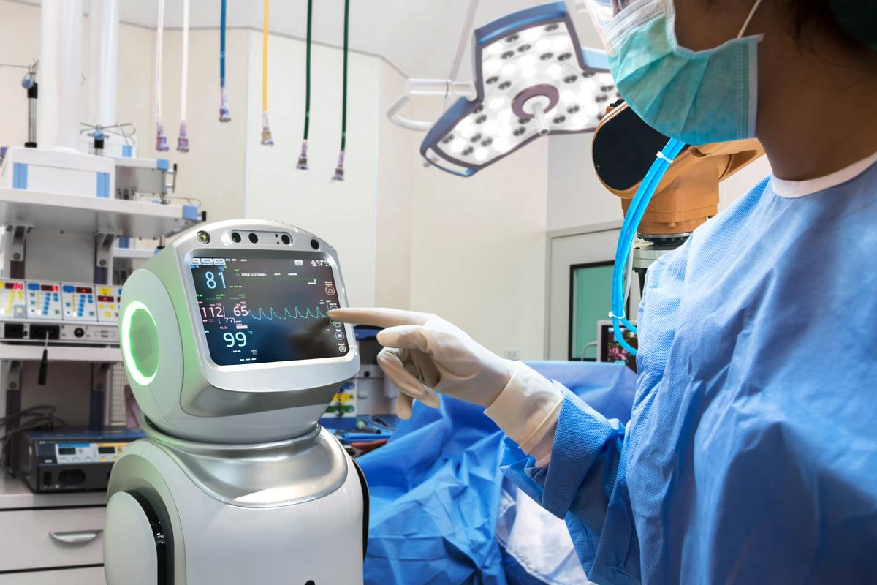
Participants
26 participants currently
From 5 continents; Africa (6), North America (5), South America (7), Europe (3), Asia (4)
11 organisations; AI providers (6), other digital health providers (2), health centers (4), universities (9)

Slide 7
Current Contributors to TDD (14 participants)
Vincent Appiah, minoHealth AI Labs, GUDRA Xavier Lewis-Palmer, minoHealth AI Labs, GUDRA Issah Abubakari Samori, minoHealth AI Labs, GUDRA Camilo Sotomayor, IA·TRad Chile & Clinical Hospital University of Chile Andrew Murchison, Oxford University Hospitals NHS Foundation Trust Benjamin Dabo Sarkodie, Euracare Advanced Diagnostic Center Alessandro Sabatelli, Braid.Health Daniel Hasegan, Braid.Health Pierre Padilla-Huamantinco, Universidad Peruana Cayetano Heredia Judy Wawira Gichoya, Emory University School of Medicine Saul Calderon Ramirez, De Montfort University (Metrics deliverables)
Edson Mintsu Hung, Universidade de Brasília Andrey O. O. dos Reis, Universidade de Brasília Renam Castro da Silva, Universidade de Brasília

Slide 8
Topic Description Document
Topic Description Overview of Radiology, Challenges facing Radiology, Overview of AI in Radiology, Challenges Facing Overview AI in Radiology, Impact of Benchmarking
Precision Evaluation framework and platform A radiograph-agnostic benchmarking platform and framework
Existing AI Solutions & Use Case: 29 conditions, X-Ray/body part classification (56 parts), 3+ modalities Image Conversion Considerations & Guidelines: 3 approaches and their Advantages and Disadvantages

Slide 9
Topic Description Document
22 metrics and scores - Threshold Metrics, Ranking Metrics, Probability Metrics - image classification, object detection, instance & semantic segmentation tasks
11 imaging modalities
Image Compression Considerations

Slide 10
Existing work on benchmarking
Identified 7 research papers
Summarised 3 of the papers
Several performance metrics have been proposed and a few are listed; Area under the curve(AUC), Accuracy, F1 score, Sensitivity and specificity (Park & Han, 2018)
Benchmarking should also take into account the annotation of data. Is the data labeled, unlabeled or semi-labeled?. This will determine what AI models and performance metrics to use.
A lot of factors should be considered when applying AI models; type of data, sample size, computational cost,etc. (Tang et al,2018)
NHS AI Lab: created the National COVID-19 Chest Imaging Database (NCCID), currently with over 40,000 images.

Slide 11
Image Compression Considerations (Updated) - TDD
Edson Mintsu Hung, Andrey O. O. dos Reis, Renam Castro da Silva Universidade de Brasília
Ensuring input data integrity and quality JPEG, JPEG 2000 and PNG image codec formats, effects of compression methods and compression quality on model performance (inference stage) Knowing ideal compression and image size for each use case, and regulating that during deployment is essential Updates:
Additional experiments with Brain Tumor classifiers
A library was developed that calculates a set of metrics, such as, accuracy, sensitivity, specificity, F-Score, etc. for testing different compression and downsizing in a dataset.

Slide 12
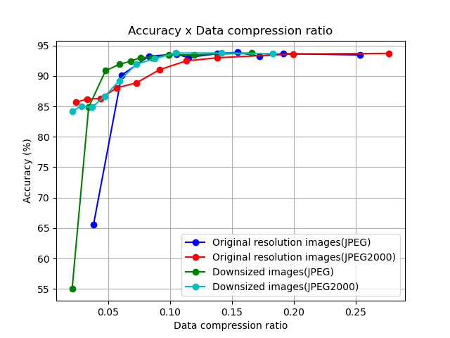
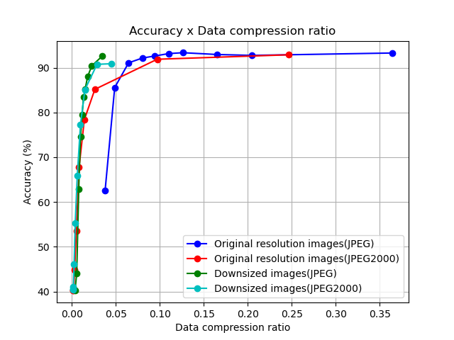
Figure 1: Impact of the compression in the test dataset accuracy of the COVID-Next classifier.
Figure 2: Impact of the compression in the test accuracy of the Brain Tumor classifier.

Slide 13
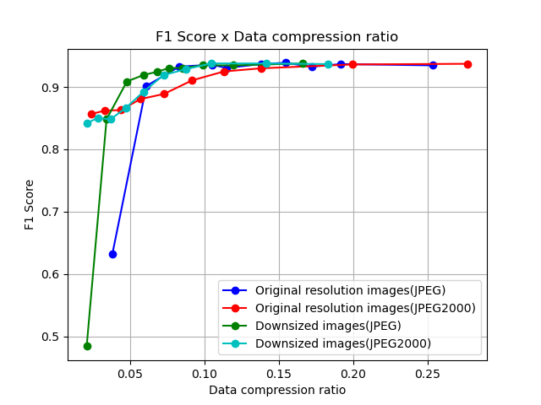
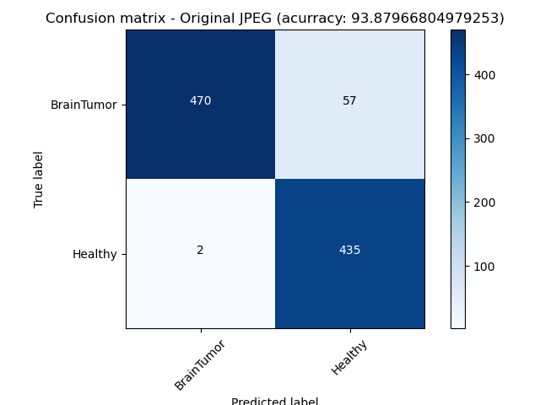
Figure 3: Impact of the compression in the test accuracy of the Brain Tumor classifier.
Figure 4: Confusion Matrix of the Brain Tumor classifier test accuracy of a JPEG compression scenario.

Slide 14
Ethical Considerations
Samori Issah, minoHealth AI Labs
Bias in AI models adopted from the false patterns in training data
Bias in AI models due to lack of representation in training data
Transparency, balanced datasets across target classes and demographics
Data ownership & ethics: patient consent in using their medical data vs greater good
Data ownership & ethics: profit sharing with patients
Early access to AI potentially can further widen inequality
Legal liability: who should be responsible: developer vs clinician vs hospital?

Slide 15
Reading Race: AI Recognises Patient's Racial Identity In Medical Images
Judy Wawira, Emory University School of Medicine (Banerjee, I, et al, 2021)
12 experiments that show that AI models can predict self-reported race across multiple imaging modalities, various datasets, and diverse clinical tasks
performance persists during the external validation across academic centers and patient populations in the US
Ablations were performed that demonstrate this detection is not due to trivial proxies, such as body habitus, age, tissue density or other potential imaging confounders for race such as the underlying disease distribution in the population
They show that the features learned appear to involve all regions of the image and frequency spectrum, suggesting that mitigation efforts will be challenging

Slide 16
Evaluation Metrics
10 additional metrics used for multi-label classification:
Exact Match Ratio (EMR), Hamming Loss, Example-Based Accuracy, Macro Averaged Accuracy, Micro Averaged Accuracy, Macro Averaged Precision, Micro Averaged Precision, Macro Averaged Recall, Micro Averaged Recall, and Alpha evaluation score.
Update: 32 metrics and scores - Threshold Metrics, Ranking Metrics, Probability Metrics - image classification, binary, multiclass and multilabel classification, object detection, instance & semantic segmentation tasks

Slide 17
Next Steps
Major portions of our TDD already completed
So our focus in the next few months would be Auditing trials with the Benchmarking platform team (implementing the various portions of the TDD)
We have 10 new people (ML, Clinical, Software platform, Regulatory, Ethical experts)
1st TG-Radiology audit meeting: 5th October, Tues, 2 PM CET

Slide 18
Topic Group on AI for Radiology
Darlington Akogo Topic Driver
Founder, Executive Director
minoHealth AI Labs
darlington@gudra-studio.com

