Slide 1
FGAI4H-M-019-A03
E-meeting, 28-30 September 2021
Source: | TG-Psy Topic Driver
Title: | Att.3 - Presentation (TG-Psy)
Purpose: | Discussion
Contact: | Nicolas Langer, University of Zurich Stefan Haufe, Charité | E-mail: n.langer@psychologie.uzh.ch
Abstract: | This PPT summarizes the status of work within TG-Psy, for presentation and discussion during the meeting.

Slide 2
Prediction of Psychiatric Multimorbidity in a Large Pediatric Sample
Department of Psychology/Methods of Plasticity Research
Prof. Nicolas Langer University of Zurich
Department of Psychology Methods of Plasticity Researcch
Dr. Stefan Haufe Charité
Universitätsmedizin Berlin
Berlin Center for Advanced Neuroimaging (BCAN)
FG-AI4H meeting Online (Geneva) January 29 2021

Slide 3
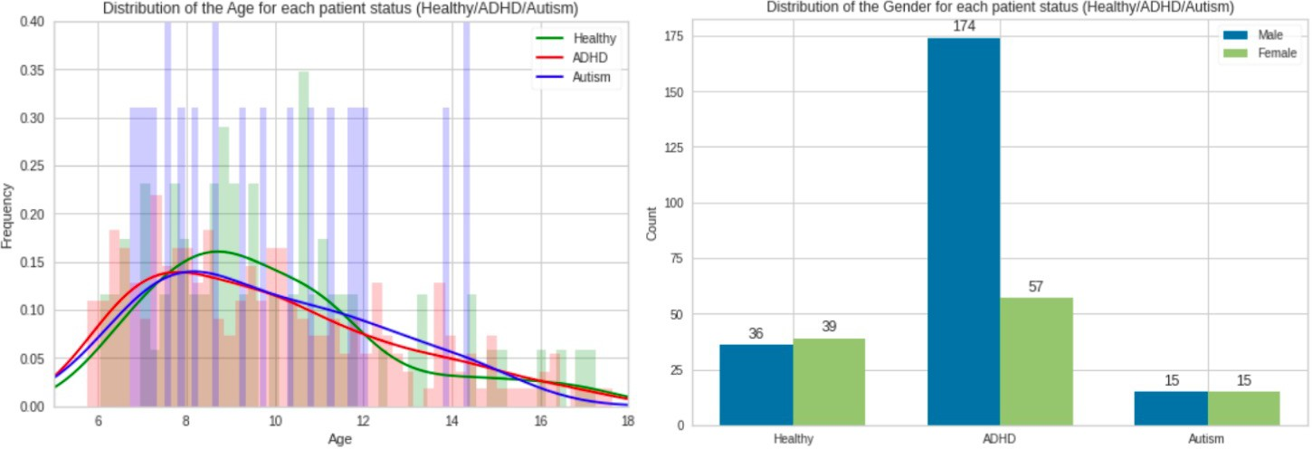
Data availability: Sample
Update: data collection stopped because of COVID-19 outbreak
Healthy Brain Network (HBN) sample
Training Data:
current release: 1602 subjects
Age 5-21 years
Population: typical developing children and children with psychiatric developmental disorders (~70/ multimorbidities)
Test Data (November 8th, 2019):
Subsample of training data
8th release: approx. 400 subjects / year
3

Slide 4
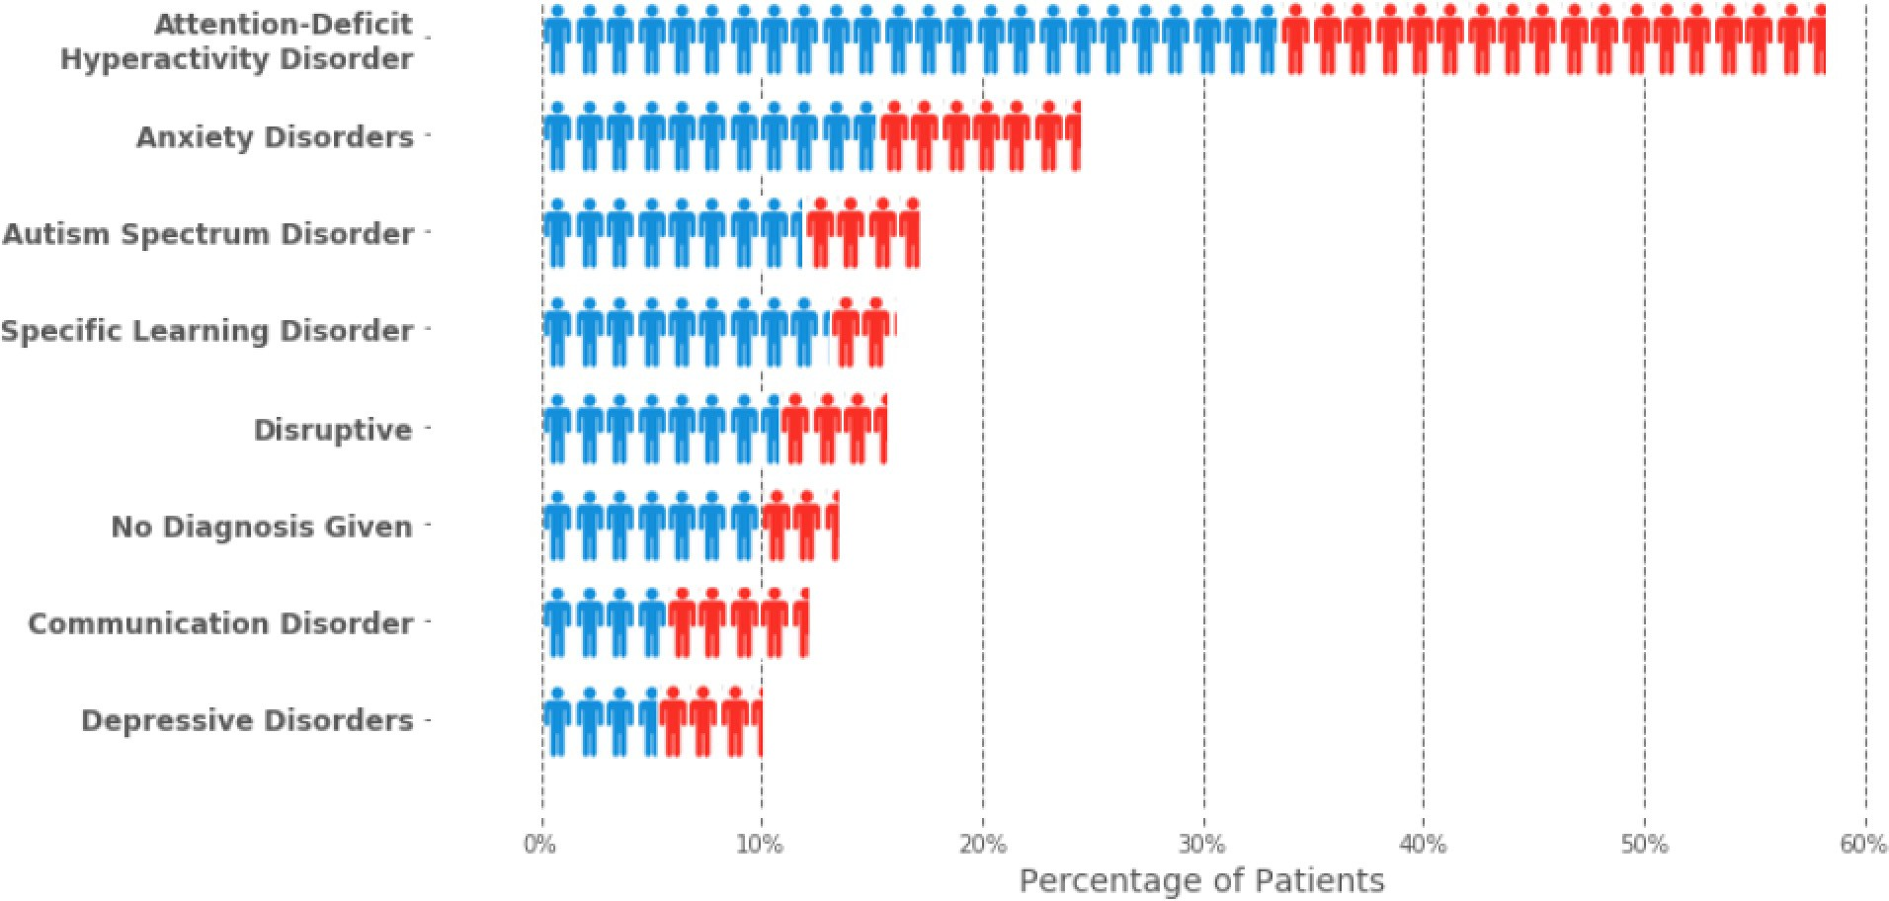
Data availability: Sample
Healthy Brain Network (HBN) sample
Training Data:
current release: 1602 subjects
Age 5-21 years
Population: typical developing children and children with psychiatric developmental disorders (~70% multimorbidities)
Test Data (November 8th, 2019):
Subsample of training data
8th release: approx. 400 subjects / year
Male Female
4

Slide 5
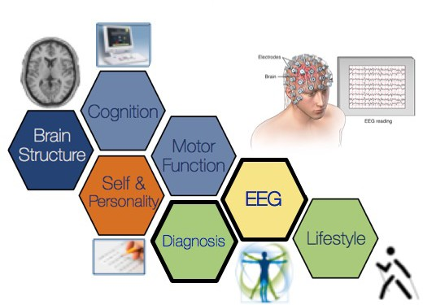
Data availability: Data
Demographics
Age, gender
Cognitive Data
e.g. WISC
Behavioral Data
Questionnaires (SWAN)
resting EEG
Raw data
Preprocessed data
EEG features
– e.g. theta-beta ratio, alpha asymmetry
Possibly T1-weighted MRI images
Source reconstruction
Cortical thickness
Prediction of Diagnosis
– DSM-V consensus diagnosis
Annotation Quality:
•
based on the decision of a clinical team
all interviews and materials conducted as basis for the DSM-5 consensus diagnosis
conducted by licensed clinicians
4

Slide 6
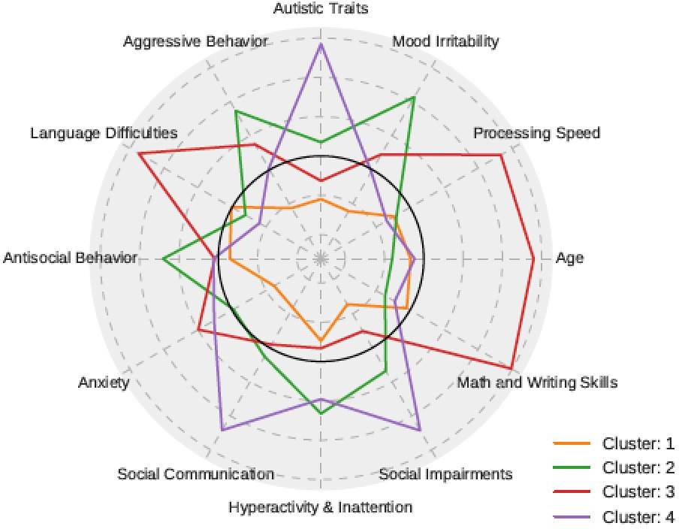
Data availability: Data
Cognitive & Behavioral Data:
Demographics
Cognition / Intelligence (e.g. WIAT, WISC-V, NIH- Toolbox)
Medical history (e.g. addiction family history)
Family structure, stress and trauma (negative life events, parenting)
Personality traits (Big 5, self-esteem)
Coping Strategies (communication skills, interpersonal factors)
Physical measures (e.g. bio-electric impedance analysis, BMI, Metabolic rate, heart rate, blood pressure, height, weight, handedness,…)
Social status (SES, parents education, family structure)
Nr. of features: ~270 (self-/ parent-/ teacher-report)
6

Slide 7
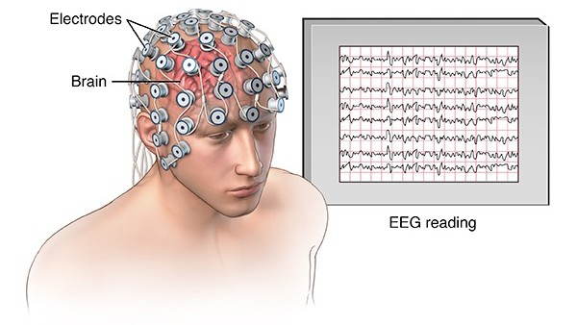
Data availability: Data
Raw EEG:
5 min.
Eyes closed (40 s) & eye open (20 s)
128 electrodes (Geodesic EGI system)
sampling rate 500 Hz
Nr. of features: ~ 150’000
• Demographics
– Age, gender
• Cognitive Data
– e.g. WISC
• Behavioral Data
– Questionnaires (SWAN
)
resting EEG
– Raw data
– Preprocessed data
– EEG features
– e.g. theta-beta ratio, alpha asymmetry
• Possibly T1-weighted MRI images
– Source reconstruction
– Cortical thickness
7

Slide 8
Update:
- all availabe data preprocessed and made publicly available
Prerequisite for Biomarker Research: Reliability of measures
Prerequisite for Reliability: Standardized Preprocessing
Automagic
• Demographics
– Age, gender
• Cognitive Data
– e.g. WISC
• Behavioral Data
– Questionnaires (SWAN
Pedroni, Bahreini Langer, (2018), biorXiv
)
resting EEG
– Raw data
– Preprocessed data
https://github.com/methlabUZH/automagic
– EEG features
– e.g. theta-beta ratio, alpha asymmetry
Preprocessed EEG:
Number of features: ~ 150’000
8

Slide 9
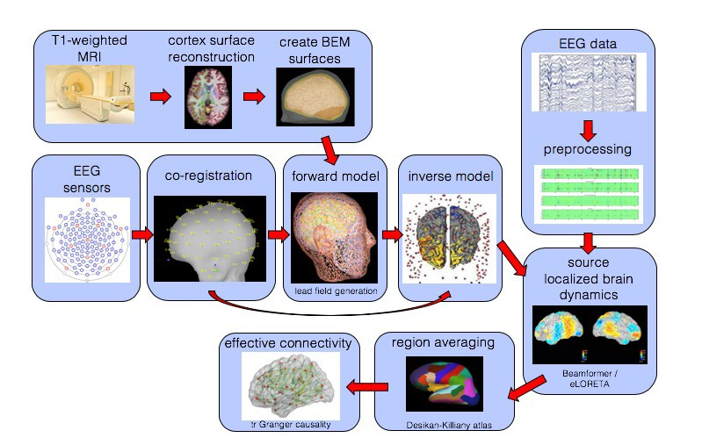
Update:
- finished pipeline for functional connectivity features – manuscript in progess
Combined MRI and EEG analysis
Time-reversed granger causality
9

Slide 10
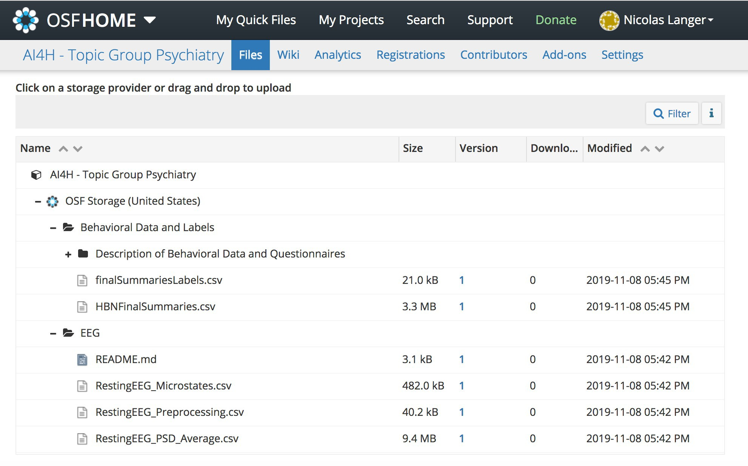
Data Availability
Only preprocessed features so far
No raw data
https://osf.io/ajhgy/wiki/home/
11

Slide 11
Webpage for Project
https://methlabuzh.wixsite.com/mysite
(best appearance in Chrome)

Slide 12
Benchmarking
Task:
prediction of multiple disorders from demographic, phenotypical (cognitive and behavioral) and EEG data
Training: on public HBN data
Benchmarking: on future releases of HBN data sets (approx. 500 subjects / year)
Implementation: participants submit executable code
Standardized input (data folder) and output (binary classification matrix)
Container architecture (docker/kubernetes)
Free choice of development tools for participants
Safe for organizers
Cloud computing: GCP/AWS or similar
Challenge platform: crowdai.org/Kaggle etc.
WE NEED HELP HERE
EvalAI, AIcrowd, crowdai.o^{rg,}
kaggle.com or ramp.studio

Slide 13
Performance metrics
D disorders
D disorders
1 | 1 | 1
1 | 1 | 1
0 | 0 | 0
0 | 1 | 1
1 | 1 | 1
1 | 1 | 0
1 | 0 | 1
0 | 1 | 1
0 | 0 | 1
0 | 0 | 0
1 | 1 | 1
0 | 1 | 0
1 | 1 | 0
1 | 1 | 1
N subjects
N subjects
Y^{true} : true test labels
Y^{pred} : predicted labels
Main metric (used for ranking): multi-task accuracy
Secondary metrics: F1-score, sensitivity, specificity, precision, recall
Multi-task metrics for continuous labels (severity scores) available.

Slide 14
Timeline
Idea: continuous prediction challenge
Participant teams can refine and upload containers any time
Benchmarking of most recent containers each time new data are released
Time stamp system allows public release of test set without delay
Tracking progress over time as new releases become available
Initial training phase
Team 1
Team 2
Team 3
2019
2020
2021

Slide 15
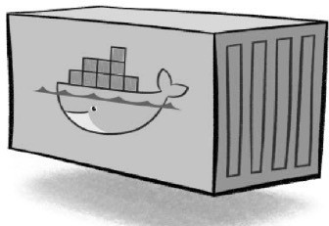
Timeline
Idea: continuous prediction challenge
Participant teams can refine and upload containers any time
Benchmarking of most recent containers each time new data are released
Time stamp system allows public release of test set without delay
Tracking progress over time as new releases become available
Initial training phase
New data release
Team 1
Team 2
Eligible for benchmarking
Team 3
2019
2020
2021

Slide 16
Timeline
Idea: continuous prediction challenge
Participant teams can refine and upload containers any time
Benchmarking of most recent containers each time new data are released
Time stamp system allows public release of test set without delay
Tracking progress over time as new releases become available
Initial training phase
Refinement phase
Team 1
Team 2
Team 3
2019
2020
2021

Slide 17
Timeline
Idea: continuous prediction challenge
Participant teams can refine and upload containers any time
Benchmarking of most recent containers each time new data are released
Time stamp system allows public release of test set without delay
Tracking progress over time as new releases become available
Initial training phase
Refinement phase
Team 1
Team 2
Team 3
...
2019
2020
2021

Slide 18
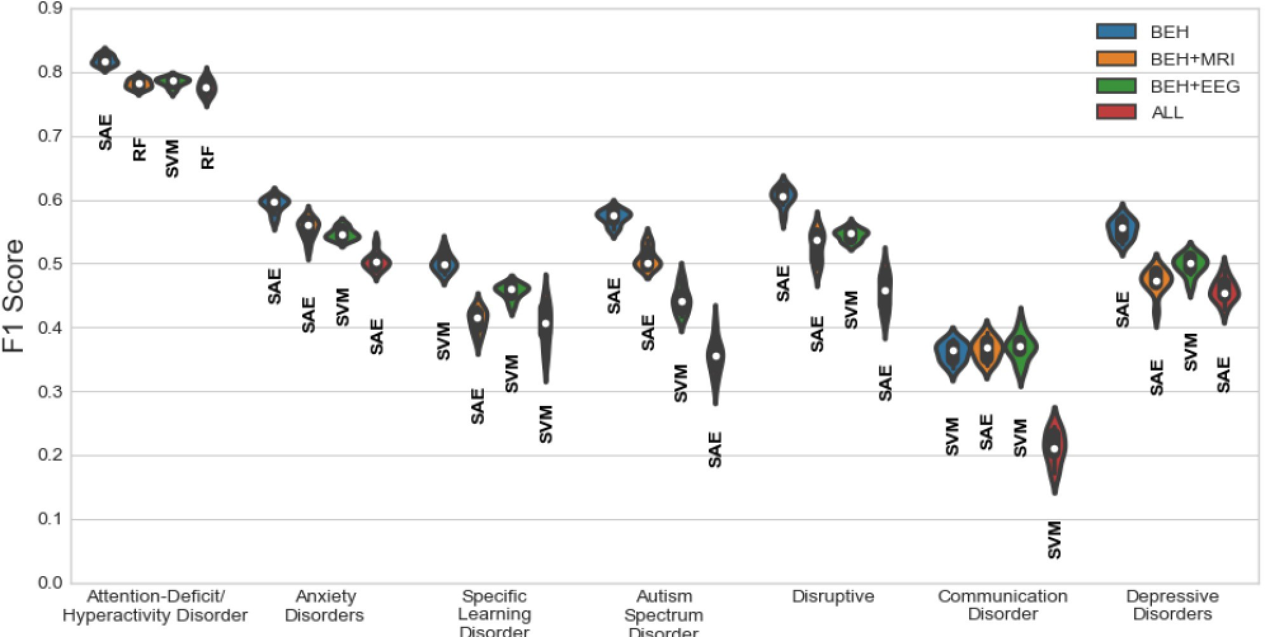
First Benchmarking Results
The multi-class, multi-label problem was decomposed into several binary classification tasks.
Support Vector Machines (SVM), Logistic Regression (LGR), Random Forest (RF) Supervised Autoencoder (SAE): An autoecoder-based model

Slide 19
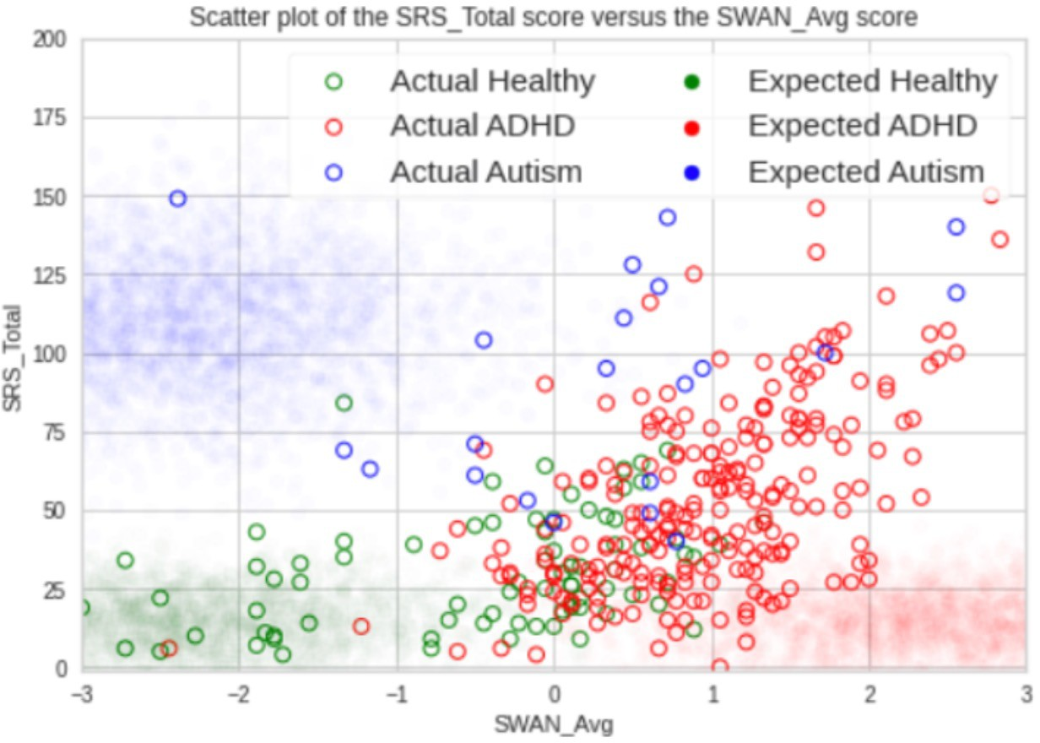
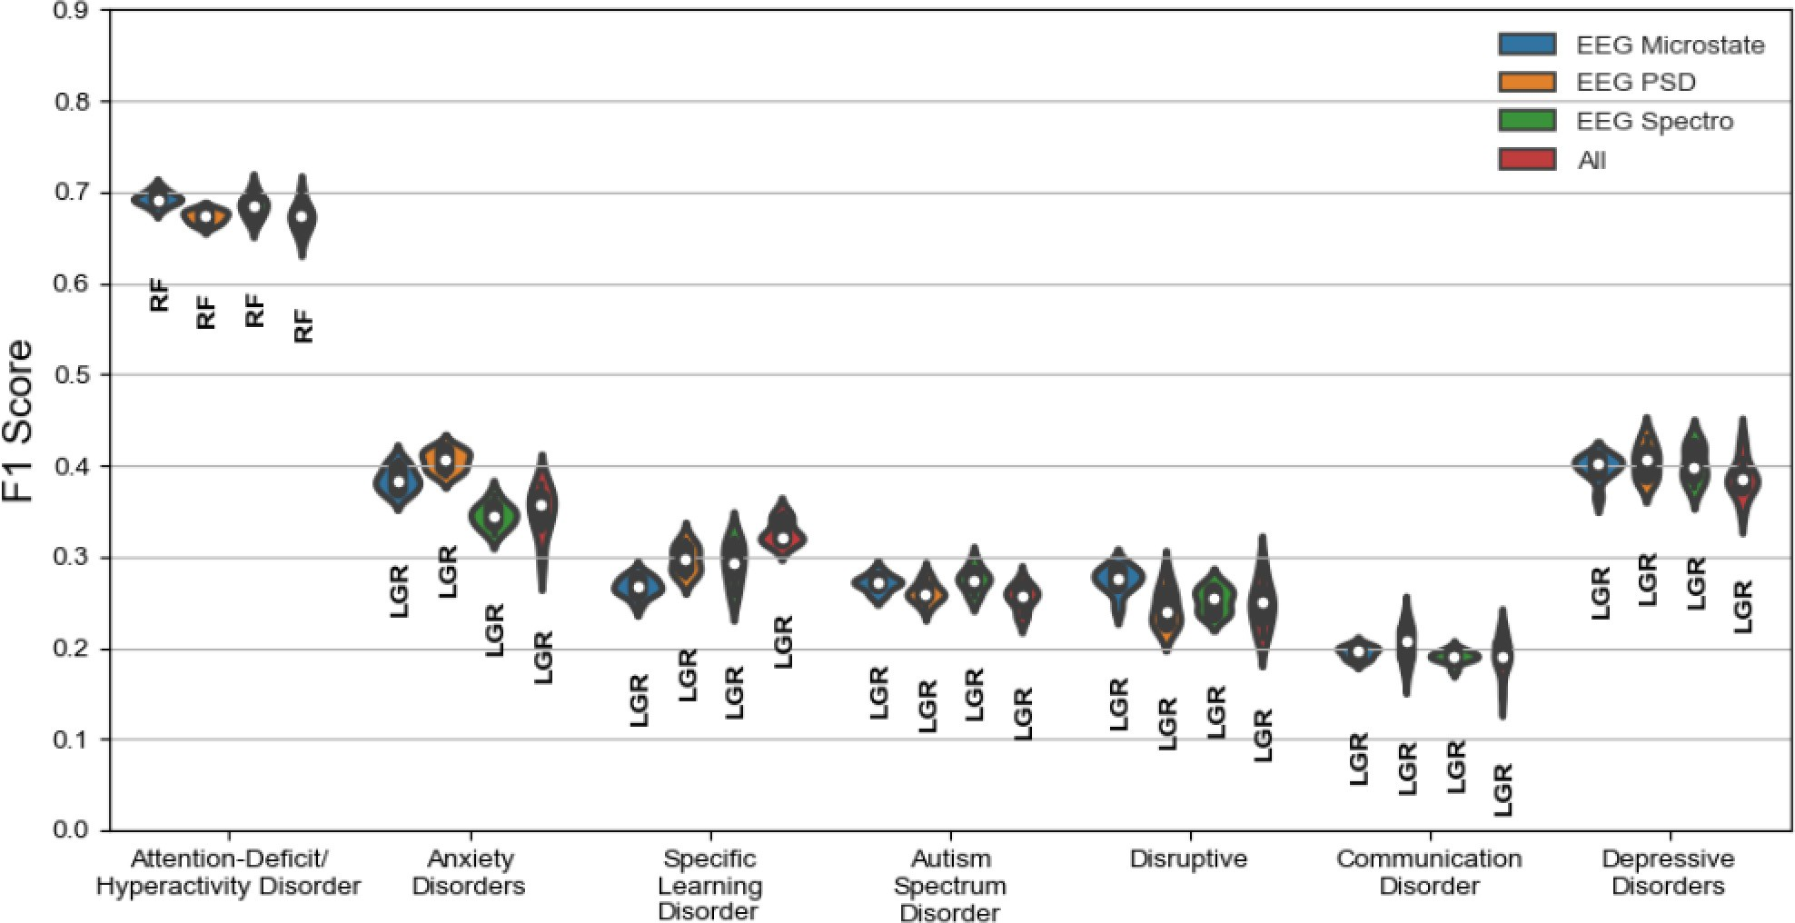
First Benchmarking Results
The multi-class, multi-label problem was decomposed into several binary classification tasks.
Support Vector Machines (SVM), Logistic Regression (LGR), Random Forest (RF) Supervised Autoencoder (SAE): An autoecoder-based model

Slide 20
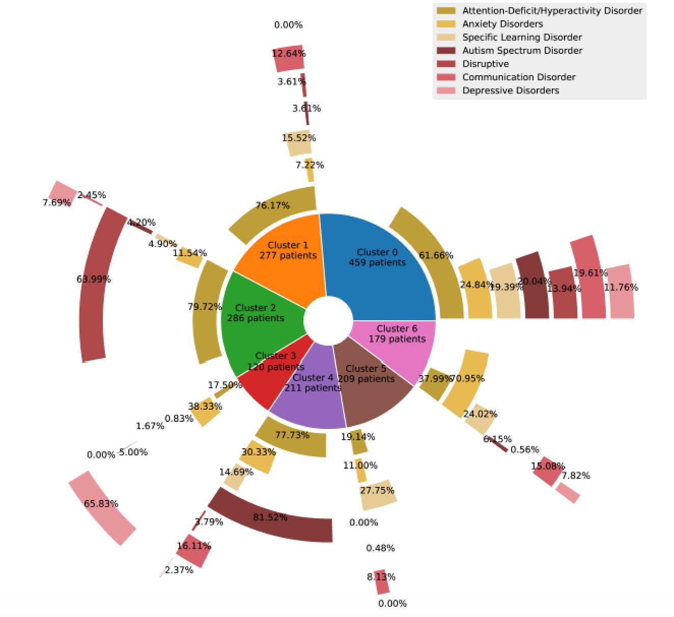
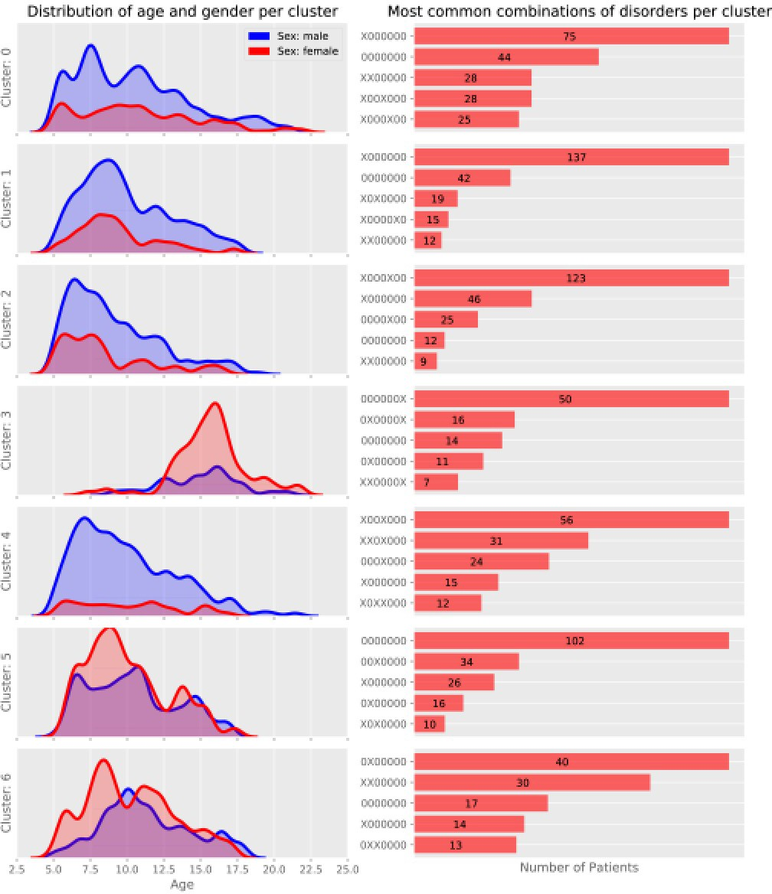
First Benchmarking Results
Alternative Approach: Data-Driven Subgroups using k-means clustering
22

Slide 21
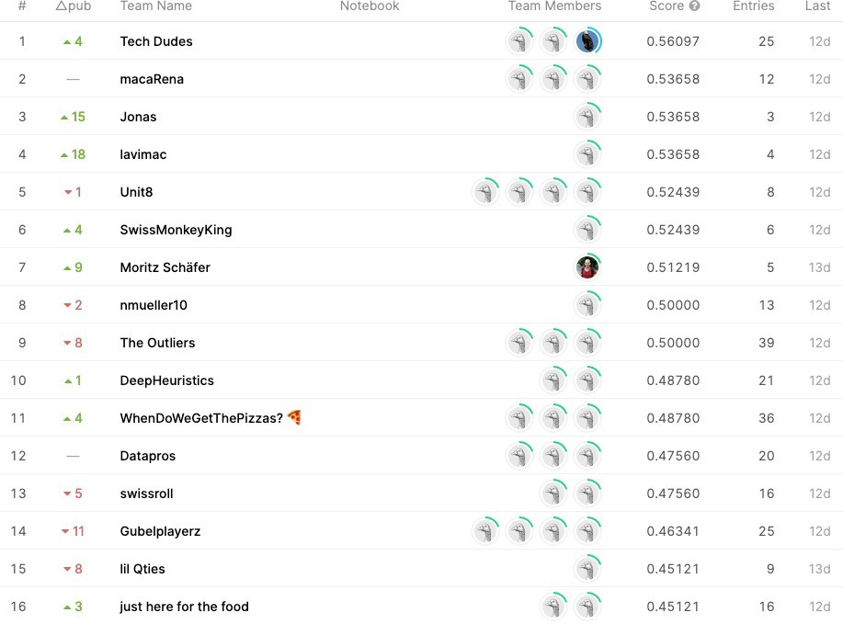
Benchmarking
Competition at datathon 2021
https://www.kaggle.com/c/datathon21-eeg/overview
Leaderboard
24

Slide 22
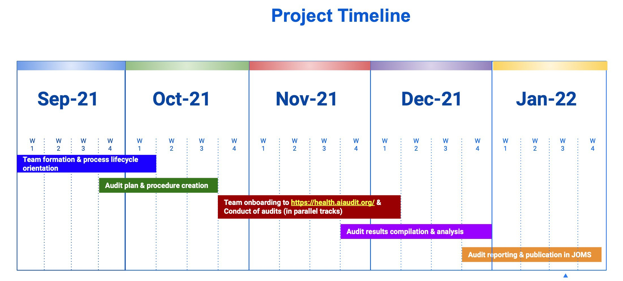
FG-AI4H Trial Audits 2.0
Team:
Anuja Negi (Meta-advisory Expert)
2. Johannes Starlinger (Meta-advisory Expert)
3. Lukas Picek (Ethical Expert)
4. Mahta Mousavi (Meta-advisory Expert)
MLH4 Trial Audits Meetings
Markus Wenzel (ML Expert)
Nicolas Langer (TG Driver / Domain Expert)
Nikita Agarwal (Software Platform Expert / Audit Developer)
Shobha Iyer (Regulatory Expert)
Stefan Haufe (ML Expert) 10.Clinical Expert to be allotted soon

Slide 23
Next Steps:
Work on J-105 document
Quantifying uncertainty (PhD student Maurice Weber, ETH)
Submit benchmark paper to Neuroimage (December 2021)
Set up a framework for automated benchmarking for new algorithm submission (AI4H Trial Audit)

Slide 24
THANK YOU FOR YOUR ATTENTION

