Slide 1
FGAI4H-M-016-A03
E-meeting, 28-30 September 2021
Source: | TG-Neuro Topic Driver
Title: | Att.3 - Presentation (TG-Neuro)
Purpose: | Discussion
Contact: | Ferath Kherif CHUV - LREN Switzerland Marc Lecoultre Switzerland | E-mail: Ferath.kherif@chuv.ch
Abstract: | This PPT summarizes the status of work within TG-Neuro, for presentation and discussion during the meeting.

Slide 2
TG-Neuro
Aim: investigate machine learning-based diagnostics for neurodegenerative diseases (Alzheimer's disease, Parkinson's Disease, and related dementia syndromes, which are located within the neurological domain of the DSM V) based on real-world imaging and genetic information.
Relevance: As the population ages, the chance of becoming demented is on the rise. Current estimates suggest that there are approximately 48 million people worldwide suffering from dementia.
The social cost of care to 1% of world’s gross domestic product – GDP.
These statistics led the World Health Organization to classify neurocognitive disorders as a global public health priority.

Slide 3
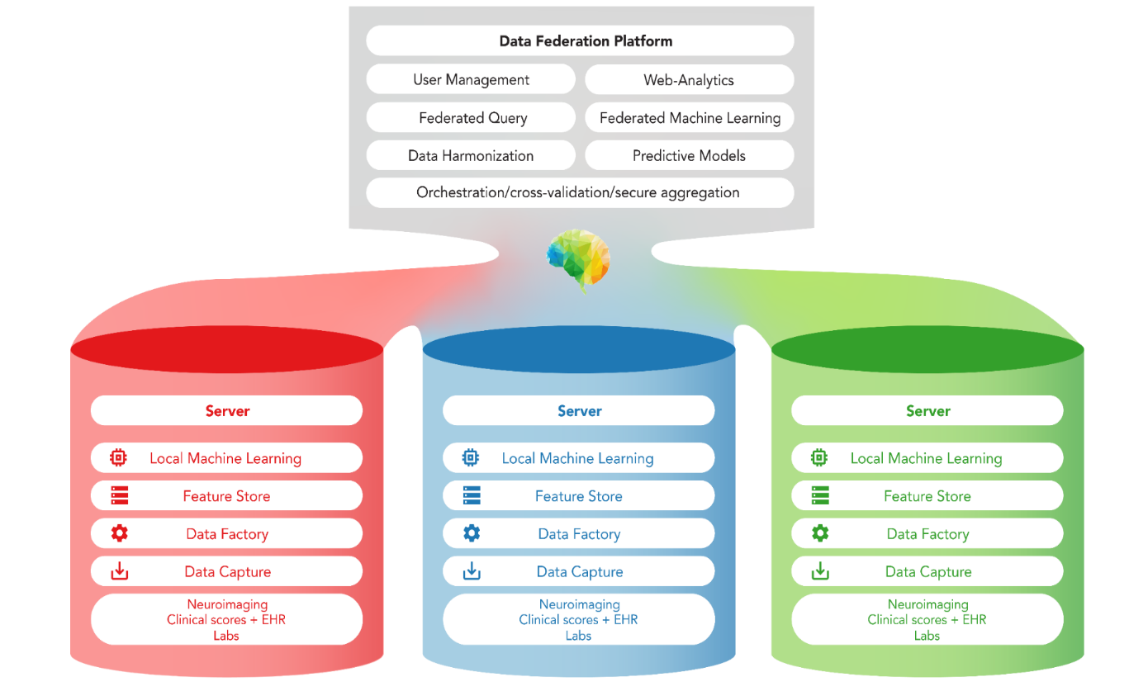
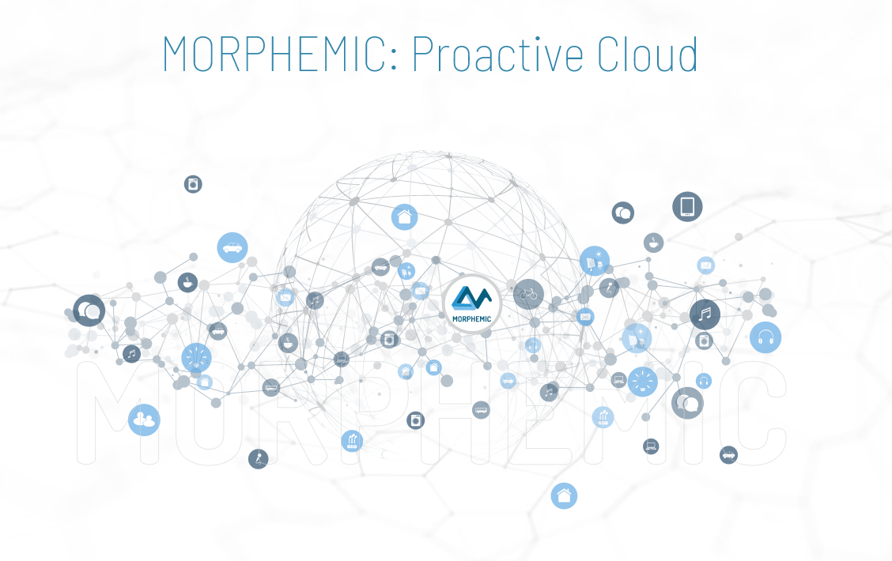
TG-Neuro Centralised and federated approach
Whole Brain images from MRI, PET or CT scans.
Image File Format: DICOM or NIFTI format
Image File Names: Images names will be anonymised to exclude any patient identifying information.
Image Resolution: the images will be supplied in their original resolution as captured from the MRI scanner
HUB
Count Vascular lesion
History
Genetic
Memory Score
Executive functioning scores
Co-morbidity symptoms
Verbal fluency
Delayed memory scores
Motor scores
Psychiatric questionnaires
Alcohol Use
Temperature
The diagnosis of cognitive disorders an disease severity:
Alzheimer's Diseas
Mild cognitive impairment (MCI)
Cognitively normal (CN)
Other Mixed Dementia (MD)
Morphemic Brain
Leverage the cloud technology

Slide 4
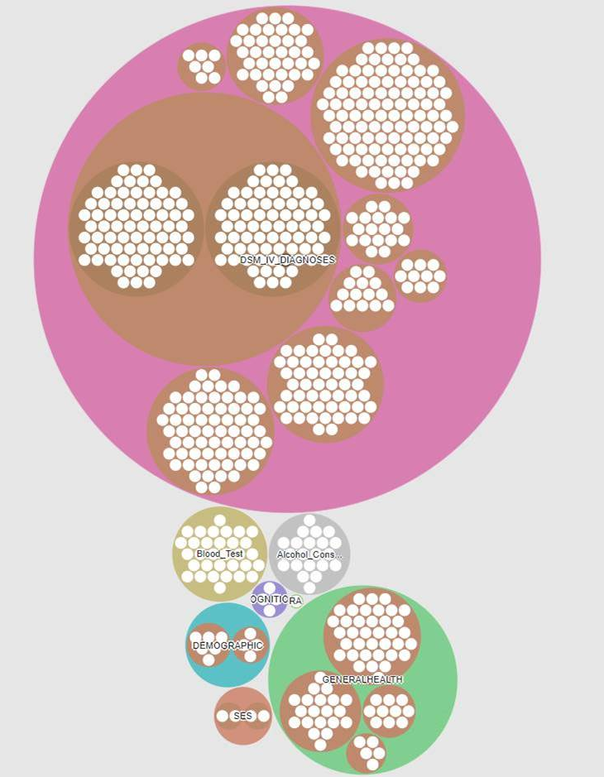
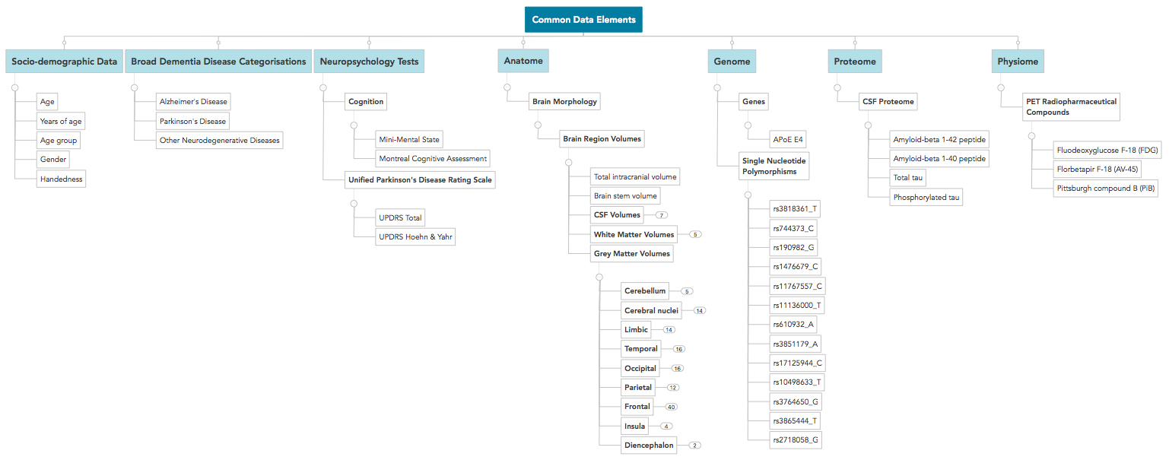
Data Catalogue (Dementia Use case)
First Metadata Model
Dementia and general Population Data

Slide 5
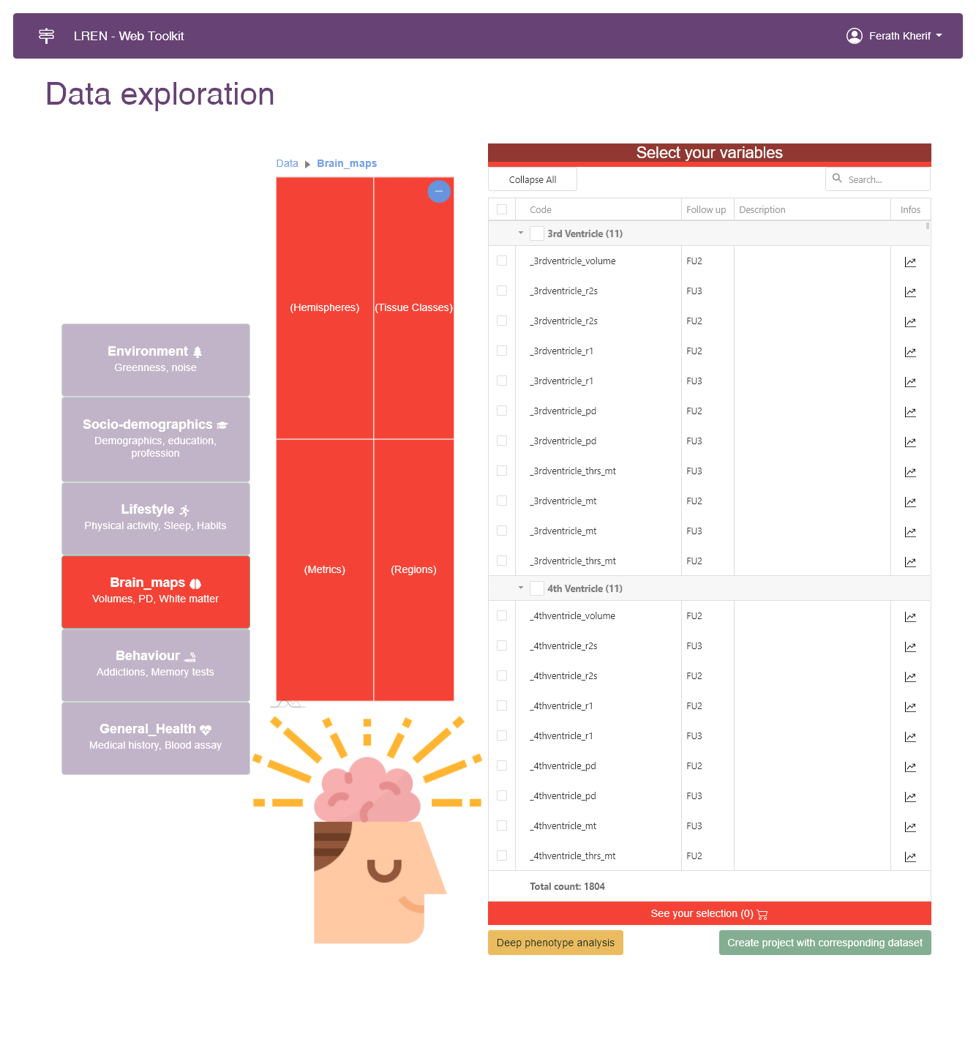
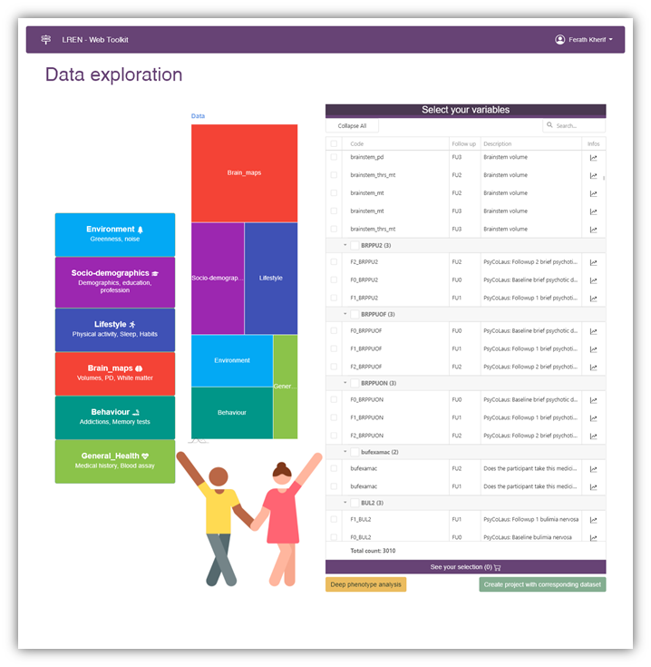
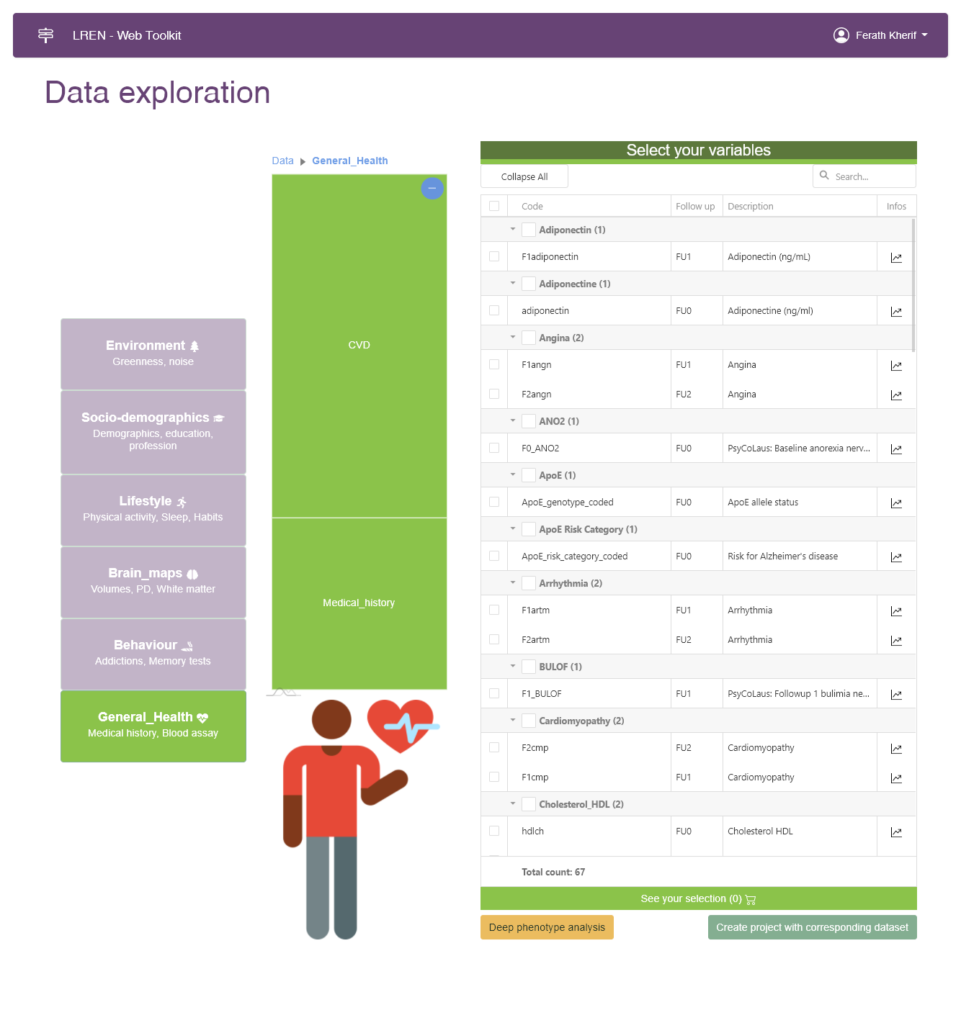
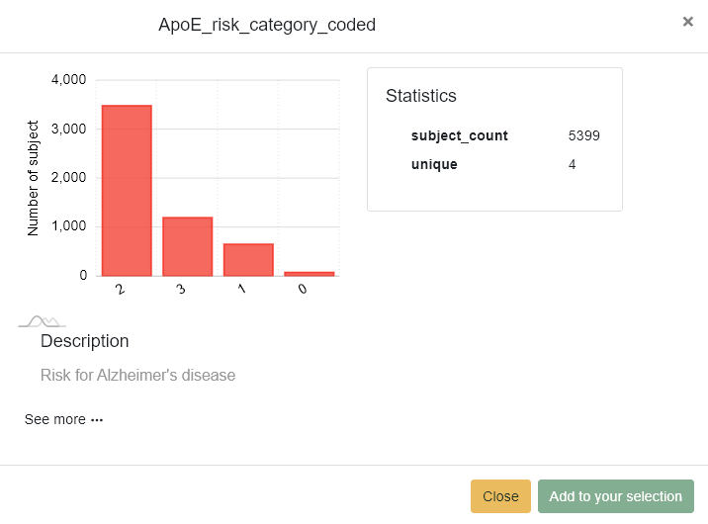
MVP: Data sourcing

Slide 6
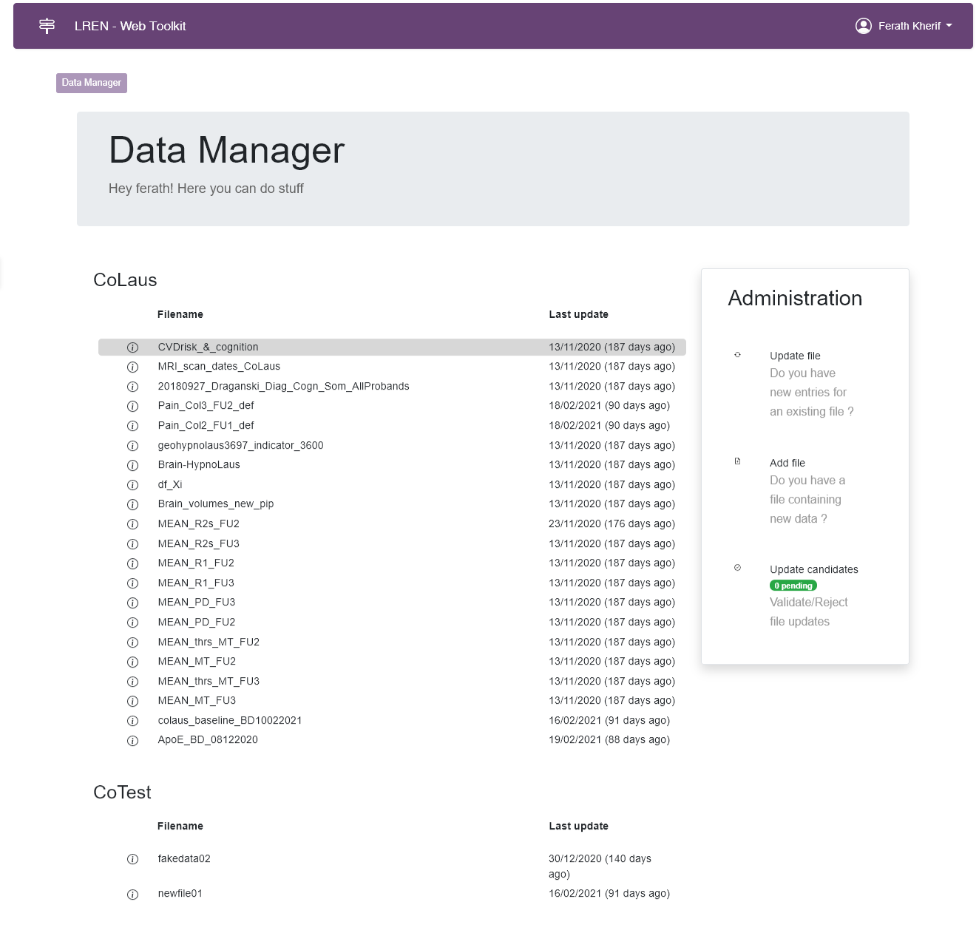
MVP: Data sourcing in Brain diseases

Slide 7
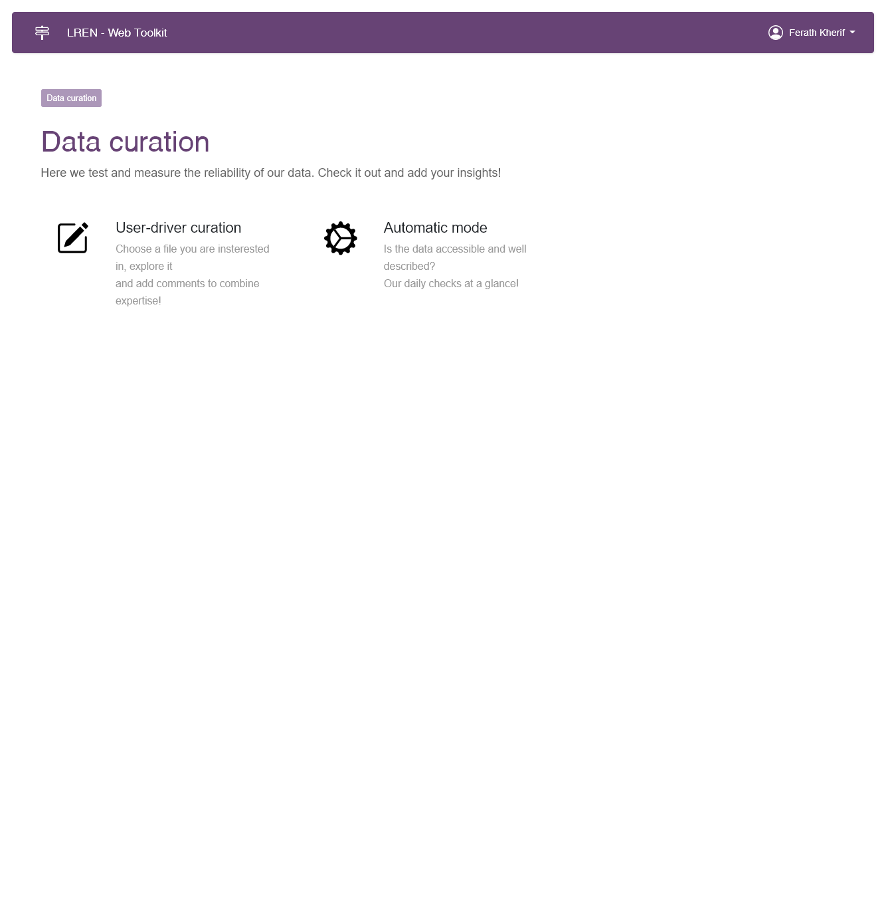
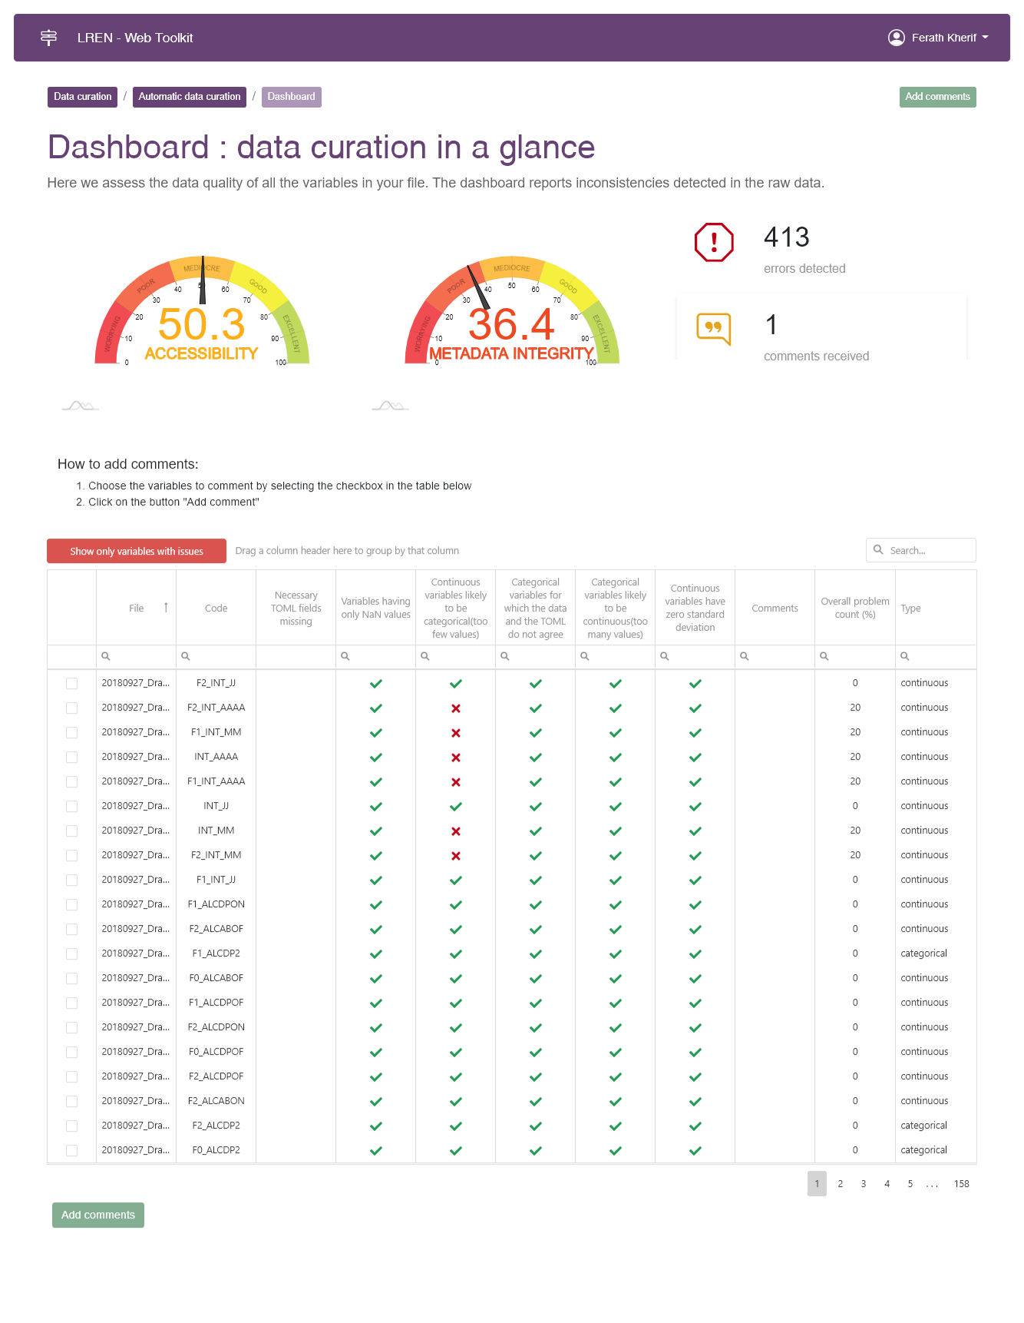
MVP: Data sourcing

Slide 8
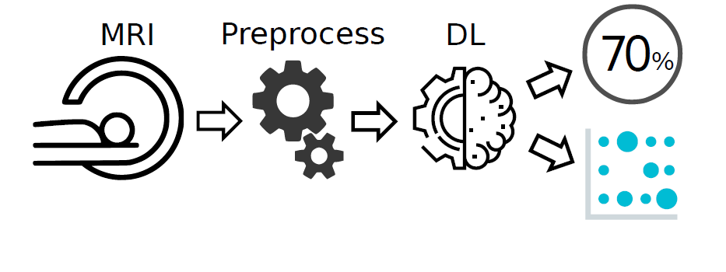
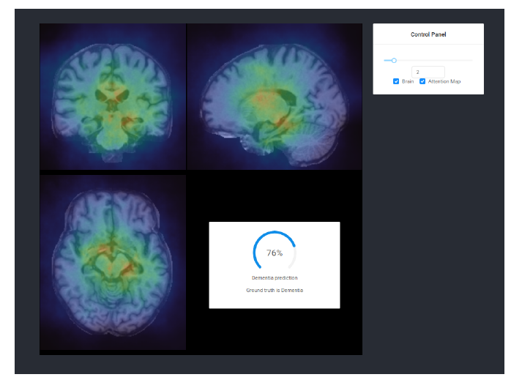
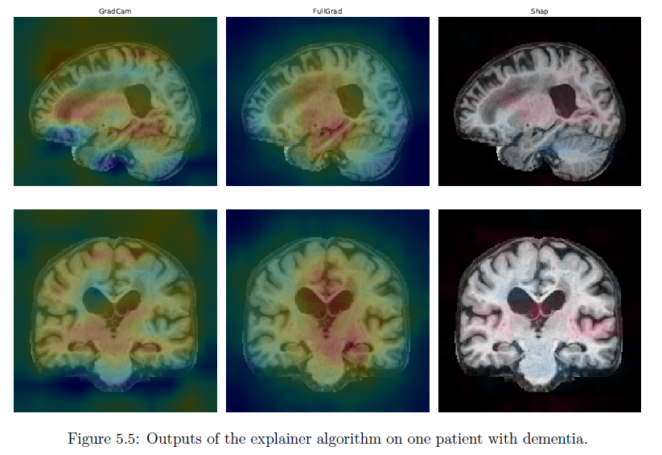
Dementia Use case : Explainable AI

Slide 9
Challenges :
Most applications do not take age into account properly; they either use it as a predictor of disease or consider it as a confound.
Depression
AGE
Large Data set
Brain Features
(Morphemic workflows)
Disease model
Age prediction and the delta age
Age Model

Slide 10
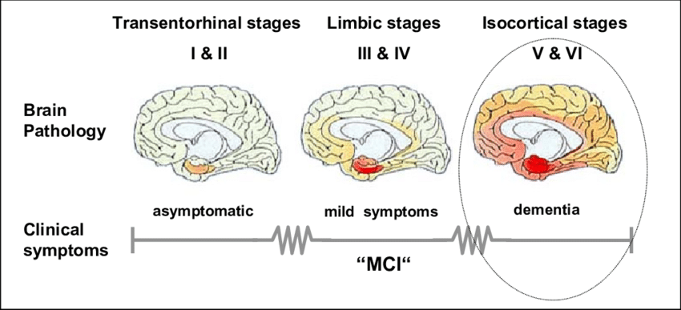
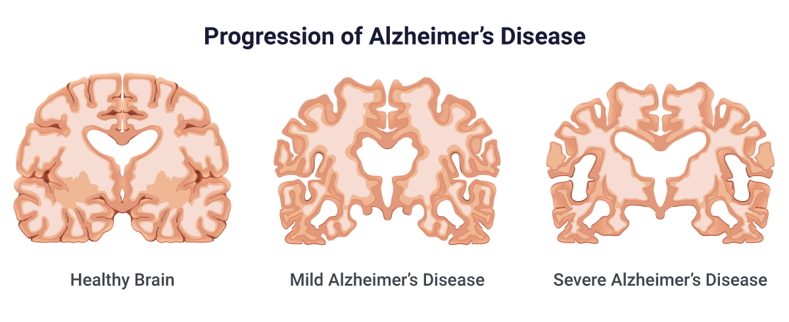
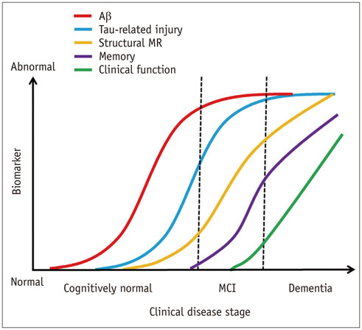
Challenges : Who is right ?
Clinical diagnoses can be inaccurate by 20%-30%.
Actual - Clinics
Accuracy $=\frac{TP+TN}{P+N}$
Sensitivity $=\frac{TP}{P}$
Precision $=\frac{TP}{TP+FP}$
TP
FP
Predicted
FN
TN

Slide 11
Link to EU and worldwide initiative
Established research contract with Brazil/Fundação Cruz (Fiocruz)
List and connect to other partners/platforms (e.g. AD Workbench/Gates)
Complete the Data catalogue
MVP data catalogue
Federated algorithms & Hybrid cloud infrastructure
Audit Trial
Challenges
EvalAI

Slide 12
Depression
Morphemic Brain
Leverage the cloud technology
AGE
Large Data set
Brain Features
(Morphemic workflows)
FPGA hardware acceleration
Age prediction and the delta age

Slide 13
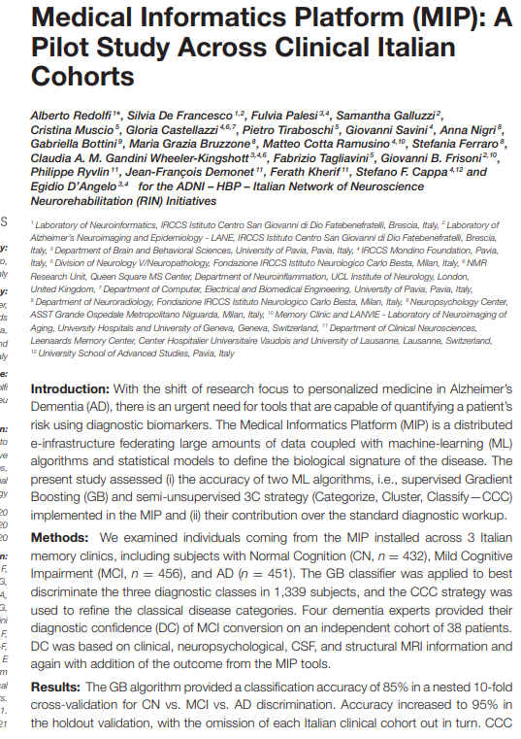
Dementia Use case : Explainable AI

Slide 14
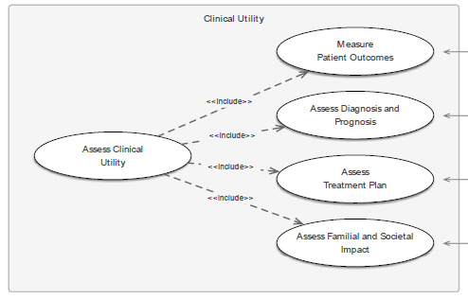
Dementia Use case : Validation
Clinical utility (phases 4 and 5).
Patient outcomes
Diagnostic thinking – does the test confirm or change a diagnosis?
Decision-making guidance
Familial and societal impacts
Clinical Impact
In 20% of cases clinicians reported that the additional information did not change their initial DC.
In 36% and in 29% of cases, they felt “somewhat” or “slightly” impacted, respectively.
In 15% of cases, they significantly changed their initial belief

