Slide 1
FGAI4H-M-012-A03
E-meeting, 28-30 September 2021
Source: | TG-Falls Topic Driver
Title: | Att.3 – Presentation (TG-Falls)
Purpose: | Discussion
Contact: | Pierpaolo Palumbo TG-Falls Topic Driver University of Bologna Italy | E-Mail: pierpaolo.palumbo@unibo.it
Contact: | Inês Sousa Associação Fraunhofer Portugal Research – Fraunhofer AICOS Portugal | Email: ines.sousa@fraunhofer.pt
Abstract: | This PPT contains a presentation of M-012.

Slide 2
AI4H TG-Falls among the elderly
30th September 2021

Slide 3
Outline
About the topic group
Introduction
Literature review and consensus process
Benchmarking by the topic group
Audit

Slide 4
About the topic group
Meeting B (Lausanne) – meeting M (e-meeting)
fgai4htgfalls@lists.itu.int
People (contributors or showing interest)
  Inês Sousa, Fraunhofer AICOS, Portugal
  Pierpaolo Palumbo, University of Bologna, Italy
  Stefania Bandinelli, SOC Geriatria – USL Toscana Centro, Italy
  Barry Greene, Chief Technology Officer, Kinesis Health Technologies, Ireland
  Arnab Paul, CEO Patient Planet, WHO Roster of Expert – DigitalHealth, India
  Salman Khan, Assistant Professor in the department of electrical engineering, University of Engineering and Technology Peshawar, Pakistan
  Kim van Schooten, PhD, Human Frontier Science Program Postdoctoral Fellow, Conjoint Senior Lecturer, UNSW Medicine, UNSW Ageing Futures Institute, Australia
  Luca Palmerini, Assistant professor, University of Bologna, Italy

Slide 5
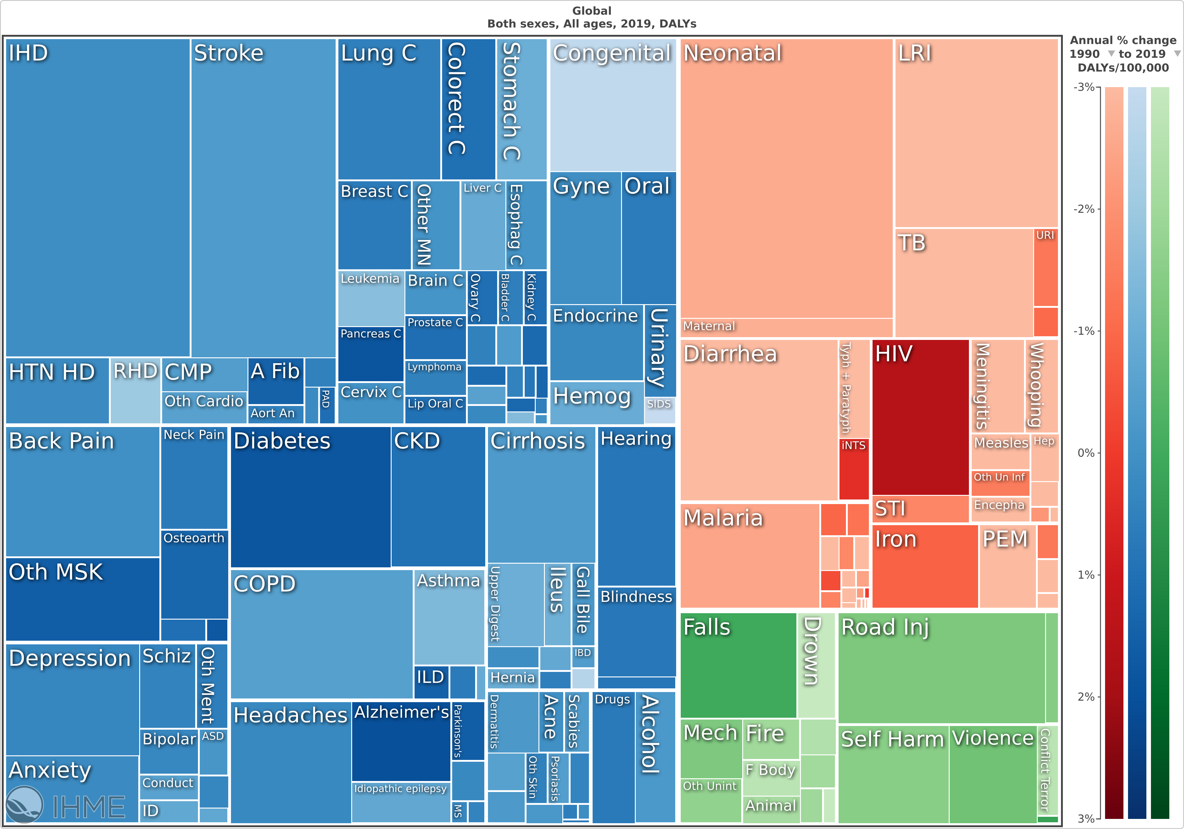
Introduction
Falls are common, multifactorial, burdensome
Falls are preventable (RR ≈0.7-0.8)
falls
Global Burden of Disease, 2019, https://vizhub.healthdata.org/

Slide 6
Subtopic, AI task
  Fall prediction:
    Subject-specific risk score of falling, within a given time window in the future, given information about the subject’s risk factors for falls and/or their balance or motor ability

Slide 7
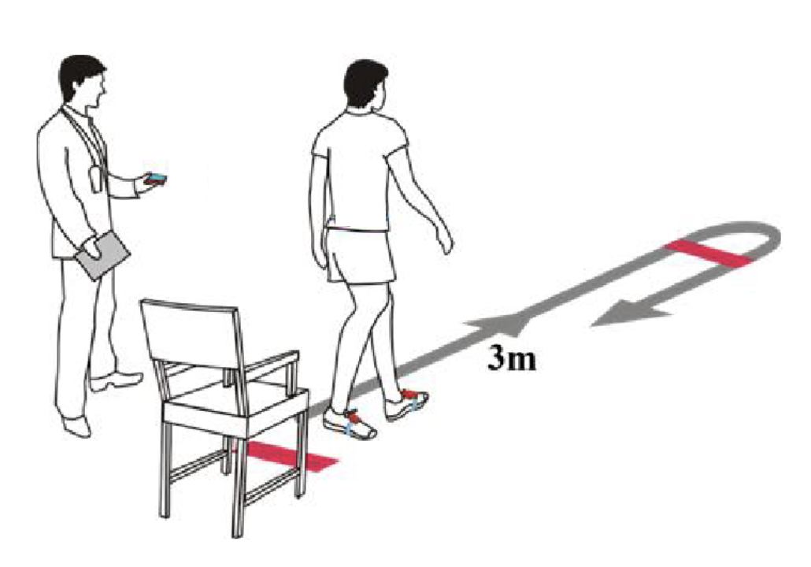
State of the art
Traditional tools: Timed Up and Go Test (TUG), Tinetti Scale
Guidelines (AGS/BGS, NICE, etc.) screening algorithms
Different AI models proposed
  Clinical variables
  Sensor variables
Few models validated (AUC 0.62-0.69)
Potential impact: decrease of ≈15-20% NNT
AUC = 0.57 (0.54-0.59)
[1] D. Schoene et al., J. Am. Geriatr. Soc., 2013
[2] E. Barry et al., BMC Geriatr., 2014
[3] Panel of Falls in Older Persons American Geriatrics Society and British Geriatrics Society, J. Am. Geriatr. Soc., 2011
[4] A. Tiedemann, et al. Inj. Prev., 2012.
[5] P. Palumbo et al., J. Am. Med. Dir. Assoc., 2016.
[6] G. V. Gade et al., BMJ Open, 2021
[7] P. Palumbo et al., Aging Clin. Exp. Res., 2018

Slide 8
Literature review and consensus process
Available datasets
Eligibility requirements for datasets
  AI input (minimum set of variables, sensors, tests), labels (collection of falls)
  Validity, accuracy, potential for harmonization
  Ethical waiver
  Constraints on data management
Eligibility requirements on AI algorithms
Benchmarking methods, criteria for performance evaluations
Target populations

Slide 9
Literature review and consensus process
Steps
  Definitions of scope and methods
  Literature review
  Delphi consensus
  Integration and publication
Literature review: existing ones as a basis
Consensus process: Delphi
Leverage the results of other standardization initiatives (Mobilise-D, OWEAR, etc)
Priority list

Slide 10
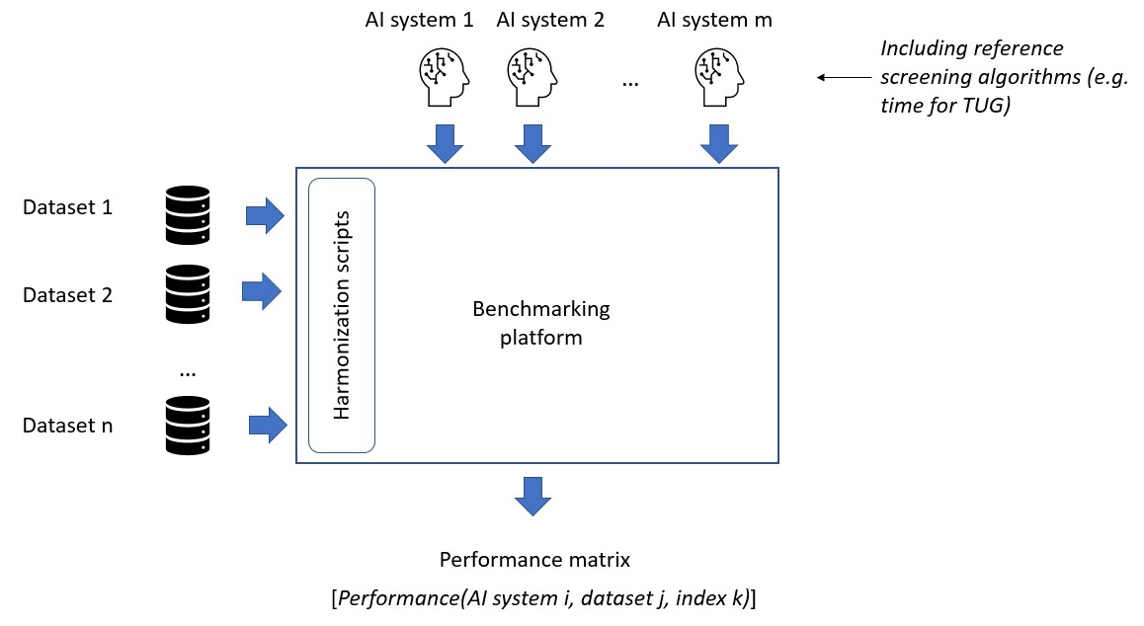

Benchmarking platform – System architecture
Result publication

Slide 11
Benchmarking system dataflow
 | v0 | Future implementations
Dataset identification | FallSensing | Literature screening, emails to authors, advertisement at meetings and conferences
Eligibility check | FallSensing considered eligible | Literature review and an expert consensus process. Eligibility criteria on: data content (on AI input and label, including aspects related to validity, accuracy, and potential for harmonization), ethical waiver, constraints set by data owners on data management
Dataset entry | Minimal data standardization Versioning Dataset description document Lifecycle Undisclosed (98%)/publicly available (2%) | Harmonization Versioning Dataset description document (population, variables and signals available, protocol, format, management rules) Lifecycle Accessible/undisclosed/ partly
Data management

Slide 12
Benchmarking process
Description of the benchmarking process and its rules will be visible to everyone
Registration
  Disclosure of any previous data access
  Agreement on result publication
  Check by the Topic Group
Sample records given to participants
AI system submission
Results provision to participants
Report to publish

Slide 13
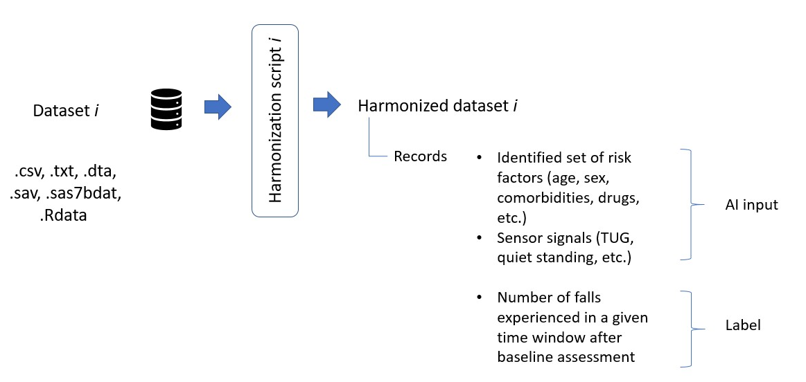


AI input
Table for clinical variables + files for sensor recordings
V0: standardization/harmonization kept to a minimum

Slide 14
AI output and label
v0
Future implementations
AI output
  Subject-specific
  Probability to fall in a 12-month period, range 0-1
  Ordered variable: higher numbers = higher risk
  Format and coding TBD
Label
  {0,1}
AI output
  Expected number of falls
  Variable time window: 6-24 months
  Suggestions on preventive actions to take
  Others
Label
  Integer, others...

Slide 15
Scores and metrics
As a baseline comparison
Example
Dataset 1 v1
 | AI system 1 | AI system 2 | AI system 3 | Time for TUG
Applicable | Yes | No | Yes | Yes
Probabilistic 0-1 | No | Yes | Yes | No
AUC | 0.65 | -- | 0.71 | 0.63
Sensitivity | 62% | -- | 58% | 40%
Specificity | 74% | -- | 81% | 72%
Brier score | -- | -- | 0.018 | --
Maximizing Youden index
Future implementations: calibration intercept and slope, other metrics...

Slide 16
Transversal work with WG
Meeting with Marc Lecoultre and Pradeep Balachandran (July 2021)
Participation in the ML4H Trial Audits 2.0 project

Slide 17
Thank you

