Slide 1
FGAI4H-M-009-A03
E-meeting, 28-30 September 2021
Source: | TG-DiagnosticCT Topic Driver
Title: | Att.3 – Presentation (TG-DiagnosticCT)
Purpose: | Discussion
Contact: | Ji Qi | E-mail: qji@infervision.com
Abstract: | This PPT contains the introduction of Infervision company, the introduction of Infervision CT Lung software, and the application of AFROC metric .

Slide 2
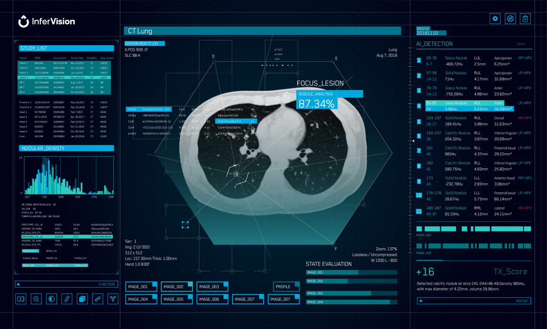
INFERVISION PRODUCTS
InferRead™️ Lung CT.AI
Augments radiologists with automated detection of pulmonary nodules in Chest CT for lung cancer screening or incidental nodule findings.

Slide 3
INFERVISION PRODUCTS
InferRead™️ Lung CT.AI Key Features
Findings List
Diagnostic Report Generation
Longitudinal Comparison
Intelligent Follow-up Guidelines
Automatic nodule Detection, Type (Solid, Semi Solid, GGN), Size
Location, Slice Number, Diameter, Volume, Malignancy
Density Analysis
Auto Report Generation based on the identified nodules
Automatically prints results to a PDF document
Comparison of current and prior scans for lesion monitoring
Provides follow-up recommendations and guidelines
Notes:
Diagnostic error is not any simple medical accident – it can lead to life and death decision that will impact a patient for life.

Slide 4
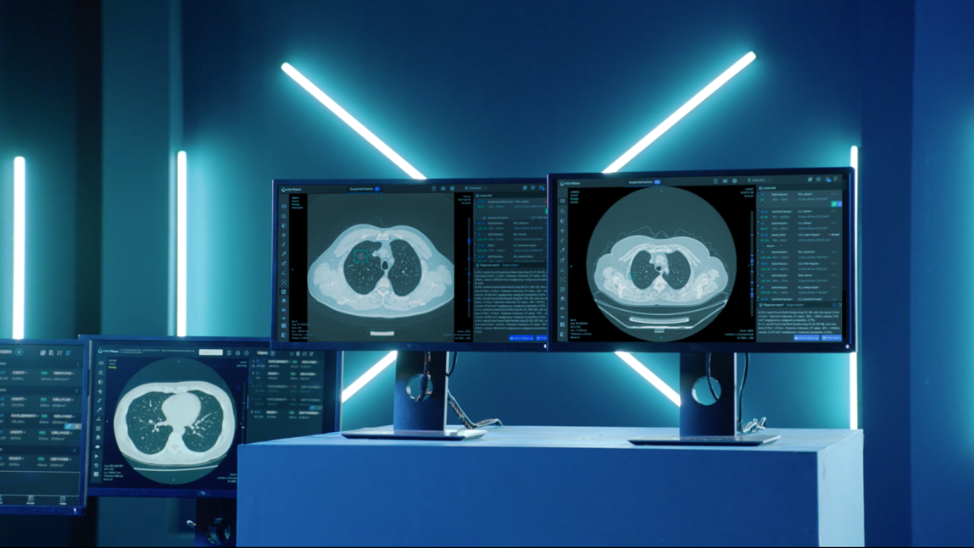
INFERVISION PRODUCTS
InferRead Lung CT.AI Values
InferRead™️ Enhances Accurate Interpretation
Automatic detection of actionable nodule(s)
Measurements including diameters, volume, and density
InferRead™️ Value Proposition
AI → IA: Intelligent Augmentation
Reduction of Turnaround Time
Fewer Missed Nodules
InferRead™️ Clinical Benefits
Notes:
Diagnostic error is not any simple medical accident – it can lead to life and death decision that will impact a patient for life.

Slide 5
The Application of Alternative Free-Response Receiver Operating Characteristic (AFROC) Metric

Slide 6
The application of AFROC Metric
Assessment Methodologies for CAD
Diagnostic accuracy: Agreement between diagnoses and “truth”
Is ROC analysis necessary?
the limitations of other available methods for evaluating diagnostic accuracy
A pair of indices: “Sensitivity” and “Specificity”
Sensitivity: Probability of calling an actually-positive case “Positive”
Specificity: Probability of calling an actually-negative case “Negative”
Notes:
Diagnostic error is not any simple medical accident – it can lead to life and death decision that will impact a patient for life.

Slide 7
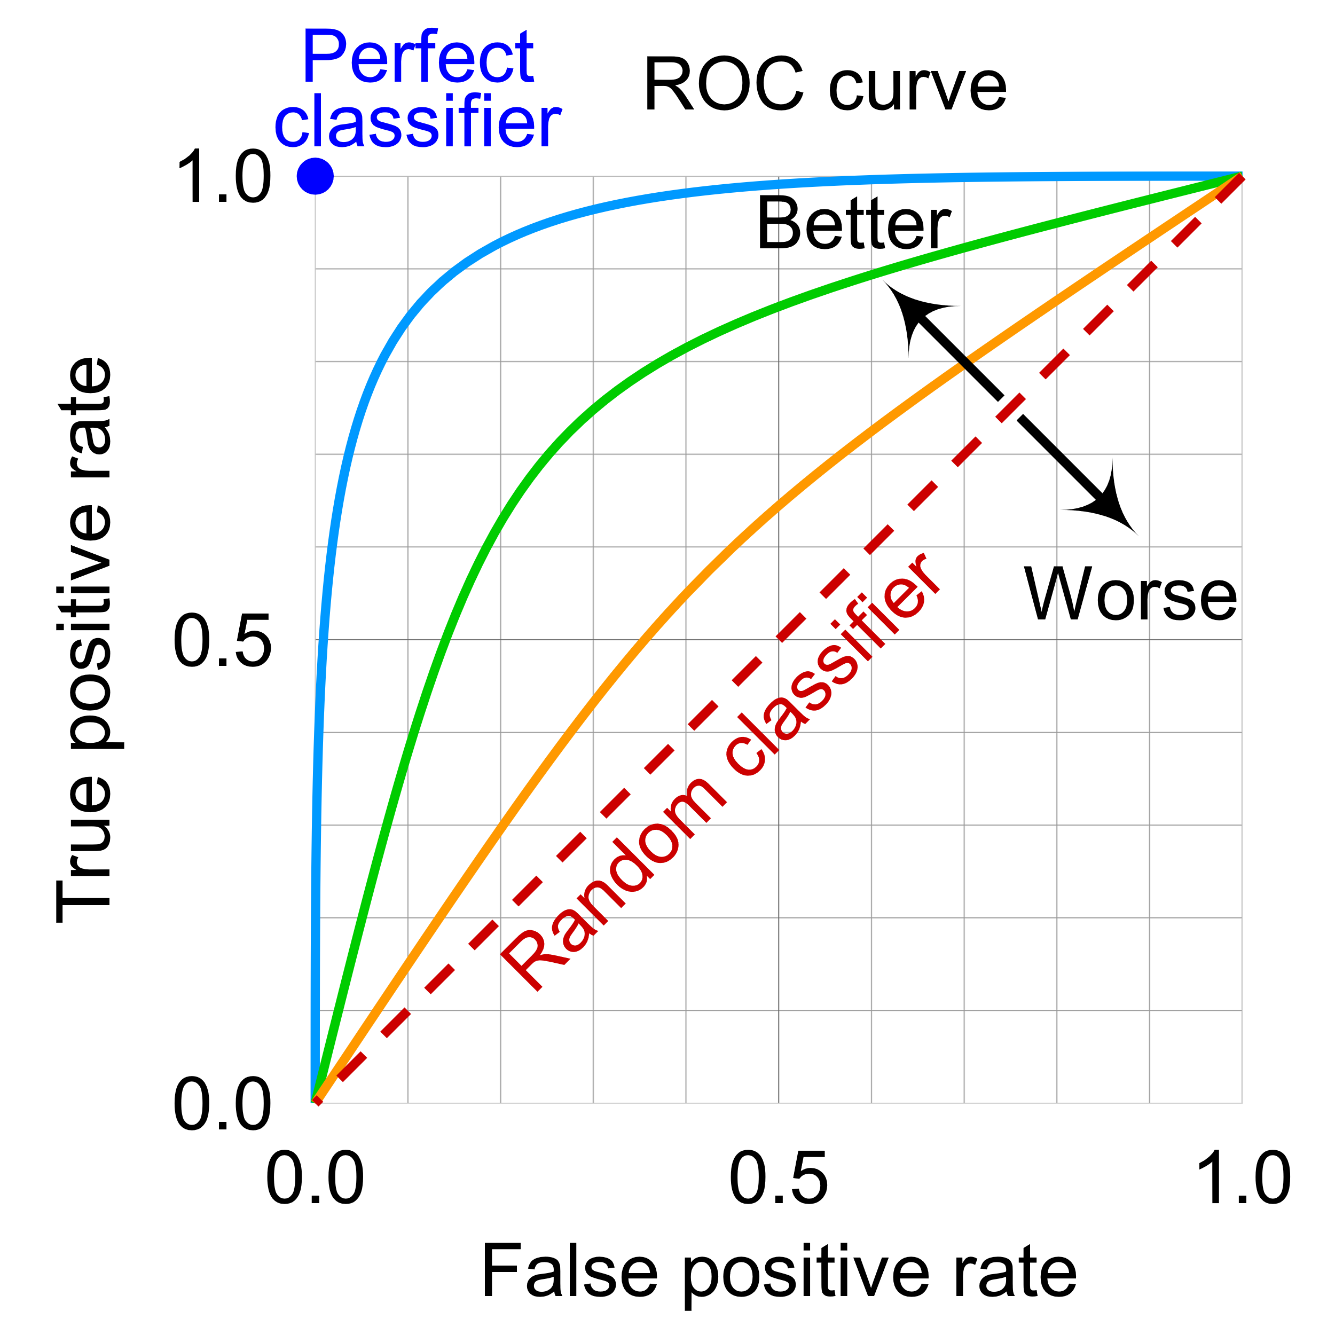
The application of AFROC Metric
Interpretations of ROC area
Features
Sensitivity (TPF) averaged over all Specificities (or FPFs) — i.e., average ROC curve height
Specificity averaged over all Sensitivities
Probability of distinguishing correctly between a randomly selected actually-positive case and a randomly selected actually-negative case
However:
this global index can be misleading when curves cross and/or there is only one region of interest
Notes:
Diagnostic error is not any simple medical accident – it can lead to life and death decision that will impact a patient for life.

Slide 8
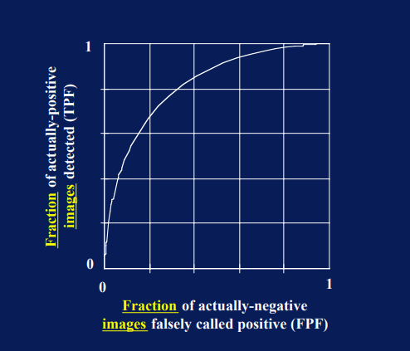
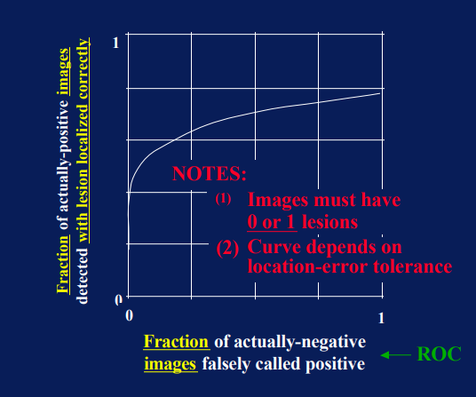
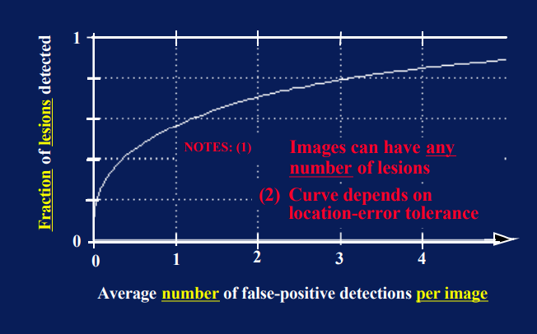
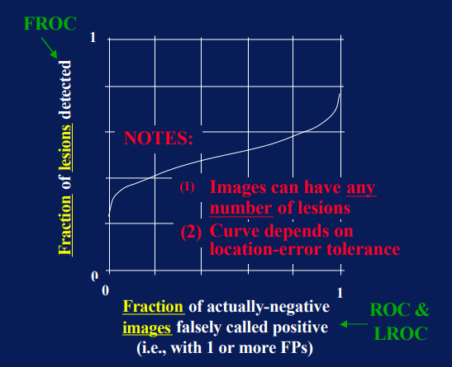
The application of AFROC Metric
Generalized ROC analysis
ROC
LROC
FROC
AFROC
Notes:
Diagnostic error is not any simple medical accident – it can lead to life and death decision that will impact a patient for life.

Slide 9
The application of AFROC Metric
Advantages of AFROC
In MRMC studies the use of the AFROC method is ideal when the amount of abnormalities and locations are required to be identified, and ranked each against values according to the confidence levels.
ROC does not distinguish statistical differences for incorrect location (FP)
Significant clinical implications which may impact on treatment cannot be accounted for in ROC’ scenario.
AFROC analysis allows for marking of more than one location on an image.
It makes up for the limitation that ROC/LROC cannot count multiple lesions accurately.
AFROC plotting uses a mixture of conventional ROC methodology and free response ROC (FROC) calculations.
It improves the shortcomings of the non-fixed X-axis of the FROC curve.
Notes:
Diagnostic error is not any simple medical accident – it can lead to life and death decision that will impact a patient for life.

Slide 10
ARTIFICIAL INTELLIGENCE IN MEDICAL IMAGING
Our mission is to improve human life with AI.

Slide 11
COMPANY INTRODUCTION
Infervision Medical Technology Group
Infervision Medical Technology is a global company that was found in 2015 by the Co-founder & CEO Kuan Chen, while a Ph.D. candidate at the University of Chicago. With the passion and expertise in AI technology, Infervision Medical Technology developed cutting-edge AI systems targeting disease detections

Slide 12
Infervision Medical Technology
Barcelona
Shanghai
Frankfurt
Beijing
Zurich
Tokyo
Philadelphia
Tampa
300⁺
8
20+
Employees (50% Developers)
Global
Offices
Countries Served
8
Global
Offices
28M+
170+
150+
Patents
Peer reviewed Papers/ Abstracts
Total Cases Analyzed

Slide 13
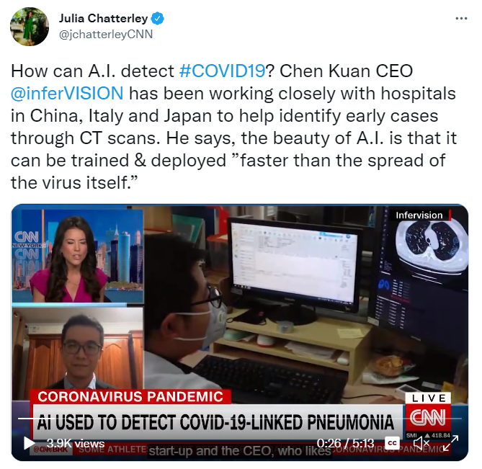
INFERVISION IN THE INDUSTRY
Highlights of Infervision

Slide 14
Infervision AI Solution Suite
InferRead CT Lung (CE, NMPA, FDA, PMDA)
InferRead CT Pneumonia (PMDA, NMPA, CE)
InferRead DR Tuberculosis (CE, WHO GDF Catalog)
InferRead CT Stroke (FDA)
InferRead DR Chest
InferRead Mammo
InferRead DR Bone Age
InferRead CT Bone
InferCloud (Not medical device)
InferScholar (Not medical device)

Slide 15
Thank You

