Slide 1
FGAI4H-L-052
E-meeting, 19-21 May 2021
Source: | Editor 5.4
Title: | DEL7.3: DAISAM reference – Progress review
Purpose: | Discussion
Contact: | Luis Oala Fraunhofer HHI Germany | E-mail: abbooda@rki.de
Abstract: | This PPT contains the current structure of the Deliverable 7.3 Data and artificial intelligence assessment methods (DAISAM) reference.

Slide 2
DEL 7.3
Data and Artificial Intelligence Assessment Methods (DAISAM) Reference (FG-AI4H DEL 7.3)
Somewhere in cyberspace, May 20, 2021
WG-DAISAM

Slide 3
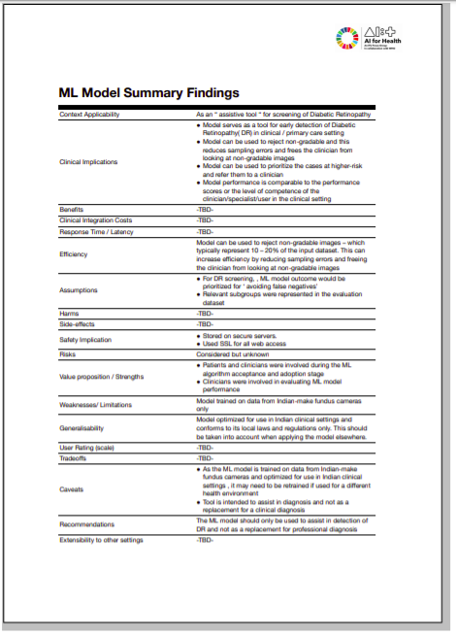
Integration of FG Workstreams
DEL7.2 Test Specifications
DEL7.3 Test Metric
DEL7.4 Clinical Considerations
DEL5.1 - 4 Data specification and handling
Numerical tests are performed
Developersubmits health AI as Docker image
Developer receives health AI spec sheet
Developerfills out form
DEL2.2 Reg. Checklist
DEL7.3 Test Metric Questionnaire
DEL7.4 Clinical Considerations
DELX.X Assessment Platform, TG TDDs, DEL7 AI4H evaluation considerations
The FG-AI4H model summary findings sheet for the retinopathy use case

Slide 4
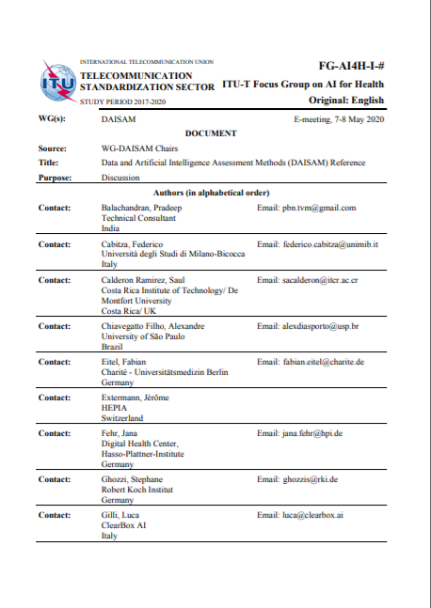
WG-DAISAM
Data and Artificial Intelligence Assessment Methods (DAISAM) Reference (FG-AI4H DEL 7.3)
A reference document defining assessment methods for data and model quality including bias and fairness, interpretability, robustness and uncertainty
Notes:
@Luis: please add your slides after this ;)

Slide 5
Overview
State: Meeting K, 01/21, t-10,281,600 seconds
Management meeting Fridays, 14.00 hrs Geneva time Contact: Pradeep, Alixandro Perturbed minds (research) Fridays, 13.00 hrs Geneva time Contact: Luis, Bruno Model reporting questionnaire (research) Thursdays, 16.00 hrs Geneva time Contact: Jana Evaluation platform (software development) Asynchronous Contact: Elora, Alixandro Good practices (regulatory) Tuesdays, 14.00 hrs Geneva time Contact: Pradeep | “aiaudit.org” Crowdsourced collection of SOTA AI quality assurance methods Contact: Luis, Pat Regulatory ML4H “ICD-10” An ontology to rule them all Contact: Christian
Ongoing
Big dreams

Slide 6
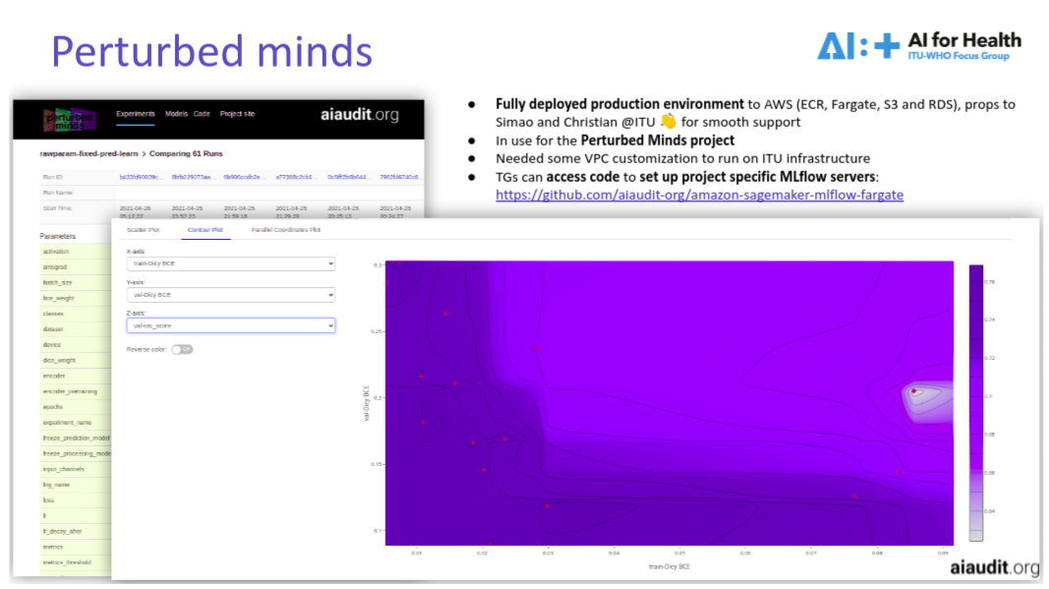
Overview
State: Meeting L, 05/21, t
(see L-045)
https://github.com/aiaudit-org/amazon-sagemaker-mlflow-fargate
Management meeting Fridays, 14.00 hrs Geneva time Contact: Pradeep, Alixandro Perturbed minds (research) Fridays, 13.00 hrs Geneva time Contact: Luis, Bruno Model reporting questionnaire (research) Tuesdays, 17.00 hrs Geneva time Contact: Jana Evaluation platform (software development) Asynchronous + Tuesdays, 16.00 hrs Geneva time Contact: Elora, Alixandro Good practices (regulatory) Tuesdays, 14.00 hrs Geneva time Contact: Pradeep | “aiaudit.org” Crowdsourced collection of SOTA AI quality assurance methods Contact: Luis, Pat Regulatory ML4H “ICD-XX” An ontology to rule them all Contact: Christian
🚀
(see L-043)
🚀
https://aiaudit.org/
https://github.com/aiaudit-org
🚀
(see L-037-A01)
🚀
https://drive.google.com/file/d/1izBKhoBPBwJe-Pvudfcz8_jxsrIqWFq2/view
(see L-041)
Ongoing
Big dreams
https://health.aiaudit.org/
https://github.com/aiaudit-org/fgai4h-evaluation-platform
(see L-037-A01)

Slide 7
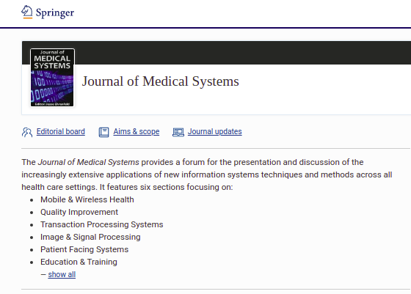
Overview
Anything new under the sun?
@WG-CE, TGs, WG-RC
Outreach and scientific footprint JOMS Editorial Finalizing review Contact: Pradeep Special collection Machine Learning for Health: Algorithm Auditing & Quality Control (research) Open call for submissions Contact: Jesse, Luis | Trial audits Paper to practice v2, collab between government bodies, clinicians and ML engineers Contact: Pradeep Next planning meeting: Coming Tuesday
@here
Ongoing
https://www.springer.com/journal/10916/
Big dreams

Slide 8
Overview
Interested?
You can find contacts of all contributors at
https://aiaudit.org/contributors/
Feel free to reach out!

Slide 9
Overview
Interested?
You can find contacts of all contributors at
https://aiaudit.org/contributors/

