Slide 1
FGAI4H-L-050-A01
E-meeting, 19-21 May 2021
Source: | Editor DEL09
Title: | Updated DEL09: AI4H applications and platforms - Att.1: Presentation
Purpose: | Discussion
Contact: | Manjeet Singh Chalga Scientist-C, ICMR, India | E-mail: manjeetchalga@gmail.com, chalgams.hq@icmr.gov.in
Abstract: | This PPT summarizes the content of L-050 for presentation and discussion during the meeting.

Slide 2
FG-AI4H-L-053
AI4H Applications and Platforms
Manjeet Singh Chalga
Scientist-C, ICMR, India
+91-95827 76792
manjeetchalga@gmail.com, chalgams.hq@icmr.gov.in

Slide 3
Objectives:
To discuss on development of AI tool for Health using Mobile Applications & Cloud Applications
To discuss on development of App based system for disease surveillance in health sector

Slide 4
Trending Mobile Applications for Health
Health Awareness Apps
Apps with Associated Devices
Apps for disease surveillance

Slide 5
Development of App based system for disease surveillance in health sector
Most of the disease surveillance programs have similar format of questionnaire and field survey activities
By developing a common format of database in a cloud based system and a mobile application, a dynamic interface based mobile application can be designed to collect data from the user.

Slide 6
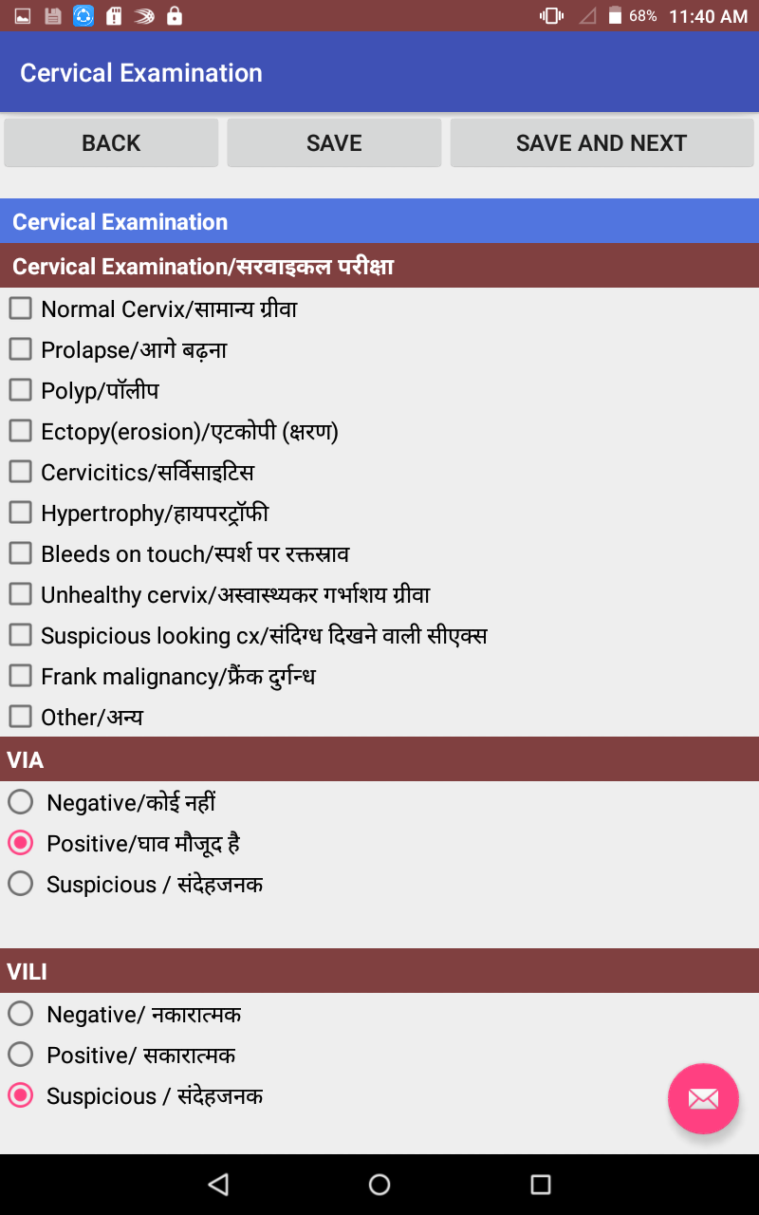
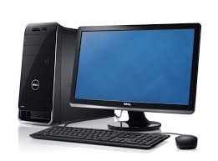
Detail of some App and cloud based projects developed using this technique
Dynamic designing
Internet
Data Sync
Mobile Database
Database of Web Based Server
Server

Slide 7
Study of TB prevalence in Tribal Areas
Hard to reach and marginalized population
Estimated at 104.28 million (8.4% of the country’s population)*
Socially and economically backward and intensely deprived
Have major Health Issues
TB one of them

Slide 8
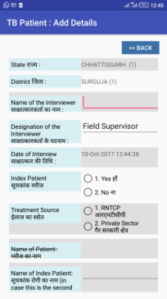
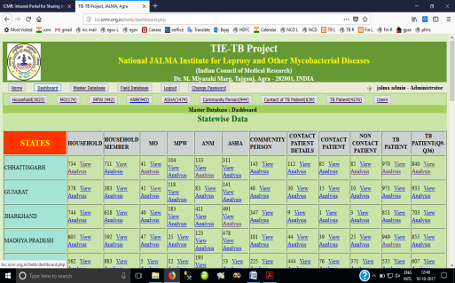
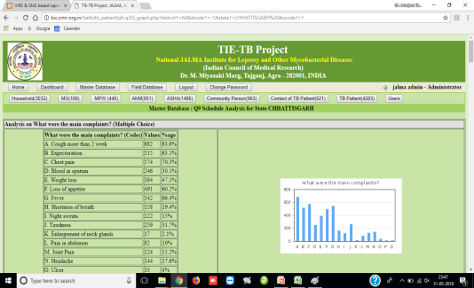
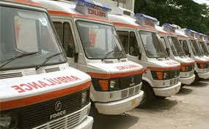
TieTB Project Flow Diagram
Mobile
App
Analyzed
Report
Present Status : Developed Mobile App and collected Data from Tribal Area from 19 Districts of 5 States Chhattisgarh, Gujarat, Jharkhand , MP & Rajasthan
Server at ICMR Headquarters
4500+ TB Patients
600+ Contacts Patients
900+ Community Persons
1400 ASHA workers
900+ ANMs
400+ MPWs
170+ Medical Officers
35 Mobile vans equipped with Digital X-ray and sputum microscopy services have been launched and providing services to TB Patients in Tribal Area

Slide 9
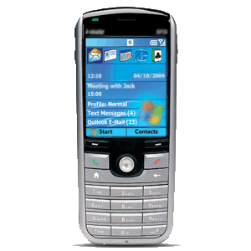
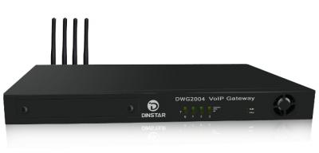
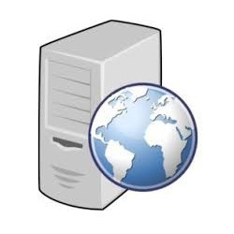
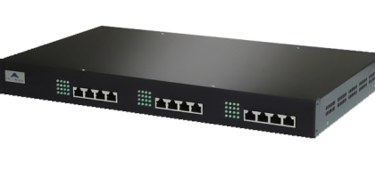
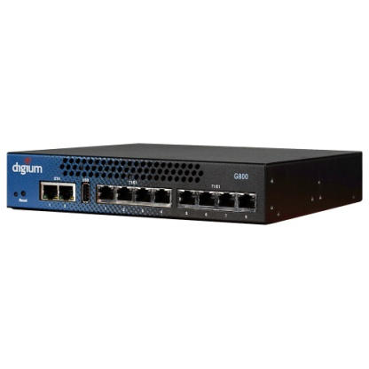
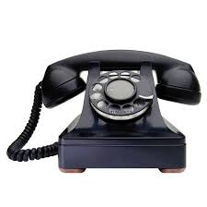
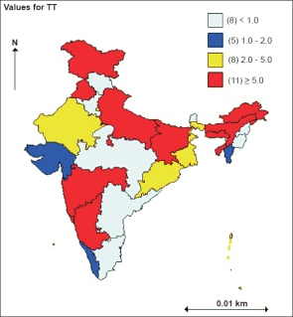
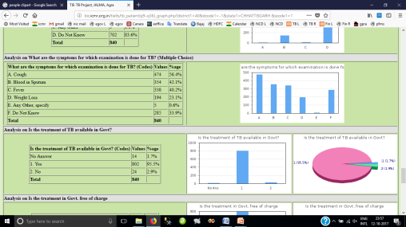
Follow up system for TB patients
Voice Call
SMS
Voice Call
SMS Gateway
GSM Gateway
Patient Registration
Call Scheduling
Data Sync with IVRS
Web Services & Program Controller
IVRS/Controller
Database Server
Analysis of Data & Reports
VoIP Gateway

Slide 10
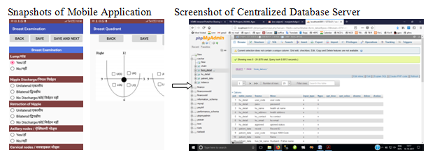
Mobile App based system to study the prevalence of Cervical, Oral and Breast Cancer Trained 260+ health workers, surveyed 55,600+ population and identified 5600+ suspected cases

Slide 11
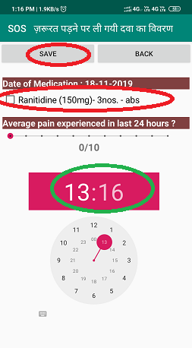
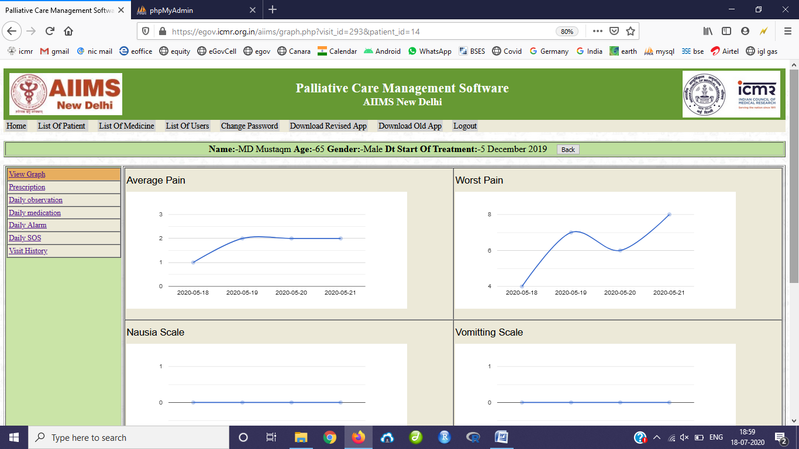
Mobile App based system using mobile Alarm system and its control through cloud based system is developed to study analgesics and adjuvants’ adherence on cancer patients receiving palliative care 135 patients are being monitored through this system

Slide 12
Result
Dynamic Apps and cloud based CMS type systems can be developed by designing a common database format which can maintain dynamic questionnaire for disease surveillance based research projects.
Such system enables to create quickly a surveillance system for any disease.
The data synchronization and data analysis becomes simple and powerful.

Slide 13
Thank You

