Slide 1
FGAI4H-L-045
E-meeting, 19-21 May 2021
Source: | Editor 5.4
Title: | DEL5.4: AI training and test data specification - Progress review
Purpose: | Discussion
Contact: | Luis Oala Fraunhofer HHI Germany | E-mail: abbooda@rki.de
Abstract: | This PPT contains the current structure of the Deliverable 5.4 AI training and test data specification.

Slide 2
DEL 5.4
Training and test data specification
Somewhere in cyberspace, May 19, 2021
WG-DAISAM

Slide 3
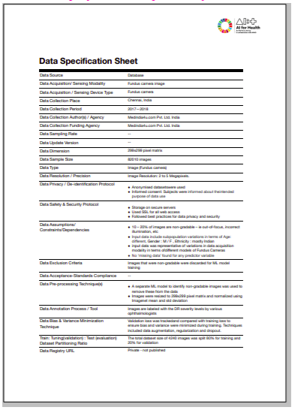
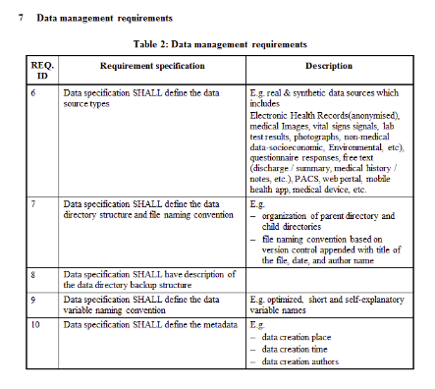
Context
DEL 5.4
Training and test data specification
FGAI4H-J-48
OCI

Slide 4
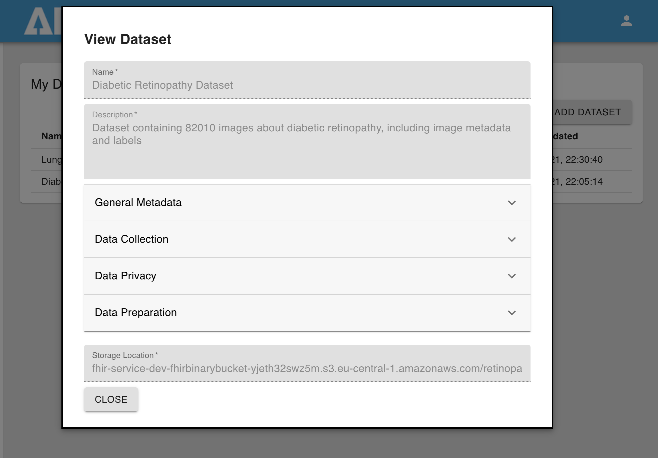
DASP
Dominik Shobha Joachim | dominik.a.schneider@merckgroup.com shobhaiyer@thebigdataanalytics.com Joachim.krois@charite.de

Slide 5
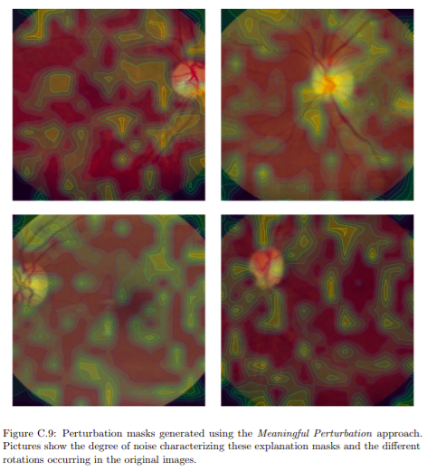
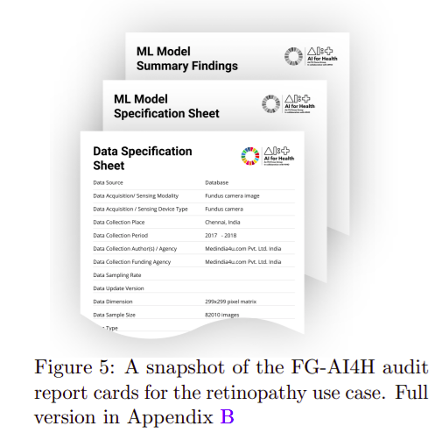
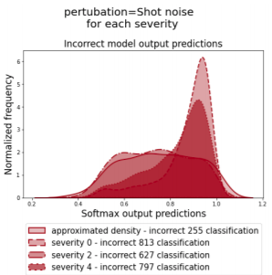
Research
Oala, Luis, Jana Fehr, Luca Gilli, Pradeep Balachandran, Alixandro Werneck Leite, Saul Calderon-Ramirez, Danny Xie Li et al. "ML4H Auditing: From Paper to Practice." In Machine Learning for Health, pp. 280-317. PMLR, 2020.
We need plausible robustness testing data
Perturbed minds
collaboration
Bruno Sanguinetti @Dotphoton
Christian Matek @ LMU
Enrico Pomarico @ HEPIA Geneva
Gabriel Nobis @ HHI
Marco Aversa @ Dotphoton/Uni Glasgow
Kurt Willis @ HHI
Luis Oala @ HHI
...

Slide 6
Perturbed minds
Milestones completed
Acquired datasets
Raw drone images
Slides of blood smears
Raw brightfield microscopy images
Set up tracking infrastructure
Set up code base for known-operator learning
Classification
Regression (segmentation)

Slide 7
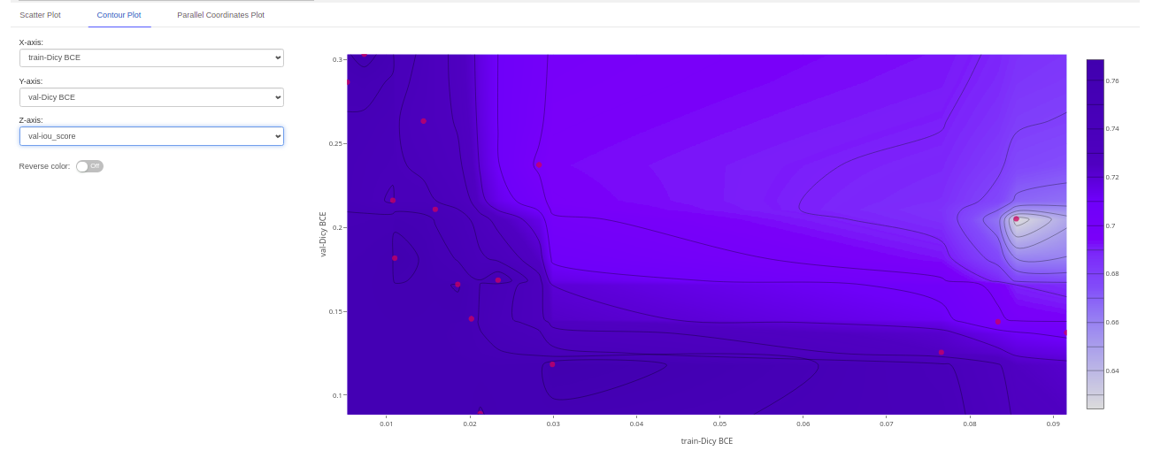
Perturbed minds
Fully deployed production environment to AWS (ECR, Fargate, S3 and RDS), props to Simao and Christian @ITU 👋 for smooth support
In use for the Perturbed Minds project
Needed some VPC customization to run on ITU infrastructure
TGs can access code to set up project specific MLflow servers: https://github.com/aiaudit-org/amazon-sagemaker-mlflow-fargate

Slide 8
Perturbed minds
Demo
Support for TGs and other WGs
We have production ready code template available for you (with correct ITU VPC setup) to host your own project specific MLflow servers: https://github.com/aiaudit-org/amazon-sagemaker-mlflow-fargate

Slide 9
Perturbed minds
Next steps and outputs
Submission of paper, code and data sets for scientific review by end of 08/21
Ingestion of project insights into DEL 5.4 and 7.3 by next FG meeting
Interested to join? In particular we are always interested to access raw, annotated imaging data
https://aiaudit.org/contributors/
https://github.com/aiaudit-org
https://app.slack.com/client/T01EDSWE8U8/

