Slide 1
FGAI4H-L-042-A01
E-meeting, 19-21 May 2021
Source: | TU Dresden, Germany
Title: | New topic group proposal: Using voice as a biomarker in preventing, predicting and monitoring disease – Att.1: Presentation
Purpose: | Discussion
Contact: | Dominik Stosik | E-mail: dominik.stosik@mailbox.tu-dresden.de
Abstract: | This PPT summarizes the content of L-042 with a proposal for a new topic group on AI for human voice for presentation and discussion during the meeting. The topic group on AI for human voice will address challenges and considerations that should be assessed when developing AI solutions for clinical applications.

Slide 2
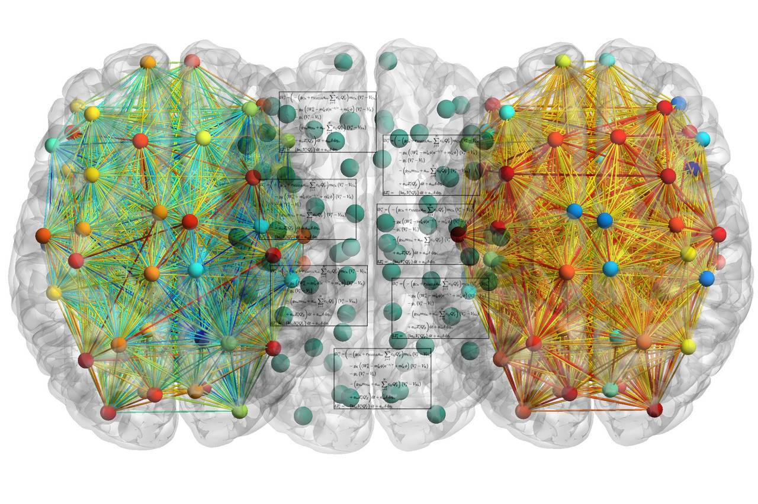
On the left, in green, is a simulation of the brain at rest. |  | On the right, in orange, is a simulation of the brain during speech production, a complex task made possible by the activity of many interconnected areas.
Att.1: Presentation FGAI4H-L-042, E-meeting, 19-21 May 2021

Slide 3
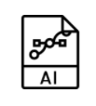
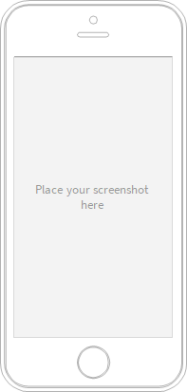
Existing models draw upon voice as isolated biomarker in detecting early onsets of psychiatric disorders and monitoring them to prevent relapses
🗣
Limitation
Talk to me
🕪
“compliance-dilemma”
Att.1: Presentation FGAI4H-L-042, E-meeting, 19-21 May 2021

Slide 4
Dreams of the Future?
🗣
🌡
Limitation
Talk to me
🕪
“compliance-dilemma”
Att.1: Presentation FGAI4H-L-042, E-meeting, 19-21 May 2021

Slide 5
Relevance
consensus that this pandemic is just the beginning of a human induced change in the ecosystem
other pathogens (i.e. bacteria) and the growing bacterial resistance to antibiotics will have a significantly negative impact on the human immune system and will be an additional burden for the healthcare system
reaction time in most cases will be crucial and AI based early detection systems will be needed more than ever
Att.1: Presentation FGAI4H-L-042, E-meeting, 19-21 May 2021

Slide 6
Impact
better care? ✅
lower cost? ✅
higher efficiency? ✅
“Vocal biomarkers, like pulse and blood pressure biomarkers, are medical indications derived from qualities in our voice. Capturing and analyzing small variations in our voice, such as pitch, intensity, vocal tract coordination, jitters, shimmers, tremors, pauses, and so on, results in a variety of health assessments that offer a more complete picture of our health in seconds.”
Att.1: Presentation FGAI4H-L-042, E-meeting, 19-21 May 2021

Slide 7
Existing work? Yes, but …
Att.1: Presentation FGAI4H-L-042, E-meeting, 19-21 May 2021

Slide 8
Do not reinvent the wheel, but
Att.1: Presentation FGAI4H-L-042, E-meeting, 19-21 May 2021

Slide 9
Do not reinvent the wheel, just realign it !
What we have | What we need
sophisticated speech recognition software and ML AI models owned by multinational technology companies (Amazon, Google) or intelligence agencies | do not try to outcompete them, but use frameworks that work on top of these
open accessible databases to train AI models (for a list see proposal paper) | data that has not been seen by any algorithm before
Big (unstructured) Data | Big structured Data
Att.1: Presentation FGAI4H-L-042, E-meeting, 19-21 May 2021

Slide 10
Realigning the wheel
What we need | How do we get it?
do not try to outcompete them, but use frameworks that work on top of these | lots of these are publicly available and would only be needed as a comparative value
data that has not been seen by any algorithm before | by taking advantage of the more and more popular medical tele- and video consultations (in University Hospital environments)
Big structured Data | it’s already there
Att.1: Presentation FGAI4H-L-042, E-meeting, 19-21 May 2021

Slide 11
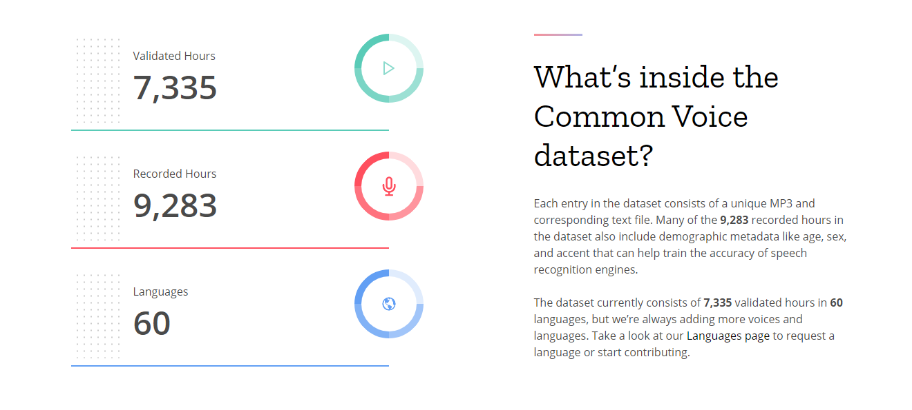
Possible obstacles and difficulties
language barriers
Privacy and Data protection
International Standards in Anonymisation and Pseudonymisation of Data
(“Institut für Qualitätssicherung und Sicherheit im Gesundheitswesen
[Institute for Quality Assurance and Safety in Health Care]”)
Att.1: Presentation FGAI4H-L-042, E-meeting, 19-21 May 2021

Slide 12
Interconnected AI Algorithms (with a little help from EHRs)
Att.1: Presentation FGAI4H-L-042, E-meeting, 19-21 May 2021

Slide 13
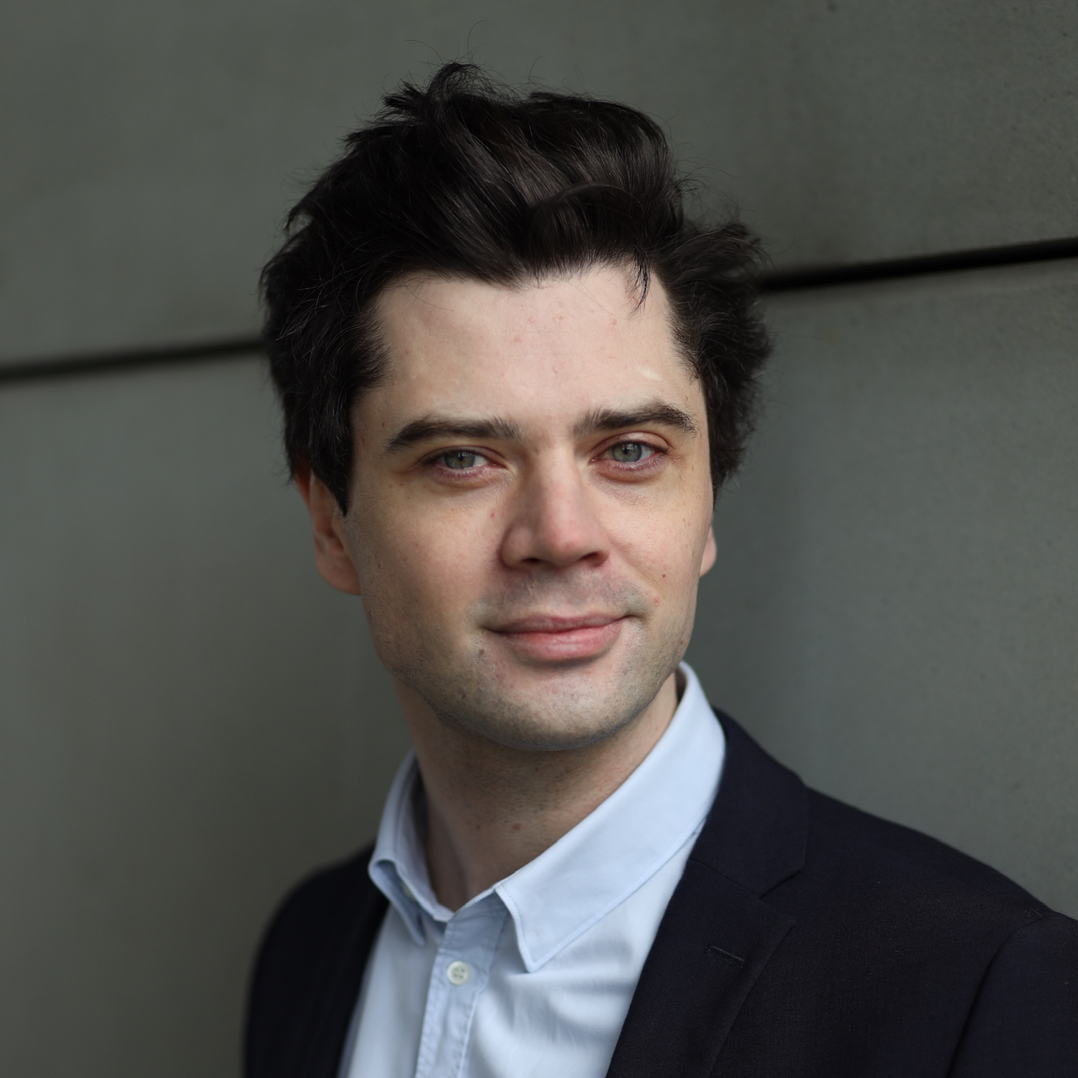
Thank You for your attention
dominik.stosik@mailbox.tu-dresden.de
Att.1: Presentation FGAI4H-L-042, E-meeting, 19-21 May 2021

