Slide 1
FG-AI4H-L-040-A01
E-meeting, 19 – 21 May 2021
Source: | Editors DEL7.4
Title: | Updated Del. 7.4: Clinical evaluation of AI for health – Att.1: Presentation
Purpose: | Discussion | Information
Contact: | Naomi Lee Shubs Upadhyay Eva Weicken | E-mail: naomi.lee@lancet.com E-mail: shubs.upadhyay@ada.com E-mail: eva.weicken@hhi.fraunhofer.de
Abstract: | This PPT contains a presentation of DEL 7.4 in L-040 for discussion at this meeting.

Slide 2
WG-CE: Working Group on
Clinical Evaluation
FG-AI4H meeting “L”, 19 - 21 May 2021

Slide 3
Agenda - Status update WG-CE
Introduction WG-CE
Timeline - where we are to date
Introduction draft outline – Table of content
Presentation draft outline (high-level overview of sections)
Next steps
A
B
C
D
E

Slide 4
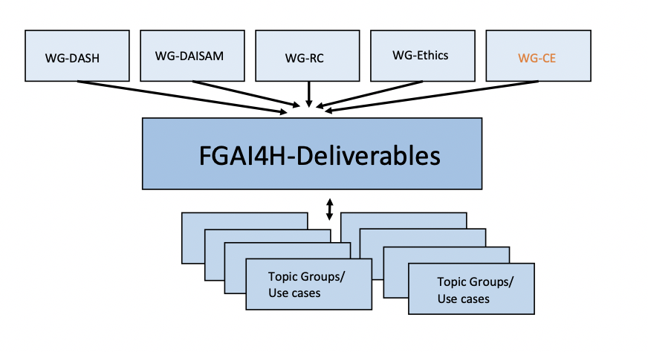
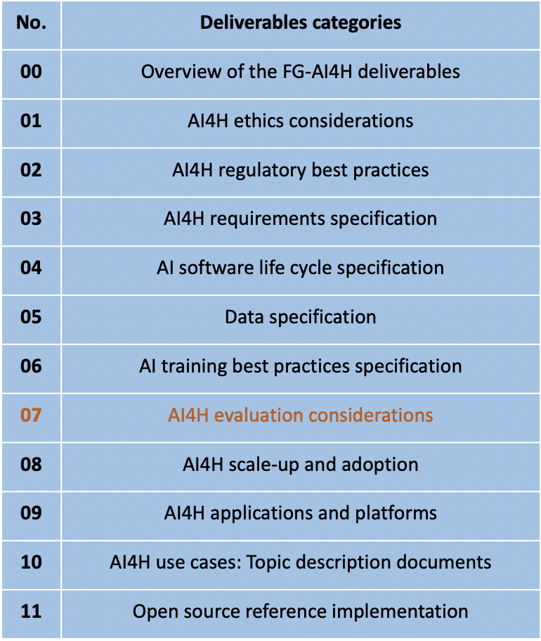
A
Introduction WG-CE
Working Group on Clinical Evaluation within FG-AI4H

Slide 5
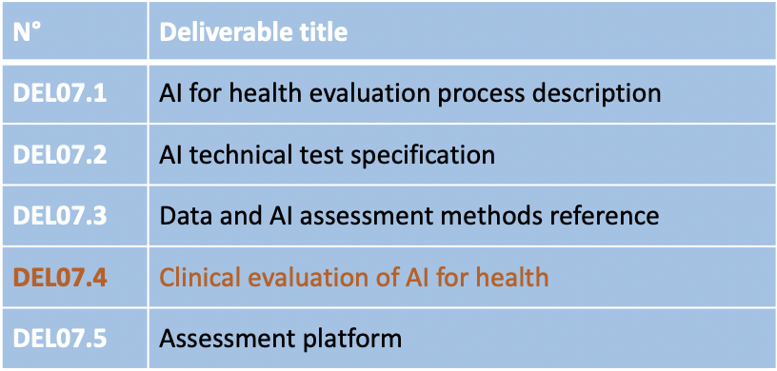
A
Introduction WG-CE
Part of No. 7 deliverable “AI4H evaluation considerations” (umbrella)
Output document of the Working group on Clinical Evaluation
Update DEL 7.4 to meeting L: Draft outline version 1.1 (before sharing with WG-CE, feedback not included yet)
Notes:
Plus next steps? Written feedback until 30 April, outline present at next FG-AI4H meeting 19 - 21 May, WHA ?? Presentation? Webinars?

Slide 6
A
Introduction WG-CE
Objective
Build a community of collaboration around clinical evaluation of AI for health
Guidance for current best practice evaluation, principles of evaluation to ensure it is generally relevant across all countries
Used by researchers, clinicians, patients, developers, civil-society, policy-makers
special consideration of clinical evaluation in LMIC settings
applicable for FG-AI4H

Slide 7
A
Introduction WG-CE
Organization of collaboration
65+ members from all around the globe (academia, research, clinicians, commissioning, etc.)
Co-chairs: Naomi Lee, Shubs Upadhyay, Eva Weicken
Writing comittee: above mentioned & Kassandra Karpathatkis, Alastair Denniston, Jane Carolan, Tommy Wilkinson, Xiao Liu
Outline (Del7.4) based on contributions of ALL members

Slide 8
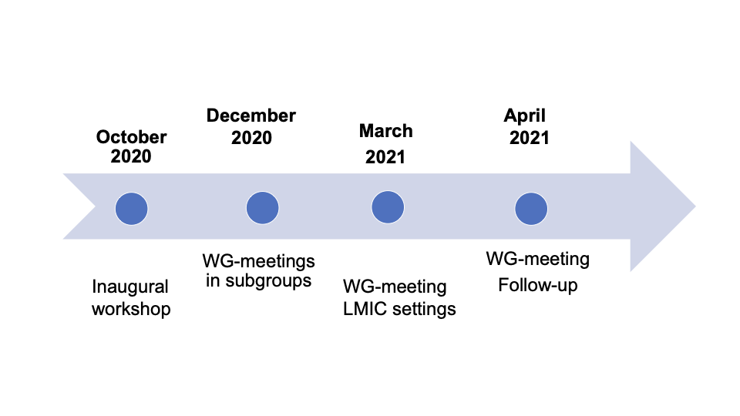
B
Timeline - Where are we to date?
Outline

Slide 9
C
Introduction draft outline
Table of contents
Introduction & Background
Scoping phase
Design phase
Development phase
Building data
Testing and validation
Clinical studies, safety and efficacy
Economic evaluation
Implementation of algorithm
Ongoing monitoring
Recommendations

Slide 10
D
Presentation outline draft
Introduction & Background
Objective: guidance for best practice evaluation, emphasis on principles of evaluation (relevance across all countries, ensure AI is safe, effective, cost-effective)
Following AI life cycle and draw on existing evaluation frameworks
Audience
Information about the contributors/FG-AI4H
Global scope, interest in evaluation that supports SDG-3
Considerations on evaluation in LMIC settings
Collaboration within FG-AI4H (WGs, TGs)

Slide 11
D
Presentation outline draft
Scoping Phase & Design phase
Helping procurers, competent authorities, decision makers consider a structured approach.
Has the developer demonstrated these things:
That the problem space is really understood
That AI is indeed the right tool to solve the problem
Defined intended users and intended benefits
Worked with clinical and other stakeholders to scope and define potential risks
Worked to understand the clinical context, setting, and impacts
Understanding its usability and fit in existing workflows (core questions), user centered approach
Started to design and plan for evaluation of benefits at patient, clinical and system level

Slide 12
D
Presentation outline draft
Development phase I
Building
Transparency of training data required in order to evaluate: quality of labels (expert opinion, biopsy confirmed), inclusiveness of data (gender/sex, age, race/ethnicity)
Is it representative of the situation in which it will be used?
Testing and validation
Analytical validation: External validation - testing model in an unseen, external dataset representative of setting and population of intended use. Identify failure cases.
Comparative benchmarking of AI tools), might be a way to constantly and quickly evaluate dynamic AI tools
Data availability may be a challenge
Reader Study
Provide the tool to the intended user and evaluate its performance in the workflow

Slide 13
D
Presentation outline draft
Development phase II
Clinical studies, safety and efficacy
aim to minimizing bias and give confidence (evidence AI is effective and safe when deployed),
prospective analysis plan, reporting in line with this and reporting guidelines
designed to evaluate impact on whole pathway and with clinically meaningful endpoint
RCTs are the benchmark of clinical studies, but other forms of study can be undertaken when this is not feasible - but this does require additional consideration of potential bias
Consider:
Study design (effectiveness, safety, cost effectiveness)
Population (diverse and reflects that of intended use setting)
Intervention (described in a way that it can be replicated)
Comparator (relevant reference that is SOC)
Pre specified outcomes, process measures
Registered and reported
Prospective observational studies with a relevant comparator, meaningful outcome and systematic safety reporting can be considered adequate for some tools

Slide 14
D
Presentation outline draft
Economic evaluation
Evaluation requires measurement of costs (direct and associated implementation costs), and wider economic considerations relative to estimated clinical effect
Comparative analysis of two or more interventions in terms of their costs and consequences which informs funding decisions
AI supported digital health interventions require more consideration for their economic evaluation than simple, individually consumed non-digital health technologies
World Bank is engaging in collaborative effort to develop framework for economic evaluation of digital health interventions due for publication 2021
Innovation or development costs can be substantial, but then marginal cost can approach zero, costs dependent on local digital architecture
Economic evaluation can be informed by real world data
The basic premise of costing for economic evaluation is that costs should reflect full net costs of the intervention aligning to the specification of the intended decision maker. This requires therefore that when estimating costs, the decision problem, perspective of the decision maker, an understanding of what the intervention would displace in the context of the decision problem should be established.
consider build cost, maintenance, delivery, site costs
Reimbursement

Slide 15
D
Presentation outline draft
Implementation of algorithm
Demand from health systems to accelerate technological solutions to address crisis
AI may be deployed earlier in evaluation process demand, some factors show during deployment at large scale), esp. generalisability > therefore need to continued evaluation
Risk of harm can be considered in terms of likelihood and consequences
-- rapid scaling following single centre evaluation in homogenous popn has higher chance of failure, can mitigate
Determine level of additional evaluation (version updates, continuously learning systems)
Ongoing monitoring
Not solely responsibility of developers but including wide groups (patients, public, HCP, etc.)
Of performance (safety and effectiveness), e.g. unexpected outputs, variations in clinical workflow
AEs may be a considerable way downstream
Requirements for post market surveillance plan, reported adverse events
Algorithmic audits for analysis of adverse events

Slide 16
D
Presentation outline draft
Recommendations
Procurers of AI tools should be clearer about the economic evaluation for AI tools
Priority setting for digital tools in all country settings requires a much more active role for health technology assessment, in addition to the role of regulators
Benchmarking of AI tools either by local procurers or by national agencies - e.g., FG-AI4H open code initiative
Longer term analysis of AI tools is required (Collaborative studies would accelerate progress and should be considered a priority)
Needs-based development of tools requires a dedicated effort to collect data in underrepresented populations and where AI may be effective, but datasets are poor
All stakeholders must be encouraged to make clinical studies to be more open and accessible

Slide 17
E
Next steps
sharing with WG members for second round of feedback
Available to view in the Deliverable documentation 7.4: welcome comments
follow-up meetings
purpose for FG-AI4H : in particular - application/translation to topic groups?
synchronization with other FG-AI4H WGs
e.g., language, life-cycle approach, “overall” implementation
wider external awareness and publication

Slide 18
Thank you & Join us!
Co-chairs:
Naomi Lee, The Lancet
Shubhanan Upadhyay, Ada Health
Eva Weicken, Fraunhofer HHI
Please contact: eva.weicken@hhi.fraunhofer.de

