Slide 1
FGAI4H-L-038-A01
E-meeting, 19-21 May 2021
Source: | Editor DEL03
Title: | Updated DEL03: AI4H requirement specifications – Att.1: Presentation
Purpose: | Discussion
Contact: | Pradeep Balachandran | E-mail: pbn.tvm@gmail.com
Abstract: | This PPT summarizes the content of L-038 for presentation and discussion during the meeting.

Slide 2
System Requirements Specification(SRS): Scope
Provides high level description of AI4H system requirements across the entire AI4H process life cycle (i.e. from Data collection to Model Deployment)
Functional requirements,
Performance requirements,
Operational requirements,
Interface requirements,
Safety and security requirements
Migration requirements,
Regulatory requirements, etc.
Primary target audience: System analysts, System Developers, System Testers, Quality Managers, Regulators
Main Goal:
- For the Topic Groups, how this SRS can aid as a tool for system requirements traceability during AI4H Acceptance Testing

Slide 3
System Requirements Specification(SRS)
Requirements analysis & modeling criteria can be generic as well as specific to a particular Use Case / Topic Group
Example:
- Generic requirements model- all image processing based AI4H systems ( Parent class)
- Custom requirements model – TG-Derma Or TG- Retinal ( Child class)
Sample- AI4H performance metric specification:
“ The retinal image classification algorithm (shall/should/may) have a mean sensitivity of 80.2% ( 95% Confidence Interval, 75.2% - 86.5% ) and mean specificity of 89.3% ( 95% Confidence Interval, 81.3% - 95.7% ) “

Slide 4
DEL 03 revision (as on FG –K Jan-21-meeting)
Reconfigured DEL 03 AI4H system requirements into a separate ‘Requirements Traceability Matrix‘ which represents a mapping of TDD technical topics to AI4H Assessment Platform Requirements (Open Code Project)
Utility: Requirements Traceability Matrix was proposed as a DAISAM tool for TDD audit process’
- Are TDD inputs ‘ verifiable' as requirements for the AI4H Assessment Platform ?
- E.g. Verify whether TG-Malaria use case has defined the ‘AI explainability’ requirements specification with the help of Requirements Traceability Matrix tool

Slide 5
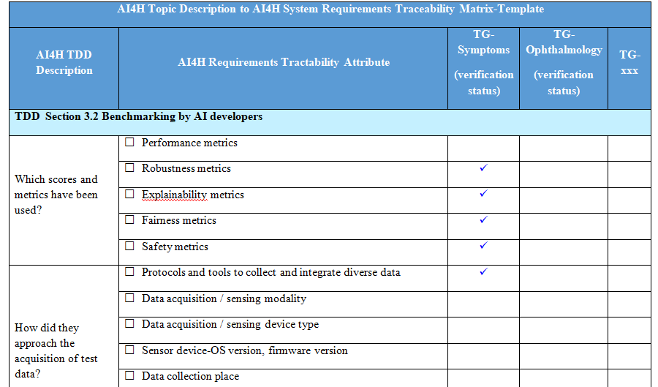
Requirements Traceability Matrix-Tool Template

Slide 6
DEL 03 revision (as on FG -L- May-21-meeting)
Extended Utility # 1: Requirements traceability matrix to enable ‘custom mode’ of reporting service under the AI4H assessment platform (Open Code Project)
The reporting parameters can be configured on the basis of model evaluation metrics defined in the requirements traceability matrix, which include the following:
AI Evaluation process flow metrics
AI Model performance evaluation metrics
AI Model risks and severity metrics
AI Model bias & fairness metrics
AI Model explainability metrics
AI Model generalizability metrics
AI Model interpretability metrics
AI Model robustness metrics
AI Model uncertainty metrics
AI Assessment platform -infrastructure resourcing metrics
Device security & privacy metrics
Patient safety metrics

Slide 7
DEL 03 revision (as on FG -L- May-21-meeting)
Extended Utility # 2: Requirements traceability matrix to provide reference inputs for ‘Test Plan Creation’ to aid ‘ AI4H quality auditing’ under the AI4H assessment platform (Open Code Project)
From an AI4H auditing perspective
Aim:
How can we use this requirements traceability matrix to estimate the quality metric- ‘cost of SRS non-conformance’ during AI4H Requirements Audit and help towards controlling or reducing that cost. ( during ‘system verification & validation’ or ‘acceptance testing’ )
This cost metric can be detrimental to the ‘Acceptance/ Rejection’ of the AI4H system
3. How can we relate every instance of SRS-non-conformance (defects or errors) to the overall non-conformance cost- as part of AI4H Acceptance Testing

Slide 8
DEL 03 revision (as on FG -L- May-21-meeting)
From an AI4H auditing perspective, requirements traceability matrix helps to create ‘Test Plans/ Test Cases’ to support the following types of tests:
Functional testing
Data Interface / Interoperability testing (with other health information systems /
databases)
Data Quality testing -for Data Integrity, Data Completeness, Data Bias
Workflow / Protocol Integration testing - to ensure proper AI solution interoperability
with clinical workflow setting
Safety and Security controls testing
- verification of the type and probability of risks ( for device, environment of use and user)
- verification of security controls for device ( software, hardware, firmware)
- verification of security controls for user
Usability testing- usability assessment report for different user groups
User-Interface testing
Installation testing, etc.

Slide 9
Thank you

