Slide 1
FGAI4H-L-037-A01
E-meeting, 19-21 May 2021
Source: | Editors
Title: | Updated DEL2.2: Good practices for health applications of machine learning: Considerations for manufacturers and regulators – Att.1: Presentation
Purpose: | Discussion
Contact: | Christian Johner | E-mail: christian.johner@johner-institut.de
Abstract: | This PPT summarizes the content of L-037 with a status report on the preparation of Deliverable 2.2, for presentation and discussion during the meeting.

Slide 2
Titelfolie erste Zeile
Titelfolie zweite Zeile
AI4H Guideline
A Project Update
By Pradeep Balachandran, Luis Oala, and Christian Johner

Slide 3
A guideline helps to apply ML in healthcare safely and compliant.
Situation
Complication
Solution
Increasing use of AI/ML in Medical Devices
Patient safety at risk
Increasing number of AI/ML Standards, Guidelines, …
Increasing (regulatory) complexity
Commonly agreed guideline for all stakeholders
Increasing number of AI/ML related problems
Increasing confusion (manufactures, authorities, …)
New regulatory and technological trends
Problems in audits and approval processes

Slide 4
The guideline addresses the relevant stakeholders.
Developers,
Data
Scientists
Regulatory Affairs
Quality Managers
(Medical Professionals)
Notified Bodies
Authorities

Slide 5
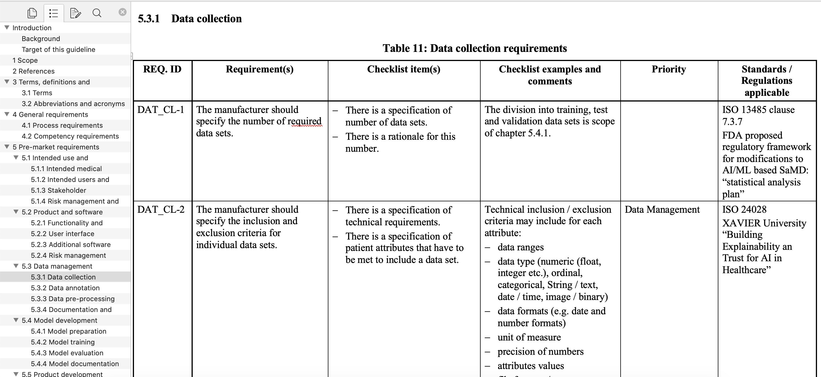
The guideline gives specific guidance.

Slide 6
A guideline helps to apply ML in healthcare safely and compliant.
Situation
Complication
Solution
The guideline exists.
There are inconsistencies and redundancies.
Other parties develop guideline for specific medical domains.
There is no workflow for updating the guideline.
System to maintain the guideline and to compile sub- sets.
AM/ML further evolves.
There is no workflow for approving changes.
Other guidance documents are published.
Time-boxed audits require definition of subsets.

Slide 7
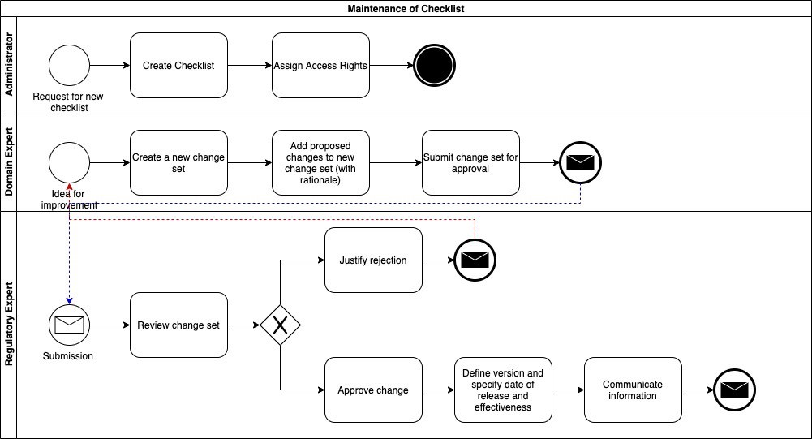
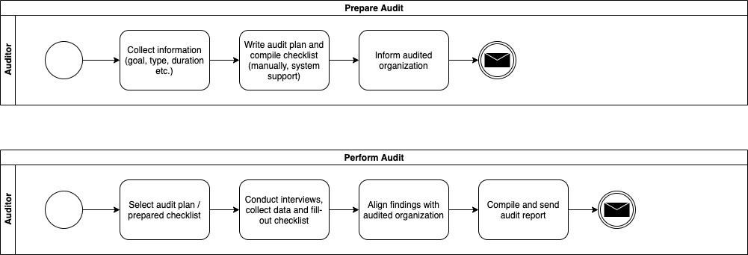
First workflows have been modelled.
6

Slide 8
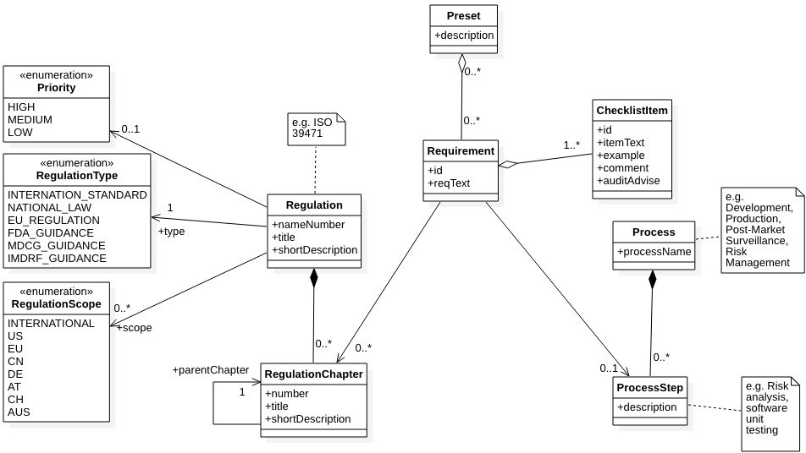
There is a first version of a data model to ensure consistency.

Slide 9
The next steps have been defined.
Finish modeling of data model.
Finish modeling of workflows.
Specify use scenarios
Specify system (including UI/UX design)
Develop system

