Slide 1
FGAI4H-L-036-A01
E-meeting, 19-21 May 2021
Source: | Markus Wenzel¹, David Neumann¹, Sandeep Reddy², Annika Reinke³, Manuel Wiesenfarth³, Alberto Merola⁴, Steffen Vogler⁵ ¹Fraunhofer HHI, ²Deakin University, ³DKFZ, ⁴AICURA, ⁵Bayer
Title: | Updated DEL07: AI for Health Evaluation Considerations - Att.1: Presentation
Purpose: | Discussion
Contact: | Markus Wenzel | E-mail: markus.wenzel@hhi.fraunhofer.de
Abstract: | This PPT summarizes the content of L-036 with the Updated DEL07: AI for Health Evaluation Considerations, for presentation and discussion during the meeting.

Slide 2
Healthcare AI Models
predict
recognize
recommend
help to decide
Artificial intelligence and machine learning offer great potential for many applications in healthcare.

Slide 3
Healthcare AI Models
… are on the rise.

Slide 4
Healthcare AI Models
Effective, safe, accurate (on new data), robust, plausible, fair?
→ Standards for trustworthy healthcare AI needed
Careful evaluation plays crucial role.

Slide 5
Evaluation Deliverables Series
N° | Title | Editors
DEL7.0 | AI4H Evaluation Considerations | Markus Wenzel (Fraunhofer)
DEL7.1 | AI4H Evaluation Process Description | Sheng Wu (WHO)
DEL7.2 | AI Technical Test Specification | Auss Abood (RKI)
DEL7.3 | Data + AI Assessment Methods Reference | Luis Oala (Fraunhofer)
DEL7.4 | Clinical Evaluation | Naomi Lee (Lancet) et al.
DEL7.5 | Assessment Platform | Steffen Vogler (Bayer) et al.

Slide 6
DEL7.0) AI4H Evaluation Considerations
Overview of deliverables DEL7.1-5
Preliminary evaluation process
Novelty
Standardized model benchmarking
Benchmarking platform requirements
Best practices from literature

Slide 7
Cyclical Evaluation Process Preliminary considerations

Slide 8
Novelty
N° | Aspect (key word; full description in DEL7) | Phase of Evaluation Cycle
 |  | Define task | Define task metrics | Collect/ audit test data | Benchmark | Evaluate | Monitor
1 | Appropriate test data sets | ● | ● | ● | ● |  | ●
2 | Internal vs. external validation |  |  | ● | ●
3 | Technical vs. clinical criteria |  |  |  | ● | ●
4 | Proper benchmarking |  |  |  | ●
5 | Complex models and settings | ● | ●
6 | Self-learning algorithms |  |  |  | ●
7 | Human factors |  |  |  |  | ● | ●
8 | Misuse accurate tools |  |  |  |  | ● | ●
9 | Design of clinical trials with AI |  |  |  |  | ●
Novel/unique aspects of healthAI model validation/evaluation​

Slide 9
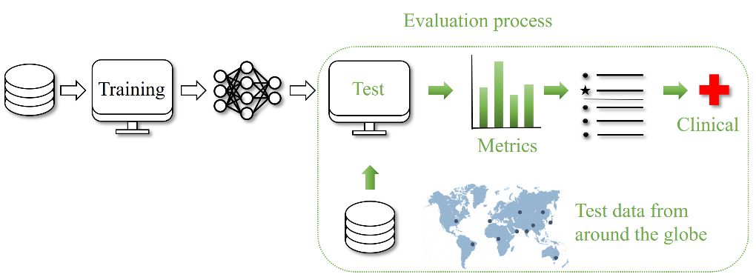
Standardized Benchmarking
Independent model validation with standard procedures on separate test data and subsequent clinical evaluation
(1) Closed environment, (2) Via interface , (3) Federated

Slide 10
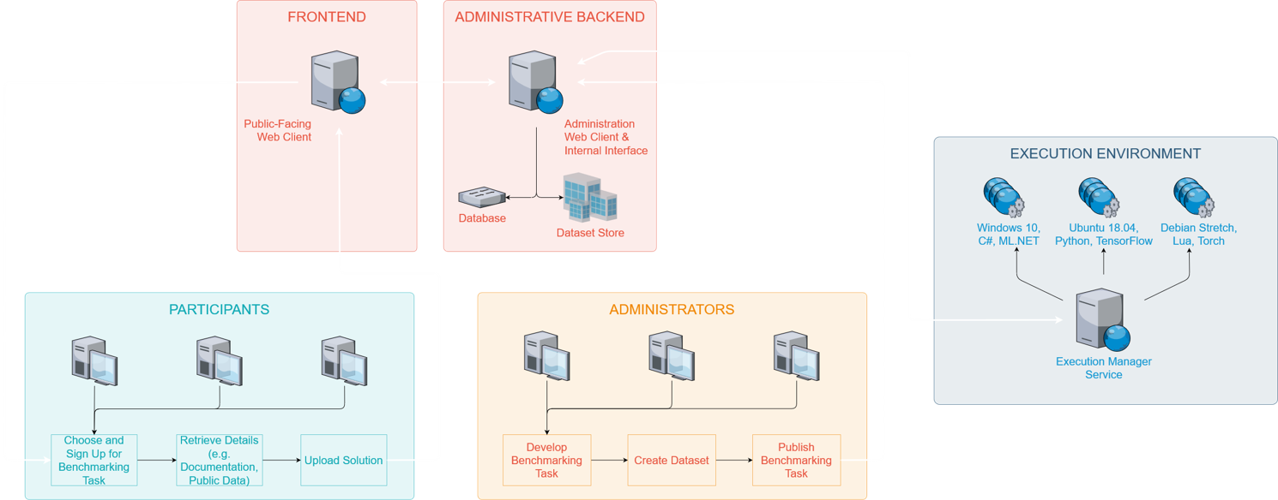
Benchmarking Platform – Requirements
System overview (administrative backend · frontend · execution environment)​
General considerations (security · hosting · computing resources · availability)​

Slide 11
Best Practices from the Scientific Literature and Other Documents
From 22+ important sources with brief discussion.
Please send us literature you find relevant.

Slide 12
Status Update
Improved text, included new references, rearranged sections, updated table
Turning vision for AI4H benchmarking platform into practice
See Open Code Initiative, evaluation package, talk yesterday

Slide 13
Next →
Update this intro DEL7.0 based on progress of DEL7.1-5
Feedback DEL editors, WGs, TGs, OCI, you?
markus.wenzel@hhi.fraunhofer.de
https://itu.int/go/fgai4h/collab → Deliverables → DEL07.docx
Many thanks to my co-authors:
David Neumann (Fraunhofer HHI)
Sandeep Reddy (Deakin University)
Annika Reinke, Manuel Wiesenfarth (DKFZ)
Alberto Merola (AICURA medical)
Steffen Vogler (Bayer)

