Slide 1
FGAI4H-L-023-A03
E-meeting, 19-21 May 2021
Source: | TG-Radiology Topic Driver
Title: | Att.3 - Presentation (TG-Radiology)
Purpose: | Discussion
Contact: | Darlington Akogo Founder, Executive Director minoHealth AI Labs | E-mail: darlington@gudra-studio.com
Abstract: | This PPT summarizes the status of work within TG-Radiology, for presentation and discussion during the meeting.

Slide 2
Topic Group on AI for Radiology
Darlington Akogo Topic Driver
Founder, Executive Director
minoHealth AI Labs
darlington@gudra-studio.com

Slide 3
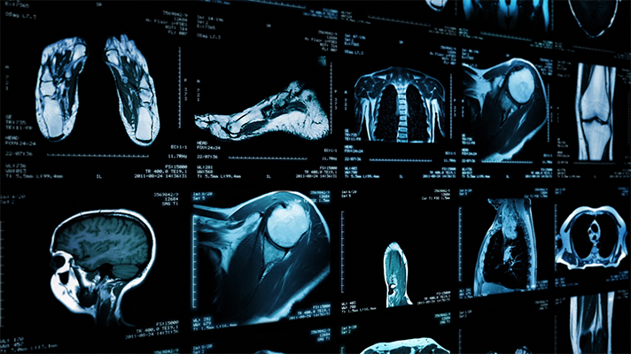
AI in Radiology - Overview
AI systems in radiology have achieved impressive results. They outperformed radiologists in some cases.
Challenge in properly testing AI radiological systems and ensuring they work in all edge and diverse cases radiologists encounter.
Study analysed 31,587 AI healthcare studies, only 69 studies provided enough data enabling calculation of test accuracy. Only 25 studies further did out-of-sample external validations. And further, only 14 of such studies compared the models’ performances to that of radiologists. (Liu et al., 2019)
Standardisation and benchmarking is required.

Slide 4
Objectives
TG-Radiology is dedicated to the development of global standards for the evaluation and benchmarking of AI radiological systems.
We are also collecting diverse data towards the assessment of AI radiological applications.

Slide 5
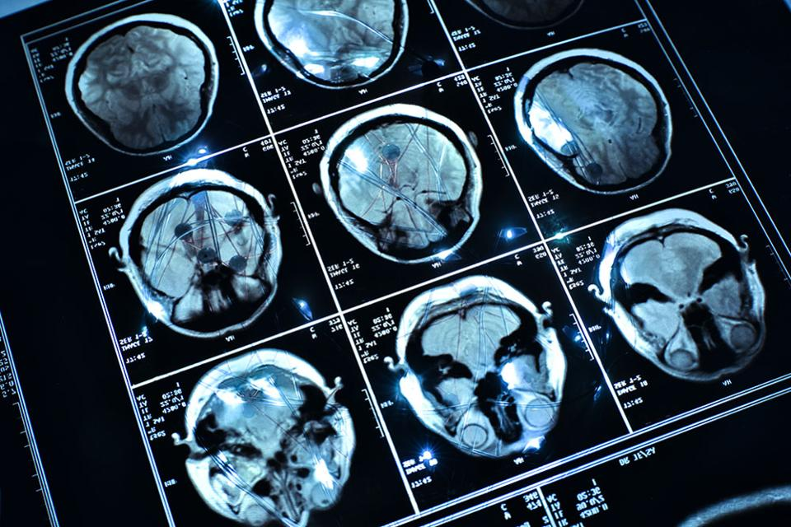
Timeline
21-24​ Jan 2020 - TG-Radiology was officially created at Meeting H, Brasilia
30 Jan 2020 - Call for Participants published
25 Feb 2020 - First Zoom meeting
26 Mar 2020 - First TDD submission (Radiograph-agnostic framework for AI Evaluation)
7-8 May 2020 - 9th FGAI4H Meeting (Use Cases & Existing Solutions)
27 Nov - TG virtual meeting
16 April 2021
Current - Updated TDD for ​​12th Meeting

Slide 6
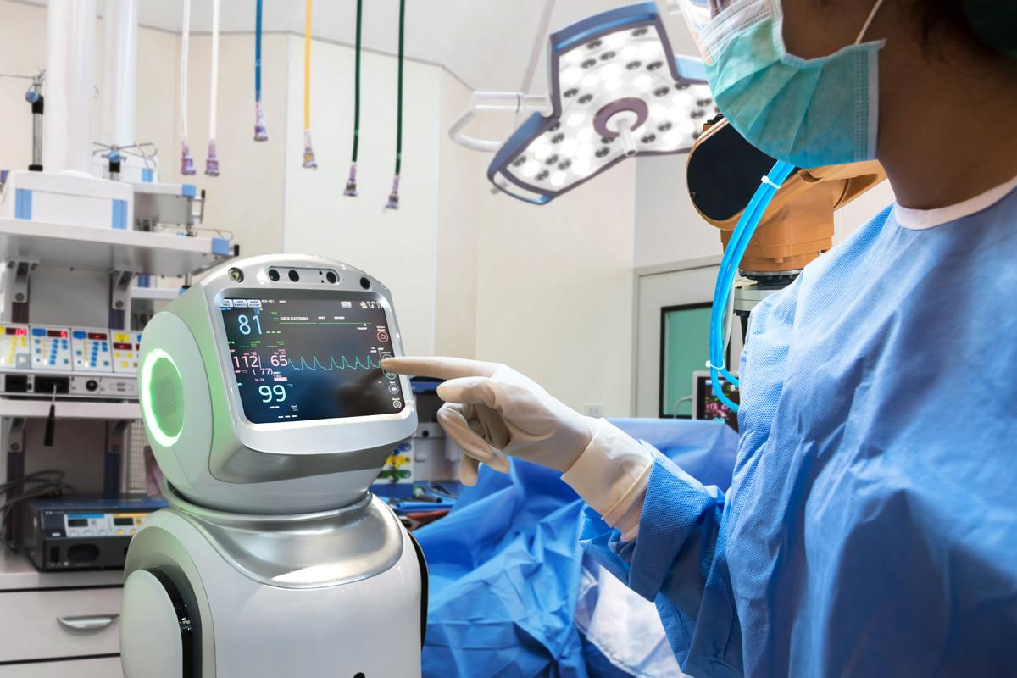
Participants
26 participants currently
From 5 continents; Africa (6), North America (5), South America (7), Europe (3), Asia (4)
11 organisations; AI providers (6), other digital health providers (2), health centers (4), universities (9)

Slide 7
Current Contributors to TDD (14 participants)
Vincent Appiah, minoHealth AI Labs, GUDRA Xavier Lewis-Palmer, minoHealth AI Labs, GUDRA Issah Abubakari Samori, minoHealth AI Labs, GUDRA Camilo Sotomayor, IA·TRad Chile & Clinical Hospital University of Chile Andrew Murchison, Oxford University Hospitals NHS Foundation Trust Benjamin Dabo Sarkodie, Euracare Advanced Diagnostic Center Alessandro Sabatelli, Braid.Health Daniel Hasegan, Braid.Health Pierre Padilla-Huamantinco, Universidad Peruana Cayetano Heredia Judy Wawira Gichoya, Emory University School of Medicine Saul Calderon Ramirez, De Montfort University (Metrics deliverables)
Edson Mintsu Hung, Universidade de Brasília Andrey O. O. dos Reis, Universidade de Brasília Renam Castro da Silva, Universidade de Brasília

Slide 8
Topic Description Document
Topic Description Overview of Radiology, Challenges facing Radiology, Overview of AI in Radiology, Challenges Facing Overview AI in Radiology, Impact of Benchmarking
Precision Evaluation framework and platform A radiograph-agnostic benchmarking platform and framework
Existing AI Solutions & Use Case: 29 conditions, X-Ray/body part classification (56 parts), 3+ modalities Image Conversion Considerations & Guidelines: 3 approaches and their Advantages and Disadvantages

Slide 9
Topic Description Document
22 metrics and scores - Threshold Metrics, Ranking Metrics, Probability Metrics - image classification, object detection, instance & semantic segmentation tasks
11 imaging modalities
Image Compression Considerations

Slide 10
16 April meeting - Topic Description Document
Onboarding new members
Discussed open work streams within the topic group
Vincent Appiah, minoHealth AI Labs took on the “Existing work on benchmarking”

Slide 11
Image Compression Considerations (Updated) - TDD
Edson Mintsu Hung, Andrey O. O. dos Reis, Renam Castro da Silva Universidade de Brasília
Ensuring input data integrity and quality JPEG, JPEG 2000 and PNG image codec formats, effects of compression methods and compression quality on model performance (post-deployment stage)
Update: Additional compression ratio, and comparison to PNG
Knowing ideal compression and image size for each use case, and regulating that during deployment is essential

Slide 12
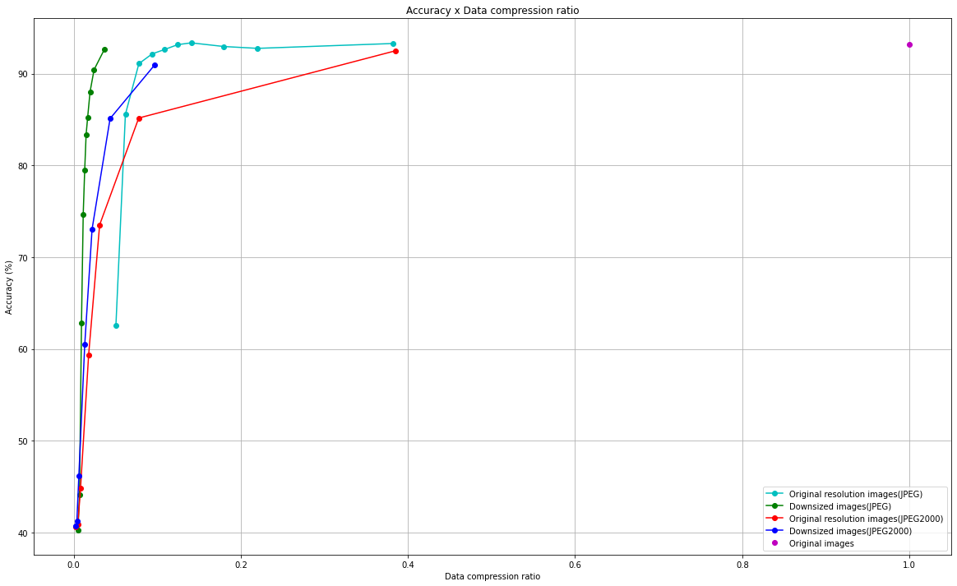

Slide 13
Existing work on benchmarking - Vincent Appiah
Identified 7 research papers
Summarised 3 of the papers
Several performance metrics have been proposed and a few are listed; Area under the curve(AUC), Accuracy, F1 score, Sensitivity and specificity (Park & Han, 2018)
Benchmarking should also take into account the annotation of data. Is the data labeled, unlabeled or semi-labeled?. This will determine what AI models and performance metrics to use.
A lot of factors should be considered when applying AI models; type of data, sample size, computational cost,etc. (Tang et al,2018)

Slide 14
Existing work on benchmarking - NHS AI Lab
NHS AI Lab created the National COVID-19 Chest Imaging Database (NCCID), currently with over 40,000 images.
A platform that allows for the assessment of UK-focused AI solutions on NCCID dataset. Goal: reduce the potential for bias and provide NHS commissioners and healthcare regulators with the evidence to judge the safety, efficacy, and generalisability of AI models before they are used in clinical practice.
Application form - technical and clinical questions
Independent assessors assess responses provided with a focus on NHS importance, technical feasibility, and financial viability

Slide 15
Existing work on benchmarking - NHS AI Lab
These external assessors prepare analysis plans, covering performance criteria and tailored to each AI solution.
The AI system is then validated on the unseen NCCID dataset via an AWS cloud-computing infrastructure provided by NHSX.
The AI developers are never given access to the NCCID unseen dataset.
The whole process takes 12-16 weeks to complete, and is done at no cost to the AI developers
To ensure Intellectual Property protections, all people involved in the AI model assessment, including external assessors will be bound to confidentiality by contractual agreements. NDA are signed, where needed

Slide 16
Existing work on benchmarking - NHS AI Lab
At the end, the AI developer will receive a written report with the assessment of the AI system against defined performance criteria.
This covers model performance using metrics including sensitivity, specificity, as well as the clinical validity of the solution.
The process is meant to be a validation study and does not qualify as a clinical investigation.
However, this report can be used as evidence to support applications to the MHRA (Medicines and Healthcare products Regulatory Agency), the United Kingdom’s healthcare products Regulatory Agency, for attaining a UKCA/CE marking or via standard conformance assessment processes.

Slide 17
Existing work on benchmarking - NHS AI Lab
We reached out to the team, so we could collaborate with them, share what we are doing, ideas on benchmarking and get updates from their benchmarking initiative.

Slide 18
Topic Group on AI for Radiology
Darlington Akogo Topic Driver
Founder, Executive Director
minoHealth AI Labs
darlington@gudra-studio.com

