Slide 1
FGAI4H-L-021-A03
E-meeting, 19-21 May 2021
Source: | TG-Symptom Topic Driver
Title: | Att.3 - Presentation (TG-Symptom)
Purpose: | Discussion
Contact: | Henry Hoffmann | E-mail: henry.hoffmann@ada.com
Abstract: | This PPT summarizes the progress made by the topic group on AI-based symptom assessment since meeting K.

Slide 2
Meeting L Update for the
Topic Group “Symptom Assessment”
E-meeting, 19–21 May 2021

Slide 3
AI-based Symptom Assessment
Mobile/Web Applications – sometimes called ”Symptom Checkers” that
Allow users to enter (INPUT)
Patient information (age, sex, …)
Current presenting Complaints (symptoms, free texts )
To then engage in a dialog similar to a doctor collecting (INPUT)
Additional symptoms, findings, factors, attributes, (lab, imaging, genetics, …)
To finally provide the user with (OUTPUT)
Pre-Clinical Triage (emergency, see doctor today, self-care … )
Differential Diagnosis (disease A 93%, B 73% - e.g. in ICD10, SNOMED CT)
Additional diagnostic tests to perform, treatment advice, explanations

Slide 4
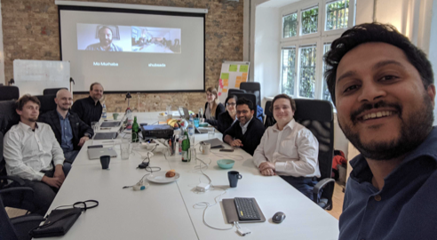
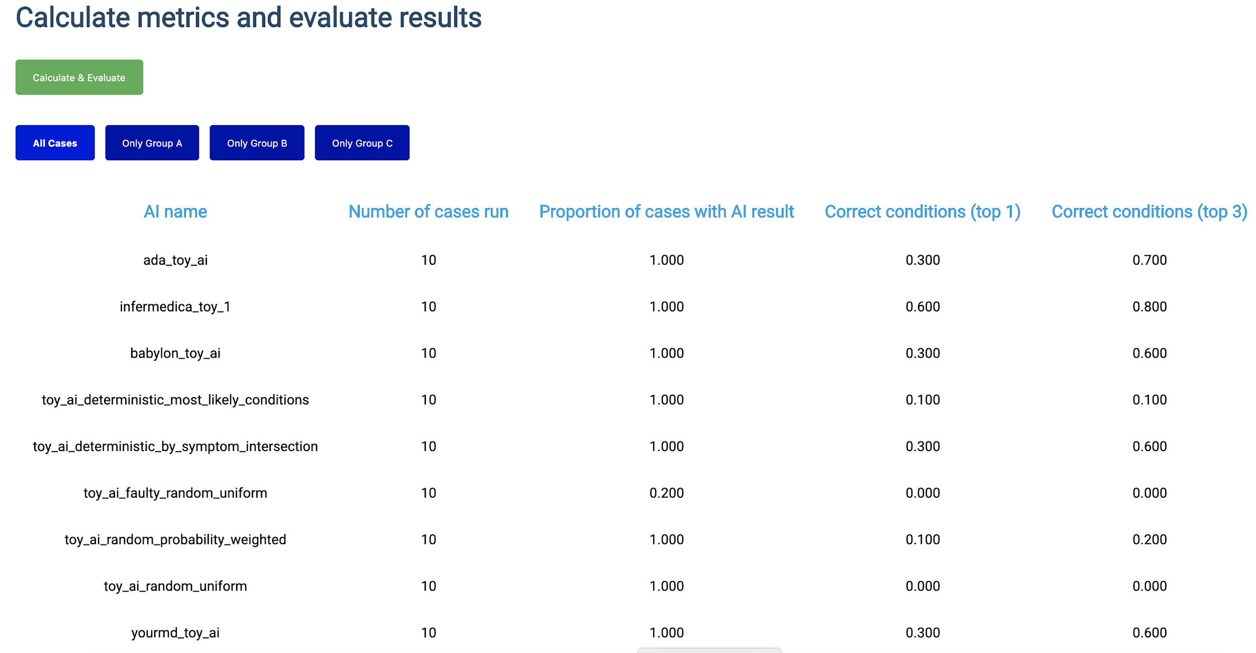
Journey & Approach
Meeting A – Geneva, 25-27 September 2018
A-020: Towards a potential AI4H use case "diagnostic self-assessment apps"
Meeting C – Lausanne, 22-25 January 2019
Topic Group created
Approach:
MMVB 1.0 … MMVB N.0 → MVB
Meeting F – Zanzibar 2-5 September 2019
First benchmarking with toy AI & toy Data
Minimal Minimal viable Benchmarking MMVB 1.0
Meeting G, H, I, J, K
Adding technical details to benchmarking and model
MMVB 2.2 work completed
Meeting K
First case encoding ontology work

Slide 5
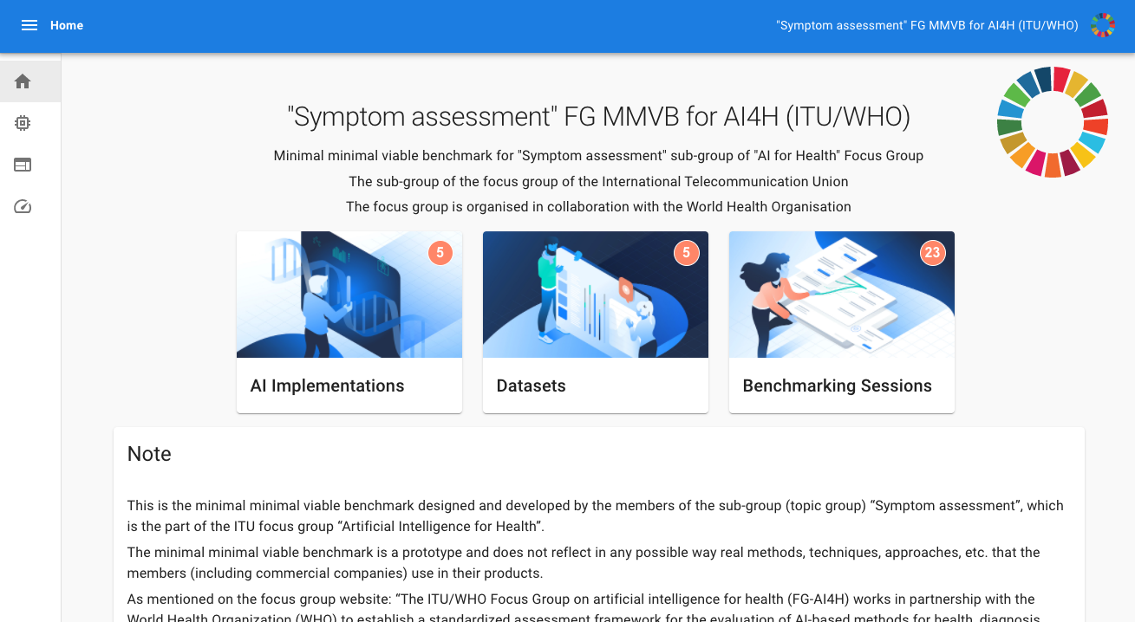
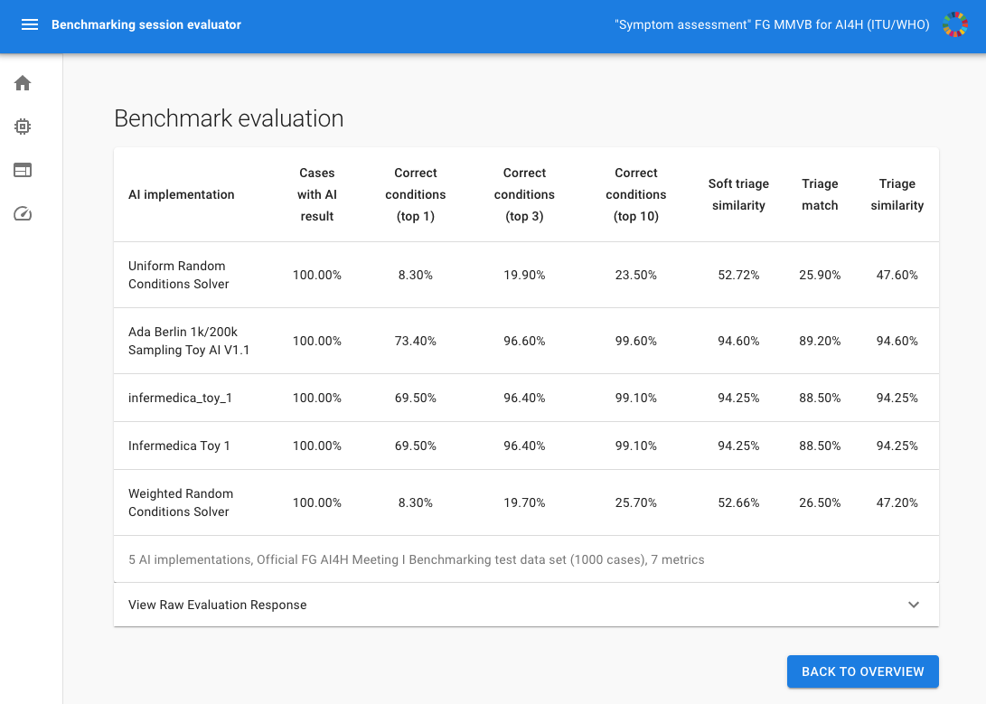
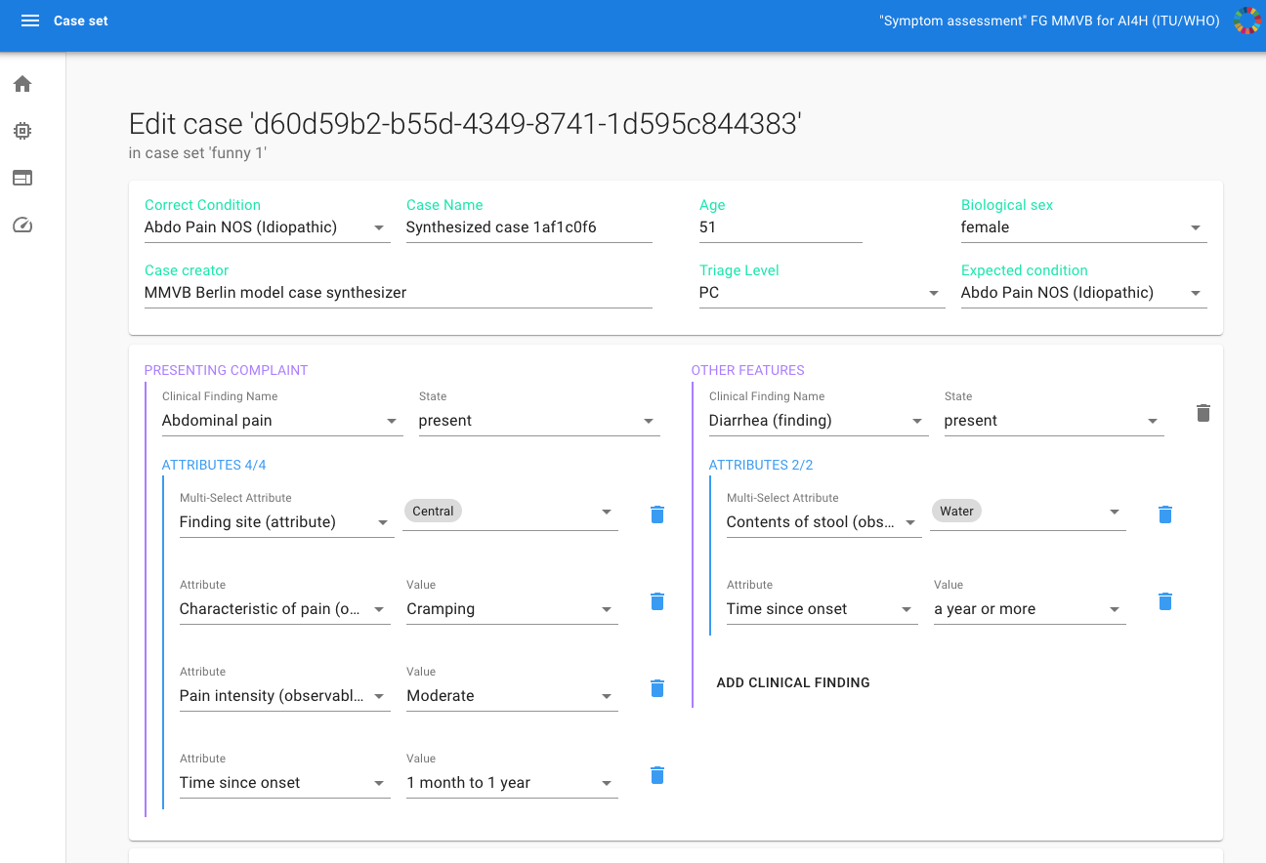
Status of the Benchmarking System
Finished MMVB 2.2 for Meeting
Based on the „Berlin Model“
Special focus on Attributes + Factor distributions
Benchmarking platform
Django Backend
JS React Frontend
Annotation Tool
Toy Ais
Ada, Babylon, Infermedica, Your.MD (all cloud hosted)
Implementation work paused
Focus on ontology
See in which direction the Open Code group goes

Slide 6
Status of the Ontology Work
Every Topic Group member has an own Benchmarking System
Essential for development work
Similar metrics
Similar cases
Completely different encoding
Core Task of the Topic Group
Agree on how to encode case data for benchmarking
Simple for diseases
Possible for symptoms/findings
Difficult for attributes

Slide 7
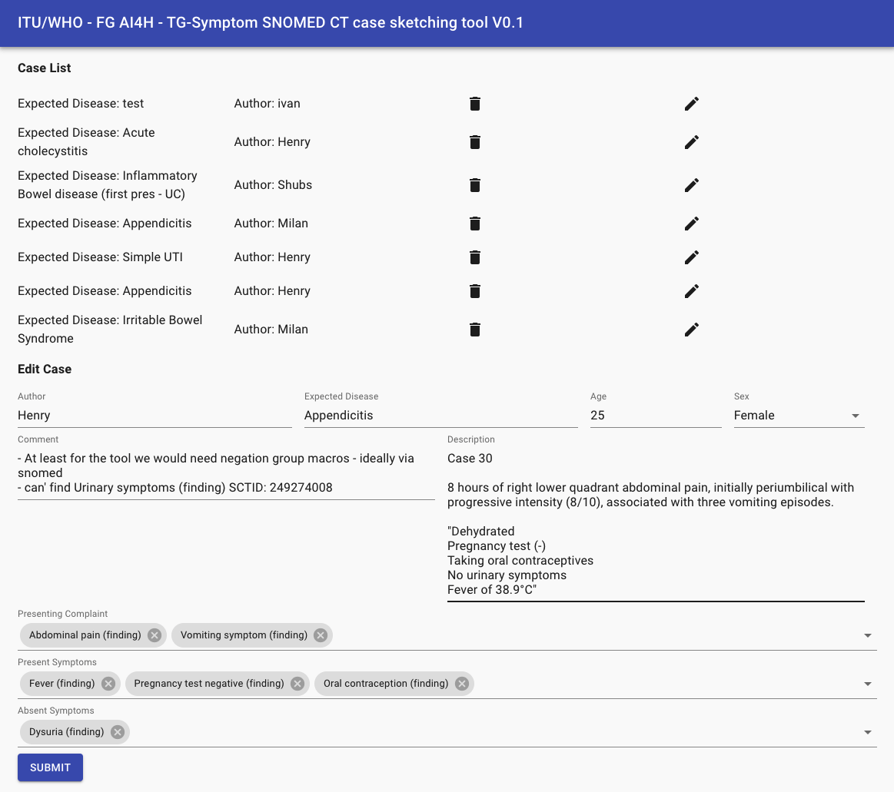
Status of the Ontology Work
Continued work started with workshop #3
Using small abdominal pain domain
Doctors creating cases vignettes with all needed symptoms
Manual mapping of symptoms to SNOMED CT
Worked good enough
Decision to test the feasibility to mostly use pre-coordinated SNOMED CT symptoms
New annotation tool
Dedicated tool for testing the encoding using SNOMED
Uses sub-set restricted by rules the TG doctors decided on
First round of encoding tests
-> looks promissing but we would need to further improve the tool to be sure
Notes:
Abdominal pain worse on motion

Slide 8
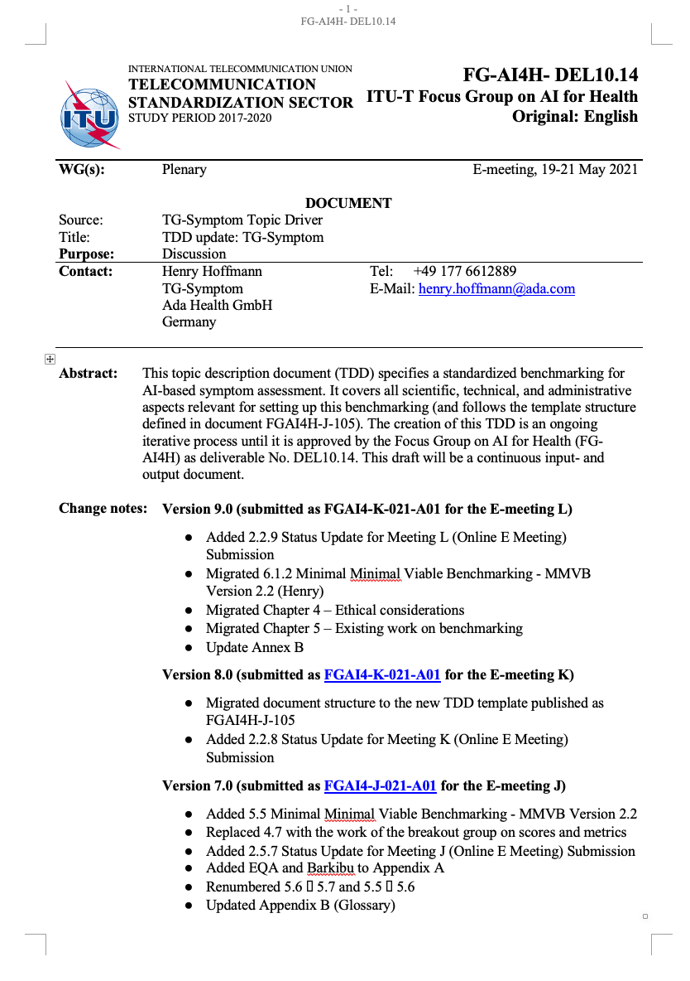
Status of the Non-Technical Work
Migration of TG-Symptom TDD continued
60 -> 129 pages
MMVB 2.0-2.2 summarized as on benchmarking iteration
Chapter 4 – Ethical considerations
Chapter 5 – Existing work on benchmarking
Other FG Interaction
Continued exchange with the Open Code group but TG-Symptom showcase not started yet
Contribution to clinical evaluation WG

Slide 9
General Status of the Topic Group
Topic Group Members:
Companies (18-1+1):
1DOC3, Ada, Babylon, Baidu, Barkibu, Buoy, Deepcare, Infermedica, Inspired Ideas, Isabel Healthcare, mfine, MyDoctor, Nivi, PNP, Symptify, Visiba Care, xund.ai, Your.MD
Independent contributors (6+1):
Reza Jarral, Thomas Neumark, Muhammad Murhaba, Pritesh Mistry, Alejandro Osornio, Salman Razzaki, Yura Perov
fgai4htgsymptom@lists.itu.int 109 (5 more)
6 Online meetings since meeting K (All with minutes/protocols in SharePoint)

Slide 10
Next Steps until Meeting M
Continue Ontology Work
Continue work on ontology-based annotation tool
Workshop #4 in next weeks
Search, hierarchy-selection
Explicit attribute encoding
Negation handling (no neurological signs)
(having a look at the annotation SDK of the Open Code group)
Testing/iterating the tool by creating cases in the group
Mapping to toy-AI and real AIs internally
TDD & Outreach
Add TDD Chapter 8 (regulatory)
Find a place for the ontology work
Start TG-Symptom MMVB 2.2 showcase with the Open Code group
Responding to e.g. questionairs from WGs

Slide 11
Thank you!
WHO/ITU FG AI4H TG Symptom Assessment
Meeting K Update
E-meeting, 19–21 May 2021

