Slide 1
FGAI4H-L-019-A03
E-meeting, 19-21 May 2021
Source: | TG-Psy Topic Driver
Title: | Att.3 - Presentation (TG-Psy)
Purpose: | Discussion
Contact: | Nicolas Langer Department of Psychology University of Zurich | E-mail: n.langer@psychologie.uzh.ch
Contact: | Stefan Haufe Charité Universitätsmedizin Berlin | E-mail: stefan.haufe@charite.de
Abstract: | This PPT summarizes the status of work within TG-Psy, for presentation and discussion during the meeting.

Slide 2
Prediction of Psychiatric Multimorbidity in a Large Pediatric Sample
Department of Psychology/Methods of Plasticity Research
Prof. Nicolas Langer University of Zurich
Department of Psychology Methods of Plasticity Researcch
Dr. Stefan Haufe Charité
Universitätsmedizin Berlin
Berlin Center for Advanced Neuroimaging (BCAN)
FG-AI4H meeting Online (Geneva) May 21 2021

Slide 3
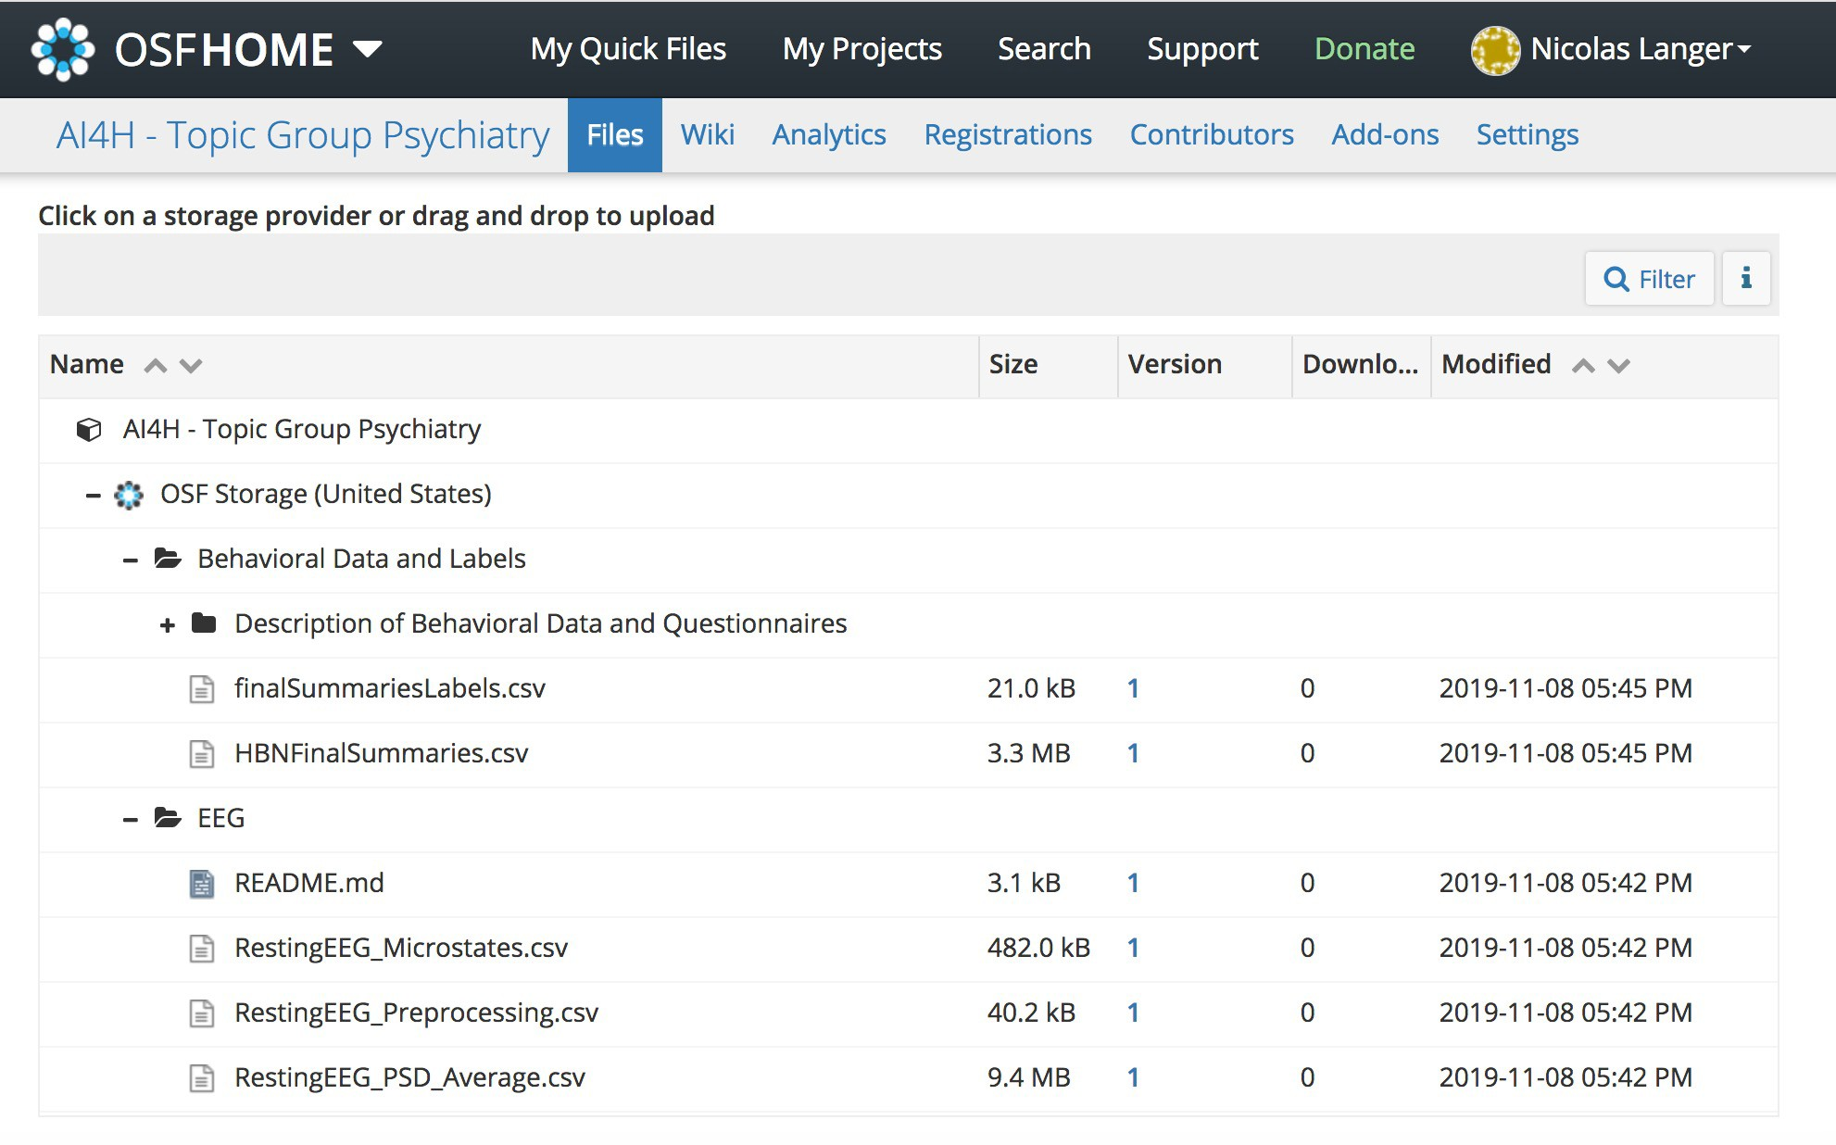
Data Availability
Only preprocessed features so far
No raw data
https://osf.io/ajhgy/wiki/home/
2

Slide 4
Webpage for Project
https://methlabuzh.wixsite.com/mysite
(best appearance in Chrome)
3

Slide 5
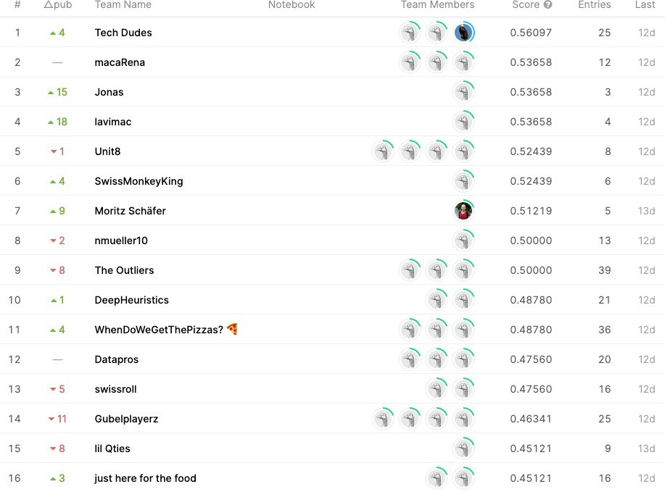
Benchmarking
Competition at datathon 2021
https://www.kaggle.com/c/datathon21-eeg/overview
Leaderboard
4

Slide 6
Next Steps:
Work on J-105 document
Quantifying uncertainty (PhD student Maurice Weber, ETH)
Submit paper to Neuroimage
Set up a framework for automated benchmarking for new algorithm submission
WE NEED HELP HERE
EvalAI, AIcrowd, crowdai.org, kaggle.com or ramp.studio
Planned collaboration on evaluation platform with Bastiaan, Alix and Elora

Slide 7
THANK YOU FOR YOUR ATTENTION

