Slide 1
FGAI4H-L-018-A03
E-meeting, 19-21 May 2021
Source: | TG-Outbreaks Topic Driver
Title: | Att.3 - Presentation (TG-Outbreaks)
Purpose: | Discussion
Contact: | Stéphane Ghozzi, & Auss Abbood, Robert Koch Institute, Berlin, Germany | E-mail: ghozzis@rki.de E-mail: abbooda@rki.de
Abstract: | This PPT contains a brief timeline of TG-Outbreaks until now and experiment results.

Slide 2
Topic Group: Disease Outbreak Detection
Stéphane Ghozzi and Auss Abbood
Robert Koch-Institute, Berlin, Germany
Geneva 21st May, 2021

Slide 3
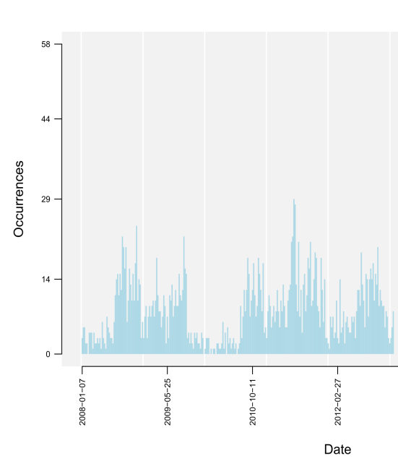
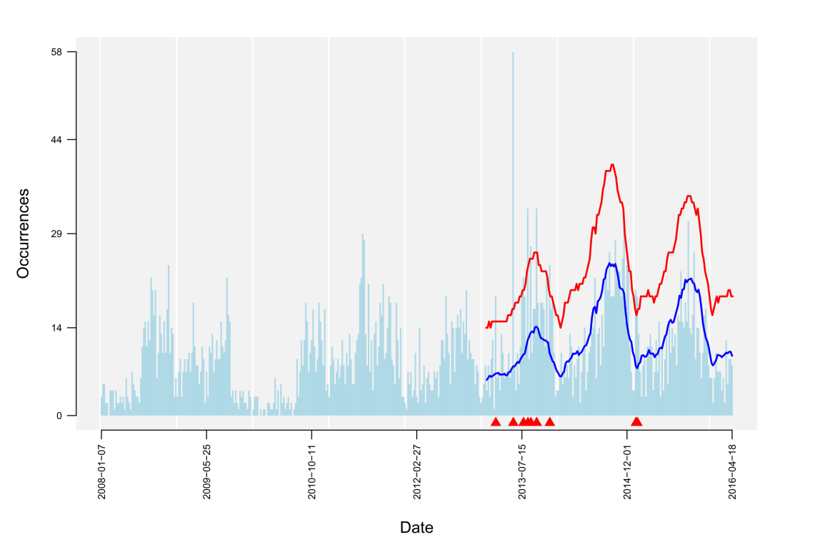
Objective
Data
AI task
warning signal
(spatio-)temporal data (reported cases of infection, symptom counts, etc.)
Detection of aberrant case numbers ( )
hint on potential outbreak event
TG Outbreaks- FG-AI4L
Notes:
Data: time series data (x-axis is the date, y-axis the occurence e.g. counts of reported cases of infection, or also counts of ocurring symptoms)
The blue line corresponds to the expected count numbers according to the previous pattern/ the baseline which includes seasonality, trends etc
The red line gives the upper bound up to which count numbers are still considered to be in the normal range of cases
The AI detects the peaks which show extreme unexpected counts of cases – for which it produces a warning signal

Slide 4
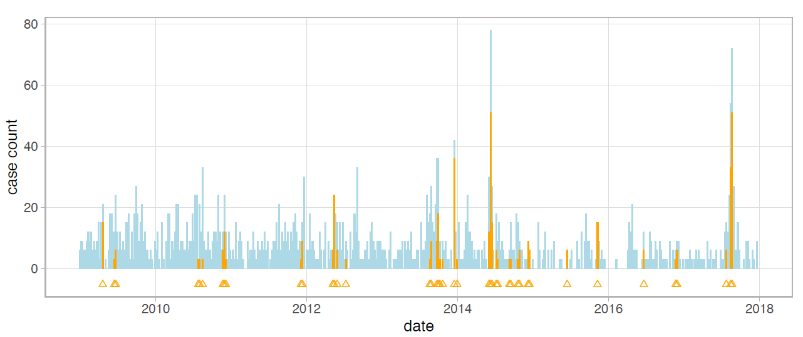
Objective
AI task
warning signal
Detection of aberrant numbers ( )
hint on potential outbreak event
Benchmarking
Test Data: confirmed outbreak labels

Slide 5
Timeline
Contacted almost 90 people
50 people are interested as of now from almost over 20 organizations and over 15 countries
Held calls to harmonize ideas and goals
Wrote an extensive review on methods and metrics in outbreak detection
Conducted a survey to find gaps in our review and to find most important use cases
TG Outbreaks - FG-AI4L

Slide 6
Now
We found that existing metrics cannot cover all relevant algorithm families alike (e.g. SaTScan and Farrington flexible)
We formulated a solution to compare performance regardless of data stratification and algorithm type
We arrieved at the fine tuning part
TG Outbreaks - FG-AI4L

Slide 7
Setting
p(d_i | x) = True label distribution per cell
2
ø
ø
3
3
X
X
2
ø
ø
2
ø
3
2
1
1
ø
ø
ø
1
X
ø
ø
X
X
X
ø
X
ø
X
X
X

Slide 8
Setting
Three signals
2
ø
ø
3
3
X
X
2
ø
ø
2
ø
3
2
1
1
ø
ø
ø
1
X
ø
ø
X
X
X
ø
X
ø
X
X
X

Slide 9
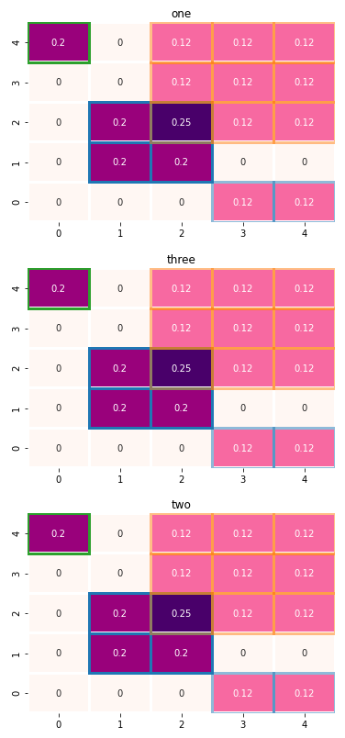
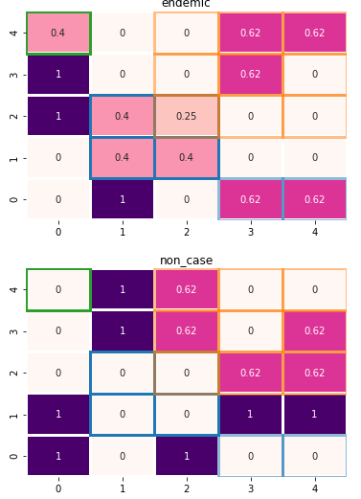
Setting
p^(d_i | x) = predicted data label per cell

Slide 10
Setting
No Signal
2
ø
ø
3
3
X
X
2
ø
ø
2
ø
3
2
1
1
ø
ø
ø
1
X
ø
ø
X
X
X
ø
X
ø
X
X
X

Slide 11
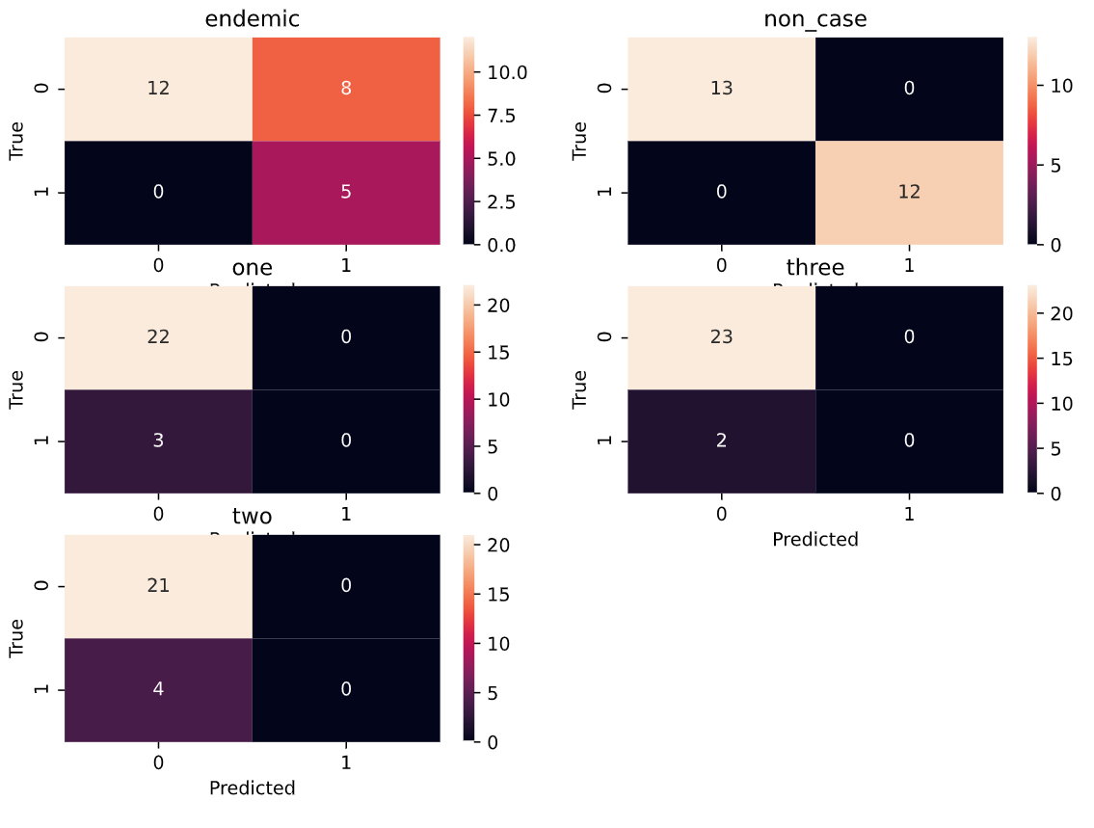
Setting
No Signal

Slide 12
Setting
One, sensitive signal
2
ø
ø
3
3
X
X
2
ø
ø
2
ø
3
2
1
1
ø
ø
ø
1
X
ø
ø
X
X
X
ø
X
ø
X
X
X

Slide 13
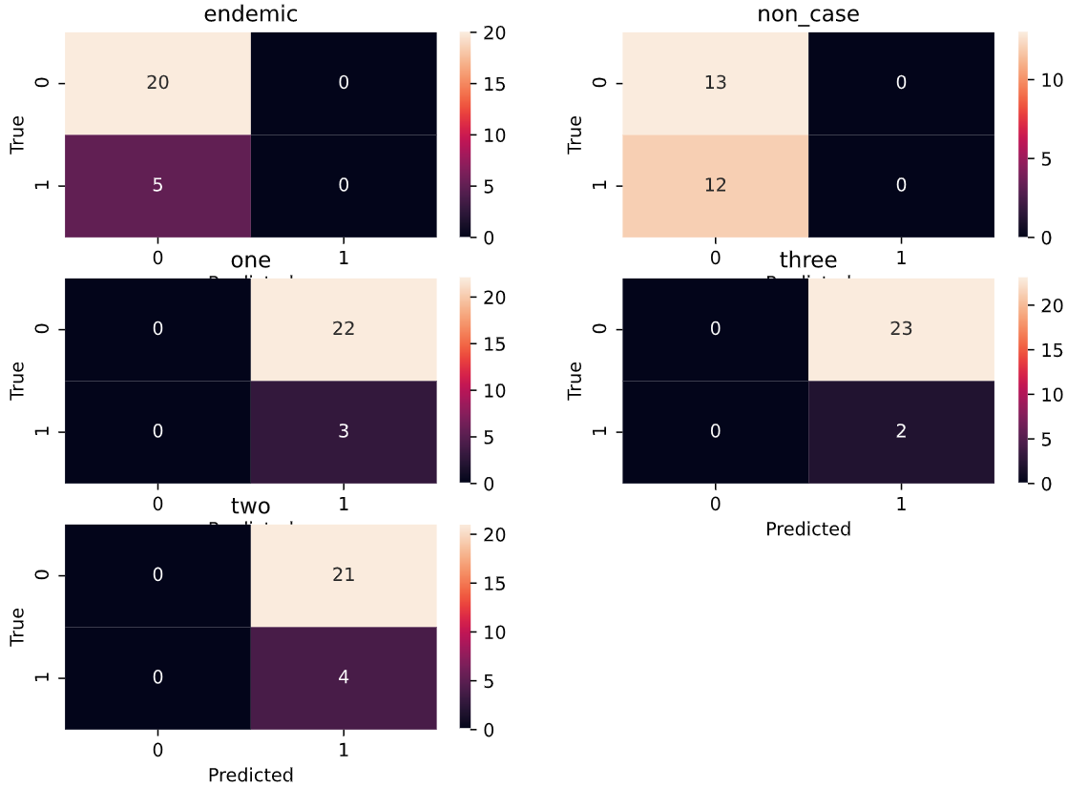
Setting
One, sensitive signal

Slide 14
Setting
Three, specific signals
2
ø
ø
3
3
X
X
2
ø
ø
2
ø
3
2
1
1
ø
ø
ø
1
X
ø
ø
X
X
X
ø
X
ø
X
X
X

Slide 15
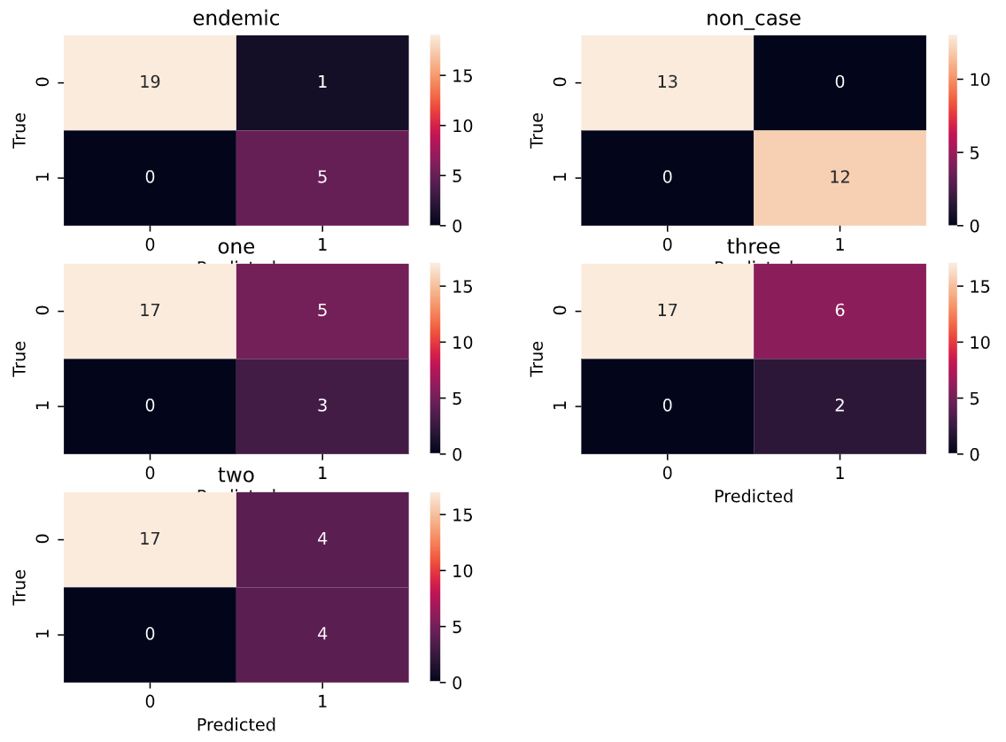
Setting
Three, specific signals

Slide 16
Setting
One, specific signals
1
ø
ø
1
1
X
X
1
ø
ø
1
ø
1
1
1
1
ø
ø
ø
1
X
ø
ø
X
X
X
ø
X
ø
X
X
X

Slide 17
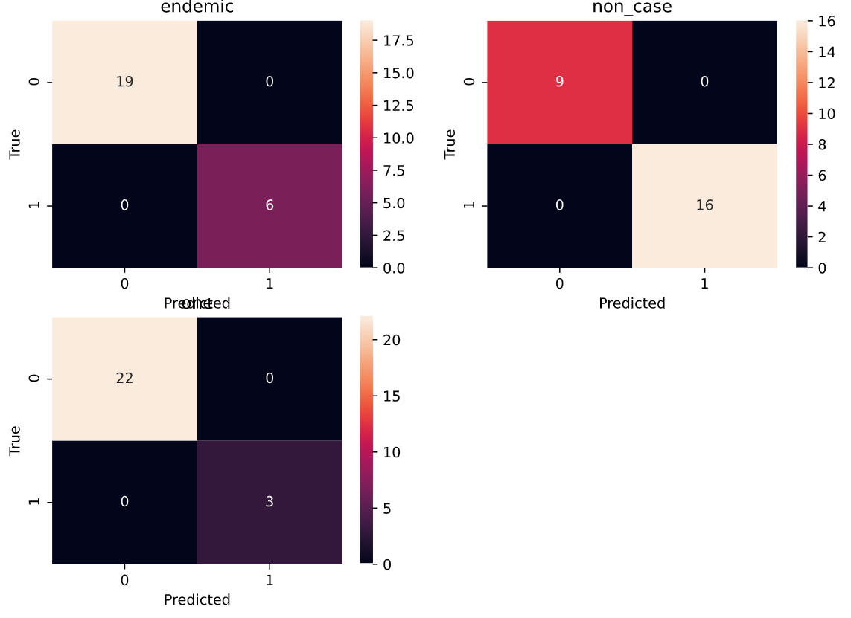
Setting
One, specific signals

Slide 18
Outlook
Further exploration of epidemiologically relevant weighting in metric
Test cases for other algorithm types

