Slide 1
FGAI4H-L-015-A03
E-meeting, 19-21 May 2021
Source: | TG-MCH Topic Driver
Title: | Att.3 - Presentation (TG-MCH)
Purpose: | Discussion
Contact: | Alexandre Chiavegatto Filho University of São Paulo, Brazil | E-mail: alexdiasporto@usp.br
Abstract: | This PPT summarizes the status of work within TG-MCH, for presentation and discussion during the meeting.

Slide 2




AI for Maternal and Child Health
Assoc. Prof .Alexandre Chiavegatto Filho
University of São Paulo, Brazil

Slide 3

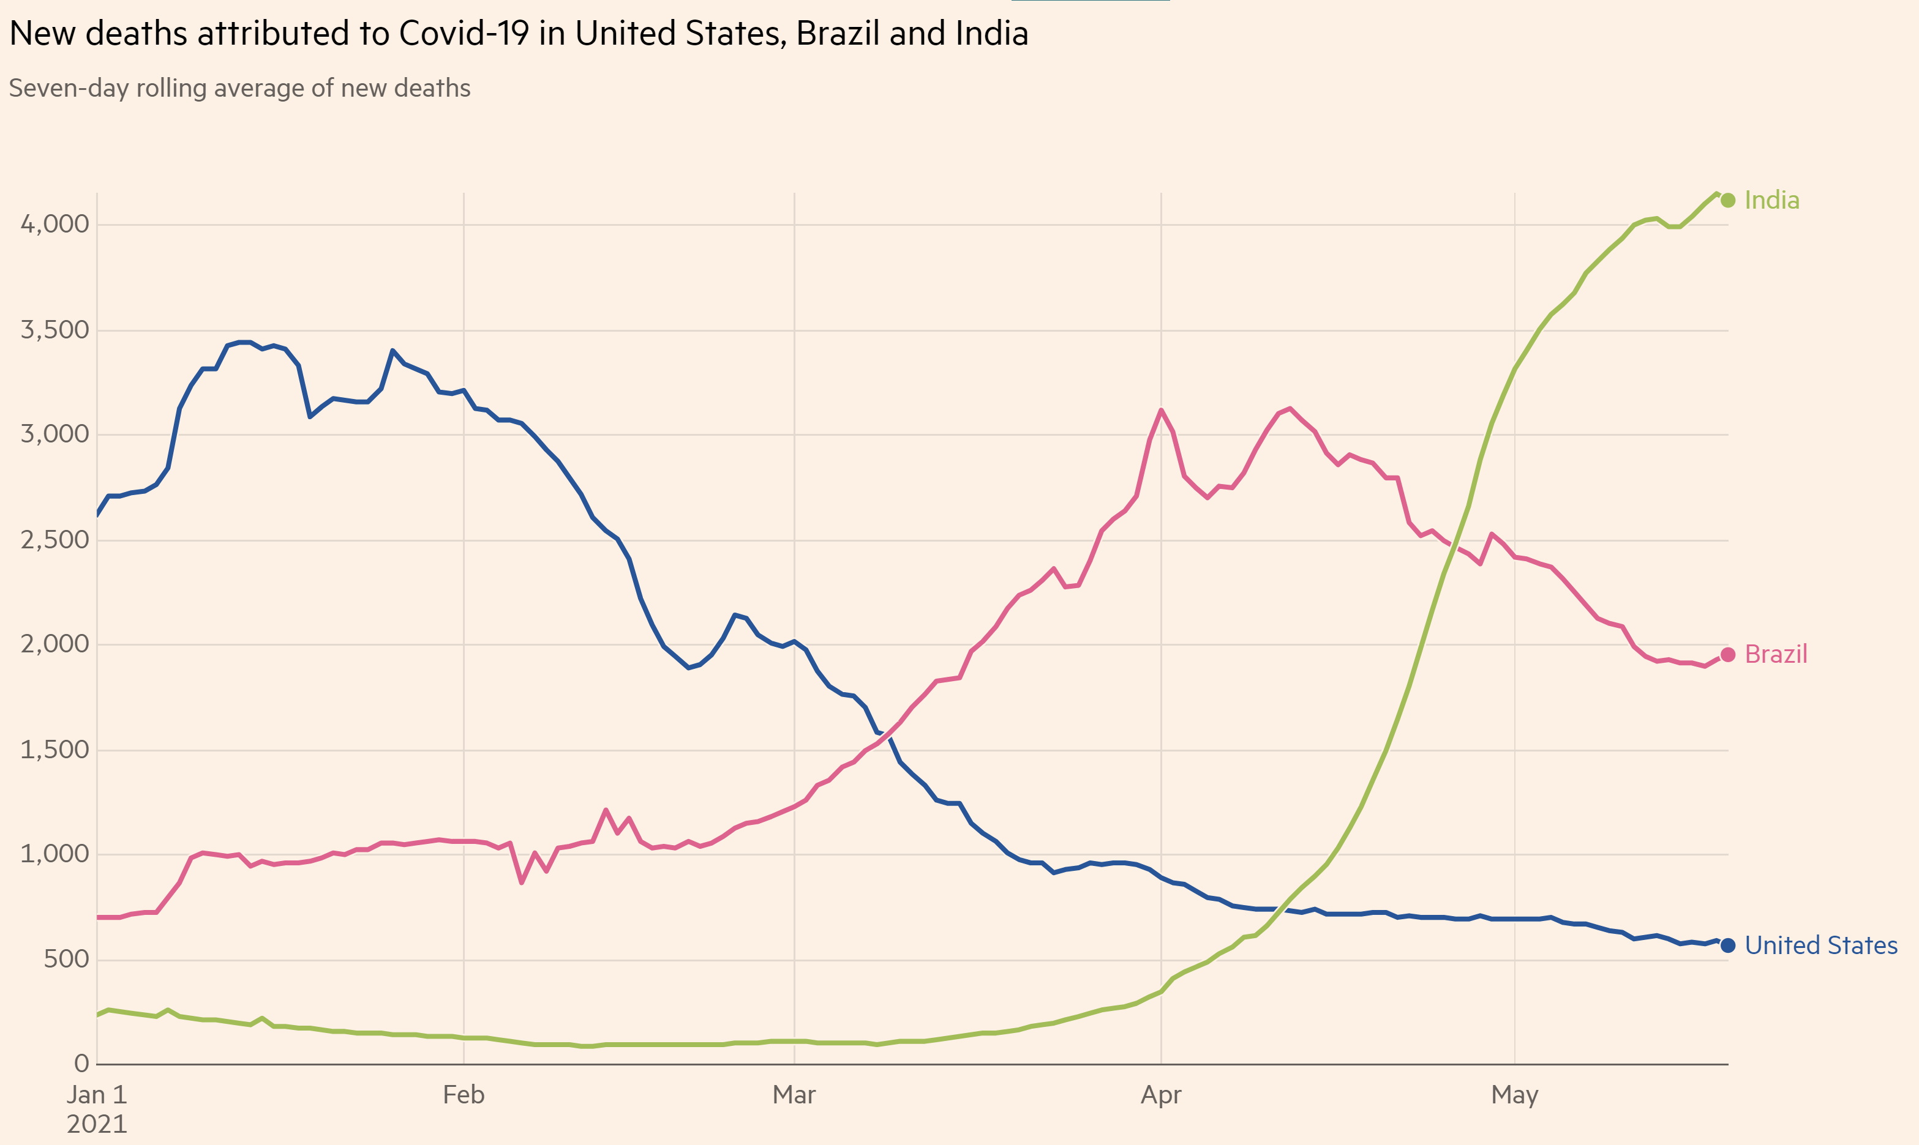

Topic Drivers
Alexandre Chiavegatto Filho
University of São Paulo, Brazil
Raghu Dharmaraju
Wadhwani AI, India

Slide 4
AI for Maternal and Child Health
Improving the health and well-being of mothers, infants, and children is one of the most important public health goals worldwide.
Every day, an estimated 810 women die from causes related to pregnancy or childbirth and over 15,000 children die from preventable diseases.
Despite notable recent improvements for most countries, the Millenium Development Goal (MDG) target for 2015 of reducing child mortality globally by two thirds was not achieved.
Artificial intelligence methods have the potential of improving maternal and child health decisions, especially in low-resource settings.

Slide 5
AI for Maternal and Child Health
Potential AI-based applications in MCH:
i. Prenatal predictions:
a. Fetal growth, final gestational age and incidence of comorbities during pregnancy.
b. Risk of maternal, fetal and infant mortality.
Hospital warning systems for the necessity of labour rooms and neonatal intensive care units.
iii. Post-natal predictions:
b. Risk of neonatal and postneonatal mortality.
c. Risk of rehospitalization after childbirth discharge.

Slide 6
AI for Maternal and Child Health
Avoiding the occurrence of negative child outcomes often involves low-cost interventions.
- But requires an alert early enough to prevent its occurrence.
In order to be effective in low-income settings:
  Algorithms need to use routinely-available variables for making predictions.
  Must be trained and validated in these low-income settings.
  Do not increase existing inequalities (if they work better for higher income patients).

Slide 7
AI for Maternal and Child Health
Previous studies:
A 2019 study used machine learning to predict postpartum hospital admission in the first 12 weeks after delivery found a high predictive performance for hospitalization from hypertensive disorders (AUC = 0.879) (Betts et al., 2019).
An analysis from 2020 found that machine learning was able to predict height-for-age z-scores in children from a rural area of Pakistan (Harrison et al., 2020).
A more recent study from 2021 fond that machine learning algorithms were able to predict with reasonable accuracy the risk of readmission for complications of hypertensive disorders of pregnancy (Hoffman et al., 2021).

Slide 8
AI for Maternal and Child Health
Neonatal mortality prediction with routinely collected data: a machine learning approach
André F.M. Batista, Carmen S.G. DinizMD, Eliana A. Bonilha Ichiro Kawachi, Alexandre D. P. Chiavegatto Filho.
Goal: to predict the risk of neonatal mortality using only data routinely available from birth records in the largest city of the Americas.
A probabilistic linkage of every birth record occurring in the municipality of São Paulo, Brazil, between 2012 e 2017 was performed with the death records from 2012 to 2018 (1,202,843 births and 447,687 deaths)
Births from 2012 and 2016 (N = 941,308; or 83.44% of the total) were used to train five different machine learning algorithms, while births occurring in 2017 (N = 186,854; or 16.56% of the total) were used to test their predictive performance on new unseen data.

Slide 9
AI for Maternal and Child Health
Neonatal mortality prediction with routinely collected data: a machine learning approach
André F.M. Batista, Carmen S.G. DinizMD, Eliana A. Bonilha Ichiro Kawachi, Alexandre D. P. Chiavegatto Filho.
The best performance was obtained by the extreme gradient boostingted trees (XGBoost) algorithm, with a very high AUC of 0.97 and F1-score of 0.55.
The 5% births with the highest predicted risk of neonatal death included more than 90% of the actual neonatal deaths. On the other hand, there were no deaths among the 5% births with the lowest predicted risk.
There were no significant differences in predictive performance for vulnerable subgroups.
The use of a smaller number of variables (WHO’s five minimum perinatal indicators) decreased overall performance but the results still remained high (AUC of 0.91).
With the addition of only three more variables, we achieved the same predictive performance (AUC of 0.97) as using all the 23 variables originally available from the Brazilian birth records.

Slide 10
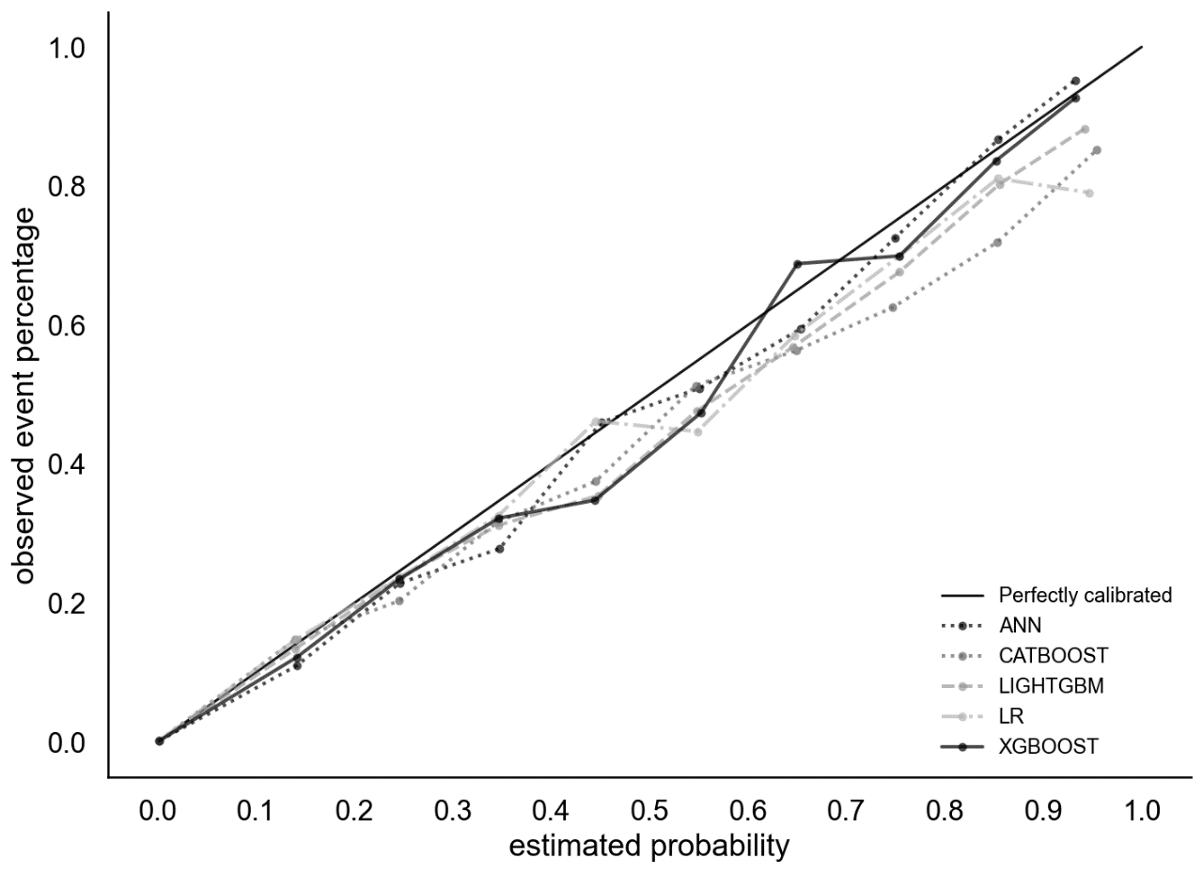
AI for Maternal and Child Health
Neonatal mortality prediction with routinely collected data: a machine learning approach
André F.M. Batista, Carmen S.G. DinizMD, Eliana A. Bonilha Ichiro Kawachi, Alexandre D. P. Chiavegatto Filho.

Slide 11
AI for Maternal and Child Health
Neonatal mortality prediction with routinely collected data: a machine learning approach
André F.M. Batista, Carmen S.G. DinizMD, Eliana A. Bonilha Ichiro Kawachi, Alexandre D. P. Chiavegatto Filho.

Slide 12
AI for Maternal and Child Health
Conclusion:
- IA is a very promising tool for MCH:
- Low cost of effective interventions in MCH if warnings come early.
- Important challenges:
- Use routinely-available variables, trained and validated in where they will be applied, do not increase existing inequalities.

Slide 13


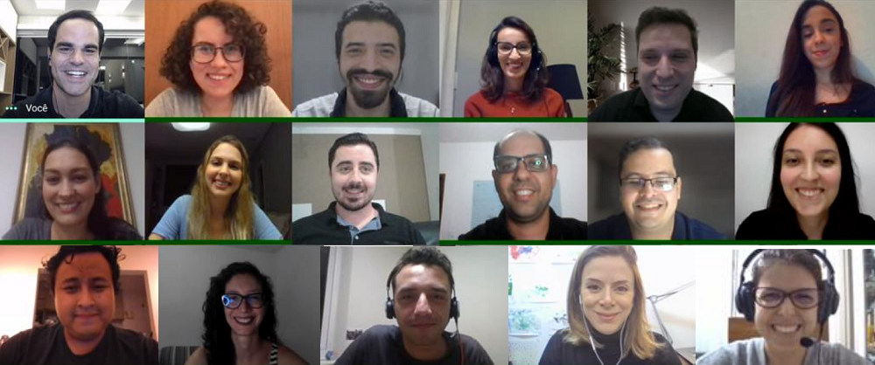




Thank you!
Alexandre Chiavegatto Filho
http://labdaps.fsp.usp.br
@SaudenoBR
@labdaps
alexdiasporto@usp.br

