Slide 1
FGAI4H-L-014-A03
E-meeting, 19-21 May 2021
Source: | TG-Malaria Topic Driver
Title: | Att.3 - Presentation (TG-Malaria)
Purpose: | Discussion
Contact: | Rose Nakasi Makerere University Uganda | E-mail: g.nakasirose@gmail.com
Abstract: | This PPT summarizes the status of work within TG-Malaria, for presentation and discussion during the meeting.

Slide 2
Topic Group-Malaria: AI based detection of Malaria-an update
Rose Nakasi
Makerere University, Uganda
E-meeting, 19th – 21st May 2021

Slide 3
Background
Malaria burden in endemic Countries
Accounts for over 3.4 billion cases globally
Lack of enough trained lab technicians
1.72 microscopes per 100,000 population, but only 0.85 Microscopists per 100,000
Gold standard diagnosis(microscopy) challenge
SOP requires not to view more than 30 slides a day
Less diagnosis throughput
Variations in individual expert judgment
AI solution
Supports image analysis and has potential to improve the timeliness and accuracy
There is need to;
Standardise benchmarking AI solutions for the detection of Malaria
Notes:
Why this Topic Group? Context, WHO/ITU necessity
The Global Problem
The opportunity (and the challenge) | What is Symptom Assessment? How might it help?
The case for benchmarking? Why needed?
How the Topic Group can help, what outcomes might feed into

Slide 4
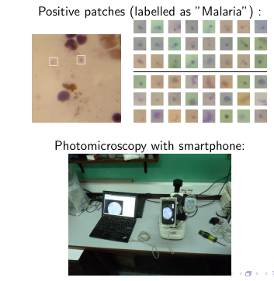
Digital imaging for malaria diagnosis
Setup

Slide 5
TG-Malaria activities
Quality datasets needed
Have more datasets for training and testing
Well labelled datasets
Solution
AI models and approaches related to malaria detection.
Suggestions on scoring metrics.
Improvements on the benchmarking framework.
Support to the group on different aspects (data, methods, benchmarking, etc.) of this topic
Extension of the solution to improve disease surveillance and prediction.
Heterogeneous Data needed

Slide 6
Topic Group members:
Name | Affiliation
Philippe Verstraete | Co-founder of Milan and Associates, Italy
Laura Moro, | Researcher, science & medical writer. Co-founder of AI Scope, Spain
Dr. Helmi Zakariah. | Cofounder of AIME company, Malaysia
Martha Shaka | Researcher at University of Dodoma, Tanzania
Ana Rivière Cinnamond | Advisor and Pubic Health Expert under Health Emergency Information & Risk Assessment Department with PAHO/WHO.
Rigveda Kadam | Senior Access Officer, FIND, Switetzerland
Seda Yerlikaya | Scientific Officer, FIND, Switetzerland
Herilalaina RAKOTOARISON | PhD student in Machine learning from the Université Paris-Saclay)
Fetulhak Abdurahman | Lecturer at Jimma University, Ethiopia

Slide 7
Updates since meeting K
Holding bi-weekly online meetings to discuss benchmarking improvements
Launched benchmarking challenge
Drafted and submitted a conference paper on our benchmarking platform
Joined WG-CE meeting on LMIC-considerations
Updates available in TDD (follows the new TDD template)

Slide 8
TG-Malaria Online meetings
Online Skype meetings
Platform beta testing
*Launching the challenge
Discussions on the outcomes of the challenge
Writing and submiting a conference paper on the outcomes of the challenge.
Held a meeting with the FG to discuss possibilities of iterating our use case with the FG evaluation platform

Slide 9
Building Benchmarking Platforms
First Benchmarking Platform v1
Our first benchmarking attempt required the following;
Inputs
A well annotated dataset of thick blood smear images
AI models to be submitted to the benchmarking platform
Outputs
Performance of AI
Scores & Metrics
ROC AUC
Precision
recall
Average precision
Report
Performance of AI models

Slide 10
Second Benchmarking platform-V2
Add new public dataset of thin blood smear dataset
A well annotated dataset of thin blood smear images
A total of 27,558 images
Infected and uninfected cells
Adding support for deep learning library (pytorch and tensorflow)
Cclassification tasks
Setting up time budget for up-to 1 hour/submissionn.
To allow for heavy submissions
Adding support for uploading dataset
Towards crowdsourcing

Slide 11
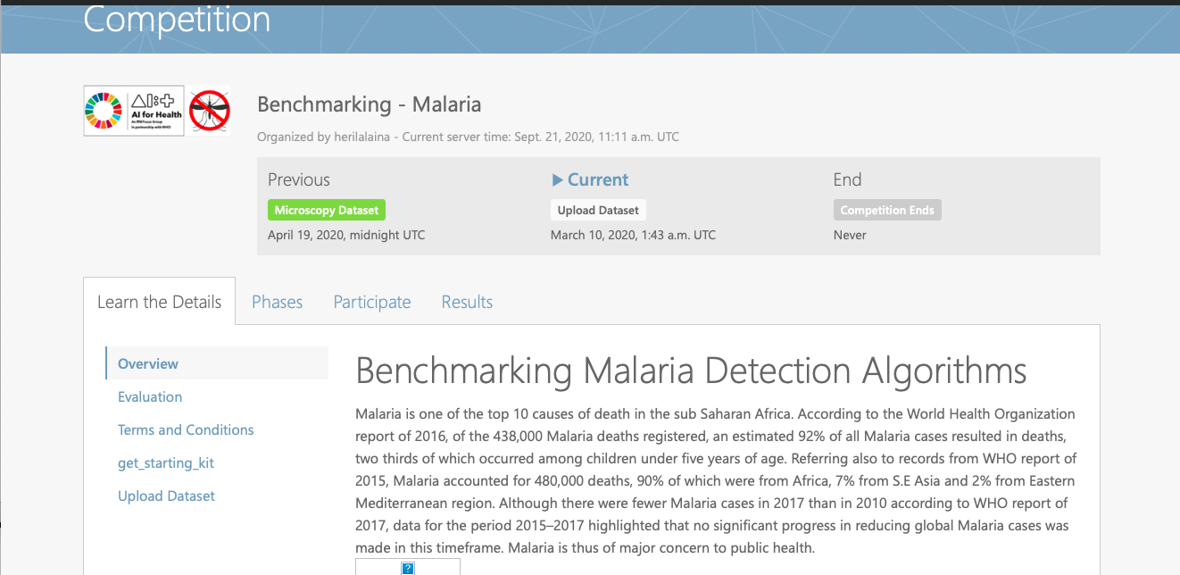
User interface for the challenge
Benchmarking-Malaria platform with codalab
https://codalab.lri.fr/competitions/775

Slide 12
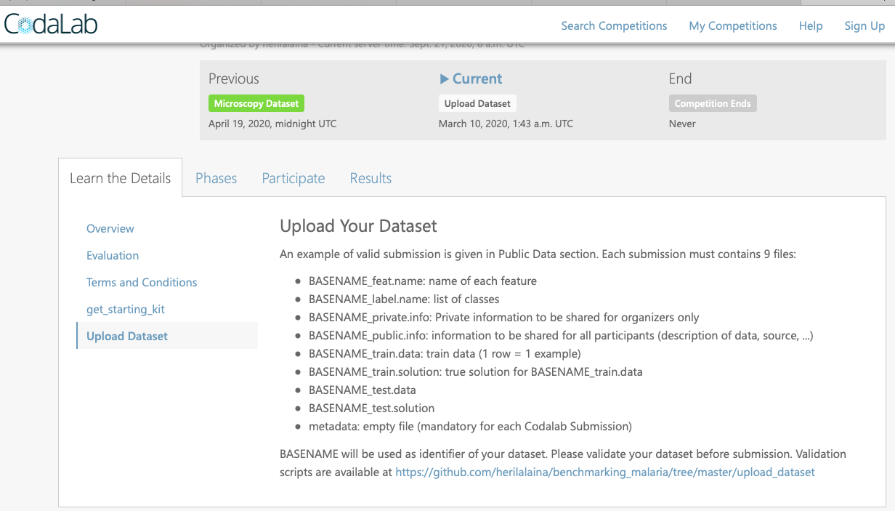
Support for uploading dataset

Slide 13
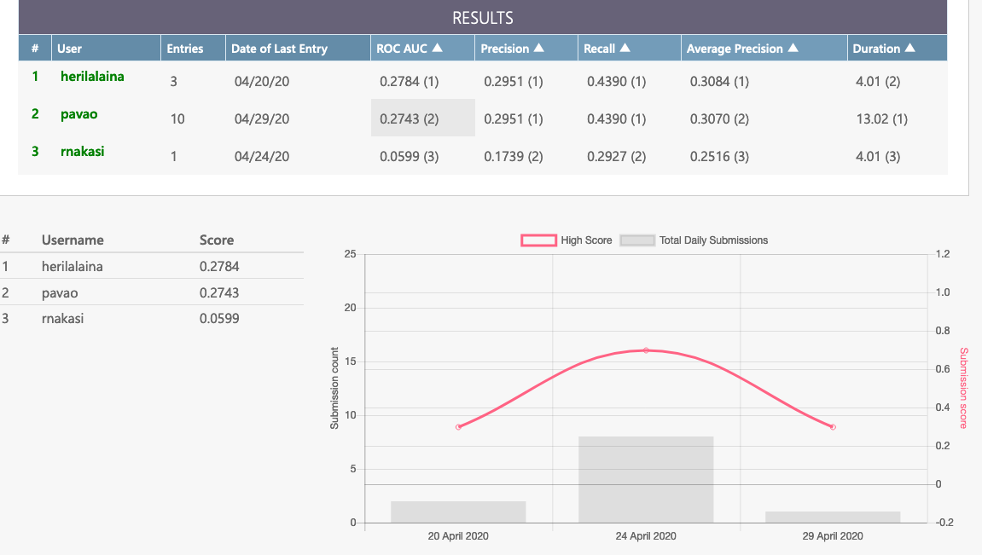
Scoring metrices
Preliminary results

Slide 14
First Malaria challenge outcomes
We achieved a second version attempt on the benchmarking platform,
Outcomes;
Received participant feedback from benchmarking V2 challenge
Few participants
Platform can ably assess performance of AI models
Platform allows for upload of microscopy blood smear image datasets

Slide 15
Next benchmarking iterations
We have achieved outcomes from our first benchmarking challenge;
Our next set of activities include;
Creating a new challenge to a wider community
Logistics needed
Investigate possibility for scaling to object detection tasks.
Iterate with other versions for benchmarking AI solutions and gain insights
FG-EvalAI platform

Slide 16
Next TG steps
Data Collection
Undisclosed datasets needed for testinng
Updates to TDD
TG building
Encourage TG member participation
Get more experts involved

Slide 17
Call for participation
Participation can be in form of:
Provision of quality labelled data
AI models and algorithms for benchmarking task on malaria
General support on different aspects of this topic (data, methods, benchmarking, etc.)

Slide 18
Contact us
TG-Malaria
fgai4htgmalaria@lists.itu.int
TG-Driver
g.nakasirose@gmail.com

