Slide 1
FGAI4H-L-012-A03
E-meeting, 19-21 May 2021
Source: | TG-Falls Topic Driver
Title: | Att.3 – Presentation (TG-Falls)
Purpose: | Discussion
Contact: | Pierpaolo Palumbo TG-Falls Topic Driver University of Bologna, Italy | E-Mail: pierpaolo.palumbo@unibo.it
Contact: | Inês Sousa Associação Fraunhofer Portugal Research – Fraunhofer AICOS, Portugal | E-mail: ines.sousa@fraunhofer.pt
Abstract: | This PPT summarizes the status of work within TG-Falls, for presentation and discussion during the meeting.

Slide 2
AI4H TG-Falls among the elderly
21st May 2021

Slide 3
Outline
Introduction
About the topic group
Subtopic, AI task
State of the art
Benchmarking platform
  System architecture
  AI input and output
  Score metrics
  Benchmarking process
  Dataset acquisition
Next steps

Slide 4
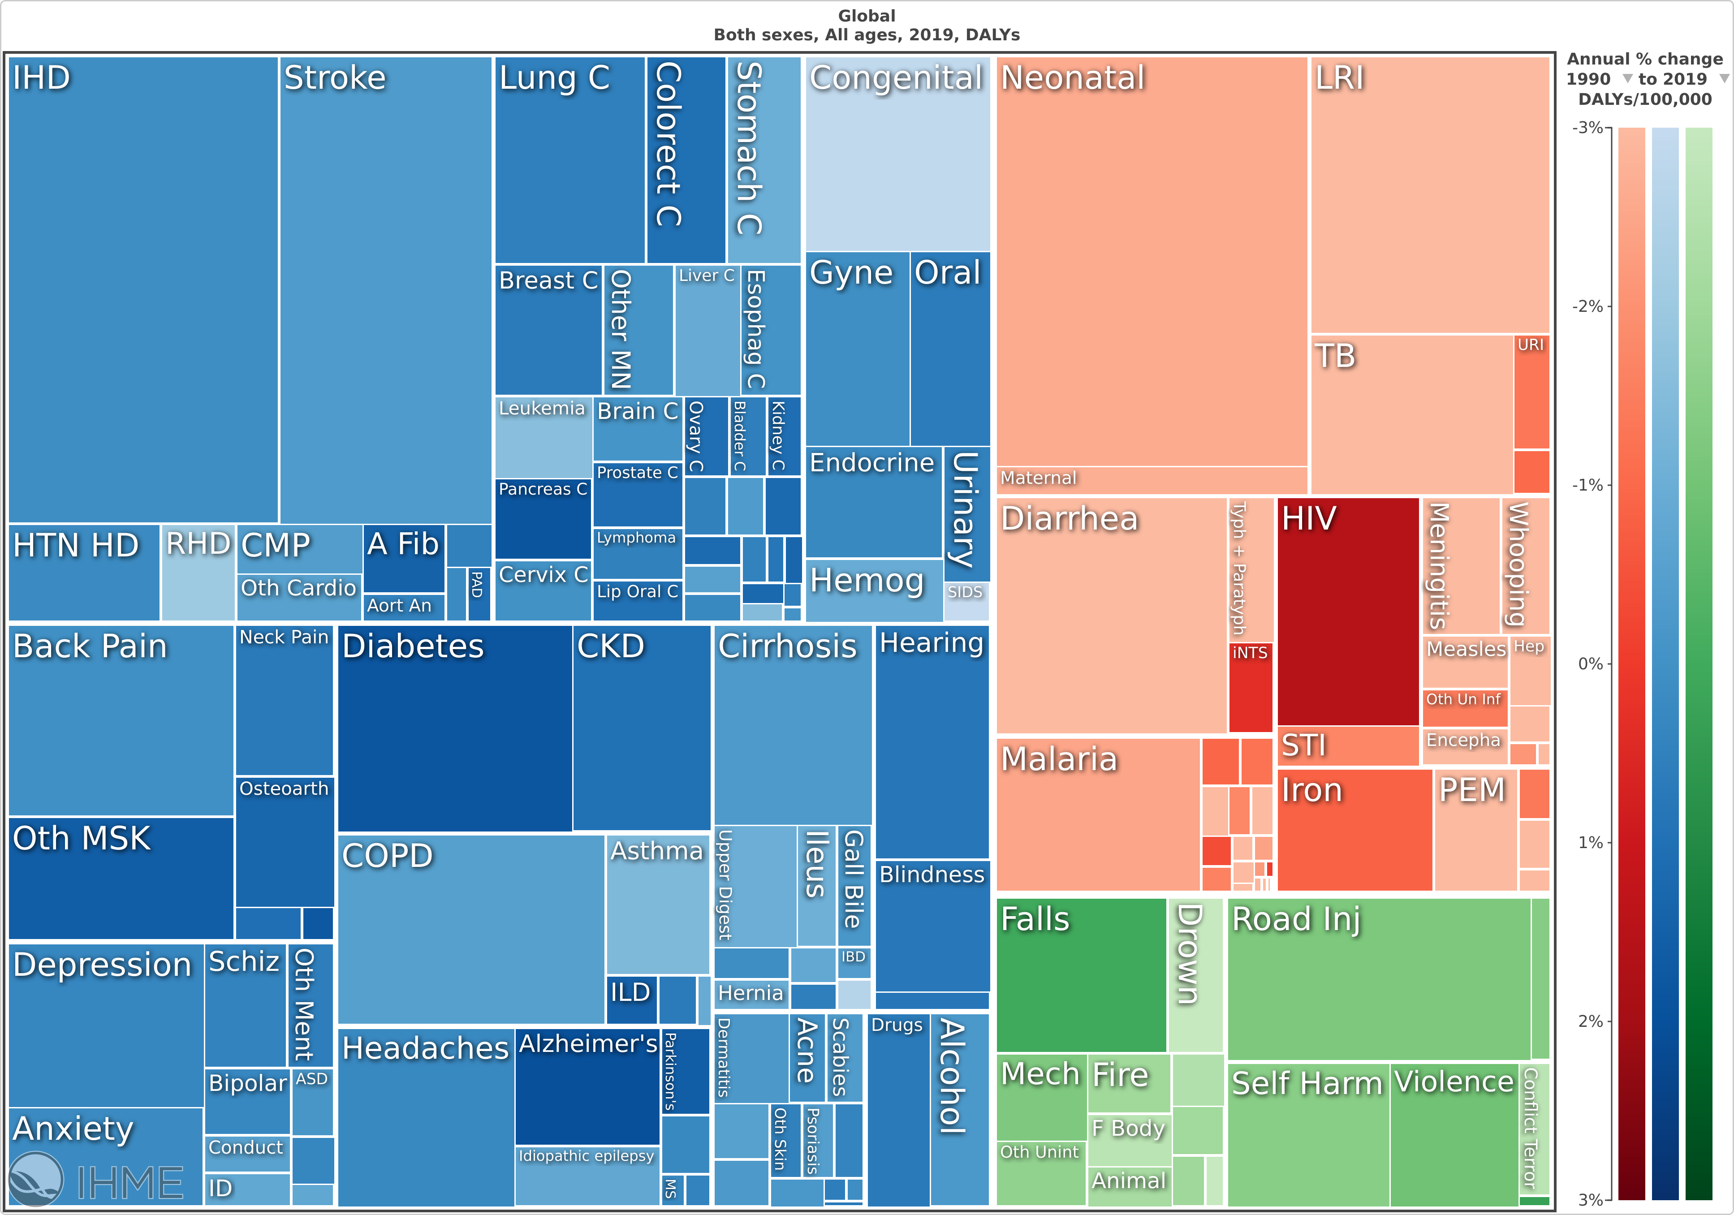
Introduction
Falls are common, multifactorial, burdensome
Falls are preventable (RR ≈0.7-0.8)
falls
Global Burden of Disease, 2019, https://vizhub.healthdata.org/

Slide 5
About the topic group
Meeting B (Lausanne) – meeting L (e-meeting)
fgai4htgfalls@lists.itu.int
People (contributors or showing interest)
  Inês Sousa, Fraunhofer AICOS, Portugal
  Pierpaolo Palumbo, University of Bologna, Italy
  Stefania Bandinelli, SOC Geriatria – USL Toscana Centro, Italy
  Barry Greene, Chief Technology Officer, Kinesis Health Technologies, Ireland
  Arnab Paul, CEO Patient Planet, WHO Roster of Expert – DigitalHealth, India
  Salman Khan, Assistant Professor in the department of electrical engineering, University of Engineering and Technology Peshawar, Pakistan
  Kim van Schooten, PhD, Human Frontier Science Program Postdoctoral Fellow, Conjoint Senior Lecturer, UNSW Medicine, UNSW Ageing Futures Institute, Australia

Slide 6
Subtopic, AI tasks
  Fall prediction:
    Subject-specific risk score of falling, within a given time window in the future, given information about the subject’s risk factors for falls and/or their balance or motor ability
  Fall detection

Slide 7
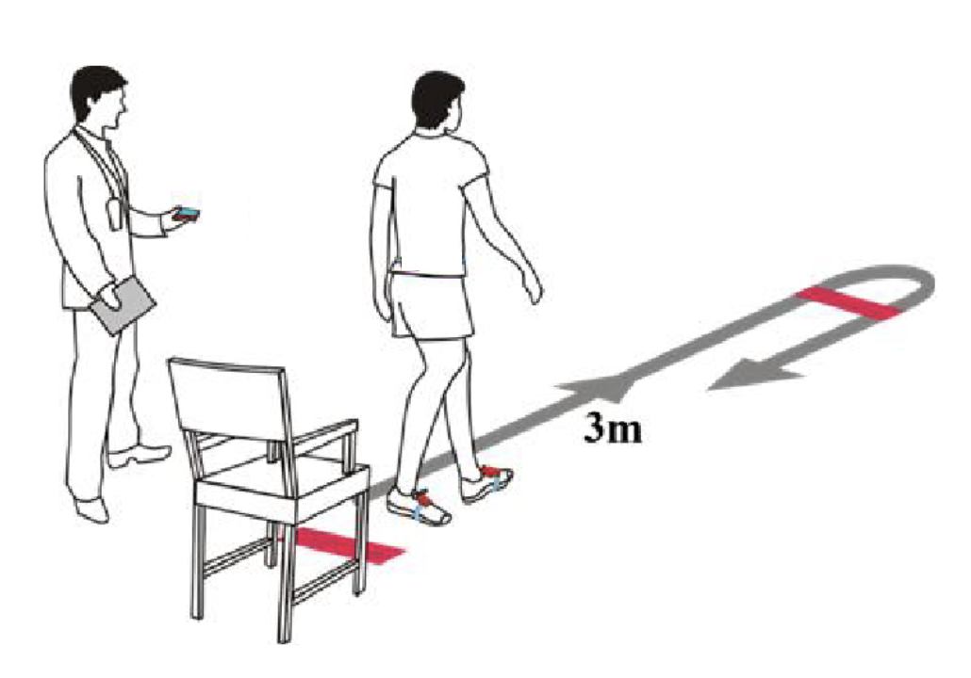
State of the art
Traditional tools: Timed Up and Go Test (TUG), Tinetti Scale
Guidelines (AGS/BGS, NICE, etc.) screening algorithms
Different AI models proposed
  Clinical variables
  Sensor variables
Few models validated (AUC 0.62-0.69)
Potential impact: decrease of ≈15-20% NNT
AUC = 0.57 (0.54-0.59)
[1] D. Schoene et al., J. Am. Geriatr. Soc., 2013
[2] E. Barry et al., BMC Geriatr., 2014
[3] Panel of Falls in Older Persons American Geriatrics Society and British Geriatrics Society, J. Am. Geriatr. Soc., 2011
[4] A. Tiedemann, et al. Inj. Prev., 2012.
[5] P. Palumbo et al., J. Am. Med. Dir. Assoc., 2016.
[6] G. V. Gade et al., BMJ Open, 2021
[7] P. Palumbo et al., Aging Clin. Exp. Res., 2018

Slide 8



Benchmarking platform – System architecture
AI system 1
AI system 2
AI system m
Including reference screening algorithms (e.g. time for TUG)
…
Dataset 1
Dataset 2
Harmonization scripts
Benchmarking platform
…
Dataset n
$$[Performance indices\left(Dataseti, AI systemj\right)]$$
Performance matrix
Result publication

Slide 9
Benchmarking platform – System architecture
Dataset i
Harmonization script i
Harmonized dataset i
Records
Identified set of risk factors (age, sex, comorbidities, drugs, etc.)
Sensor signals (TUG, quiet standing, etc.)
Number of falls experienced in a given time window after baseline assessment [3]
.csv, .dta, .sav, .sas7bdat, .Rdata
AI input
Label
[1] https://g2aging.org/
[2] Deandrea, S., Lucenteforte, E., Bravi, F., Foschi, R., La Vecchia, C., & Negri, E. (2010). Risk Factors for Falls in Community-dwelling Older People: A Systematic Review and Meta-analysis. Epidemiology, 21(5), 658–668.
[3] Lamb, S. E., Jørstad-Stein, E. C., Hauer, K., & Becker, C. (2005). Development of a common outcome data set for fall injury prevention trials: the Prevention of Falls Network Europe consensus. Journal of the American Geriatrics Society, 53(9), 1618–1622. https://doi.org/10.1111/j.1532-5415.2005.53455.x

Slide 10
System architecture
Different systematic reviews already identified (e.g. [2])
Dataset i
Harmonization script i
Harmonized dataset i
Records
Identified set of risk factors (age, sex, comorbidities, drugs, etc.)
Sensor signals (TUG, quiet standing, etc.)
Number of falls experienced in a given time window after baseline assessment [3]
.csv, .dta, .sav, .sas7bdat, .Rdata
AI input
Most datasets will not have IMU signals
Most datasets are already partly harmonized [1]
(see effort by RAND Corporation)
Critical harmonization
Label
[1] https://g2aging.org/
[2] Deandrea, S., Lucenteforte, E., Bravi, F., Foschi, R., La Vecchia, C., & Negri, E. (2010). Risk Factors for Falls in Community-dwelling Older People: A Systematic Review and Meta-analysis. Epidemiology, 21(5), 658–668.
[3] Lamb, S. E., Jørstad-Stein, E. C., Hauer, K., & Becker, C. (2005). Development of a common outcome data set for fall injury prevention trials: the Prevention of Falls Network Europe consensus. Journal of the American Geriatrics Society, 53(9), 1618–1622. https://doi.org/10.1111/j.1532-5415.2005.53455.x

Slide 11
Benchmarking platform – AI input and output
  Either:
  the probability of falling at least once in a future time window
  the expected number of falls in a future time window
  an ordered, fuzzy label for the risk of falling (e.g., low, medium, high)
  Optionally, suggestions on possible preventive actions to take
Identified set of risk factors (age, sex, comorbidities, drugs, etc.) [2]
Sensor signals (TUG, quiet standing, etc.)
Number of falls experienced in a given time window after baseline assessment [3]
AI input
AI output
Label

Slide 12
Benchmarking platform – Scores and metrics
  Either:
  the probability of falling at least once in a future time window
  the expected number of falls in a future time window
  an ordered, fuzzy label for the risk of falling (e.g., low, medium, high)
  Optionally, suggestions on possible preventive actions to take
Identified set of risk factors (age, sex, comorbidities, drugs, etc.) [2]
Sensor signals (TUG, quiet standing, etc.)
Number of falls experienced in a given time window after baseline assessment [3]
AI input
AI output
Label
$$[Performance indices\left(Dataseti, AI systemj\right)]$$
Multiple figures of merit
Discriminative ability (AUC), calibration (calibration curves, χ², MSE)
(No calibration indices if AI output is not probabilistic)

Slide 13
Benchmarking platform – Benchmarking process
The applicants receive information on the AI task, datasets, documentation
The applicants submit their AI algorithms to test and a declaration of not having accessed those data before
Q: how much this process will be shared among all TGs of the FG?
  Technological platform
  Rules
  Time schedule
  Result publication

Slide 14
Benchmarking platform – Dataset acquisition
Study | Country | N | Clinical, sensor data | Available to us
FallSensing | Portugal | ≈400 | Clin + sensor | Yes
InCHIANTI | Italy | ≈800 | Clin + sensor | Not yet
HRS | USA | ≈20,900 | Clin | Yes
MHAS | Mexico | ≈14,700 | Clin | Yes
ELSA | UK | ≈10,000 | Clin | Not yet
SHARE | Europe + Israel | ≈77,000 | Clin | Yes
KLoSA | Korea | ≈6,900 | Clin | Yes
IFLS | Indonesia | ? | Clin | Not yet
TILDA | Ireland | ≈6,400 | Clin | Not yet
CHARLS | China | ≈19,800 | Clin | Not yet
LASI | India | ≈72,000 | Clin | Yes
CRELES | Costa Rica | ≈2,000 | Clin | Yes
ELSI | Brazil | ? | Clin | Not yet
MARS | Malesia | ≈6,000 | Clin | Not yet
JSTAR | Japan | ≈4,000 | Clin | Not yet
HRS family
[1] A. C. Martins et al., JMIR Res. Protoc., 2018.
[2] L. Ferrucci et al., J. Am. Geriatr. Soc., 2000. http://inchiantistudy.net/wp/
[3] https://g2aging.org/
Gateway to Global Aging Data, Produced by the Program on Global Aging, Health & Policy, University of Southern California with funding from the National Institute on Aging (R01 AG030153)

Slide 15
Benchmarking platform – Dataset acquisition
Study | Country | N | Clinical, sensor data | Available to us
FallSensing | Portugal | ≈400 | Clin + sensor | Yes
InCHIANTI | Italy | ≈800 | Clin + sensor | Not yet
HRS | USA | ≈20,900 | Clin | Yes
MHAS | Mexico | ≈14,700 | Clin | Yes
ELSA | UK | ≈10,000 | Clin | Not yet
SHARE | Europe + Israel | ≈77,000 | Clin | Yes
KLoSA | Korea | ≈6,900 | Clin | Yes
IFLS | Indonesia | ? | Clin | Not yet
TILDA | Ireland | ≈6,400 | Clin | Not yet
CHARLS | China | ≈19,800 | Clin | Not yet
LASI | India | ≈72,000 | Clin | Yes
CRELES | Costa Rica | ≈2,000 | Clin | Yes
ELSI | Brazil | ? | Clin | Not yet
MARS | Malesia | ≈6,000 | Clin | Not yet
JSTAR | Japan | ≈4,000 | Clin | Not yet
Info for applications
Details on data handling and processing
Time schedule
HRS family
[1] A. C. Martins et al., JMIR Res. Protoc., 2018.
[2] L. Ferrucci et al., J. Am. Geriatr. Soc., 2000. http://inchiantistudy.net/wp/
[3] https://g2aging.org/
Gateway to Global Aging Data, Produced by the Program on Global Aging, Health & Policy, University of Southern California with funding from the National Institute on Aging (R01 AG030153)

Slide 16
Next steps
Increase intra-TG collaboration, collaboration with WGs
Complete the TDD
Applications for data access
Harmonization scripts
EU Falls Festival April 4-5, 2022

Slide 17
Thank you

