Slide 1
FGAI4H-L-008-A03
E-meeting, 19-21 May 2021
Source: | TG-Bacteria Topic Driver
Title: | Att.3 - Presentation (TG-Bacteria)
Purpose: | Discussion
Contact: | Nada MALOU Clinical lead Fondation MSF | E-mail: nada.malou@paris.msf.org
Contact: | Louis LAROCHE Product manager Fondation MSF | E-mail: louis.laroche@paris.msf.org
Abstract: | This PPT summarizes the status of work within TG-Bacteria, for presentation and discussion during the meeting.

Slide 2
Antibiogo
Using AI to tackle antimicrobial resistance
AI for Health - May 2021

Slide 3
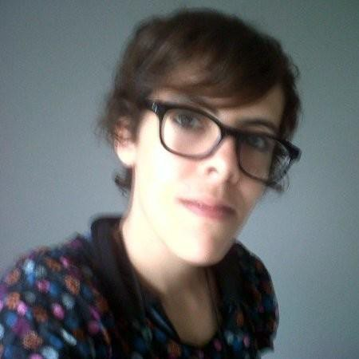
Hello AI for Health
Nada MALOU
Clinical lead
Fondation MSF
nada.malou@paris.msf.org
Fondation MSF intro
Antimicrobial resistance
Product value
Machine learning speciﬁcs
Louis LAROCHE
Product manager
Fondation MSF
louis.laroche@paris.msf.org

Slide 4
Fondation Médecins Sans Frontières
Improving MSF’s performance in the ﬁeld through 3 main focus areas:
Humanitarian knowledge
Applied medical research
Tech innovation:
3D PROGRAM
COVID19
ANTIBIOGO
3D printing prosthesis/orthosis for burn and amputee patients
GAZA - HAITI
Web app to support countries ripost to COVID19 pandemic
NIGER - DRC
A diagnostic tool to provide access to accurate antibiotics
JORDAN - MALI - SENEGAL

Slide 5
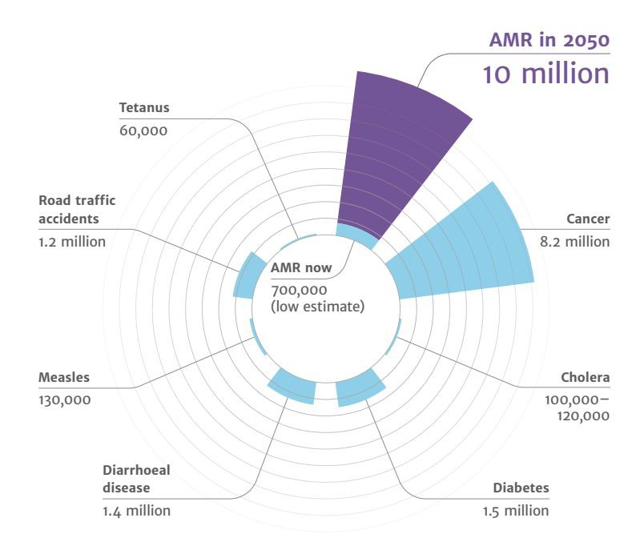
A global health issue
Deaths attributable to AMR every year
Antibiotic or antimicrobial resistance (AMR) is deﬁned as the resistance of bacterial to antibiotics that were previously eﬀective for treatment of infections.
AMR drivers by WHO:
Non rational use of antibiotics
Lack of hygiene and infection control
Non access to diagnostic tools
Review on AMR's report (O'Neill, 2016)

Slide 6
How does a microbiology lab work?
Patient sample
Incubation time
Lab tech sets up
Doctor
Patient
Microbio expert
Lab tech reads
Prescription
AST

Slide 7
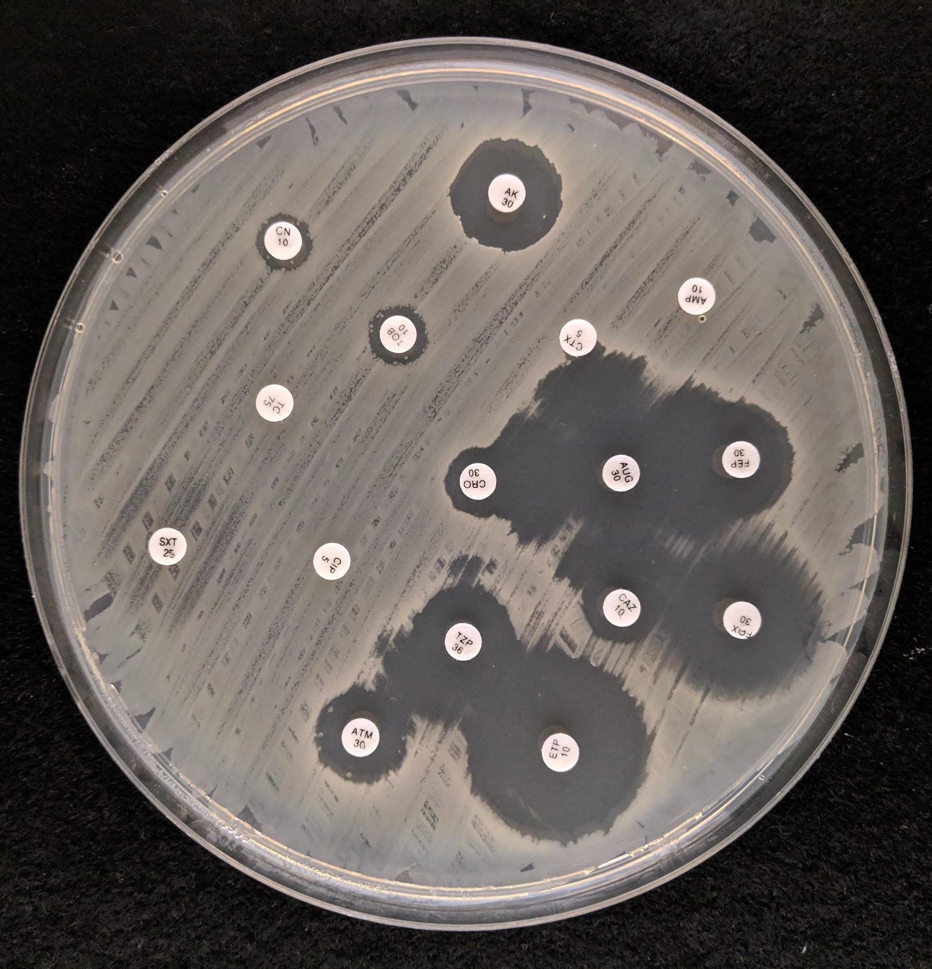
Antibiotic Susceptibility Testing (AST)
Measurement:
Short training
Easy to achieve
Low error margin
Interpretation:
3K rules to know, updated yearly
Requires highly qualiﬁed staﬀ
Alternative: SIRscan

Slide 8
Value proposition
Antibiogo is a free, open source and oﬄine Android app
that supports non-expert laboratory technicians measuring and interpreting antibiotic susceptibility tests (AST),
to help doctors prescribe accurate antibiotics to their patients.

Slide 9
Product demo
Measure easily
Complete interpretation
Read results & take action
Share AST results
View on Youtube

Slide 10
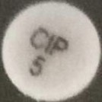
Reading antibiotic pellets on a Petri dish using machine learning
There is a limited set of ~50 possible labels
We used a Convolutional Neural Network (CNN) classiﬁer to categorize labels
We use an ensemble of 10 training models
We embed the model in the app using Tensorﬂow lite to be available oﬄine
Results: 99.97% test accuracy
Limitation: there are multiple pellet brands, and model is only trained on two (i2a, lioﬁlchem). We are currently struggling to train it on 2 other major brands.

Slide 11
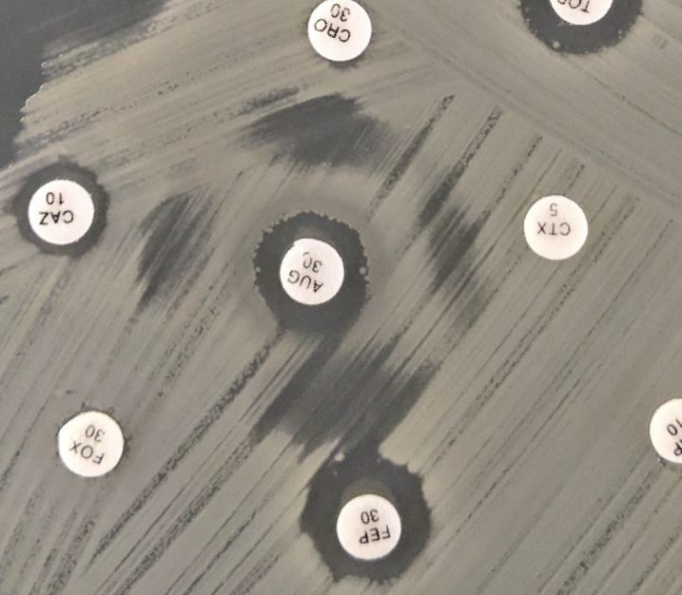
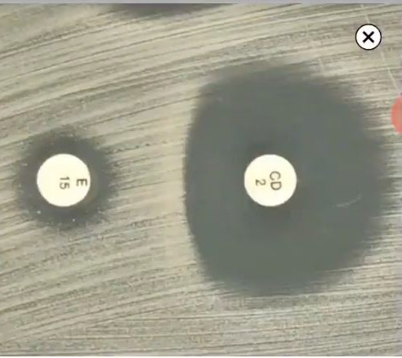
Complex resistance mechanisms identiﬁcation postmortem
Trained ML models that recognize:
D-Zone: 99.7% accuracy
Synergy: 98% accuracy
Synergy > ESBL
We decided not to use the model, because:
We still need to ask conﬁrmation to the user
Suggesting a result inducts bias in user conﬁrmation
Identifying mechanisms is straightforward for lab technicians
Low algorithm transferability
D-Zone > MRSA

Slide 12
Antibiogo
Thank you =) Any question?

