Slide 1
FG-AI4H-L-004-A01
E-meeting, 19 – 21 May 2021
Source: | Editors
Title: | Updated DEL10 - Att.1: Presentation
Purpose: | Discussion | Information
Contact: | Eva Weicken | E-mail: eva.weicken@hhi.fraunhofer.de
Abstract: | This PPT contains a presentation of DEL 10_0 “Del. 10_0: AI4H use cases: Topic Description Documents” found in L-004.

Slide 2
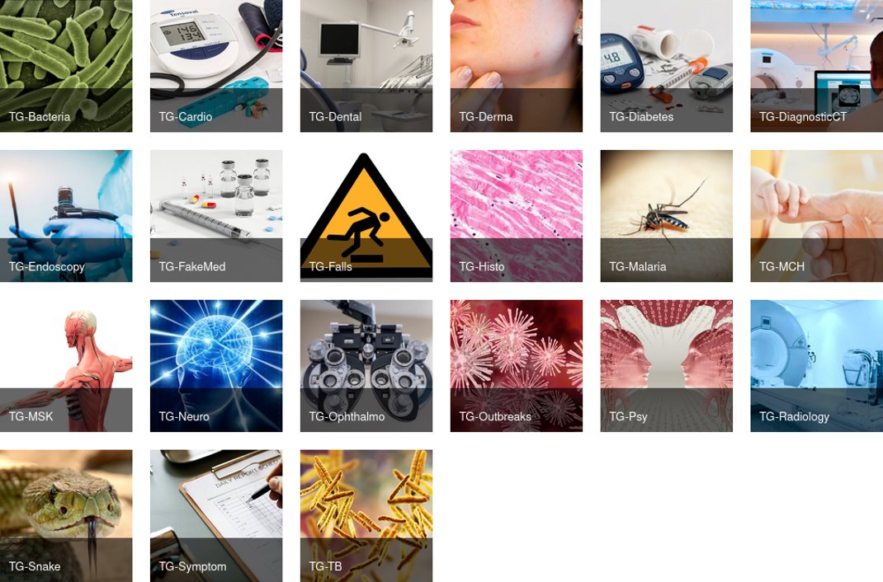
FG-AI4H Topic groups by May 2021
DEL 10.0: AI4H Use cases – Topic description documents
define benchmarking standards of AI tools for a specific health topic

Slide 3
Topic groups
DEL 10.0: AI4H Use cases – Topic description document
Dedicated to a specific health use case in the context of AI
Aim at producing evidence and case studies
bringing together experts and data
Propose procedures to benchmark AI models for a given task within a health topic
Draft topic description documents

Slide 4
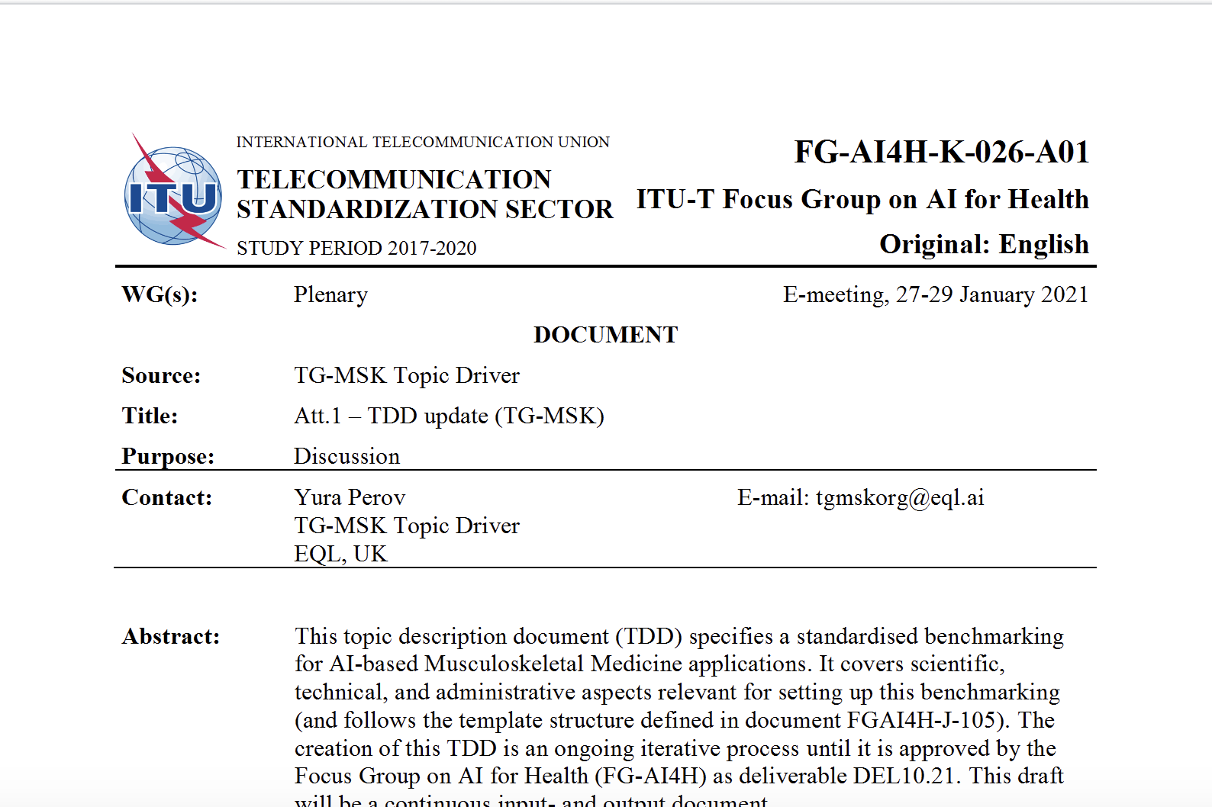
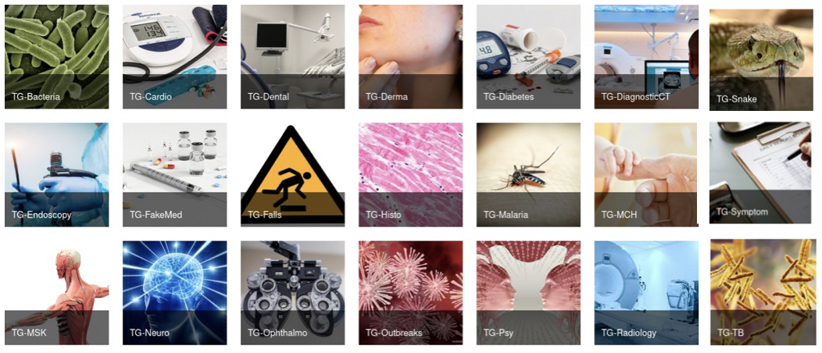
Topic Description Document (TDD)
DEL 10.0: AI4H Use cases – Topic description documents
21 Topic groups create
TDDs:
deliverables No. 10.1 – 10.21

Slide 5
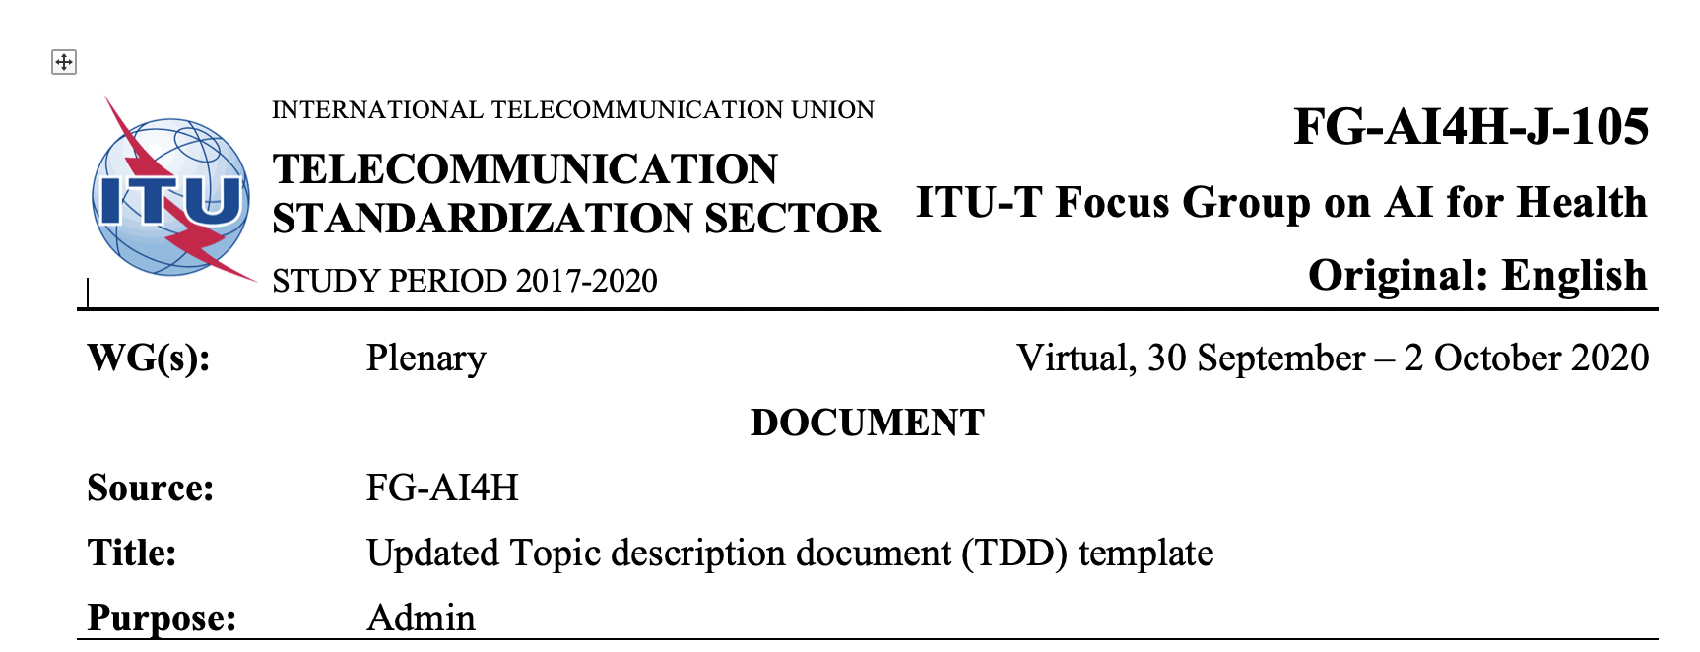
Topic Description Document (TDD)
DEL 10.0: AI4H Use cases – Topic description documents
TDD includes:
Background
Features
Operations
Considerations
Iterative process, updates presented at each meeting
Same TDD-template for all topic groups (Update J-105)

Slide 6
FG-AI4H topic groups + working groups
DEL 10.0: AI4H Use cases – Topic description documents
Features from both groups is “Ad Hoc group on Digital technologies for COVID Health Emergency (AHG-DT4HE)”

Slide 7
FG-AI4H topic groups collaboration
DEL 10.0: AI4H Use cases – Topic description documents
Open Code Initiative
e.g., TG-Ophthalmo, TG-Malaria, TG-Dental, TG-Symptoms
WG-DAISAM
Paper "ML4H-auditing: From paper to practice“ > TG-Ophthalmo, TG-Neuro
WG-CE
“LMIC meeting“ > TG-Malaria, TG-Radiology, TG-MCH

Slide 8
Overview status-update topic groups
DEL 10.0: AI4H Use cases – Topic description documents
N° | Topic group | Topic driver(s) | Document (latest version) | Comment
10_01 | Use of AI in cardiovascular disease management (TG-Cardio) including clinical predictions sub-topic: cardiovascular disease risk prediction | Benjamin Muthambi | K-006-A01 (including subtopic cardiovascular risk prediction) | Needs content for subtopic on cardiac image analysis. Pending transfer to updated TDD-template
10_02 | Dermatology (TG-Derma) | (Maria Vasconcelos) > Weihong Huang | [same as meeting E] K-007-A01 | Change of TG-drivers Pending transfer to updated TDD-template
10_03 | Diagnosis of bacterial infection and anti-microbial resistance (TG-Bacteria) | Nada Malou | [initial TDD] K-008-A01 | Pending transfer to updated TDD-template
10_04 | Falls among the elderly (TG-Falls) | (Inês Sousa) > Pierpaolo Palumbo | K-012-A01 | Temporary change of TG-drivers
10_05 | Histopathology (TG-Histo) | Frederick Klauschen | [same as meeting I] K-013-A01 | Pending transfer to updated TDD-template
10_06 | Malaria detection (TG-Malaria) | Rose Nakasi | K-014-A01
10_07 | Maternal and Child Health (TG-MCH) | Raghu Dharmaraju & Alexandre Chiavegatto Filho | [same as meeting H] K-015-A01 | Pending transfer to updated TDD-template
10_08 | Neurological disorders (TG-Neuro) | Marc Lecoultre | K-016-A01 | Pending transfer to updated TDD-template
10_09 | Ophthalmology (TG-Ophthalmo) | Arun Shroff | K-017-A01 | Pending transfer to updated TDD-template
10_10 | Outbreak detection (TG-Outbreaks) | Stéphane Ghozzi & Auss Abbood | K-018-A01

Slide 9
Overview status-update topic groups
DEL 10.0: AI4H Use cases – Topic description documents
N° | Topic group | Topic driver(s) | Document (latest version) | Comment
10_11 | Psychiatry (TG-Psy) | Nicolas Langer | K-019-A01
10_12 | AI for Radiology (TG-Radiology) | Darlington Ahiale Akogo | K-023-A01 | Pending transfer to updated TDD-template
10_13 | Snakebite and snake identification (TG-Snake) | Rafael Ruiz de Castañeda | [same as meeting I] K-020-A01 | Pending transfer to updated TDD-template
10_14 | Symptom assessment (TG-Symptom) | Henry Hoffmann | K-021-A01
10_15 | Tuberculosis (TG-TB) | Manjula Singh | K-022-A01 | Pending transfer to updated TDD-template
10_16 | Volumetric chest computed tomography (TG-DiagnosticCT) | Kuan Chen | K-009-A01 | Pending transfer to updated TDD-template
10_17 | Dental diagnostics and digital dentistry (TG-Dental) | Falk Schwendicke & Joachim Krois | K-010-A01
10_18 | Falsified Medicine (TG-FakeMed) | Franck Verzefé | [same as meeting J] K-011-A01 | Pending transfer to updated TDD-template
10_19 | Primary and secondary diabetes prediction (TG-Diabetes) | Andrés Valdivieso | K-024-A01 | Pending transfer to updated TDD-template
10_20 | AI for endoscopy (TG-Endoscopy) | Jianrong Wu | K-025-A01
10_21 | Musculoskeletal Medicine (TG-MSK) | Yura Perov | K-026-A01

Slide 10
Topic groups & Peer-Review Process
DEL 10.0: AI4H Use cases – Topic description documents
Peer-review process of deliverables/TDDs
Internal review
Requires updated TDD-template

Slide 11
Thank you for your attention!
For any feedback and questions, please contact: eva.weicken@hhi.fraunhofer.de

