Slide 1
FGAI4H-K-053-A01
E-meeting, 27-29 January 2021
Source: | Editors
Title: | Updated DEL09: AI4H applications and platforms - Att.1 - Presentation
Purpose: | Discussion
Contact: | Manjeet Singh Chalga ICMR, New Delhi India | Tel: +91-9582776792 Email: chalgams.hq@icmr.gov.in, manjeetchalga@gmail.com
Abstract: | This PPT summarizes the content of K-053 for presentation and discussion during the meeting.

Slide 2
FG-AI4H-K-053-A01
DEL-09 : AI4H Applications and Platforms
Manjeet Singh Chalga
Scientist-C, ICMR, India
+91-95827 76792
manjeetchalga@gmail.com, chalgams.hq@icmr.gov.in

Slide 3
Objectives:
to discuss on development of AI tool for Health using Mobile Applications & Cloud Applications
to provide a forum for open communication among various stakeholders,
to coordinate the benchmarking process in collaboration with the Focus Group management and working groups.

Slide 4
Key features required for development of AI tool for Health using Mobile Application
PAS 277:2015 Health and wellness apps. Quality criteria across the life cycle. Code of practice
Good practice guidelines on health apps and smart devices (mobile health or mhealth)
Guiding Principles of Practice and Transparency for Mobile Health Solutions (CTA-2073)

Slide 5
Types of Mobile Application
Native Apps
Web Based Apps
Hybrid Apps

Slide 6
Trending Mobile Applications for Health
Health Awareness Apps
Apps with Associated Devices
Apps for disease surveillance

Slide 7
Designing of dynamic Mobile Application
Most of the health research issues have similar pattern of questionnaire or activities.
By identifying the common pattern of health surveys and issues, a simple database can be designed at a webserver.
The mobile application can be designed to read the database from the webserver and prepare the dynamic console of the App.

Slide 8
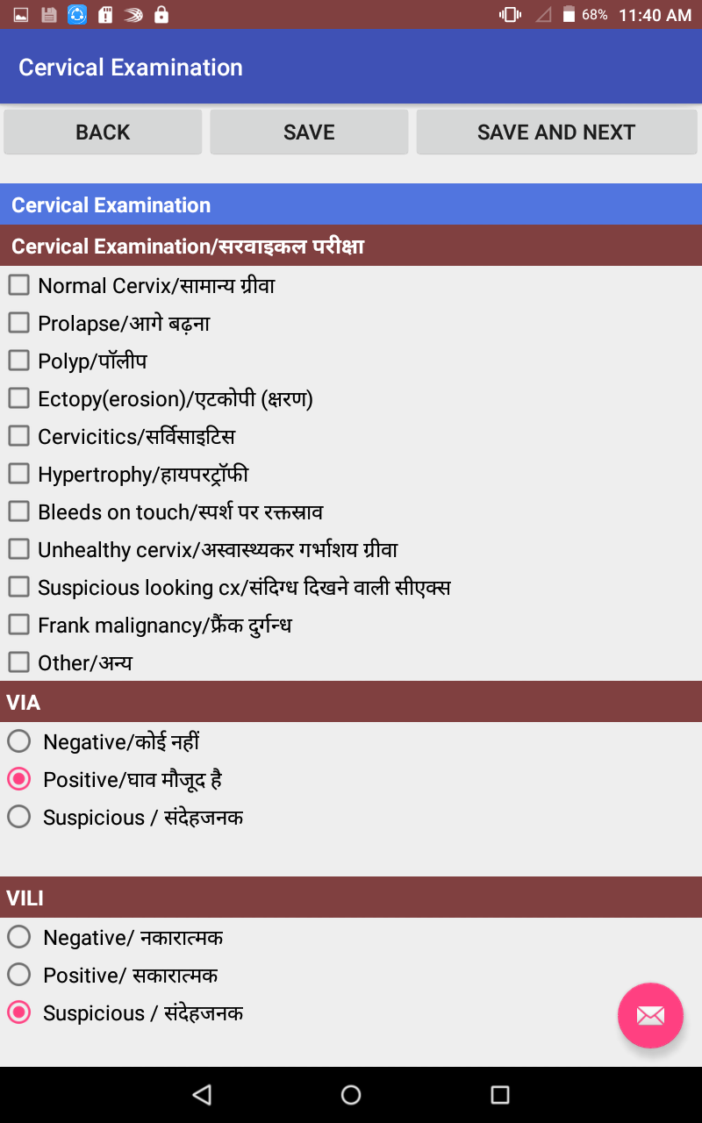
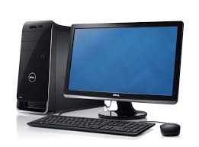
Detail of some App and cloud based projects we are working on
Dynamic designing
Internet
Data Sync
Mobile Database
Database of Web Based Server
Server

Slide 9
1. Targeted Intervention to Expand and Strengthen TB (TIETB) Control in Tribal Populations under the Revised National Tuberculosis Control Programme, India

Slide 10
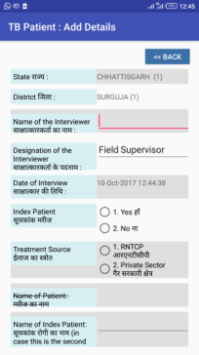
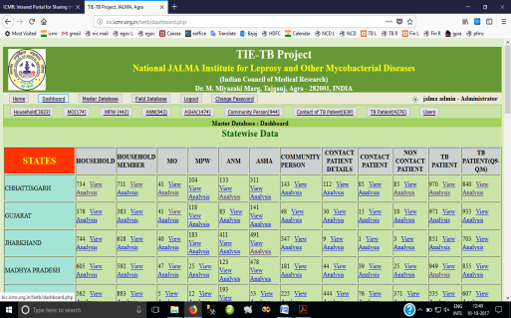
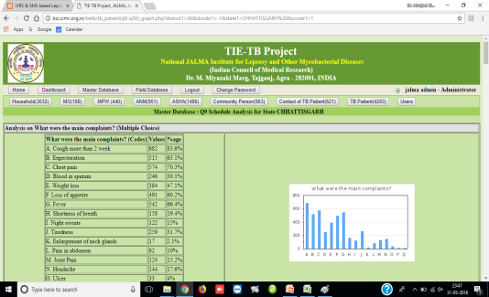
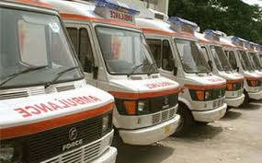
TieTB Project Flow Diagram
Mobile
App
Analyzed
Report
Present Status : Developed Mobile App and collected Data from Tribal Area from 19 Districts of 5 States Chhattisgarh, Gujarat, Jharkhand , MP & Rajasthan
Server at ICMR Headquarters
4500+ TB Patients
600+ Contacts Patients
900+ Community Persons
1400 ASHA workers
900+ ANMs
400+ MPWs
170+ Medical Officers
35 Mobile vans equipped with Digital X-ray and sputum microscopy services have been launched and providing services to TB Patients in Tribal Area

Slide 11
2. To develop an IT based Leprosy and TB Patients monitoring system in order to ensure complete treatment of the patients

Slide 12
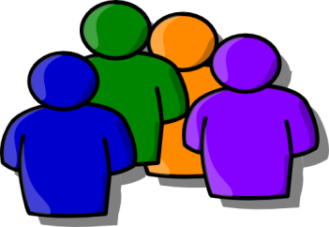
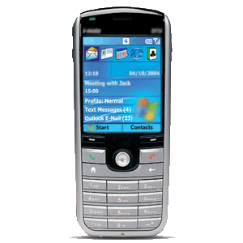
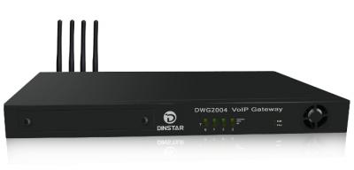
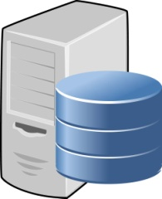
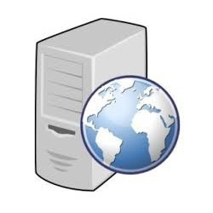
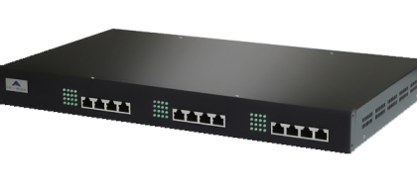
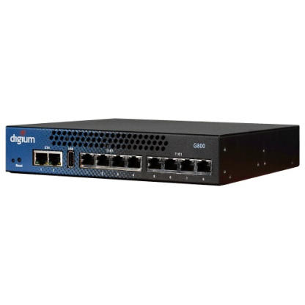
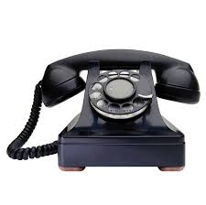
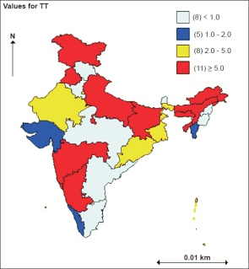
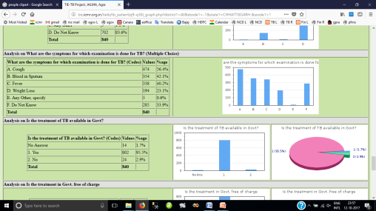
Robo Dialing System
Voice Call
SMS
Voice Call
SMS Gateway
GSM Gateway
Patient Registration
Call Scheduling
Data Sync with IVRS
Web Services & Program Controller
IVRS/Controller
Database Server
Analysis of Data & Reports
VoIP Gateway

Slide 13
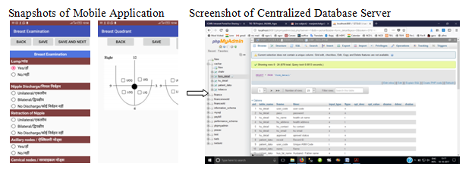
3. Screening and Early Detection of Cervical, Oral and Breast Cancer in Cachar, Assam Trained 250+ health workers, surveyed 46,000+ population and identified 4400+ suspected cases

Slide 14
4. Screening families of workers of Tea Garden for risk of Non-Communicable Diseases and early detection of Cancer in the Dibrugarh, Assam Trained health workers of that area, surveyed 9600+ population and identified 1200+ cases at high risk of Non-Communicable diseases

Slide 15
5. Prevalence of fluorosis in the community of selected districts of India and development of an appropriate intervention model from prevention and control of fluorosis Trained project staff, surveyed 50000+ population from 7 districts of India Project is ongoing

Slide 16
6. Programmatic Implementation and Comparison of MIP Vaccine Immunoprophylaxis and Rifampicin Chemoprophylaxis for Contacts for Leprosy Patients under the National Leprosy Eradication Programme (NLEP) in High Endemic Settings Trained project staff and surveyed 17000+ families population Project is ongoing

Slide 17
7. Prevalence and Determinants for TB Disease among Contacts of TB Patients: A Bi-directional Study Trained project staff and surveyed 70+ city area Project is ongoing

Slide 18
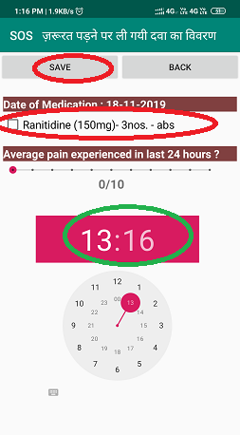
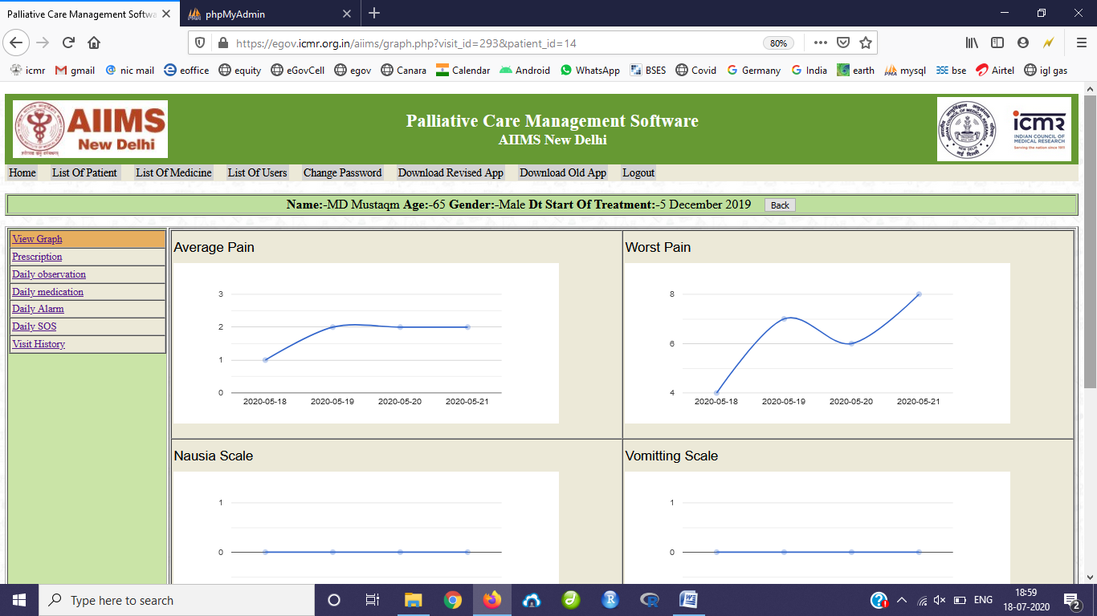
8. A randomised controlled trial to compare the efficacy of mobile app vs conventional prescription of analgesics and adjuvants’ adherence on selected variables among cancer patients receiving palliative care at a tertiary care centre

Slide 19
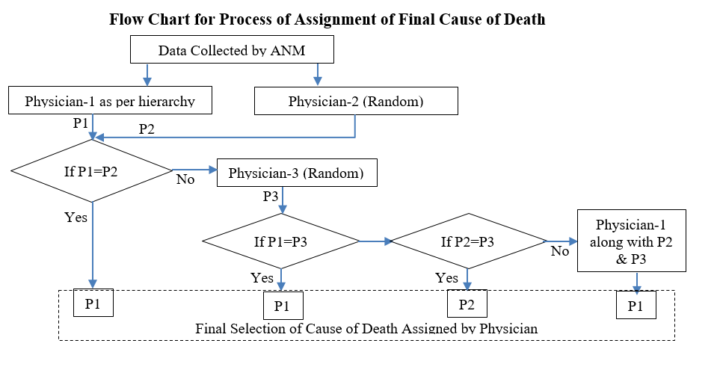
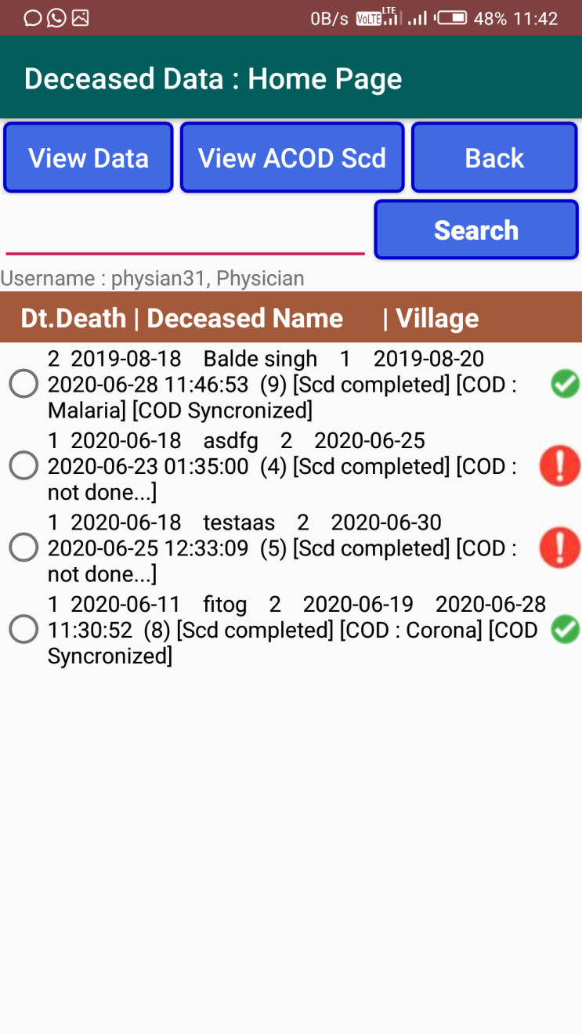
9. Digitization of Process of Assigning medical cause of death process

Slide 20
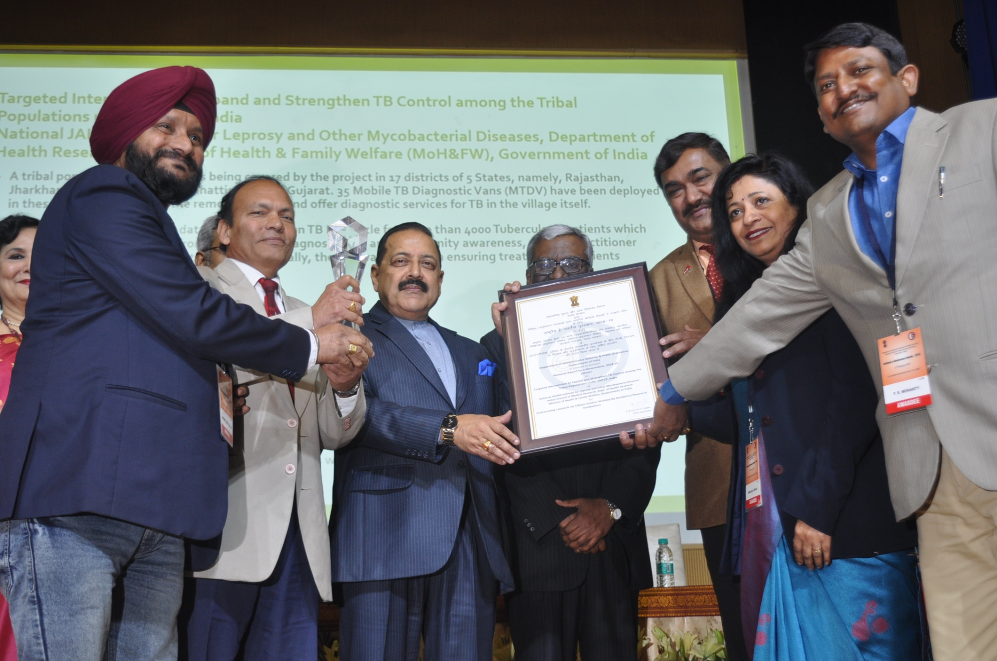
Received National Award for project on TB in Tribal Areas

Slide 21
Result
Dynamic Apps are prepared and their design depends on the database of the main server
Dynamic nature of mobile application makes updation more easy.
The data synchronization procedure becomes simple
Data analysis becomes more powerful

Slide 22
Thank You

