Slide 1
FGAI4H-K-052
E-meeting, 27-29 January 2021
Source: | Editors
Title: | DEL08: AI4H scale-up and adoption - Implementation Roadmap
Purpose: | Discussion
Contact: | Sameer Pujari WHO | E-mail: pujaris@who.int
Abstract: | This PPT summarizes the content of DEL08 for presentation and discussion during the meeting.

Slide 2
Del08 : Scaled Implementation of AI4Health Implementation roadmap
Sameer Pujari
Department of Digital health and innovation

Slide 3
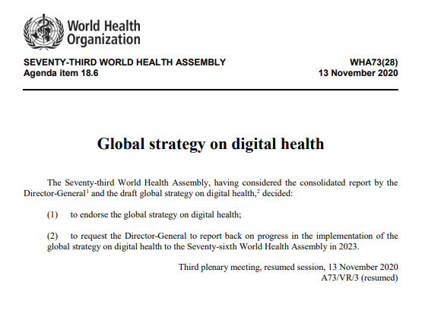
S01.
S02.
Promote global collaboration and advance the transfer of knowledge on digital health
Advance the implementation of national digital health strategies
Global strategy on digital health
2020-2025
S03.
Strengthen governance for digital health at global, regional and national levels
S04.
Advocate people-centred health systems that are enabled by digital health

Slide 4
Overview
The roadmap activities agreed by Member States under the Global Strategy on Digital health
SO1-ST01-Analyse digital health network landscape
SO1-ST02-Provide policy dialogue for digital prioritization at national level
SO2-ST04-Capacity building for strategy implementation and investment
SO2-ST05-Digital health maturity model
SO3-ST01-Criteria for impact assessment
SO4-ST06-Develop an ethics framework for technologies for health

Slide 5
How to align and document activities in the Roadmap
Step 02
Prioritize and identify challenges
Assess each initiative across criteria and stakeholder
Step 03
Plan
Create Action plan
(Who, What, When Why and How)
Step 04 Implementation cycle
Implement & Evaluate, Innovate, Iterate
Step 01
Mapping existing initiatives

Slide 6
Step 01 : (Leverage Opportunities) Mapping existing initiatives
Open data collaborative
AI Retinopathy
UN digital cooperation roadmap
SO2-ST03-Identify and engage stakeholders
SO1-ST04-Participate in the UN multistakeholder digital inclusion coalition
SO1-ST01-Analyse digital health network landscape
Scale up implementation of mHealth program BHBM
Investment case
Digital health clearing house
SO2-ST02-Prioritise national investment
SO2-ST02-Prioritise national investment
SO3-ST05-Assess and promote innovative solutions
01
SO1-ST03-Participate in multistakeholder groups
SO4-ST03-Develop a framework allowing individual feedback to validate DH tools & services
Virtual care implementation guidance
National digital strategy planning and implementation
mHealth handbooks
SO3-ST03-Technical guidance
SO2-ST01-National DH strategy
SO3-ST04-Guidelines+handbooks
SO1-ST02-Provide policy dialogue for digital prioritization at national level
SO1-ST10-Develop guideline, guidance, framework and toolkits
Dynamic digital health maturity
Ai for health focus group
WHO-ITU Handbook on digital health platforms
SO2-ST05-Digital health maturity model
SO4-ST07-Promote ethics, governance and security in handling and processing data
SO3-ST03-Technical guidance

Slide 7
01. Country priorities
System
Big
Small
Impact
Dynamic digital health maturity
Dissemination, communication knowledge transfer (DCK) Task force
mHealth handbooks
Network of networks
Digital health advisory group (DHTAG)
02
Technical know-how
Networks of DH collaborating centres
Policy
Smart guideline
Yellow vaccination card
Telemedicine portal
Digital health 101
Step 02 : Prioritize and identify challenges
Workforce

Slide 8
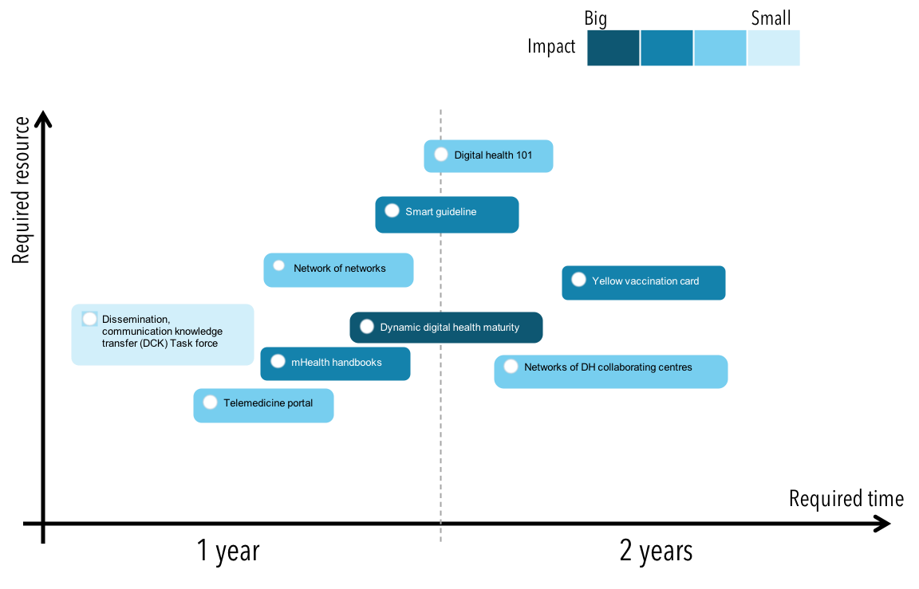
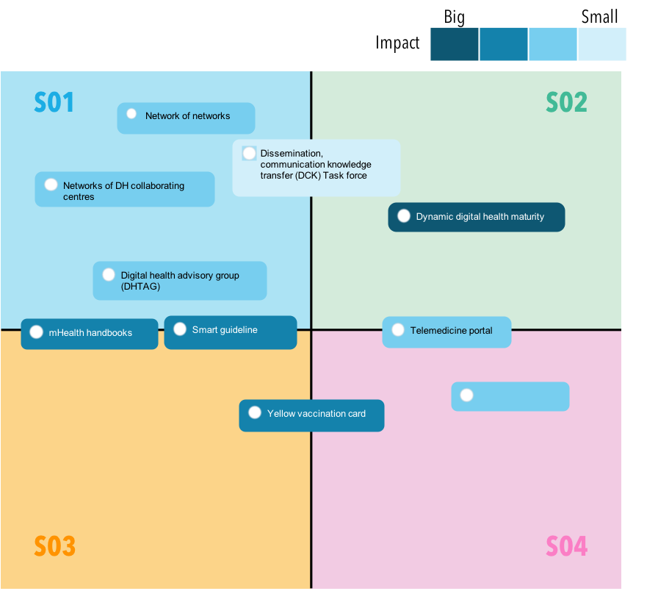
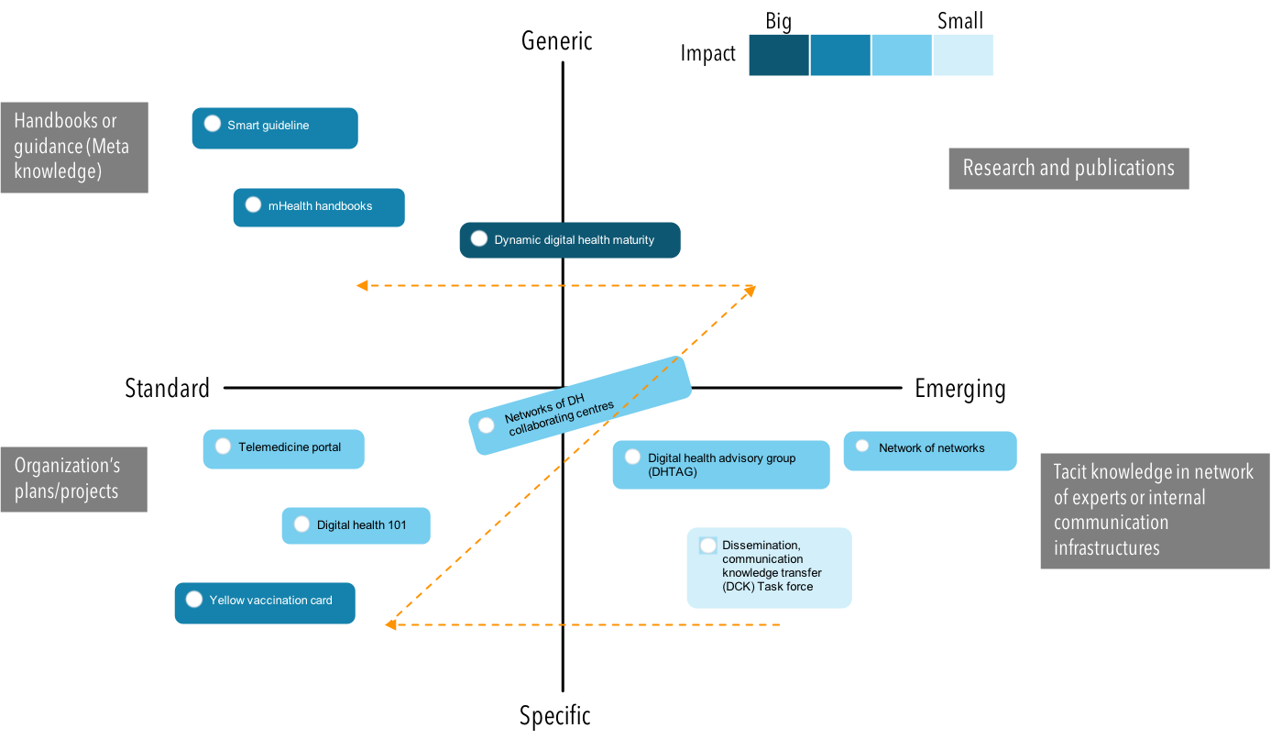
03. Time-effort-impact evaluation
Step 02 : Prioritize and identify challenges
02. Digital health strategic objectives
02
04. Value generation

Slide 9
Step 03 : Action plan
Initiative Example
Diabetic retinopathy
Who (the team)
What (components)
Where (location)
WHO secretariat
Member States
Country level
Tools
When (timeline)
Short term (1-2 years)
Complete before end of 2021
Required capability
How
Knowledge management
Stakeholder engagement
03
Leadership
2021-Q1 | 2021-Q2 | 2021-Q3 | 2021-Q4 | 2022-Q1 | 2022-Q2 | 2022-Q3 | 2022-Q4
Pilot and operational plan structured
Training and prep for launch
Implementation and evaluation
Self assessment and enhancement tools added
Evaluate, Innovate and Iterate

Slide 10
Step 04 : Implementation Cycle (based on country specific digital maturity)
1. Commit
2. Catalyse
Commit
Catalyse
Encourage Member States, partners and other stakeholders to commit to global, regional, and national strategies on digital health
Create, scale and sustain an environment and processes that will facilitate and induce collaboration towards delivering results.
04
4. Enhance & Iterate
3. Measure
Iterate
Measure
Take a new cycle of actions based on what has been experienced, measured and learned
Create and adopt processes for monitoring and evaluating the Strategy´s effectiveness

Slide 11
The roadmap is structured so we can ensure that the Digital Health is safe, sustainable and leaves no one behind.
Thank you.
Anup, visually impaired pupil listening at Resource centre for children with visual impairments, Jharkhand, India.
Credit: WHO/NOOR/Arko Datto
Notes:
The roadmap is structured so together we can ensure that the Digital Health is safe, sustainable and leaves no one behind. We look forward to supporting you all.

