Slide 1
FGAI4H-K-049
E-meeting, 27-29 January 2021
Source: | Editors
Title: | DEL02: AI4H regulatory best practices and WG-RC - Progress Review
Purpose: | Discussion
Contact: | Shada Alsalamah, PhD World Health Organization | E-mail: alsalamahs@who.int
Abstract: | This PPT summarizes the content and progress of DEL02 for presentation and discussion during the meeting.

Slide 2



Working Group on Regulatory Considerations on AI for Health
(WG-RC)
DEL02: Overview of Regulatory Considerations on Artificial Intelligence for Health
Shada Alsalamah, PhD
World Health Organization
FG AI4H - 27-29 January 2021

Slide 3
WG-RC DEL 02- Purpose & Scope
A general high-level overview of non-inclusive key regulatory considerations for the use of AI in health.
A resource that can be considered by regulators, developers, and other stakeholders.
Not intended to be a guidance, regulation, or policy.
Dialogue between developers and regulators to establish a common understanding around the use of the AI solutions in health

Slide 4
Topic Areas for Regulatory Considerations*
Documentation and Transparency
Risk Management and Lifecycle Approach
Data Quality
Analytical and Clinical Validation
Engagement and Collaboration
Data Protection and Information Privacy
* These topic areas are not fully inclusive

Slide 5
WG-RC Progress & Aim of Today’s Presentation
Present a brief update on each topic since Meeting J.
Receive early feedback from FG members.
Present next steps towards a final DEL 02.

Slide 6
1/6 Considerations for Documentation and Transparency
Essential for AI solutions and systems that may be subject to regulatory review.
Regulators
  Trace back the development process & have evidence and trusted documentation of essential steps and decision points.
Systems
  Protect against data manipulation & malicious attacks
  Track and record access and changes applied as appropriate.

Slide 7
1/6 Considerations for Documentation and Transparency
Supports and informs regulatory decision making
Helps identify and guard against bias.
Creates an opportunity to show the strength of a science-based development.
Helps establish a shared understanding among all stakeholders.
Supports confidence and trust in the AI solution and development process.

Slide 8
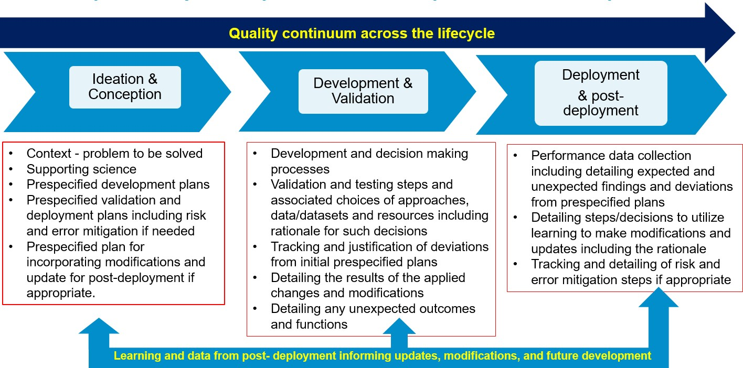
1/6 Considerations for Documentation and Transparency

Slide 9
2/6 Considerations for Risk Management and Lifecycle Approach
Aims to present a holistic risk-based approach for the AI medical device throughout its lifecycle pre- and post- marketing.
Covering 3 areas:
  AI medical devices developing and deployment process
  AI medical device product lifecycle
  Holistic risk management

Slide 10
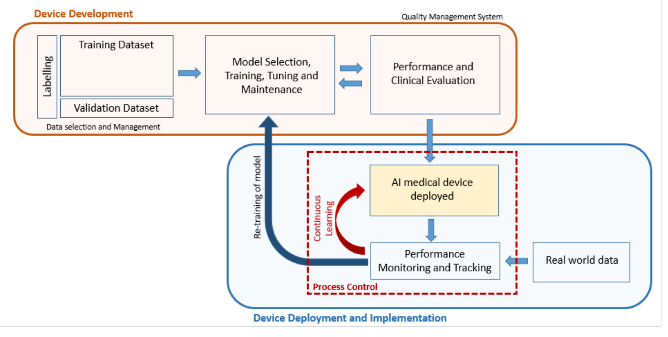

2/6 Considerations for Risk Management and Lifecycle Approach
1- Medical Devices Developing and Deployment Process
The process of developing and deployment of the AI medical device

Slide 11
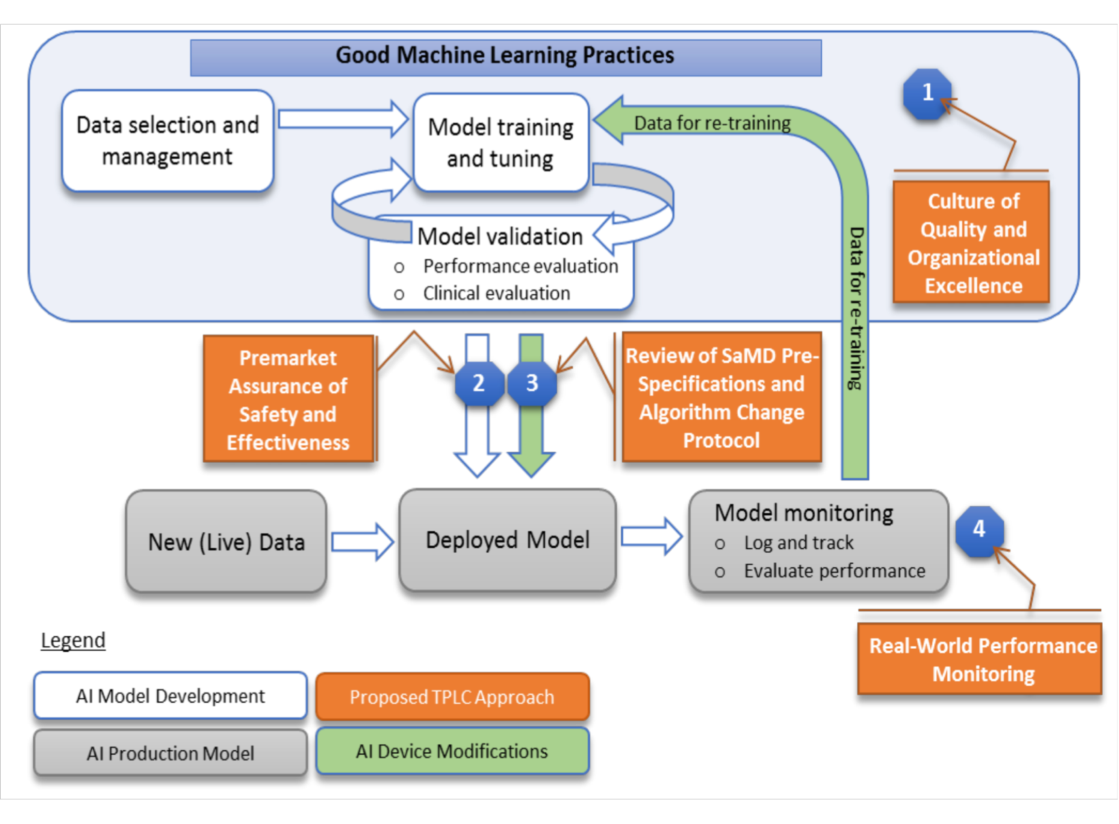
2/6 Considerations for Risk Management and Lifecycle Approach
2- AI Medical Device Product Lifecycle
good AI practices throughout the development and deployment
To facilitate continuous learning and product improvement while providing effective safeguards.

Slide 12
2/6 Considerations for Risk Management and Lifecycle Approach
3- Holistic Risk Management
Consider all risks associated with cybersecurity threats and vulnerabilities.
Employ a risk-based approach to ensure the design and development of medical devices with appropriate cybersecurity protections.
Take a holistic approach to device cybersecurity by assessing risks and mitigations throughout the product’s life cycle.

Slide 13
2/6 Considerations for Risk Management and Lifecycle Approach
General AI medical device risk management approach
Pre-market Development Management
Post-market Management
Change Management
Figure General AI medical device risk management approach.

Slide 14
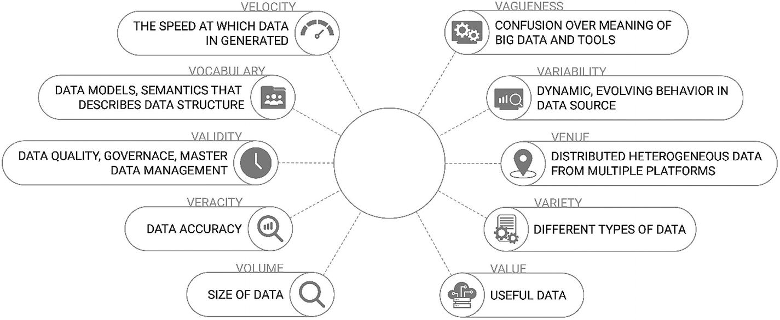
3/6 Considerations for Data Quality- Key Challenges
Data set management
Data inconsistency
Dataset selection and curation
Data set management
Data inconsistency
Dataset selection and curation
Data usability
Data integrity & Data labelleing
Model training
Documentation and transparency
Human factors

Slide 15
4/6 Considerations for Analytical and Clinical Validation
Intended Use
Analytical Validation
Clinical Validation
Cost effectiveness
Post market safety monitoring

Slide 16
5/6 Considerations for Engagement and Collaboration
Explored with whom, why, and how they foster engagement & collaboration
With whom?
  Healthcare professionals, academia, industry, patients/patient advocates, domestic government agencies, media, healthcare providers, and consumers
Why?
  Communicate benefits and intended use, learn about new developments in industry/academia, inform stakeholders about developments in regulation, and acquire feedback from stakeholders about medical devices
How?
  Hosting workshops and meetings (e.g., with domestic government institutes and international counterparts), producing digital/print material, offering training modules and other types of education, and central alerting systems.

Slide 17
5/6 Considerations for Engagement and Collaboration
How does this impact clinical outcomes? Two case studies review findings:
Clinicians have had direct engagement with regulators for device classifications associated with each trial
Rapid responses and very informative and helpful engagement from regulatory team has resulted in efficient turnaround times for trial initiation

Slide 18
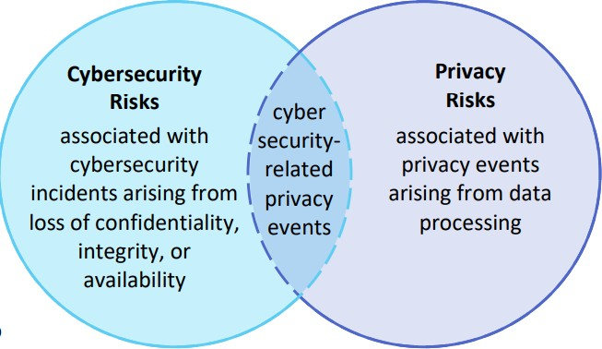
6/6 Data Protection and Information Privacy
How can we nurture development of strategies in resource-limited settings?
Key Consideration areas:
  Quality Continuum
  Risk Assessment
  Annotated Notes and Audit Tri
  Cybersecurity
NIST Privacy Framework – Cybersecurity and Privacy Risk Relationship

Slide 19


6/6 Data Protection and Information Privacy
Health sources for AI solutions (What needs to be protected?)
Regulatory landscape (How it should be protected?)
Developers and their companies should
  Gain an understanding of applicable data protection regulations and information privacy laws
  Consider the different jurisdictions’ regulations and laws
  Stay current on new laws and requirements

Slide 20
Next Steps Planned for Q1 2021
Targeted Month | Planned Milestones/ Deliverables
January | Address internal SG leads comments for topics harmonization. Initiate WHO publication process
February | Receive written feedback from whole WG-RC group Welcome written feedback from FG members Welcome feedback from relevant deliverables chair’s Contributors’ organizations internal check
March | Address All review comments Submit to WHO editors Receive final approval from WG-RC group after editing Publish DEL02

Slide 21

Thank you

