Slide 1
FGAI4H-K-047-A01
E-meeting, 27-29 January 2021
Source: | Editor
Title: | Updated DEL00: Overview of the FG-AI4H deliverables - Att.1 - Presentation
Purpose: | Discussion
Contact: | Shan Xu CAICT China | Email: xushan@caict.ac.cn
Abstract: | This PPT summarizes the content of K-047 for presentation and discussion during the meeting.

Slide 2
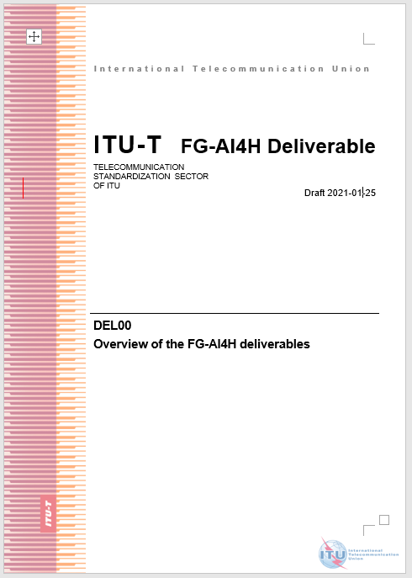
Abstract
This deliverable provides an overview of the various FG-AI4H deliverables. To establish a standardized assessment framework for the evaluation of AI-based methods for health, a series of deliverables is planned, including 9 generalized specifications on ethics, regulatory, requirement, data, training, evaluation, application, etc., and 20 topic description documents on specific use cases with corresponding AI/ML tasks.
This document is to give a comprehensive understanding and overview on the structure, relationship, progress, and corresponding scopes on those deliverables, and improve possible collaborations.

Slide 3
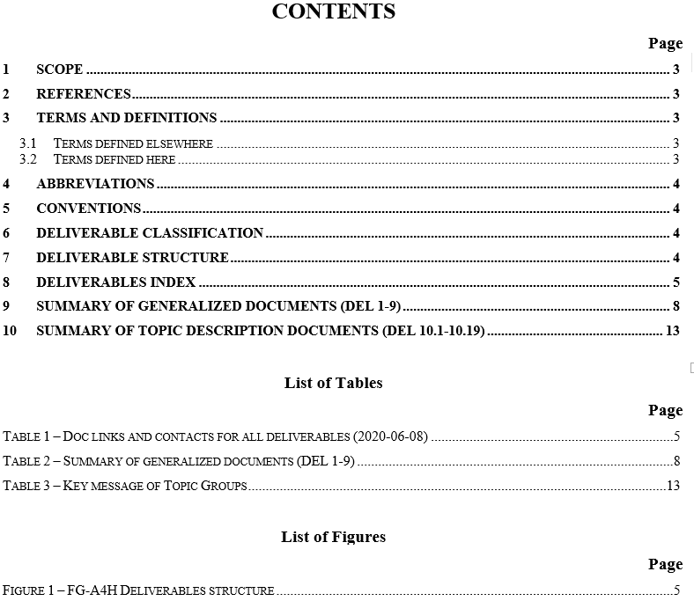

Slide 4
Introduction
May 2018: idea at AI for Good, Geneva
July 2018:
Formal creation, Ljubljana
September 2018: Meeting A, WHO HQ
The ITU/WHO Focus Group on artificial intelligence for health (FG-AI4H) was established by ITU-T Study Group 16 at its meeting in Ljubljana, Slovenia, 9-20 July 2018.
This group is committed to establish a standardized assessment framework for the evaluation of AI-based methods for health, diagnosis, triage or treatment decisions.
A list of deliverables for the FG-AI4H was planned and corresponding groups was established, with 9 deliverables (DEL 1-9) on generalized consideration and 20 topic groups (DEL 10.1-10.20).
November 2018: Meeting B, New York
January 2019: Meeting C, EPFL
April 2019: Meeting D,
Shanghai World Expo
May 2019:Meeting E,
AI for Good, Geneva
September 2019: Meeting F, Zanzibar
November 2019: Meeting G, New Delhi
January 2020: Meeting H, Brasilia
Mar 2020: Meeting I, Singapore (IMDRF)
May 2020: Meeting I, Virtual meeting
Sep 2020: Meeting J, Virtual meeting
Jan 2021: Meeting K, Virtual meeting
To be continued…

Slide 5
Deliverable classification
Generalized specifications (DEL 1-9): focus on generalized specifications including ethics, regulatory, requirement, data, training, evaluation, application, etc. Each part is interconnected to form a whole standardized framework for AI-based methods for health.
Topic groups (DEL 10.1-10.20): focus on use cases in specific health domains with corresponding AI/ML tasks. Each case is an example of a whole process recommended by generalized specifications (DEL 1-9), and profiled in specific application scenarios.

Slide 6
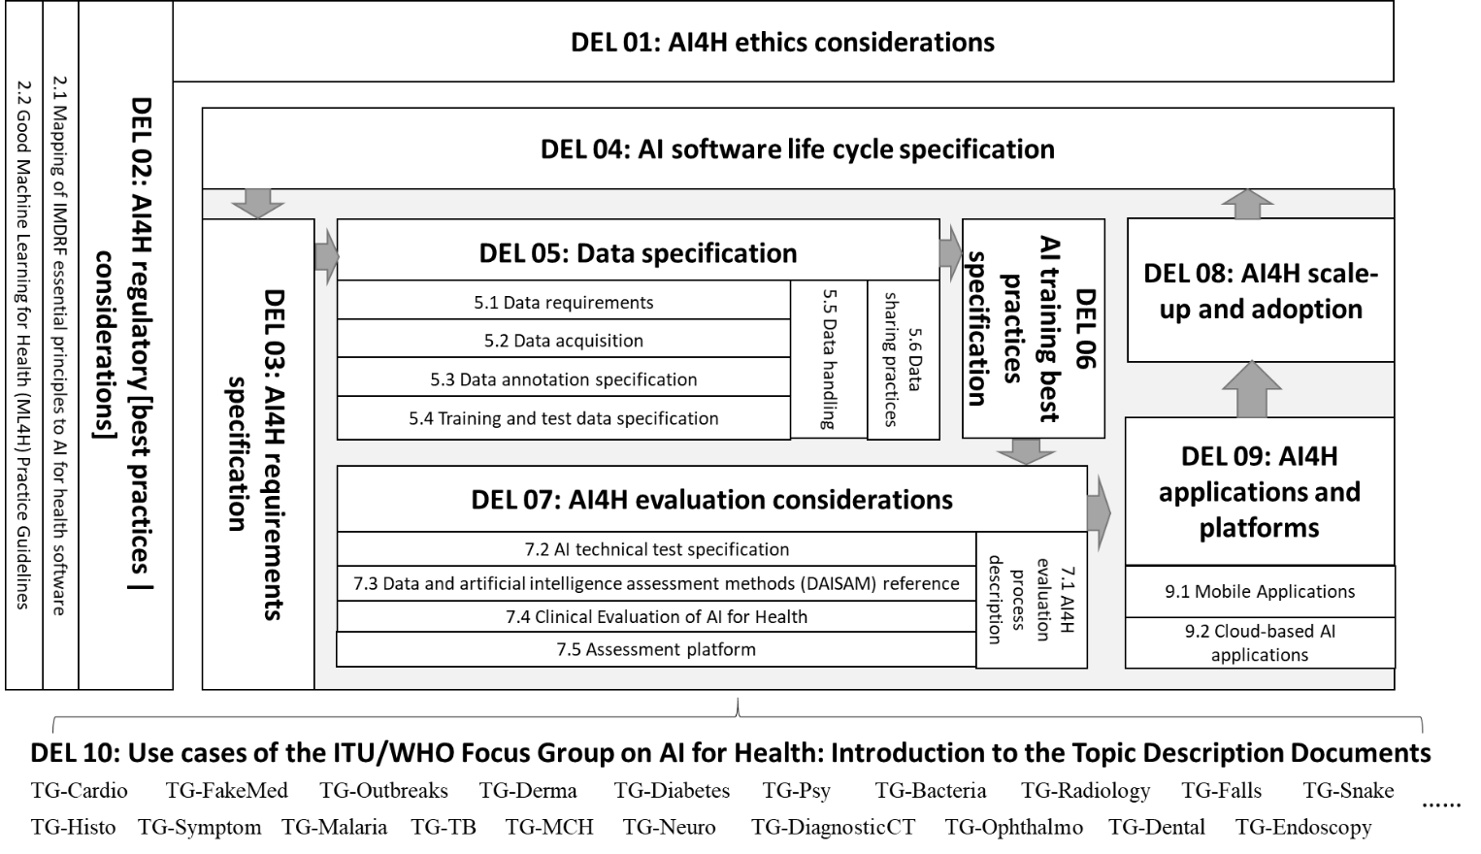
Deliverable structure

Slide 7
No. | Deliverable | Updated draft editor | Availability*
0 | Overview of FG-AI4H deliverables | Shan Xu (CAICT, China) | I-211
1 | AI4H ethics considerations | Andreas Reis (WHO) | G-201
2 | AI4H regulatory [best practices | considerations] | Jackie Ma (Fraunhofer HHI, Germany), Khair ElZarrad & Rose Purcell (FDA, USA) | I-038
2.1 | Mapping of IMDRF essential principles to AI for health software | Luis Oala (Fraunhofer HHI, Germany), Pradeep Balachandran (Technical Consultant eHealth, India), Pat Baird (Philips, USA), Thomas Wiegand (Fraunhofer HHI, Germany) | G-038, G-038-A01
2.2 | Regulatory checklist | Pradeep Balachandran (India) and Christian Johner (Johner Institut, Germany) | I-036 & Nextcloud document
3 | AI4H requirements specification | Pradeep Balachandran (India) | I-033
4 | AI software life cycle specification | Pat Baird (Philips, USA) | I-204
5 | Data specification | Marc Lecoultre (MLlab.AI, Switzerland) | G-205
5.1 | Data requirements | [Gupta Saurabh (AIIMS, India), Manjula Singh (ICMR, India)]** | I-044
5.2 | Data acquisition | Rajaraman (Giri) Subramanian (Calligo Tech, India), Vishnu Ram (India) | G-205-A02
5.3 | Data annotation specification | Shan Xu (CAICT, China), Harpreet Singh (ICMR, India), Sebastian Bosse (Fraunhofer HHI, Germany) | I-043-R01
5.4 | Training and test data specification | Luis Oala (Fraunhofer HHI, Germany), Pradeep Balachandran (India) | I-034
5.5 | Data handling | Marc Lecoultre (MLlab.AI, Switzerland) | DEL05
5.6 | Data sharing practices | Ferath Kherif (CHUV, Switzerland), Banusri Velpandian (ICMR, India), WHO Data Team | I-046 G-205-A06
6 | AI training best practices specification | Xin Ming Sim and Stefan Winkler (AI Singapore) | I-032
7 | AI4H evaluation considerations | Markus Wenzel (Fraunhofer HHI, Germany) | I-028
7.1 | AI4H evaluation process description | Sheng Wu (WHO) | G-207-A01
7.2 | AI technical test specification | Auss Abbood (Robert Koch Institute, Germany) | I-027
7.3 | Data and artificial intelligence assessment methods (DAISAM) reference | Luis Oala (Fraunhofer HHI, Germany) | I-035 & Live version
7.4 | Clinical evaluation of AI for health | Naomi Lee, Rupa Sarkar (Lancet, UK) | I-051
*** 7.[5] | Assessment platform | Luis Oala (Fraunhofer HHI, Germany), Steffen Vogler (Bayer, Germany) | I-037 & Git live version
8 | AI4H scale-up and adoption | Sameer Pujari (WHO) and Robyn Whittaker (New Zealand) | –
9 | AI4H applications and platforms | Manjeet Chalga (ICMR, India), Aveek De (CMS, India) | I-050
9.1 | Mobile applications | Khondaker Mamun (UIU, Bangladesh), Manjeet Chalga (ICMR, India) | I-048
9.2 | Cloud-based AI applications | Khondaker Mamun (UIU, Bangladesh) | I-049
* NOTE: The document numbers indicated reflect the status as of the start of the Brasilia meeting (H) and Geneva Virtual meeting (I). Colour codes indicate deliverable drafting status (as of the issuance of this document) as "active" (green) and "unclear whether active" (blue). Updates will be issued as I-200 series.
** Need replacement editors.
*** Provisional number, to be confirmed.

Slide 8
No. | Deliverable | Updated draft editor | Availability*
10 | AI4H use cases: Topic description docs. | Eva Weicken (Fraunhofer HHI, Germany) | I-030
10.1 | Cardiovascular disease management (TG-Cardio), including risk prediction and clinical prediction sub-topics | Benjamin Muthambi (Watif Health, South Africa) | G-006 (general)
10.1 A | Cardiovascular disease management (TG-Cardio), risk prediction sub-topic | Benjamin Muthambi (Watif Health, South Africa) | I-006-A01 (risk prediction)
10.2 | Dermatology (TG-Derma) | Maria Vasconcelos (Fraunhofer Portugal) | I-007-A01
10.3 | Diagnosis of bacterial infection and anti-microbial resistance (TG-Bacteria) | Nada Malou (MSF, France) | –
10.4 | Falls among the elderly (TG-Falls) | Inês Sousa (Fraunhofer Portugal), Pierpaolo Palumbo (University of Bologna, Italy) | I-012-A01
10.5 | Histopathology (TG-Histo) | Frederick Klauschen (Charité Berlin, Germany) | I-013-A01
10.6 | Malaria detection (TG-Malaria) | Rose Nakasi (Makerere University, Uganda) | I-014-A01
10.7 | Maternal and child health (TG-MCH) | Raghu Dharmaraju (Wadhwani AI, India) and Alexandre Chiavegatto Filho (University of São Paulo, Brazil) | I-015-A01
10.8 | Neurological disorders (TG-Neuro) | Marc Lecoultre (MLlab.AI, Switzerland) | I-016-A01
10.9 | Ophthalmology (TG-Ophthalmo) | Arun Shroff (MedIndia) | I-017-A01
10.10 | Outbreak detection (TG-Outbreaks) | Auss Abbood (Robert Koch Institute, Germany) and Stéphane Ghozzi (HZI, Germany) | I-018-A01
10.11 | Psychiatry (TG-Psy) | Nicolas Langer (ETH Zurich, Switzerland) | I-019-A01-R01
10.12 | AI for radiology (TG-Radiology) | Darlington Ahiale Akogo (minoHealth AI Labs, Ghana) | I-023-A01
10.13 | Snakebite and snake identification (TG-Snake) | Rafael Ruiz de Castaneda (UniGE, Switzerland) | I-020-A01
10.14 | Symptom assessment (TG-Symptom) | Henry Hoffmann (Ada Health, Germany) | I-021-A01
10.15 | Tuberculosis (TG-TB) | Manjula Singh (ICMR, India) | I-022-A01
10.16 | Volumetric chest CT (TG-DiagnosticCT) | Kuan Chen (Infervision, China) | I-009-A01
10.17 | Dental diagnostics and digital dentistry (TG-Dental) | Falk Schwendicke and Joachim Krois (Charité Berlin, Germany); Tarry Singh (deepkapha.ai, Netherlands) | I-010-A1
10.18 | Falsified Medicine (TG-FakeMed) | Franck Verzefé (TrueSpec-Africa, DRC) | –
10.19 | Primary and secondary diabetes prediction (TG-Diabetes) | Andrés Valdivieso (Anastasia.ai, Chile) | I-024-A01
10.20 | AI for endoscopy (TG-Endoscopy) | Jianrong Wu (Tencent Healthcare, China) | I-052-A01
* NOTE: The document numbers indicated reflect the status as of the start of the Brasilia meeting (H) and Geneva Virtual meeting (I). Colour codes indicate deliverable drafting status (as of the issuance of this document) as "active" (green) and "unclear whether active" (blue). Updates will be issued as I-200 series.
** Need replacement editors. *** Provisional number, to be confirmed.

Slide 9
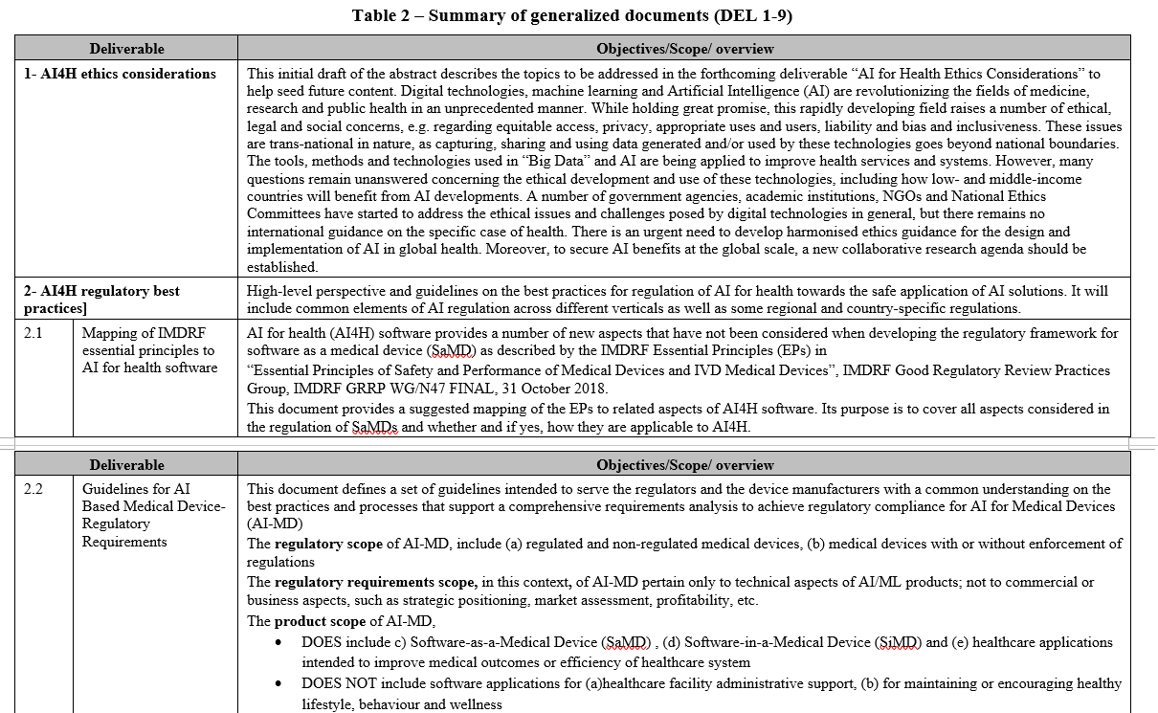
Summary of generalized documents (DEL 1-9)

Slide 10
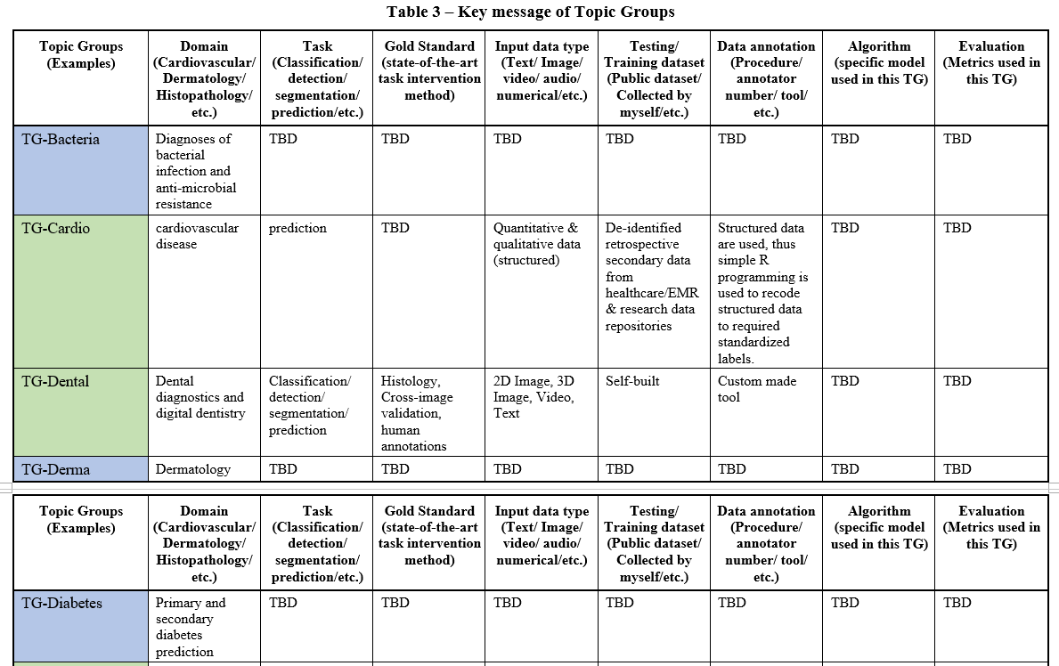
Summary of TDD (DEL 10.1-10.20)

Slide 11
Thank you!
Appreciate if you have any suggestions, ideas and comments on the DEL00,
please feel free to contact xushan@caict.ac.cn

