Slide 1
FGAI4H-K-041-A01
E-meeting, 27-29 January 2021
Source: | Editors
Title: | Updated DEL7.4: Clinical evaluation of AI for health - Att.1 - Presentation
Purpose: | Discussion
Contact: | Naomi Lee Shubhanan Upadhyay Eva Weicken | E-mail: naomi.lee@lancet.com E-mail: shubhanan.upadhyay@ada.com E-mail: eva.weicken@hhi.fraunhofer.de
Abstract: | This document contains the companion presentation for the updated deliverable DEL7.4: Clinical evaluation of AI for health (K-041) at meeting K (Online, 27-29 January 2021).

Slide 2
Agenda
A
Introduction of WG-CE
Work to date
Subgroups keytopics
Outlook
B
C
D

Slide 3
A
Introduction of WG-CE
build a community of collaboration
develop guideline documentation on existing evaluation frameworks
specific considerations on ‘pre- and post deployment’ clinical evaluation and LMIC settings
collaboration with other FG-AI4H working groups and topic groups

Slide 4
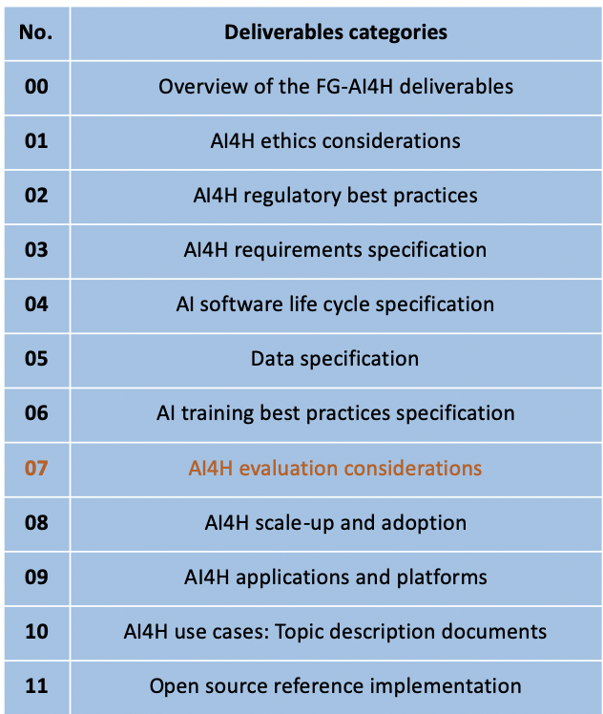
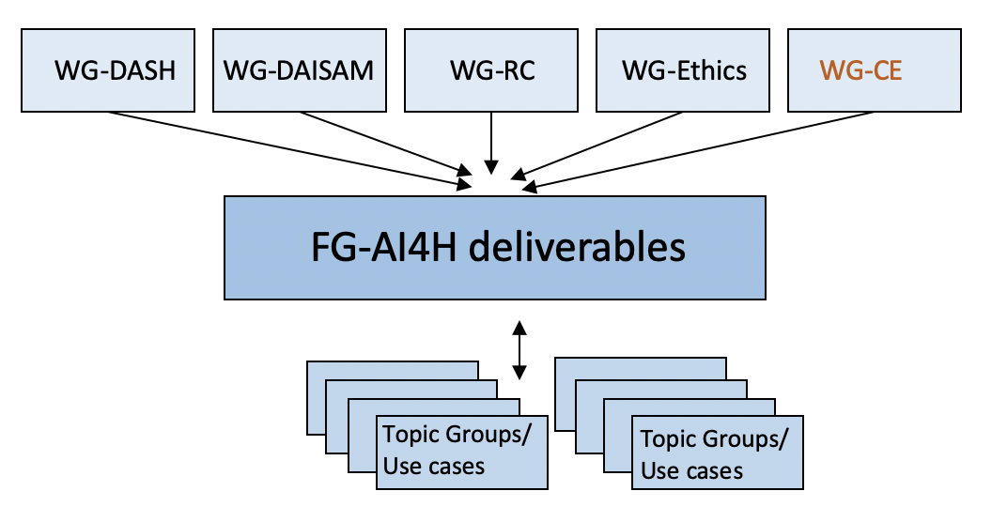
A
Introduction of WG-CE

Slide 5
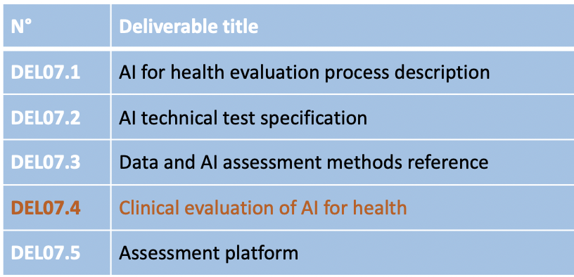
A
Introduction of WG-CE
Part of No. 7 deliverables “AI4H evaluation considerations” (umbrella)
Output document of WG-CE is DEL07.4

Slide 6
B
Work to date
WG-CE
53 members by January 2021
workshop 14 October 2020 (created pre- and post deployment subgroups)
subgroup meetings 15&16 December 2020
Pre-deployment expert lead: Kassandra Karpathakis, NHSX
Post-deployment expert lead: Alastair Denniston, University of Birmingham
Draft outline based on outcomes of WS and meetings

Slide 7
C
Subgroups keytopics
Pre-deployment
Analytical Validation
User validation
Clinical studies (safety and efficacy)
Cost effectiveness
Specific considerations for low – and middle income settings

Slide 8
C
Subgroups keytopics
Post-deployment
Clinical benefit vs risk
Evidence of effectiveness: Performance, Safety and Impact
How much can be achieved with independent dataset benchmarking?
Limitations of benchmarking (e.g., proxy to real clinical evidence and prospective clinical studies)
Post-deployment surveillance*
Evaluating adaptive/learning models and ‘the version change problem’*
*Overlaps with aspects of SaMD Regulation

Slide 9
D
Outlook
Draft outline, define gaps
reporting back from the group
follow-up meetings

Slide 10
Working Group on Clinical Evaluation of AI for Health
Join us!
Co-chairs:
Naomi Lee, Lancet
Shubhanan Upadhyay, Ada Health GmbH
Eva Weicken, Fraunhofer HHI
Please contact: eva.weicken@hhi.fraunhofer.de

