Slide 1
FG-AI4H-K-040-A01
Online, 27-29 January 2021
Source: | DAISAM WG Chairs
Title: | Updated DEL03: AI4H requirement specifications - Att.1: Presentation
Purpose: | Discussion
Contact: | Pradeep Balachandran | E-mail: pbn.tvm@gmail.com
Abstract: | This document contains the latest version of the project deliverable FG-AI4H DEL03 "AI4H requirement specification" and supersedes the previous version of the document (FG-AI4H-J-033).

Slide 2
Scope of the SRS document
Provides high level description of AI4H system requirements:
functional requirements,
performance requirements,
operational requirements,
interface requirements,
other system constraints, etc.
Requirements modeling criteria based on the following aspects:
safety & security ,
risk management,
bias,
trustworthiness, etc.

Slide 3
DEL 03 revision (as on FG Sep-20-meeting)
Reconfigured DEL 03 AI4H system requirements into a separate ‘Requirements Traceability Matrix‘ which represents a mapping of TDD technical topics to AI4H Assessment Platform Requirements
Utility: Requirements Traceability Matrix was proposed as a DAISAM tool for TDD audit process’
Tool Objective : Quality assurance of test plan inputs
All Assessment Platform test plans should be traceable to system requirements
Are TDD inputs ‘ verifiable' as requirements for the AI4H Assessment Platform ?)

Slide 4
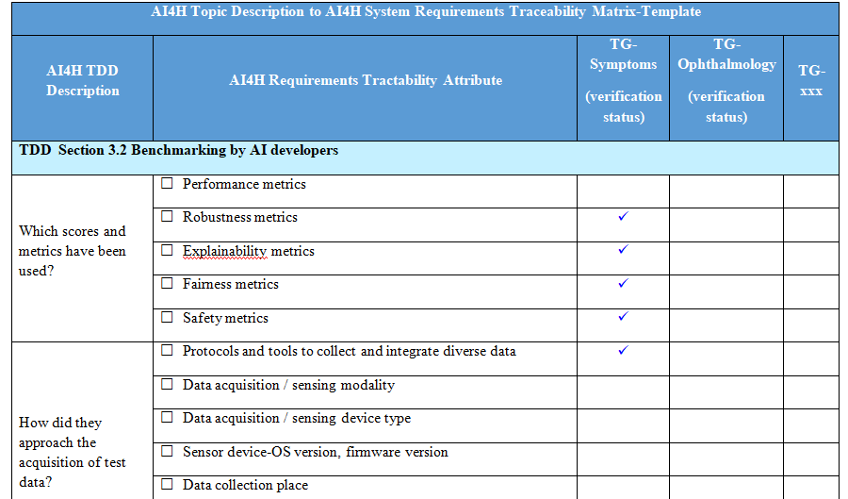
Requirements Traceability Matrix-Tool Template

Slide 5
DEL 03 revision (as on FG Jan-21-meeting)
Utility: Requirements traceability matrix to enable ‘custom mode’ of reporting service under the AI4H assessment platform
It defines the criteria for configuring the reporting parameters for AI4H model evaluation which include the following:
AI Evaluation process flow measures
AI Model performance evaluation results
AI Model risks and severity
AI Model bias & fairness measures
AI Model explainability measures
AI Model generalizability measures
AI Model interpretability measures
AI Model robustness measures
AI Model uncertainty measures
AI Assessment platform -computational infrastructure measures
Intended use
Device security & privacy
Patient safety

Slide 6
Thank you

