Slide 1
FGAI4H-K-038-A01
E-meeting, 27-29 January 2021
Source: | Markus Wenzel¹, David Neumann¹, Sandeep Reddy², Annika Reinke³, Manuel Wiesenfarth³, Alberto Merola⁴, Steffen Vogler⁵ ¹ Fraunhofer, ²Deakin University, ³DKFZ, ⁴AICURA, ⁵Bayer
Title: | Updated DEL07: AI for Health Evaluation Considerations - Att.1 - Presentation
Purpose: | Discussion
Contact: | Markus Wenzel | E-mail: markus.wenzel@hhi.fraunhofer.de
Abstract: | This PPT summarizes the content of K-038 for presentation and discussion during the meeting.

Slide 2

AI for Health Models...
Predictions/ Inferences
… are they trustworthy? accurate, robust, plausible, fair, effective, safe?

Slide 3
Evaluation deliverables series
N° | Title | Editors
DEL7.0 [Intro] | AI4H Evaluation Considerations | Markus Wenzel (Fraunhofer)
DEL7.1 | AI4H Evaluation Process Description | Sheng Wu (WHO)
DEL7.2 | AI Technical Test Specification | Auss Abood (RKI)
DEL7.3 | Data + AI Assessment Methods Reference | Luis Oala (Fraunhofer)
DEL7.4 | Clinical Evaluation | Naomi Lee (Lancet) et al.
DEL7.5 | Assessment Platform | Steffen Vogler (Bayer) et al.

Slide 4
DEL7.0 [Intro] AI4H Evaluation Considerations
Overview of deliverables DEL7.1-5
Background
Novelty
Preliminary evaluation process
Standardized model benchmarking
Benchmarking platform requirements
Best practices from literature

Slide 5
Novelty
Which aspects of health
AI model validation/evaluation are novel/unique/essential?
Ten initial ideas (in Table 2).
Please send us yours.

Slide 6
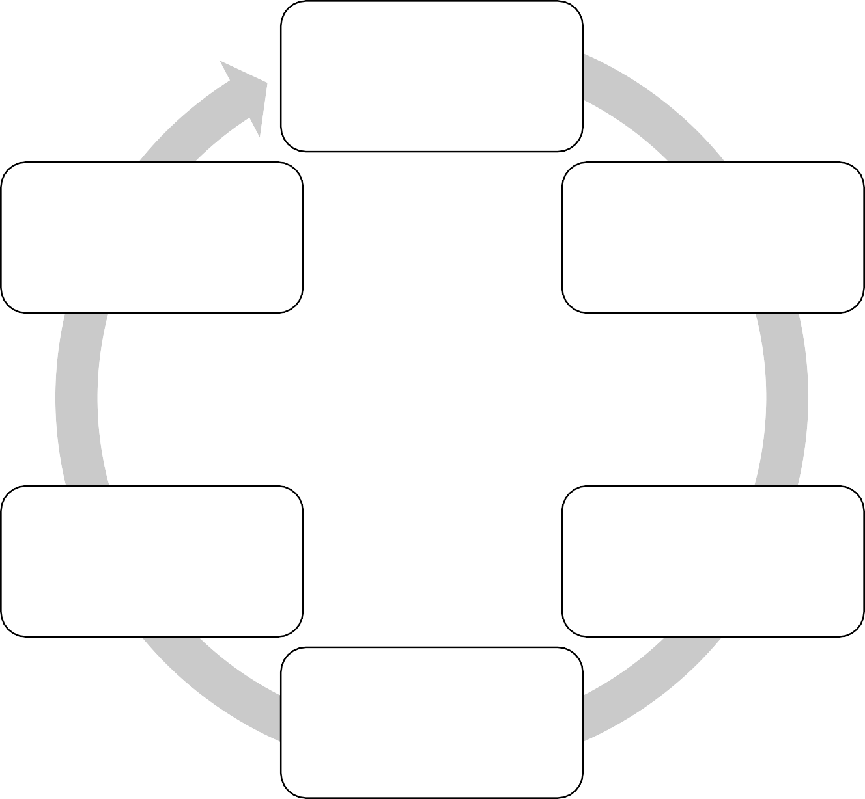
Evaluation process
Preliminary considerations
Define health AI task + quality criteria
Safety/quality
mechanisms
+ monitoring
Define assessment metrics + test data
Evaluate safety, efficacy, usability in clinic or field
Collect + audit test data
Benchmark AI models
on test data

Slide 7
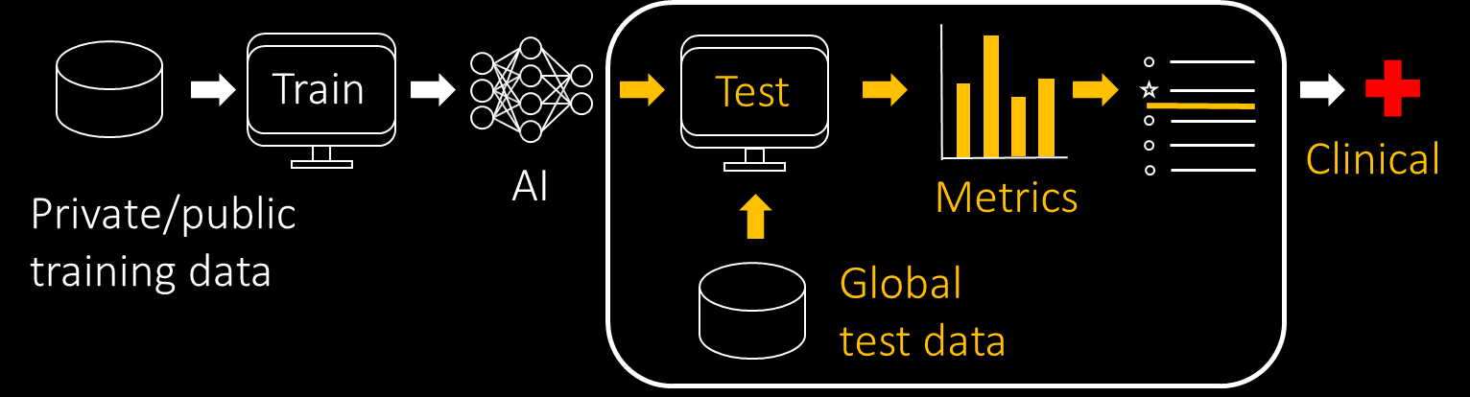
Standardized model benchmarking
Closed environment
Via interface
Federated

Slide 8
Benchmarking platform – requirements
System overview (administrative backend · frontend · execution environment) General considerations (security · hosting · computing resources · availability)

Slide 9
Best practices from the scientific literature and other documents
From 16+ important sources with brief discussion.
Please send us literature you find relevant.

Slide 10
Status update
Revised text, added new literature sources and new figure, rearranged order of the sections, moved Appendix to main text, updated technical description.
Turning vision for AI4H benchmarking platform into practice
  Identified open-source code of eval.ai as good basis for our purposes
(matches well the requirements defined here in DEL7)
  Implement with Open Code Project (evaluation package, presentation yesterday)

Slide 11
Next
Track progress of DEL7.1-5 + include in this intro DEL7.0
Feedback DEL editors, WGs, TGs, open code project, you?
https://itu.int/go/fgai4h/collab → Deliverables → DEL07.docx
markus.wenzel@hhi.fraunhofer.de
Many thanks to
David Neumann Fraunhofer
Sandeep Reddy Deakin University
Annika Reinke, Manuel Wiesenfarth DKFZ
Alberto Merola AICURA medical
Steffen Vogler Bayer

