Slide 1
FGAI4H-K-035-A01-R02
E-meeting, 27-29 January 2021
Source: | FIBREE Foundation
Title: | AI4H Open Code Project - Data Storage Package (DS): AI design's processes and digital data governance by the cover of fundamental rights - Att.1 - Presentation
Purpose: | Discussion
Contact: | Andrea Romaoli Data Storage Package - Lead 1. FIBREE Foundation - Regional CHAIR 2. Leader of Global Compact for WEPs by UN WOMEN | Email: andgarciar@gmail.com Email: andrea.garcia@fibree.org
Abstract: | This PPT summarizes the content of K-035 for presentation and discussion during the meeting.

Slide 2
ITU -WHO AI FOR HEALTH OPEN CODE DATA STORAGE PACKAGE
A.I. DIGITAL GOVERNANCE
ANDREA ROMAOLI
International lawyer expert in technologies
Chair FIBREE Foundation – Malta
Leader of Global Compat for WEPs by UNW – Malta
andrea.garcia@fibree.org

Slide 3
OPEN CODE AND GLOBAL HEALTH
3
Terminology, Principles and Values
Licenses
Governance
TERMINOLOGY, PRINCIPLES and VALUES
As per the ITU "open source" definition:
"A common definition of open source software is that it (and any modified versions) must be shared freely, and that source code must be easily available to allow users to modify it or correct faults. Also, no additional licences should be required for shared copies. It implies to a truly INCLUSIVE SOCIETY ”
ITU NEWS MAGAZINE. Open Source Software. Accessed at: January 17, 2021.

Slide 4
Principles and Values
4
Human- Centric isn't mechanism!!!!
Human- Centric is Ethical Standand
fair competition
cognitive empathy and emotional empathy
iterative design for continuous learning and real outcomes
Equitable Justice
Inclusion
Rights of Freedom
Participative Democracy
The Rights of to live in a healthy planet
IS IT RELEVANT ??

Slide 5
A.I. OPEN CODE LICENSES
5
4
FREE SOFTWARE – THE ETHICAL BEHAVIOR
Open Code licenses means a huge difference from those of proprietary licenses.

Slide 6
MODIFIED BSD LICENSE
6
the Open Code AI4H Assessment Platform is released under a MODIFIED BSD LICENSE: a permissive software license that allows a broad implementation and redistributing software under soft rules filling the INTEREST PUBLIC PRINCIPLE by the Governance.
COPYRIGHTS
X
COPYLEFT

Slide 7
PUBLIC INTEREST and TECHNOLOGICAL INNOVATION :
7
A.I. OPEN SOURCE ASSESSMENT PLATFORM UNDER MODIFIED BSD LICENSE
Article 27.under article 27, session 1:
(1) Everyone has the right freely to participate in the cultural life of the community, to enjoy the arts and to share in scientific advancement and its benefits.
(2) Everyone has the right to the protection of the moral and material interests resulting from any scientific, literary or artistic production of which he is the author.
Article 28
Everyone is entitled to a social and international order in which the rights and freedoms set forth in this Declaration can be fully realized

Slide 8
OECD does the Technology Governance definition:
"Technology governance can be defined as the process of exercising political, economic and administrative authority in the development, diffusion and operation of technology in societies. It can consist of norms (e.g. regulations, standards and customs), but can also be operationalised through physical and virtual architectures that manage risks and benefits. Technology governance pertains to formal government activities, but also to the activities of firms, civil society organisations and communities of practice. In its broadest sense, it represents the sum of the many ways in which individuals and organisations shape technology and how, conversely, technology shapes social order.”
8

Slide 9
Reliable protocol and Decision-making process
9
Collect personal data for specified purpose only
Establish policies for requesting express consent
Establish terms and conditions for using the data
Be responsible for security of the data you are collecting and processing
Establish a mechanism about documentation on data processing activities
Make sure the sub-contractor respects the rules
Nominate a Data Protection Officer (DPO) for managing large-scale data.
7 key principles** from GDPR:

Slide 10
REASON D'ÊTRE FOR ESTABLISHING A GOVERNANCE MECHANISM INSIDE ARCHITECTURE STEPS
10
GDPR, Chapter 3, from Article 12 to 23 on Rights of data subject establishes rights for the user that must be made available to prevent CASES OF VIOLATION OF THE PROTECTIONS:
INFORMATION, RECTIFICATION AND ERASURE
IOT DEVICES PROTECTION
TO MITIGATE THE RISK OF ATTACKS
RESPONSIBILITY on PRIVACY POLICIES + TERMS & CONDICTIONS in AI Systems
PROCEDURES FOR TECHNICAL INCLUSION / EXCLUSION CRITERIA

Slide 11
TANGIBLE ACCOUNTABILITY AND FAIR MARKET
11
The European Union requires a detailed explanation of how AI algorithms are built and the entire architectural process to prevent damage of AI Bias.
DIGITAL SERVICES ACT
+
DIGITAL MARKETS ACT
Data Protection Officer (DPO)
penalties: 10% of the European turnover
AI Bias
illegal and harmful data management
six dimensions of human rights

Slide 12
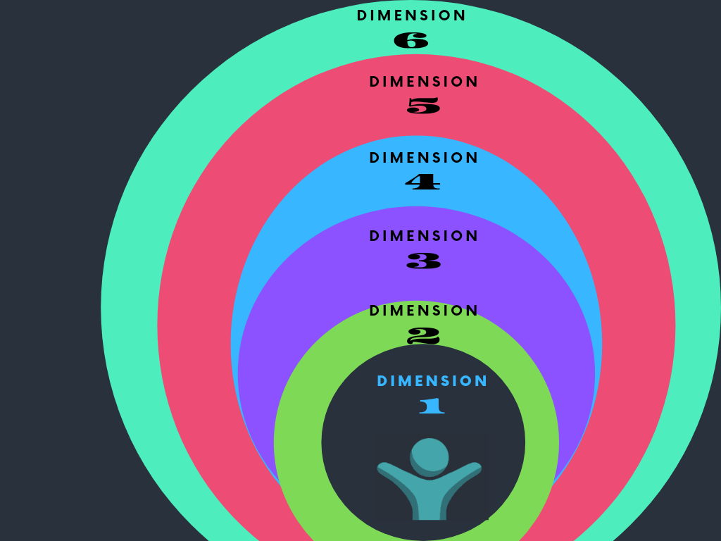
AI DESIGN & ARCHITECTURE by HUMAN- CENTRIC PRINCIPLE
12

Slide 13
13

Slide 14
AI FOR HEALTH
14
The focus toward to Sustainability on assure the human evolution for a safe and healthy future generation that considers the RECONCILIATION BETWEEN HUMANITY AND CLIMATE are urgent issues that require financial, technological and human resources.
Health involves international cooperation because it is global interest also includes strategies to management of data and A.I. algorithm.

Slide 15
16
THANK YOU !!!!
ANDREA ROMAOLI
andrea.garcia@fibree.org
Jan 2021

