Slide 1
FGAI4H-K-034
E-meeting, 27-29 January 2021
Source: | Editor
Title: | DEL04: AI software lifecycle specification – Progress Review
Purpose: | Information & Discussion
Contact: | Pat Baird, Philips | E-mail: pat.baird@philips.com
Abstract: | Information: This presentation contains a summary of DEL04 for new members. No additional edits have been made to DEL04 since meeting J. Discussion: I would like to request help from the team regarding risk management.

Slide 2
DEL04: AI software lifecycle specification
Provides a summary of existing software development lifecycle standards and how they could be applied for healthcare AI.
Intended audience includes people that may not be familiar with regulated healthcare environment and the applicable standards for software.
Includes supplemental suggestions from Xavier Health project that was focused on the product development lifecycle.

Slide 3
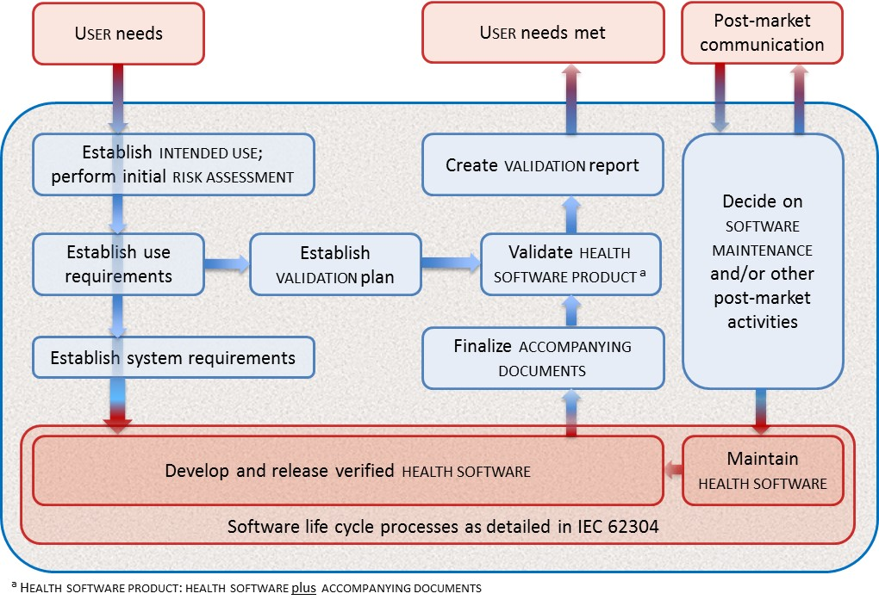
The primary standard for medical device software development is ISO/IEC 62304, and it has this lifecycle diagram
However, this standard was written when a software for a “medical device” was just one component of the entire product, and 62304 assumes that product-level testing is handled by another standard
So ISO/IEC 82304-1 was developed to include process steps like the intended use, validation that the product meets the intended use, post-market monitoring, etc.
However, there are still some additional factors; these have been identified in the Xavier work.

Slide 4
Lifecycle steps & references
ESTABLISH INTENDED USE ([82304-1])
PERFORM INITIAL RISK ASSESSMENT ([82304-1])
ESTABLISH USE REQUIREMENTS ([82304-1])
ESTABLISH SYSTEM REQUIREMENTS ([82304-1])
CREATE SOFTWARE PLAN(S) ([62304], [XAVIER])
SOFTWARE REQUIREMENTS ([62304], [XAVIER])
SOFTWARE ARCHITECTURE ([62304], [XAVIER])
SOFTWARE DETAILED DESIGN ([62304], [XAVIER])
SOFTWARE INTEGRATION, UNIT-LEVEL, INCLUDING TESTING ([62304], [XAVIER])
SOFTWARE INTEGRATION, INTEGRATION LEVEL, INCLUDING TESTING ([62304], [XAVIER])
SOFTWARE SYSTEM TESTING ([62304], [XAVIER])
SOFTWARE RELEASE ([62304], [XAVIER])
ESTABLISH VALIDATION PLAN ([82304-1])
VALIDATE THE PRODUCT ([82304-1])
CREATE VALIDATION REPORT ([82304-1])
MONITOR PRODUCT PERFORMANCE ([82304-1], [XAVIER])
MAINTAIN SOFTWARE AFTER LAUNCH ([82304-1])
RETIREMENT ([82304-1])
RISK MANAGEMENT (CONTINUOUS) ([82304-1], [XAVIER])
CHANGE CONTROL / PROBLEM RESOLUTION (CONTINUOUS) ([62304], [XAVIER])
CONFIGURATION MANAGEMENT (CONTINUOUS) ([62304], [XAVIER])

Slide 5
References:
IEC 62304:2006, Medical device software: software lifecycle process. https://webstore.iec.ch/publication/6792
Note that 62304 is in the process of being updated; I expect there to be a 2021 version released in the next few months.
IEC 82304-1:2016, Health software – Part 1: General requirements for product safety. https://www.iso.org/standard/59543.html
Xavier Health, Perspectives and Good Practices for AI and Continuously Learning Systems in Healthcare, August 2018, https://www.advamed.org/‌sites/default/files/resource/perspectives_and_good_practices_for_ai_and_continuous_learning_systems_in_healthcare.pdf (visited 2020-06-08)

Slide 6
New Thought!! Risk Management?
Risk Management & patient safety are obviously important in healthcare.
There are already existing standards regarding the risk management process for healthcare, and there are standards for risk management of software, but ML systems can fail in unique ways that people might not think about.
We (members of standards organizations) are starting a risk management standard to close this gap. We are reaching out to experts that we know.
It occurs to me that FGAI4H has many experts with experience in this field… I would love any input that team members would have regarding how ML fails & what mitigations you’ve put in place.

Slide 7
Questions..
What process / what means are available to collect wisdom from our subject matter experts?
Although originally intended to help accelerate the creation of an international standard, does the FGAI4H team want a deliverable? Perhaps a checklist of risks to consider when developing (and evaluating) a ML application?

