Slide 1
FGAI4H-K-033-A01
E-meeting, 27-29 January 2021
Source: | Dermatology AI for Global Health, USA
Title: | TG-Derma: Dermatology AI for global health (DAIGH) proposal for image recognition challenge for skin diseases – Att.1: Presentation
Purpose: | Discussion
Contact: | Lincoln Manzi | E-mail: dermatology.global.health@gmail.com
Abstract: | This PPT summarizes the content of K-033 for presentation and discussion during the meeting.

Slide 2
Executive Summary
Skin disease is a significant, and often under-appreciated, health care issue in the developing world
One component of an approach to better address skin disease burden in the developing world could be to use smartphones as diagnostic tools
We have assembled a dataset and built a proof-of-concept Deep Learning diagnostic system for several skin conditions prevalent in the developing world
Multi-participant challenges (e.g., ImageNet) have demonstrated the ability to produce rapid, dramatic improvements in image classification performance
We are seeking institutional partners to organize an initial skin disease image classification challenge focused on conditions prevalent in the developing world
This can be the starting point for the broader vision of developing and distributing free software to enable smartphones to support diagnosis of a wide range of health conditions in the developing world

Slide 3
The Burden of Skin Disease in the Developing World
Skin disease is a significant, and often under-appreciated, health care issue in the developing world
Skin disease is the 4th leading cause of nonfatal disease burden worldwide
Skin diseases represent approximately 2% of global burden of disease measured by disability-adjusted life years (DALYs)
Different skin conditions (e.g., melanoma and acne vulgaris) are leading contributors to burden of disease in wealthy countries versus those skin conditions (e.g., dermatitis and cellulitis) that are the largest contributors to disease burden in developing countries
There is a sparsity of physicians with dermatological training in many low and middle-income countries
Sources: Global Skin Disease Morbidity and Mortality, Karimkhani, et al (2017); Global Burden of Skin Disease: Inequities and Innovations, Seth, et al (2017)

Slide 4
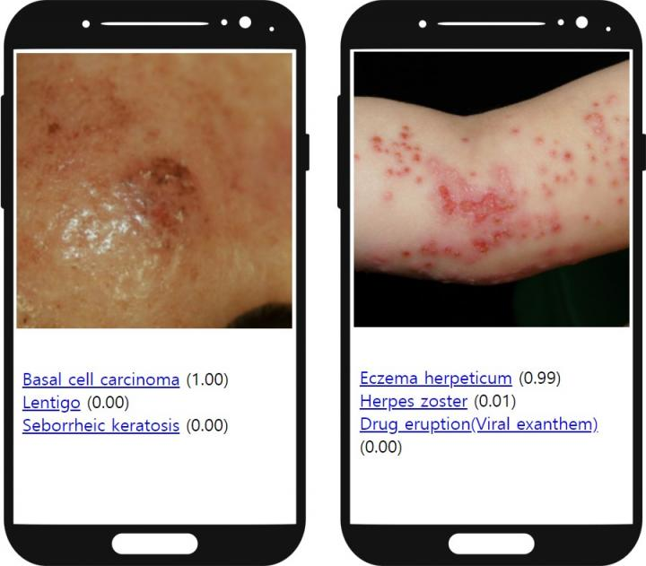
Concept of Smartphone Skin Diagnosis
One component of an approach to better address skin disease burden in the developing world is to use smartphone photos to help diagnose conditions and/or motivate remote clinician evaluation
Sources: Augmented Intelligence Dermatology, Han, et al (2020). Image Credits: SkinVision; Model Dermatology

Slide 5
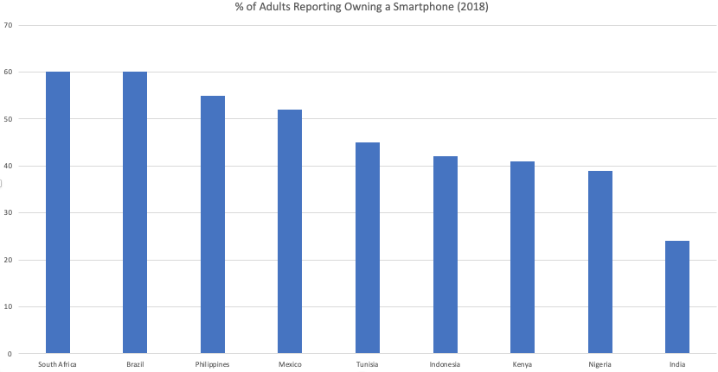
Smartphone Availability in Emerging Economies
Smartphones are widely and increasingly distributed in emerging economies
More than 700 million smartphone users in just these example countries in 2018
Smartphone user count grew an estimated 20% between 2018 and 2019 in these countries, resulting in an estimated 840 million users in these 9 countries in 2019
Conservatively, there are more than 1 billion smartphone users across all emerging economies in 2021
Sources: Pew Research Center Spring 2018 Global Attitudes Survey; Newzoo Global Mobile Market Report (2018 and 2019); DAIGH estimates

Slide 6
Results to Date
We have assembled a dataset and built proof-of-concept Deep Learning diagnostic system
Sourced ~20K of affected areas of skin with a wide variety of ethnicities and skin tones. Each image is annotated with one of 23 disease classifications by dermatologists
Constructed and tested numerous Deep Learning architectures to predict disease based only on images
Several commercial systems address a similar challenege(e.g., UMSkinCheck, MoleMapper, Miiskin, MoleScope and SkinVision ), but are focused on developed world conditions, especially melanoma
We focused on four conditions prevalent in the developing world: Scabies, ringworm, acne, and eczema
Best architecture achieved 80% accuracy on a held-out test set of images
US Patent 63/034564: "Image-Based Skin Disease Identification" (Pending)

Slide 7
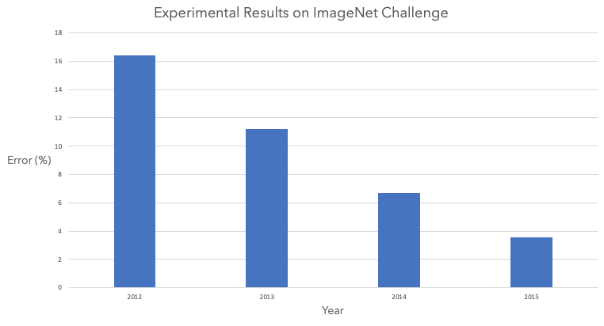
ImageNet Challenge: Deep Learning Model Performance Over Time
The annual ImageNet Large Scale Visual Recognition Challenge demonstrated that multi-participant challenges can produce rapid, dramatic improvements in image classification performance
Human Benchmark
Source: The History Began from AlexNet: A Comprehensive Survey of Deep Learning Approaches, Alom, et al (2018)

Slide 8
Skin Disease Classification Challenge
We are seeking institutional partners to organize an initial skin disease image classification challenge focused on skin conditions prevalent in the developing world
We can make available an open-sourced training dataset of ~18K annotated images with a stratified randomized hold-out test set of ~2K images that are available for non-commercial use with attribution
We can also make available the base architectures, code and results developed in support of our proof-of-concept
This can be the starting point for the broader vision of developing and distributing free software to convert the computational power and sophisticated sensors (camera, microphone, gyroscope, GPS, etc.) embedded in smartphones to support diagnosis of a wide range of health conditions in the developing world from heart disease to mental health

Slide 9
Thank You!
Questions?

