Slide 1
FGAI4H-K-028-A01
E-meeting, 27-29 January 2021
Source: | WHO
Title: | Draft Guidance document: Ethics and governance of artificial intelligence for health - Att.1: Presentation
Purpose: | Discussion
Contact: | Andreas Reis Chair, FG-AI4H WG-Ethics WHO | Email: reisa@who.int
 | Sameer Pujari Vice chair, FG-AI4H WHO | Email: pujaris@who.int
Abstract: | This PPT summarizes the content of K-028 for presentation and discussion during the meeting.

Slide 2




WHO Guidance on Ethics & Governance of AI for Health
Update for FG AI4H e-meeting
27-29 Jan 2021
Dr Andreas Reis, MD, MSc
Global Health Ethics and Governance Unit, WHO Geneva

Slide 3
WHO Global Health Ethics Unit and 13th GPW
" …WHO must be at the forefront of such new scientific fields and the ethical challenges they pose…. WHO is uniquely positioned to understand and tackle proactively the ethical, regulatory, professional and economic implications and to provide independent guidance with universal legitimacy to ensure that [Universal Health Coverage] is enhanced and not undermined by new scientific frontiers."

Slide 4
Developing Guidance for Ethics and Governance of AI in Health
Joint project of the Global Health Ethics Unit and Digital Health Department.
Consisted of in-person meeting in October 2019 and since has been a series of virtual meetings and expert testimony.
Goal to issue guidance document to Member States in Q1 2021.

Slide 5

Group Composition
20 international experts, participants & observers
Group balanced across WHO regions and includes academics, human rights experts, civil society, representatives of international organizations, industry and government.
Co-Chairs: Partha Majumder (India) & Effy Vayena (Switzerland)

Slide 6
Where are we now?
One face-to-face (Oct 2019) and several virtual meetings of the WHO Expert Group held (2020)
Numerous hearings of outside experts
Civil society consultation held (Oct. 2020)
Nov. 2020: First complete draft of the guidance was sent for external expert review
January 2021: Feedback received

Slide 7
Table of contents
1. Introduction
2. Describing artificial intelligence in health and medicine
3. Applications of artificial intelligence in health
4. Ethical challenges for the use of artificial intelligence in health care
  Assessing whether artificial intelligence should be used
  The use of artificial intelligence to achieve universal health coverage
  Artificial intelligence and the digital divide
  Data collection and use
  Accountability and responsibility for decision-making with artificial intelligence
  Autonomous decision-making
  AI, bias, and discrimination
  Impacts of AI on labour and employment (in health and medicine)
  Challenges with the commercialisation of health care using AI
5. Risks associated with the widespread adoption of AI for health
6. Existing governance frameworks that apply to AI in health
7. Key ethical principles for the use of AI in health
8. Liability regimes for AI in health

Slide 8
Table of contents
9. Elements of a governance framework for AI in health
Governance of AI across different health care contexts
Governance of data
Control and benefit sharing
Governance of the private sector
Governance of the public sector
Regulatory framework
International architecture and governance of AI in health
Medium and long-term considerations for governance of AI in health care
10. Building an ethical approach in practice for AI in health
Ethical and transparent design of technologies
Bills of rights
Research agenda
Engagement and role of the public and building trust with providers and patients
Public stewardship and oversight of health data
Impact assessments
Putting prediction to good use
Policy observatory and model legislation
Annex 1. Checklists for ethical use and oversight of AI in health:
- AI programers/designers
- MoH
- Care providers

Slide 9
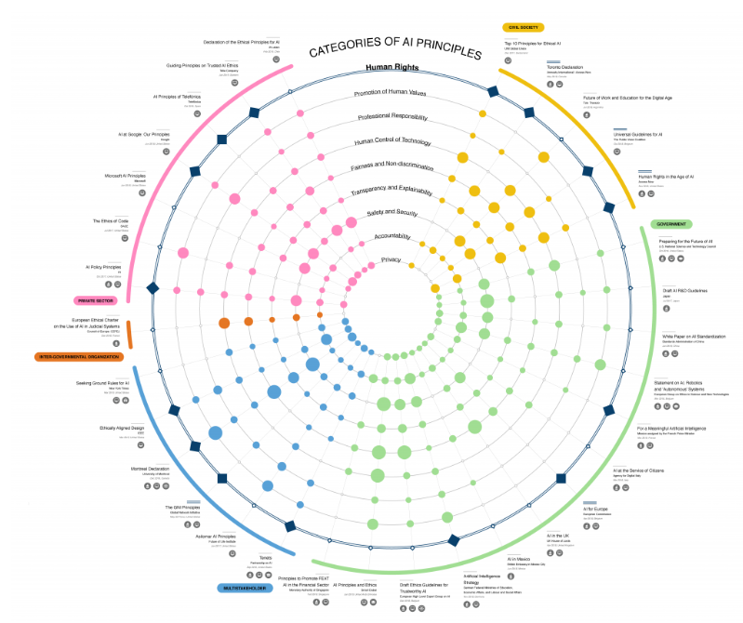
Principles for AI in health
One area of work for the expert group is to develop ethical principles for AI in health.
At present no international consensus principles for AI in health.
Source: https://cyber.harvard.edu/story/2019-06/introducing-principled-artificial-intelligence-project

Slide 10
Ethical Principles
Grounded in universal values (human dignity) and ethical requirements (do no harm, beneficence, autonomy, fairness/justice)
Human rights and ethical principles are interlinked.
Document enumerates core ethical principles, what they mean, and briefly how they can be implemented (recognizing other sections of report discuss implementation in-depth).

Slide 11
External evaluation group feedback
Feedback received from diverse set of reviewers:
NGOs: Access Now, Privacy International, medConfidential, KELIN (Kenya)
Academics: Meg Davis, Calvin Ho, Hannah Lim, Pamela Andanda, Juan Duran, Jay Shaw
Government: Osama El-Hassan (UAE), Anurag Aggarwal (India), Japan MOH (TBD)
Providers: International Council of Nurses, World Medical Association
TG AI4H

Slide 12
External evaluation group feedback
Overall excellent feedback
Some voiced concern over length, denseness of the report. Emphasised importance of Executive Summary.
Could improve ‘connectivity’ of Section 4 (ethical challenges), Section 7 (principles) and Section 9 (governance)
-> slight restructuring of the document

Slide 13
External evaluation group feedback
Balance of perspectives from US/EU versus rest of world
Tension’ between human rights and ethics
Strengthen discussion of and role of non-governmental organisations, community groups, non-commercial actors
There should be more concrete/clear recommendations for WHO, including role in risk assessment and mitigation.

Slide 14
External evaluation group feedback
Substantive issues
Uses of AI in health (refinement and sharpening needed)
Discussion of informed consent/consent-like mechanisms (for data and for use of AI in healthcare)
Liability
Forms of transparency that should be required for use of AI

Slide 15
Recommendations for WHO
Current report does not include many concrete recommendations for WHO (and other international agencies)
What should be key recommendations for WHO, ITU etc.?
What are the key international processes or partnerships related to AI in health (that should be of focus for WHO)?

Slide 16
Completion of guidance document
-1st half Feb 2021: revision of guidance document
End February: Review by Andreas/Chairs and legal review/editor’s review
March: Additional expert group discussion; finalisation of paper (layout etc).
Launch?
Dissemination and implementation?

Slide 17
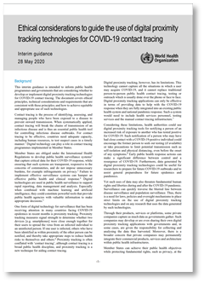
Other topics on the agenda
Digital proximity tracking and surveillance for COVID-10
Digital vaccination certificates
    Ethical Considerations to Guide the Use of Digital Proximity Tracking Technologies for COVID-19 Contact Tracing
    https://www.who.int/publications/i/item/WHO-2019-nCoV-Ethics_Contact_tracing_apps-2020.1

Slide 18
Acknowledgements
Sameer Pujari, WHO Digital Health
Rohit Malpani, WHO Consultant
WHO Expert Group on Ethics & Governance of AI
FG AI4H

Slide 19

Thank you very much!

