Slide 1
FGAI4H-K-024-A03
E-meeting, 30 September – 2 October 2020
Source: | TG-Diabetes Topic Driver
Title: | Att.3 - Presentation (TG-Diabetes)
Purpose: | Discussion
Contact: | Dr. Andrés Valdivieso Ahnfelt Director of Innovation Department in Anastasia.ai Santiago, Chile | Email: avaldivieso@anastasia.ai
Abstract: | This PPT summarizes the status of work within TG-Diabetes, for presentation and discussion during the meeting.

Slide 2
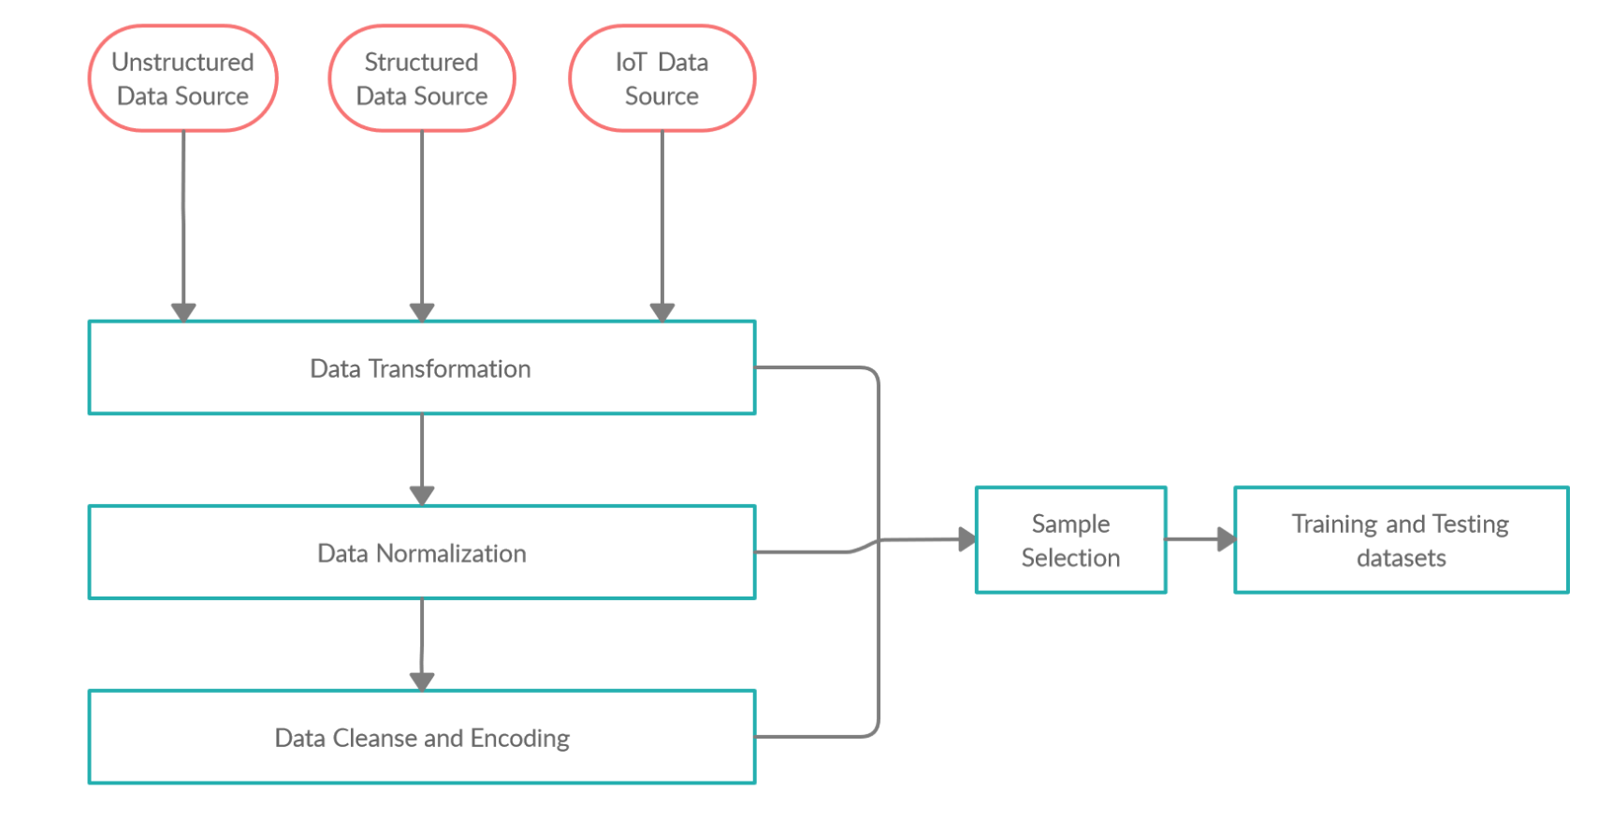

Slide 3
Martin Irrazaval Gutierrez (CEO)
Santiago Brunet Gutierrez (CTO)

