Slide 1
FGAI4H-K-021-A03
E-meeting, 30 September – 2 October 2020
Source: | TG-Symptom Topic Driver
Title: | Att.3 – Presentation (TG-Symptom)
Purpose: | Discussion
Contact: | Henry Hoffmann | E-mail: henry.hoffmann@ada.com
Abstract: | This PPT summarizes the progress made by the topic group on AI-based symptom assessment since meeting J.

Slide 2
Meeting K Update for the
Topic Group “Symptom Assessment”
E-meeting, 27–29 January 2021
Notes:
Hallo,
My name is Henry Hoffmann and it is now my pleasure to present you on behalf of our Topic Group an update on AI-based symptom assessment benchmarking.

Slide 3
AI-based Symptom Assessment
Mobile/Web Applications – sometimes called ”Symptom Checkers” that
Allow users to enter (INPUT)
Patient information (age, sex, …)
Current presenting Complaints (symptoms, free texts )
To then engage in a dialog similar to a doctor collecting (INPUT)
Additional symptoms, findings, factors, attributes, (lab, imaging, genetics, …)
To finally provide the user with (OUTPUT)
Pre-Clinical Triage (emergency, see doctor today, self-care … )
Differential Diagnosis (disease A 93%, B 73% - e.g. in ICD10, SnomedCT)
Additional diagnostic tests to perform, treatment advice, explanations
Notes:
Symptom assessment – is about applications, sometimes called „symptom checkers“ that,
Allow users to enter some current symptom they want to get advice for, for instance some sharp abominal pain
To then engage in an AI based diagog, mimicing the doctor-patient conversation to collect further symptoms, factors, attributes …
To finally provide the user with some advice that might be
A pre-clinical triage saying if it is ok to stay at home or if it is important to see a doctor at the same day
Some systems also list some differential diagnoses that might be the underlying causes for the patients symptoms
And the systems might also give further advice for instance on further tests, treatment or just some general explanations

Slide 4
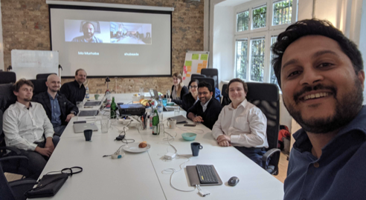
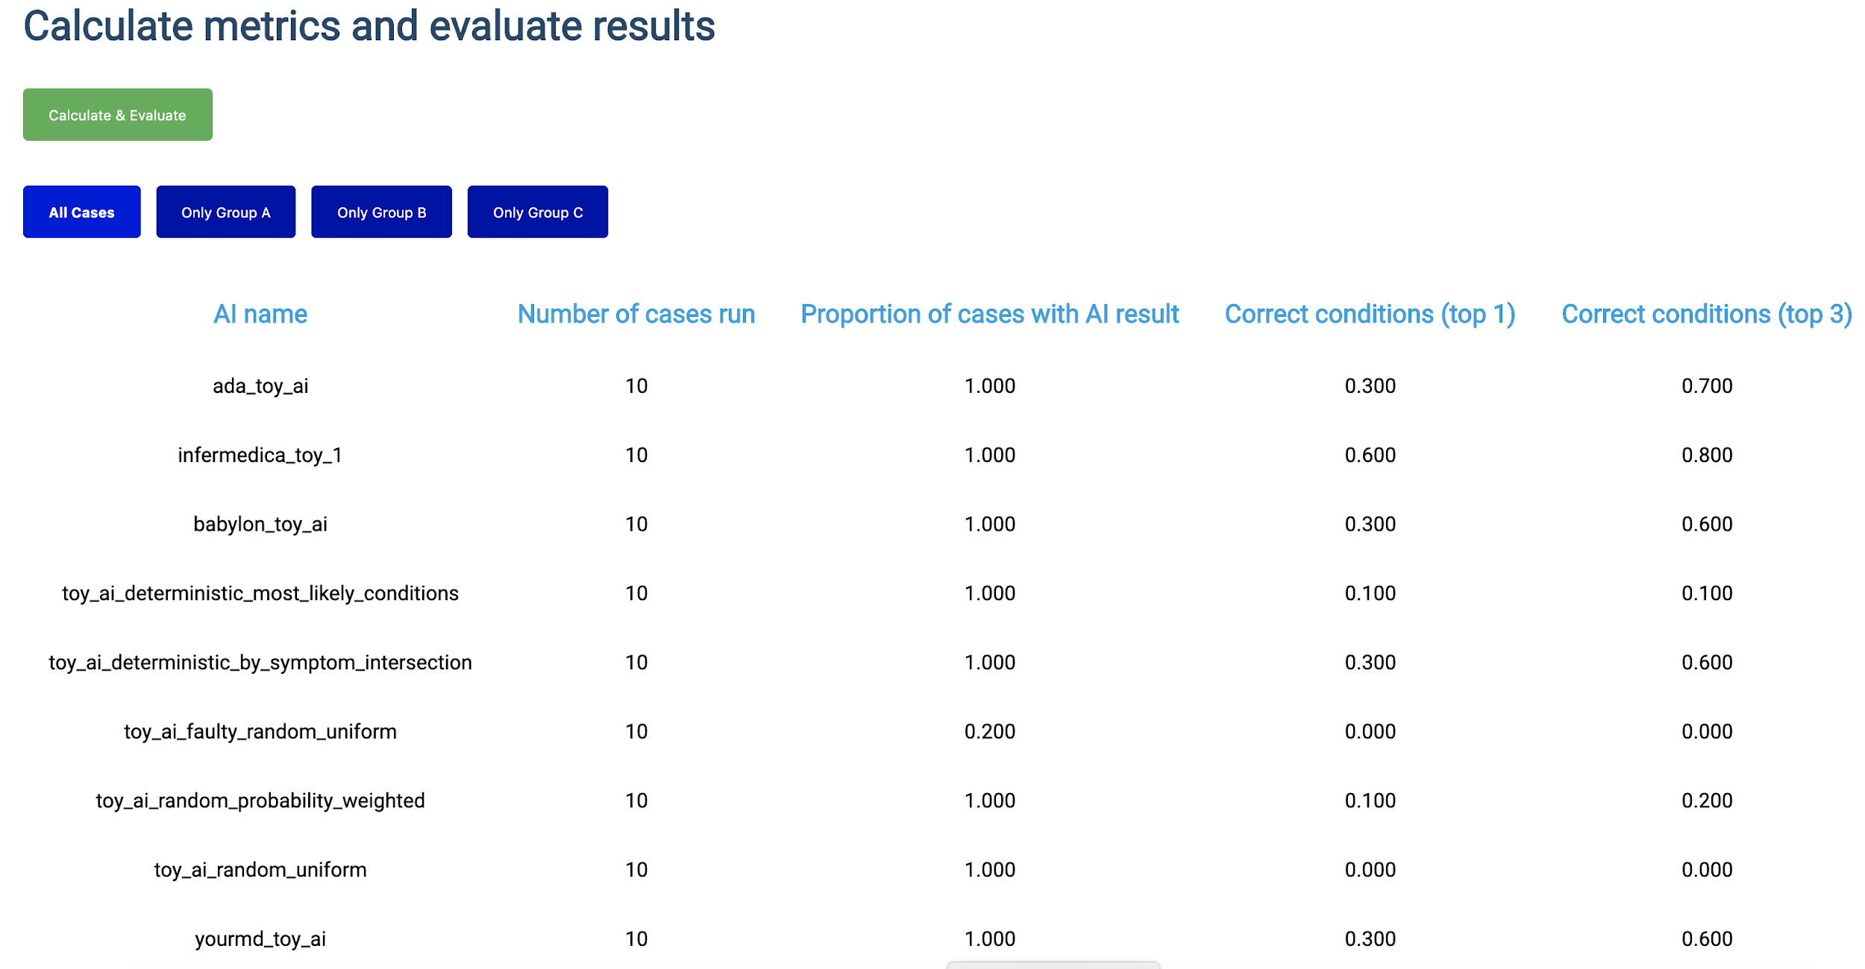
Journey & Approach
Meeting A – Geneva, 25-27 September 2018
A-020: Towards a potential AI4H use case "diagnostic self-assessment apps"
Meeting C – Lausanne, 22-25 January 2019
Topic Group created
Approach:
MMVB 1.0 … MMVB N.0 → MVB
Meeting F – Zanzibar 2-5 September 2019
First benchmarking with toy AI & toy Data
Minimal Minimal viable Benchmarking MMVB 1.0
Meeting G, H, I, J
Gradual increase of complexity by adding model details
Notes:
Such applications are use by millions of users worldwide
And if done right they can as some kind digital frontdoor to the health systems make the systems more efficient by navigating patients to the right solution at the right time
But, as most AI systems in the focus group there was no standardized benchmarking for such systems yet
An so, right from the beginning in Meeting A we worked on creating such benchmarking
In Meeting C then the current Topic Group was officially created and start its work
We following here a stepwise approach.
As you know there are many companies involved already having internal benchmarking, an so here it is more about agreeing on system that can benchmark all system
For this we need to create a whole new benchmarking system which is much easiert to do if everyone can see and work on all parts of the benchmarking software which is obviously not possible with the real production Ais
Also for debugging it is better to start with small toy model with only a few conditions and symptoms
The idea is then to increase the complexiy step by step, usually in workshops where we agree on the next level of complexity, until we are then ready for prime-time, benchmarking the real Ais with real data
So, we presented a first toy benchmarking at meeting F
And since then are in the phase of stepwise increasing the complexity

Slide 5
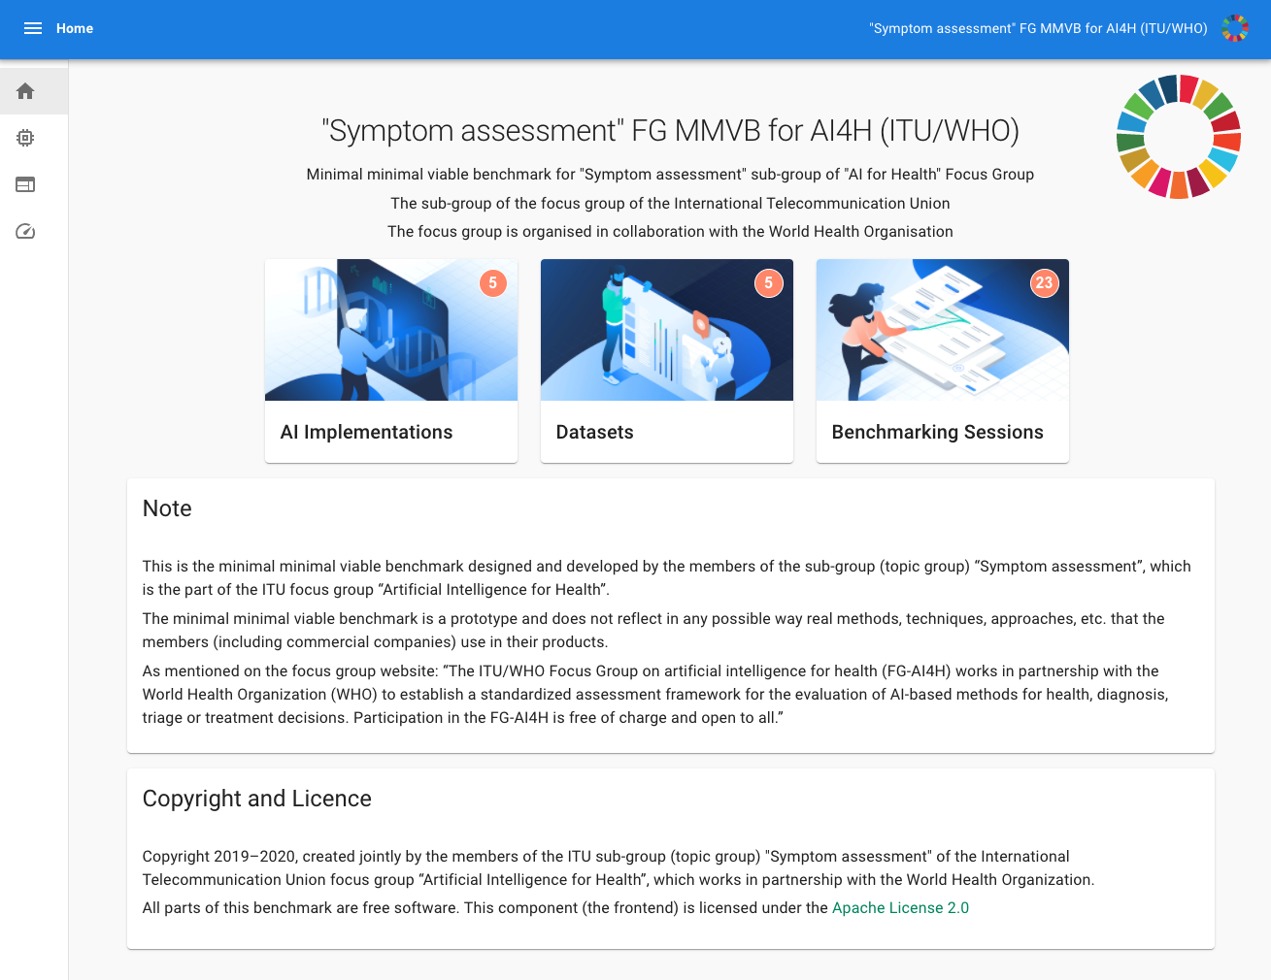
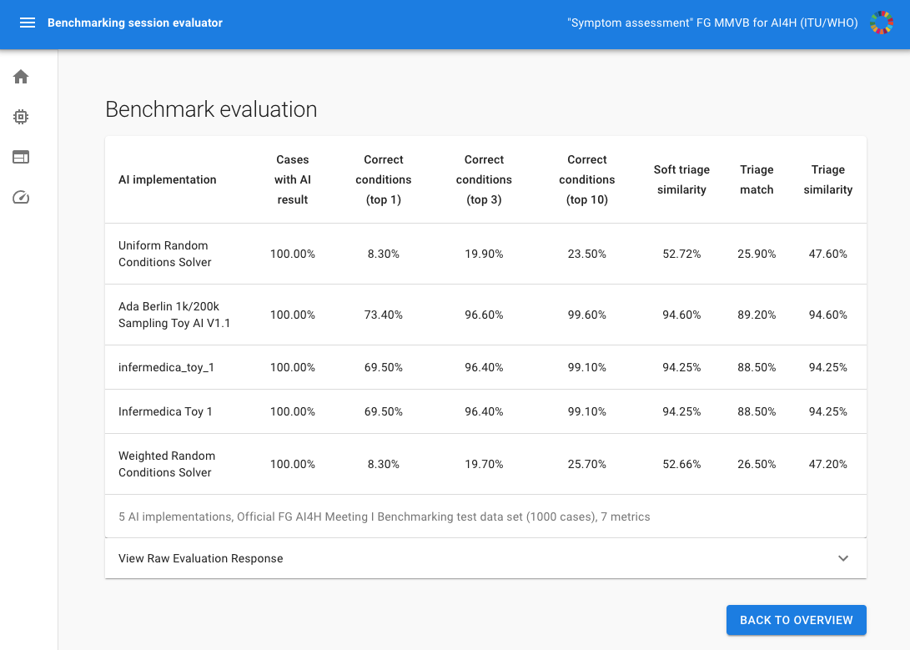
Status of the Benchmarking System
Finished MMVB 2.2 for Meeting
Based on the „Berlin Model“
Special focus on Attributes + Factor distributions
Benchmarking platform
Django Backend
JS React Frontend
Annotation Tool
Toy Ais
We added some more AIs since meeting J
Ada, Babylon, Infermedica, Your.MD
Implementation work paused
Focus on ontology
See in which direction the Open Source group goes
Notes:
The Topic group has now 15 companies, with xund.ai recently joining thats one more than last time
Since last meeting Pritesh Mistry, Alejandro Osornio, Salman Razzaki and Yura Perov joined as individual contributors supporting the group, making it a total 6
We have 2 sub-topic groups
One on Self-assessment
and one on clinical symptom assesment
Currently both sub-topics work together on the first benchmarking
Once this is done we will split the workstreams to take care of the sub-topic details

Slide 6
Status of the Ontology Work
Every Topic Group member has an own Benchmarking System
Essential for development work
Similar metrics
Similar cases
Completely different encoding
Core Task of the Topic Group
Agree on how to encode case data for benchmarking
Simple for diseases
Possible for symptoms/findings
Difficult for attributes
Current Assumption
It is possible to use Snomed
Notes:
The Topic group has now 15 companies, with xund.ai recently joining thats one more than last time
Since last meeting Pritesh Mistry, Alejandro Osornio, Salman Razzaki and Yura Perov joined as individual contributors supporting the group, making it a total 6
We have 2 sub-topic groups
One on Self-assessment
and one on clinical symptom assesment
Currently both sub-topics work together on the first benchmarking
Once this is done we will split the workstreams to take care of the sub-topic details

Slide 7
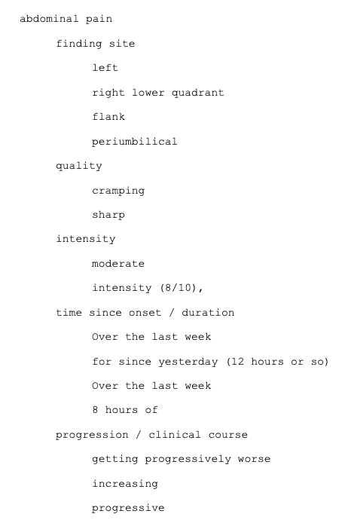
Status of the Ontology Work
Workshop #3 (12.-13.11.2020)
Procedure for agreeing on ontologies
Next MMVB iteration Ais
Next MMVB and MVB Disease sets
Available Resources, Metadata,
Current Approach / Learnings
We will try out the alignment process on a small subset
Use same 11 abdominal pain Berlin model diseases
Extend it to ALL related symptoms
TG doctors create cases
For each symptom
Collect and harmonize relevant features (filling up where needed)
Encode them with aproporate pre/post coordination using snomed
Exploring processes for negotiating different perspectives
Encoding then all the cases in the defined ontology subset update MMVB
Notes:
The Topic group has now 15 companies, with xund.ai recently joining thats one more than last time
Since last meeting Pritesh Mistry, Alejandro Osornio, Salman Razzaki and Yura Perov joined as individual contributors supporting the group, making it a total 6
We have 2 sub-topic groups
One on Self-assessment
and one on clinical symptom assesment
Currently both sub-topics work together on the first benchmarking
Once this is done we will split the workstreams to take care of the sub-topic details

Slide 8
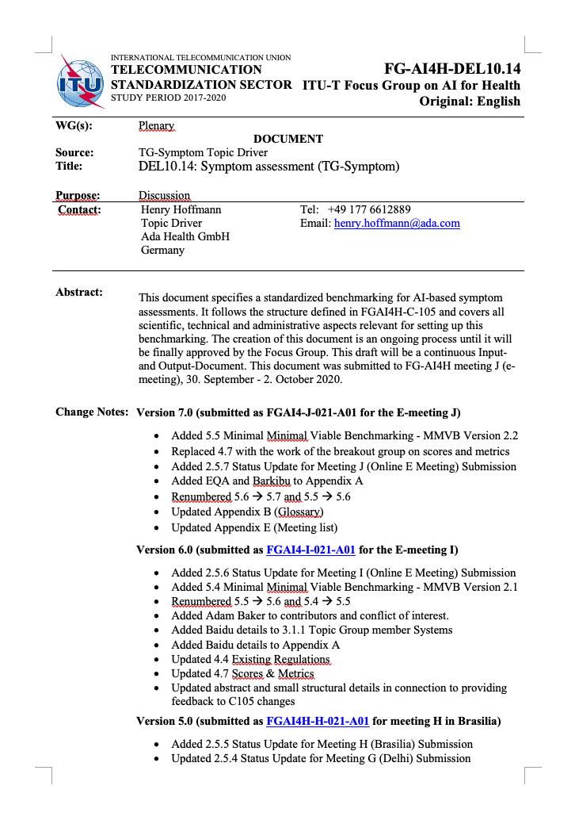
Status of the Non-Technical Work
TDD Template Contribution
Integrating Feedback from the FG together with Eva Weicken and Markus Wenzel
Migration of TG-Symptom TDD started
Chapters 1, 2, 3, 6.1
Chapters 4,5 started in a distributed way in the TG
Taking notes on template impovements/bugs
Missing 6.2-6.4, 7, 8
Other FG Interaction
Review + Feedback of ethics document FGAI4H-K-028
Continued exchange with the Open Source group
Notes:
The Topic group has now 15 companies, with xund.ai recently joining thats one more than last time
Since last meeting Pritesh Mistry, Alejandro Osornio, Salman Razzaki and Yura Perov joined as individual contributors supporting the group, making it a total 6
We have 2 sub-topic groups
One on Self-assessment
and one on clinical symptom assesment
Currently both sub-topics work together on the first benchmarking
Once this is done we will split the workstreams to take care of the sub-topic details

Slide 9
General Status of the Topic Group
Topic Group Members:
Companies (17+1):
1DOC3, Ada, Babylon, Baidu, Barkibu, Buoy, Deepcare, EQL, Infermedica, Inspired Ideas, Isabel Healthcare, mfine, MyDoctor, PNP, Symptify, Visiba Care, xund.ai, Your.MD
Independent contributors (6):
Reza Jarral, Thomas Neumark, Muhammad Murhaba, Pritesh Mistry, Alejandro Osornio, Salman Razzaki
Sub-Topic Groups
Self-assessment
Clinical symptom assessment
fgai4htgsymptom@lists.itu.int 104 (5 more)
8 Online meetings since meeting J (All with minutes/protocols in SharePoint)
Notes:
The Topic group has now 15 companies, with xund.ai recently joining thats one more than last time
Since last meeting Pritesh Mistry, Alejandro Osornio, Salman Razzaki and Yura Perov joined as individual contributors supporting the group, making it a total 6
We have 2 sub-topic groups
One on Self-assessment
and one on clinical symptom assesment
Currently both sub-topics work together on the first benchmarking
Once this is done we will split the workstreams to take care of the sub-topic details

Slide 10
Next Steps until Meeting L
Continue Ontology Work
Encode the symptoms collected from the case vignettes
Define reproducible agreement process
Encode cases using FHIR the chosen SNOMED subset
(trying it out in our benchmarking platform)
TDD & Outreach
Complete the transition to the new TDD structure
Implement a TG-Symptom MMVB 2.2 showcase with the Open Source group
Review the refined ethics document
…
Notes:
The Topic group has now 15 companies, with xund.ai recently joining thats one more than last time
Since last meeting Pritesh Mistry, Alejandro Osornio, Salman Razzaki and Yura Perov joined as individual contributors supporting the group, making it a total 6
We have 2 sub-topic groups
One on Self-assessment
and one on clinical symptom assesment
Currently both sub-topics work together on the first benchmarking
Once this is done we will split the workstreams to take care of the sub-topic details

Slide 11
Thank you!
WHO/ITU FG AI4H TG Symptom Assessment
Meeting K Update
E-meeting, 27–29 January 2021

