Slide 1
FGAI4H-K-018-A03
E-meeting, 30 September – 2 October 2020
Source: | TG-Outbreaks Topic Driver
Title: | Att.3 – Presentation (TG-Outbreaks) [Same as Meeting J]
Purpose: | Discussion
Contact: | Stéphane Ghozzi & Auss Abbood Robert Koch Institute Germany | Email: GhozziS@rki.de ; AbboodA@rki.de
Abstract: | This PPT summarizes the status of work within TG-Outbreaks, for presentation and discussion during the meeting.

Slide 2
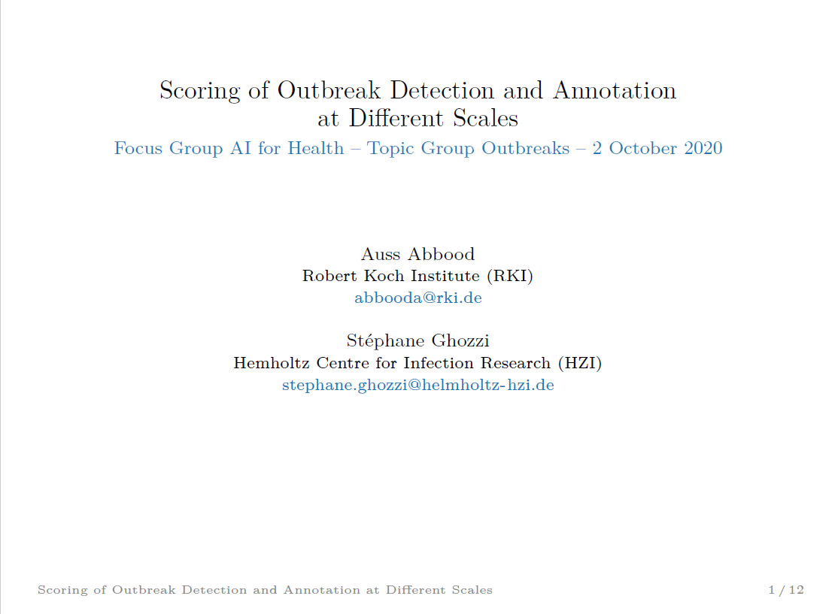

Slide 3
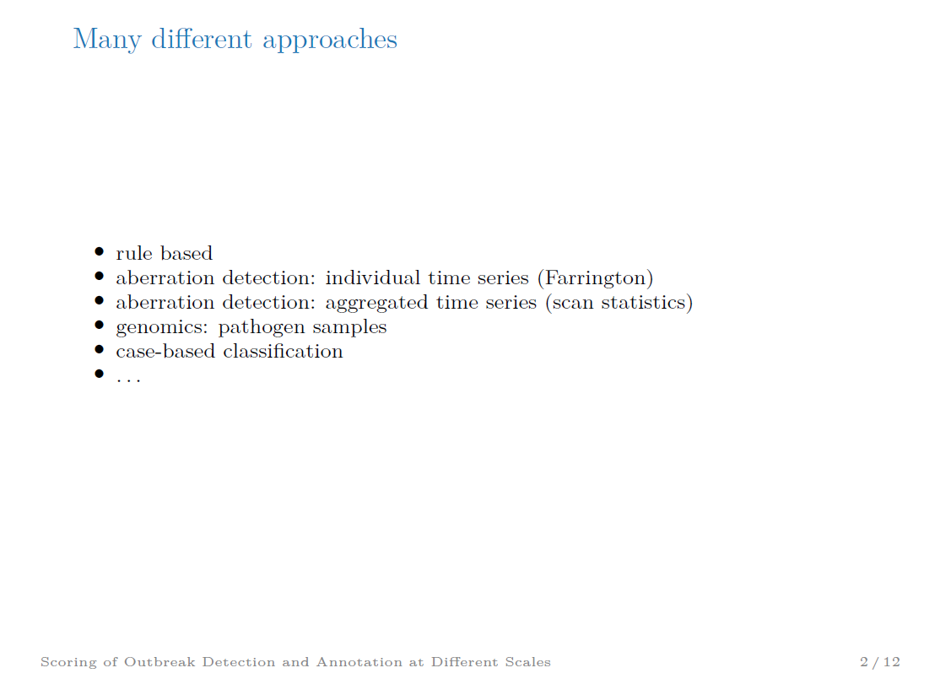

Slide 4
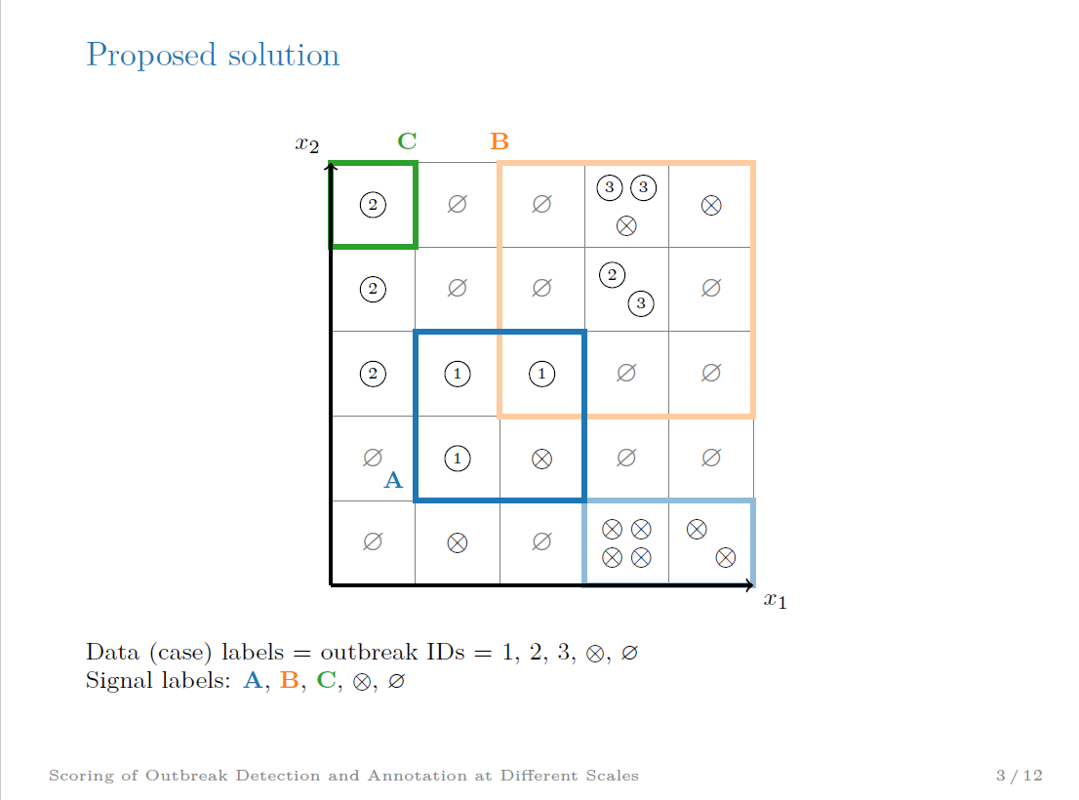

Slide 5
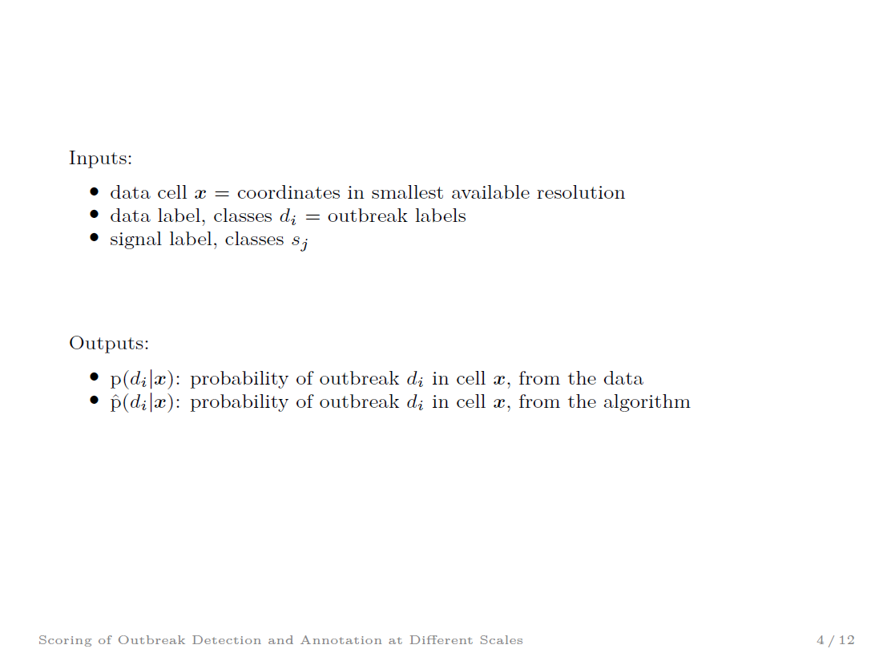

Slide 6
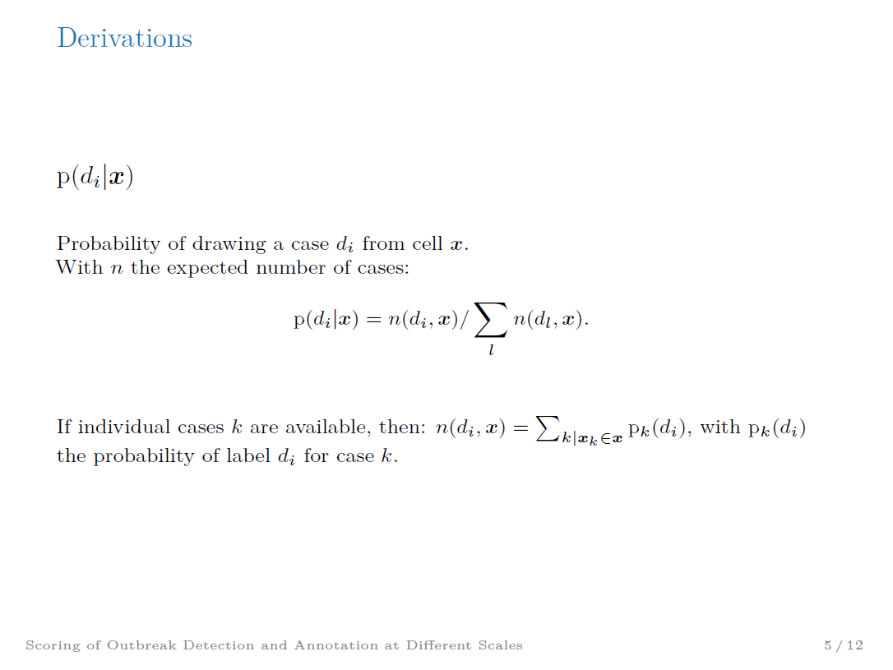

Slide 7


Slide 8
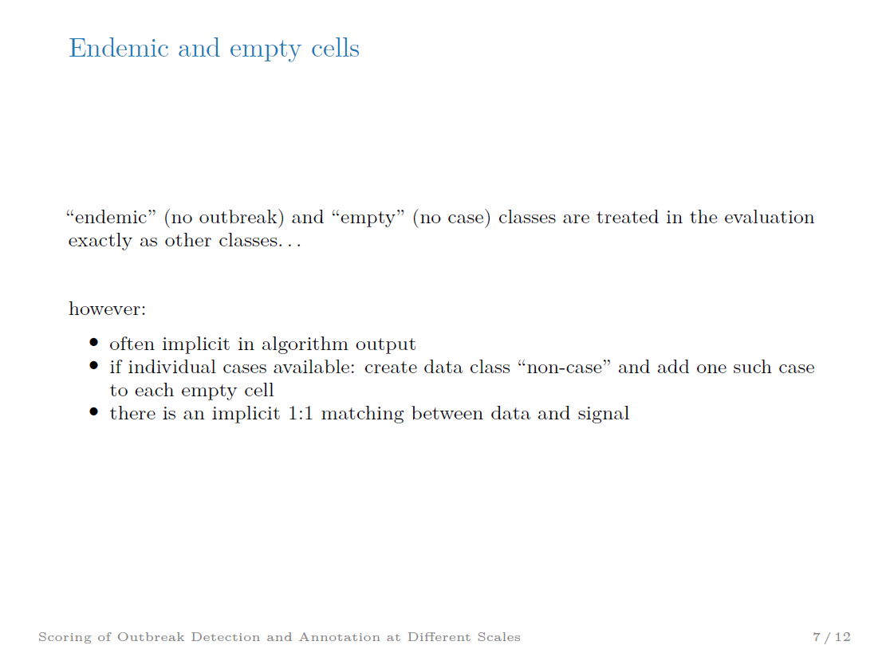

Slide 9


Slide 10
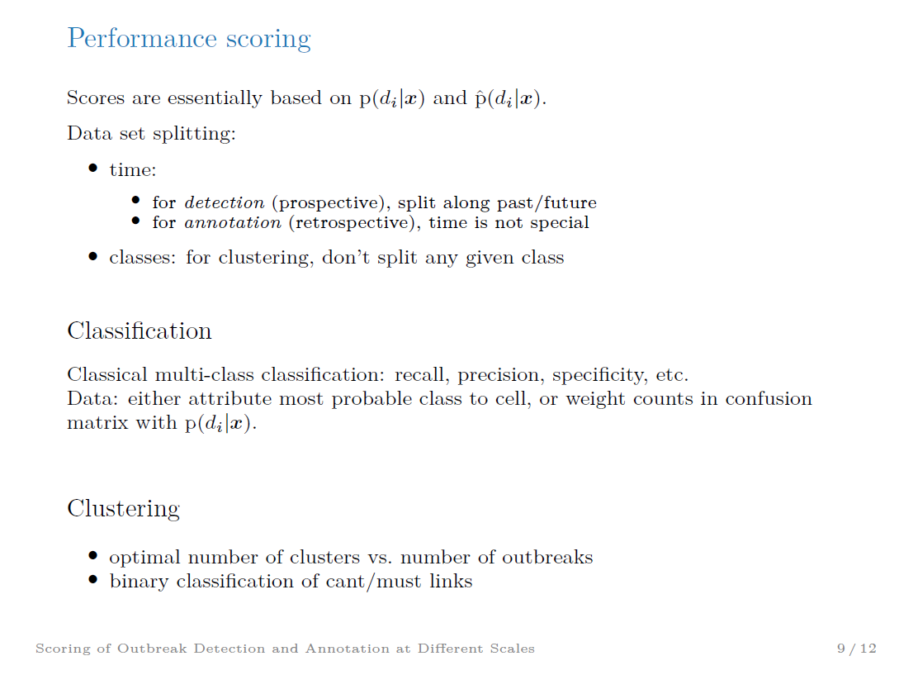

Slide 11
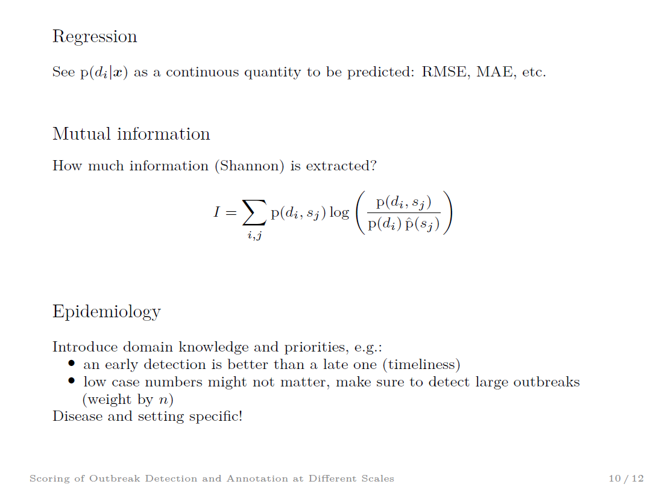

Slide 12


Slide 13


