Slide 1
FGAI4H-K-012-A03
E-meeting, 30 September – 2 October 2020
Source: | TG-Falls Topic Driver
Title: | Att.3 - Presentation (TG-Falls)
Purpose: | Discussion
Contact: | Pierpaolo Palumbo TG-Falls Topic Driver University of Bologna Italy | E-Mail: pierpaolo.palumbo@unibo.it
Contact: | Inês Sousa Associação Fraunhofer Portugal Research – Fraunhofer AICOS Portugal | Tel: +351 220 430 326 Email: ines.sousa@fraunhofer.pt
Abstract: | This PPT summarizes the status of work within TG-Falls, for presentation and discussion during the meeting.

Slide 2
AI4H TG-Falls among the elderly
29th January 2021

Slide 3
Overview
Introduction
About the topic group
Topic description
Ethical considerations
Existing work in benchmarking
Benchmarking by the topic group
Overall discussion of the benchmarking
Regulatory considerations
Next steps

Slide 4
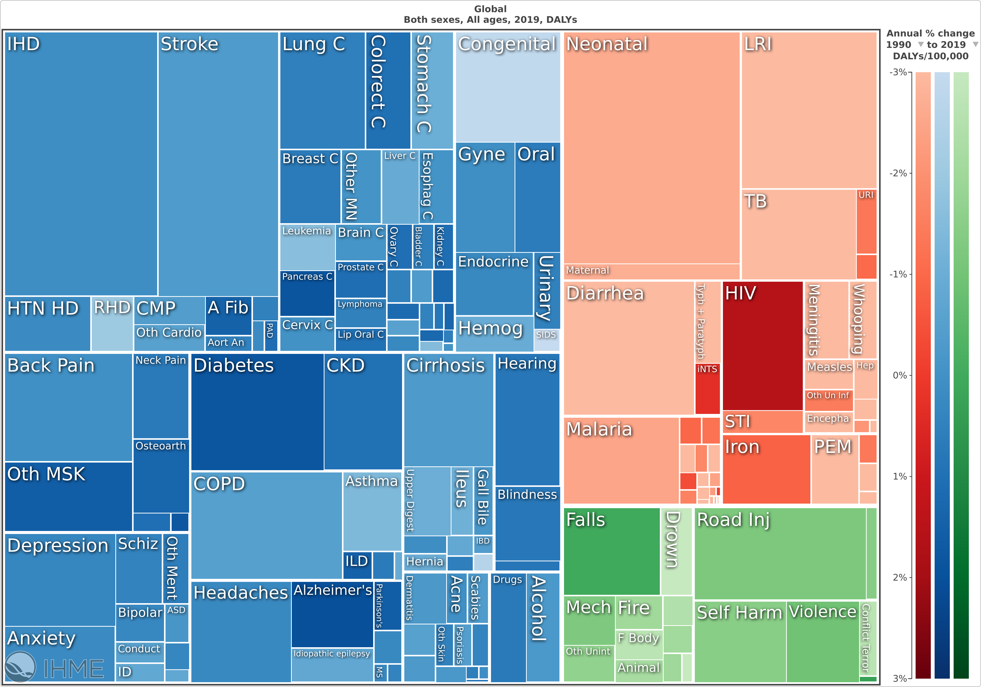
Introduction
falls
Global Burden of Disease, 2019, https://vizhub.healthdata.org/

Slide 5

About the topic group
Meeting B (Lausanne) – meeting K (e-meeting)
fgai4htgfalls@lists.itu.int
EU Falls Festival 2021 --> 2022
People (contributors or showing interest)
  Inês Sousa, Fraunhofer AICOS, Portugal
  Pierpaolo Palumbo, University of Bologna, Italy
  Stefania Bandinelli, SOC Geriatria – USL Toscana Centro, Italy
  Barry Greene, Chief Technology Officer, Kinesis Health Technologies, Ireland
  Arnab Paul, CEO Patient Planet, WHO Roster of Expert – DigitalHealth, India
  Salman Khan, Assistant Professor in the department of electrical engineering, University of Engineering and Technology Peshawar, Pakistan
  Kim van Schooten, PhD, Human Frontier Science Program Postdoctoral Fellow, Conjoint Senior Lecturer, UNSW Medicine, UNSW Ageing Futures Institute, Australia

Slide 6
Topic description
AI tasks
Current gold standards
Relevance and impact
Existing AI solutions

Slide 7
Topic description - AI tasks
  Fall prediction:
    Subject-specific risk score of falling, within a given time window in the future, given information about the subject’s risk factors for falls and/or their balance or motor ability
  Fall detection

Slide 8
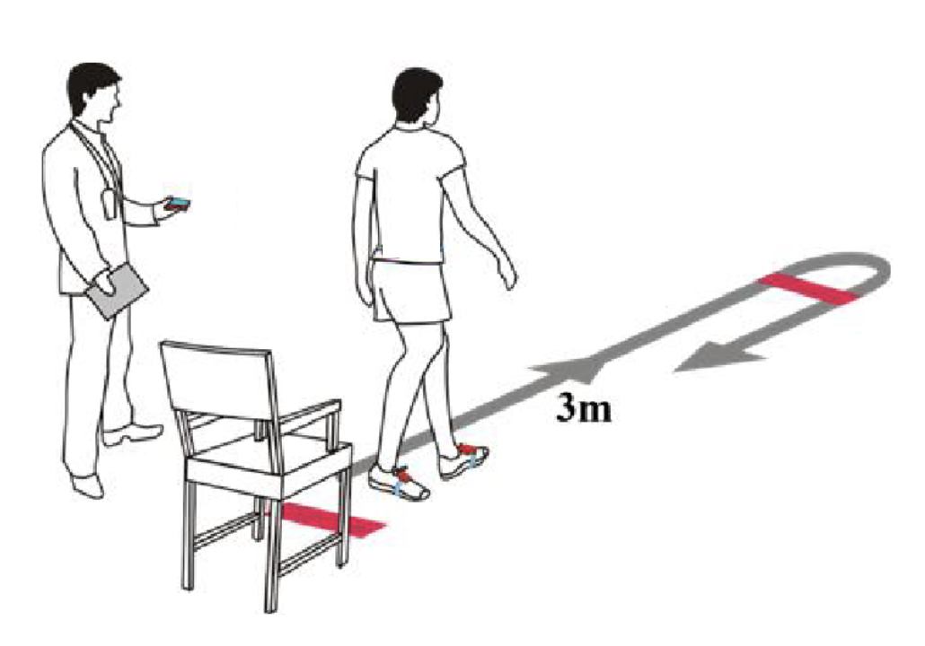
Topic description – current gold standards
Timed Up and Go Test (TUG)
[1] E. Barryet al., “Is the Timed Up and Go test a useful predictor of risk of falls in community dwelling older adults: a systematic review and meta- analysis.,” BMC Geriatr., 2014.
[2] D. Schoene et al., “Discriminative ability and predictive validity of the timed up and go test in identifying older people who fall: systematic review and meta-analysis.,” J. Am. Geriatr. Soc., 2013.

Slide 9
Topic description – current gold standards
AGS/BGS screening algorithm
[1] Panel of Falls in Older Persons American Geriatrics Society and British Geriatrics Society, “Summary of the Updated American Geriatrics Society/British Geriatrics Society clinical practice guideline for prevention of falls in older persons.,” J. Am. Geriatr. Soc., 2011.
[2] P. Palumbo et al., “Simulating the effects of a clinical guidelines screening algorithm for fall risk in community dwelling older adults,” Aging Clin. Exp. Res., 2018.

Slide 10

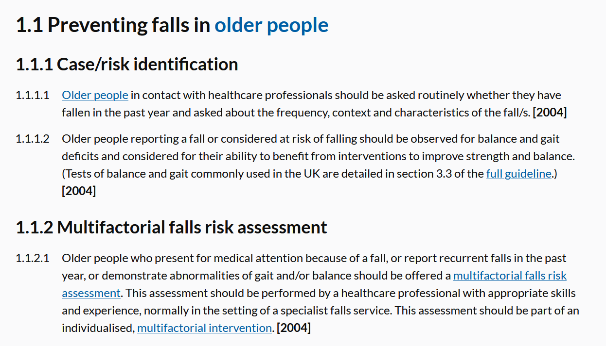
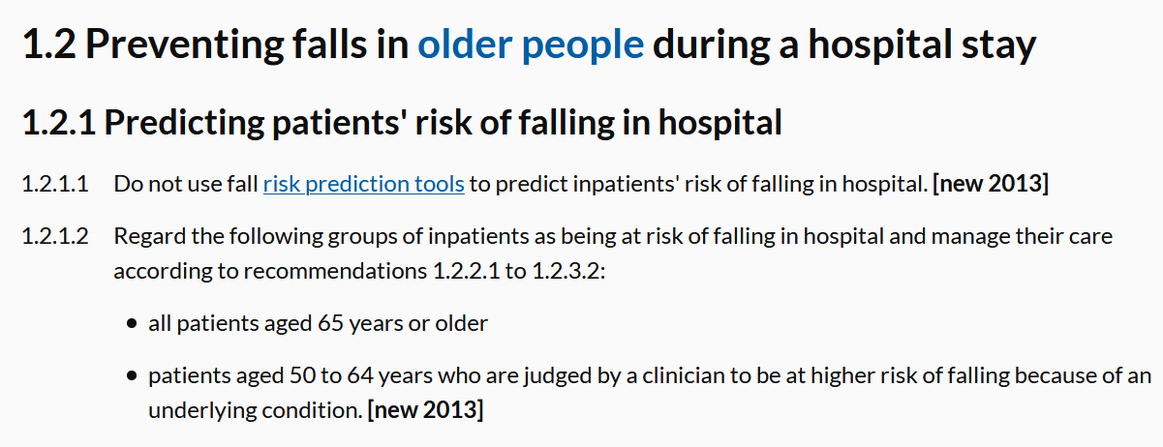
Topic description – current gold standards
https://www.nice.org.uk/guidance/cg161

Slide 11
Topic description – existing AI solutions
Sensor data
Clinical data
Clinical + sensor data
[1] J. Howcroft et al., “Review of fall risk assessment in geriatric populations using inertial sensors.,” J. Neuroeng. Rehabil., 2013.
[2] T. Shany, et al., “Review: Are we stumbling in our quest to find the best predictor? Over-optimism in sensor-based models for predicting falls in older adults,” Healthcare Technology Letters, 2015.
[3] B. R. Greene et al., “Digital assessment of falls risk, frailty, and mobility impairment using wearable sensors,” npj Digit. Med., 2019.
[4] J. R. Silva et al., “Fusion of Clinical, Self-Reported, and Multisensor Data for Predicting Falls,” IEEE J. Biomed. Heal. Informatics, 2019, doi: 10.1109/JBHI.2019.2951230.

Slide 12
Ethical considerations
TBC
“…fear of falling is also a risk factor for falls, thus an indication of the presence of high fall risk should be accompanied by a plan for mitigation of this risk and comprehensive explanation of preventive measures”

Slide 13
Existing work on benchmarking
Review on traditional tools
External validation studies
[1] D. Schoene et al., “Discriminative ability and predictive validity of the timed up and go test in identifying older people who fall: systematic review and meta-analysis.,” J. Am. Geriatr. Soc., 2013.
[2] A. Tiedemann, et al. “The QUICKSCREEN tool--a validated falls risk assessment, developed and implemented in Australia for use in primary care,” Inj. Prev., 2012.
[3] P. Palumbo et al., “Predictive Performance of a Fall Risk Assessment Tool for Community-Dwelling Older People (FRAT-up) in 4 European Cohorts,” J. Am. Med. Dir. Assoc., 2016.

Slide 14
Benchmarking by the topic group
Overview
Benchmarking methods
  System architecture
  System dataflow
  Safe and secure system operation and hosting
  Benchmarking process
AI input data structure for the benchmarking
AI output data structure
Test data label/annotation structure
Scores and metrics
Test dataset acquisition
Data sharing policies
Baseline acquisition
Reporting methodology
Result
Discussion
Retirement

Slide 15
Benchmarking by the topic group – AI I/O, labels
INPUT
The data shall be a collection of diverse datasets.
The datasets should contain information on acknowledged and/or putative fall risk factors (either clinical or sensor-based).
The datasets could have records with missing values.
The subjects represented in the datasets should be older adults (or also other subjects with increased fall risk, e.g. Parkinson’s disease patients?).
The variables of the datasets should be named as much as possible with harmonized conventions. Standard nomenclatures to consider could be: ICD-10, SNOMED, ICF, ATC for drugs, etc.
Each dataset could be openly accessible, undisclosed, or partly accessible and partly undisclosed.
Each dataset should be accompanied by documentation with a protocol on data collection methods.
Others…
OUTPUT
The algorithms should produce one or more of the following subject-specific outputs:
  the probability of falling at least once in a future time window
  the expected number of falls in a future time window
  an ordered, fuzzy label for the risk of falling (e.g., low, medium, high)
The length of the time window for fall prediction should be 6, 12, or 24 months (?)
Additionally, the algorithms could provide indications on possible preventive interventions to take.
LABELS
Number of falls experienced by the subject within a time window after the assessment of the risk factors that constitute the input data
The time window could be of 6, 12, or 24 months

Slide 16
Benchmarking by the topic group – scores and metrics
Each AI system shall be evaluated on each dataset, according to multiple figures of merit, in a multi-dimensional evaluation grid
The figures of merit should include: sensitivity, specificity, accuracy, positive and negative predictive values, and area under the ROC curve (AUC)
AI systems that issue a probabilistic prediction, should also be evaluated for calibration (which figure of merit?)

Slide 17
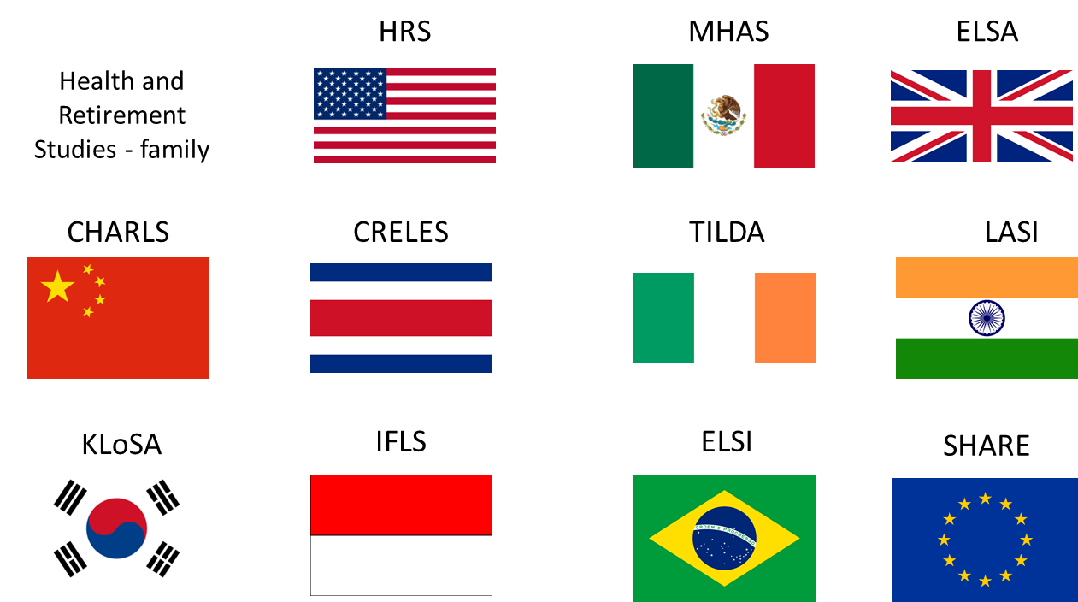


Benchmarking by the topic group – dataset acquisition
FallSensing
Clinical + sensor data
Undisclosed
N=403
InCHIANTI
Clinical + sensor data
Available to all interested researchers upon agreement
Clinical data
Publicly available
[1] A. C. Martins et al., “Multifactorial Screening Tool for Determining Fall Risk in Community-Dwelling Adults Aged 50 Years or Over (FallSensing): Protocol for a Prospective Study.,” JMIR Res. Protoc., 2018.
[2] L. Ferrucci et al., “Subsystems contributing to the decline in ability to walk: bridging the gap between epidemiology and geriatric practice in the InCHIANTI study.,” J. Am. Geriatr. Soc., 2000. http://inchiantistudy.net/wp/
[3] https://g2aging.org/

Slide 18
Regulatory considerations
TBD
Existing applicable regulatory frameworks
Regulatory features to be reported by benchmarking participants
Regulatory requirements for the benchmarking system
Regulatory approach for the topic group

Slide 19
Next steps
Increase intra-TG communication/collaboration
Increase collaboration with WGs
Progress on the TDD

Slide 20
Thank you

