Slide 1
FGAI4H-J-055
E-meeting, 30 September – 2 October 2020
Source: | Editors
Title: | DEL02: AI4H regulatory best practices - Progress Review
Purpose: | Discussion
Contact: | Shada Alsalamah WHO | E-mail: alsalamahs@who.int
Abstract: | This presentation contains an overview of DEL02 - Regulatory Considerations on AI for Health and recent updates, for discussion at the FG-AI4H e-meeting, 30 September – 2 October 2020.

Slide 2



Working Group on Regulatory Considerations on AI for
Health (WG-RC)
DEL 02: Regulatory Considerations on AI for Health
Shada Alsalamah, PhD
World Health Organization
FG AI4H - 30 September 2020

Slide 3
WG-RC DEL 02- Purpose & Scope
A high-level overview of key regulatory considerations for the use of AI in health.
A resource that can be considered by regulators, developers, and other stakeholders.
Not intended to be a guidance, regulation, or policy.
Dialogue between developers and regulators to establish a common understanding around the use of the AI solutions in health

Slide 4
Topic Areas for Regulatory Considerations*
Documentation and Transparency
Risk Management and Lifecycle Approach
Data Quality
Analytical and Clinical Validation
Engagement and Collaboration
Data Protection and Information Privacy
* These topic areas are not fully inclusive

Slide 5
WG-RC Progress & Aim of Today’s Presentation
May 4-5, 2020 (Last meeting)
o Proposed an outline describing suggested topics for regulatory considerations on AI for Health.
Sep 30, 2020 (Today’s meeting)
  Present a brief update on each topic since last meeting.
  Receive early feedback from FG members.
  Present next steps towards a final DEL 02.

Slide 6
1/6 Documentation and Transparency
Essential for AI solutions and systems that may be subject to regulatory review.
Regulators
  Trace back the development process & have evidence and trusted documentation of essential steps and decision points.
Systems
  Protect against data manipulation & malicious attacks
  Track and record access and changes applied as appropriate.

Slide 7
1/6 Documentation and Transparency
Allows for independent re-creation of the approach and key decision points
Establishes trust among all stakeholders, in the product/tool, and in the development process
Enables audits by regulatory entities as appropriate
Incorporates lessons learned and continuous improvement

Slide 8

1/6 Documentation and Transparency*
Terminology
  Transparency
  Documentation
Considerations
  Quality Continuum
  Pre-specification
  Risk-based approach and proportionality
* Reflecting work-in-progress - terminology and other elements will likely be updated

Slide 9
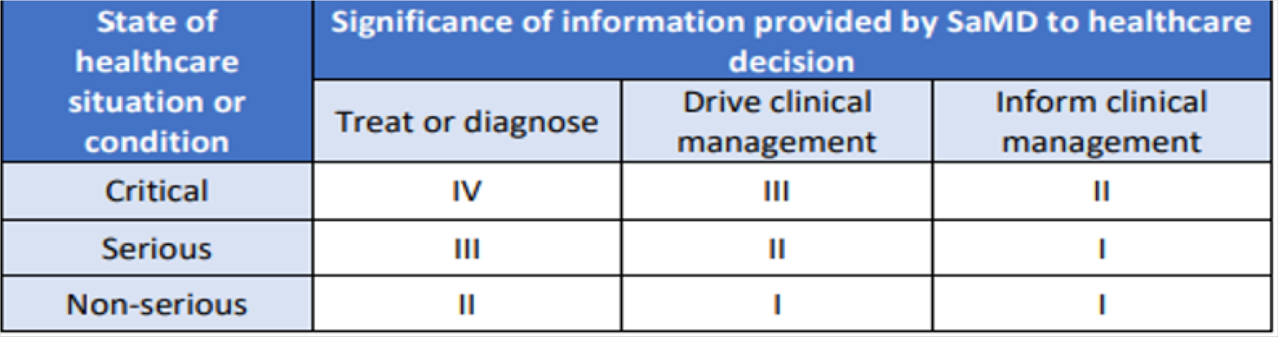

2/6 Risk Management and Lifecycle Approach
Putting in place the controls and counter measures to ensure that an AI solution functions as expected while minimizing any risk should be proportional to the risks that could be imposed if the AI solution were to malfunction.
Developers need to consider the intended use of the AI solution and the clinical context, if appropriate, to evaluate the level of risk.
SaMD IMDRF risk categorization

Slide 10
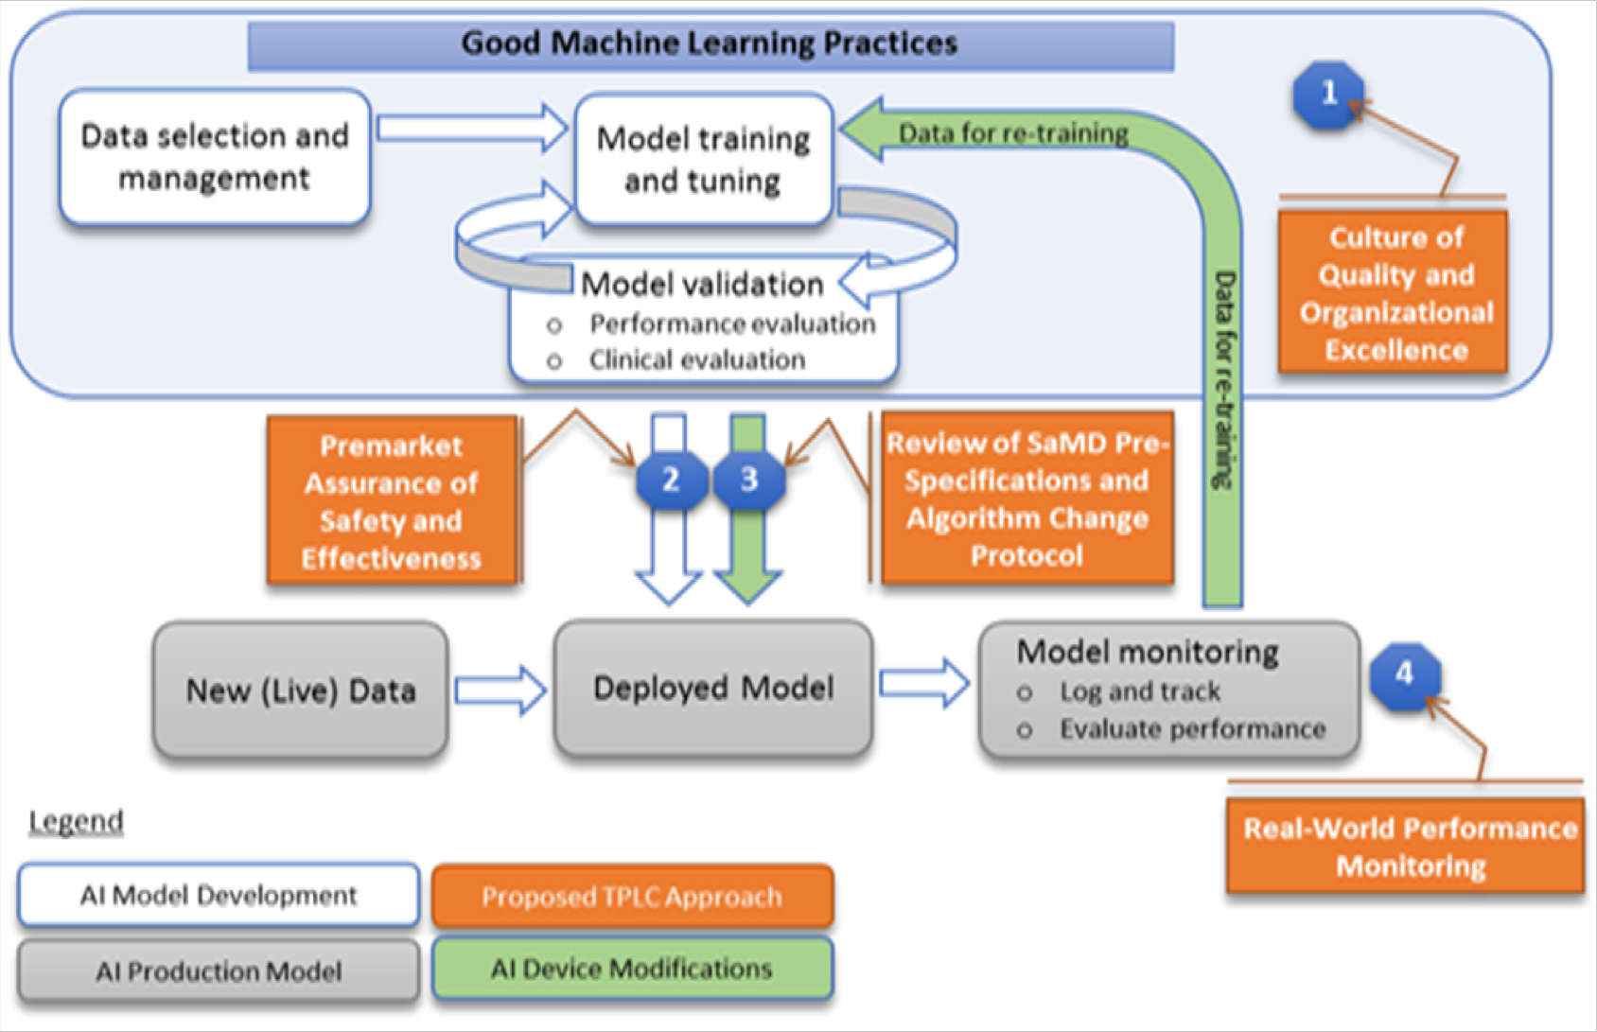
2/6 Risk Management and Lifecycle Approach
Total Product Lifecycle Approach
Facilitate continuous learning and product improvement while providing effective safeguards
Overlay of FDA’s TPLC approach on AI/ML workflow

Slide 11
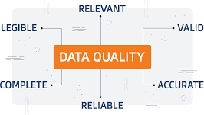
3/6 Data Quality
Harmonizing data from different sources, standards, and formats into a coherent dataset(s) is especially challenging.
A number of factors that may affect the quality of health data.

Slide 12
3/6 Data Quality
Careful design or prompt troubleshooting can potentially enhance any
possible harm if data quality issues are identified early.
Stakeholders should create data ecosystems to facilitate the sharing of good-quality data sources to mitigate the unique data quality issues.

Slide 13
4/6 Analytical and Clinical Validation
Developers should understand the complexity of the clinical and/or public health context in which this AI solution will be utilized
Regulators should cover the principles of safety, effectiveness, and performance
Perform well-documented technical and clinical validation steps throughout AI solution lifecycle.
  Technical/analytical validation (How accurate the solution is)
  Clinical validation (If it improves clinical outcomes)
  System validation (If the solution delivers the intended outcomes)

Slide 14
5/6 Engagement and Collaboration
How do regulatory bodies approach engagement and collaboration?
How does this engagement and collaboration impact clinical outcomes?
How can we nurture development of engagement and collaboration strategies in resource-limited settings?

Slide 15
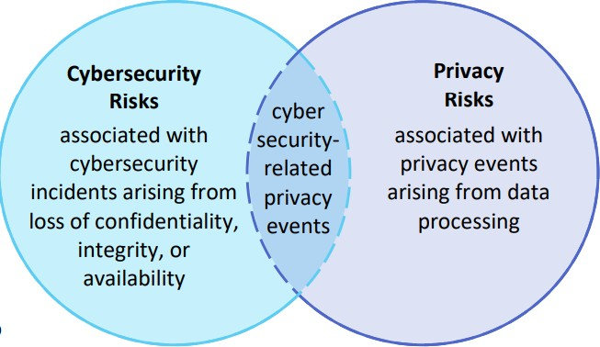
6/6 Data Protection and Information Privacy
Key Concepts
  Privacy
  Data Protection
  Health Data
Considerations
  Quality Continuum
  Risk Assessment
  Annotated Notes and Audit Trial
  Cybersecurity
NIST Privacy Framework – Cybersecurity and Privacy Risk Relationship

Slide 16


6/6 Data Protection and Information Privacy
Health data sources for AI solutions (What needs to be protected?)
Regulatory landscape (How it should be protected?)
Developers and their companies should
  Gain an understanding of applicable data protection regulations and information privacy laws
  Consider the different jurisdictions’ regulations and laws
  Stay current on new laws and requirements

Slide 17
Next Steps Planned for 2020
Targeted Month | Planned Milestones/ Deliverables
October | Develop DEL02 1st Draft Share with the whole WG-RC group Meet for discussion and feedback (tentative 25-26 Oct)
November | Finalize DEL 02 Receive written feedback from whole WG-RC group Internal check with contributors’ organizations
December | Present it at FGAI4H meeting Welcome written feedback from FG members Submit to WHO editors Receive final approval from WG-RC group after editing Publish DEL02

