Slide 1
FGAI4H-J-053-A01
E-meeting, 30 September – 2 October 2020
Source: | Editors
Title: | Updated DEL 7.4 Clinical Evaluation of AI for health – Att.1: Presentation
Purpose: | Discussion | Information
Contact: | Naomi Lee Shubhanan Upadhyay Eva Weicken | E-mail: naomi.lee@lancet.com shubs.upadhyay@ada.com eva.weicken@hhi.fraunhofer.de
Abstract: | This PPT contains an update of DEL 7.4 – output document of the Working Group on Clinical Evaluation of AI for health.

Slide 2
Why?
Benchmarking: measuring comparative performance of AI tools
Clinical stakeholders: So What? Utility, Impact
Outputs:
Bring together expert clinicians and academics
Deliverable 7.4
Input to each TG on big picture considerations
Where does benchmarking fit in overall terrain of Clinical Evaluation?

Slide 3
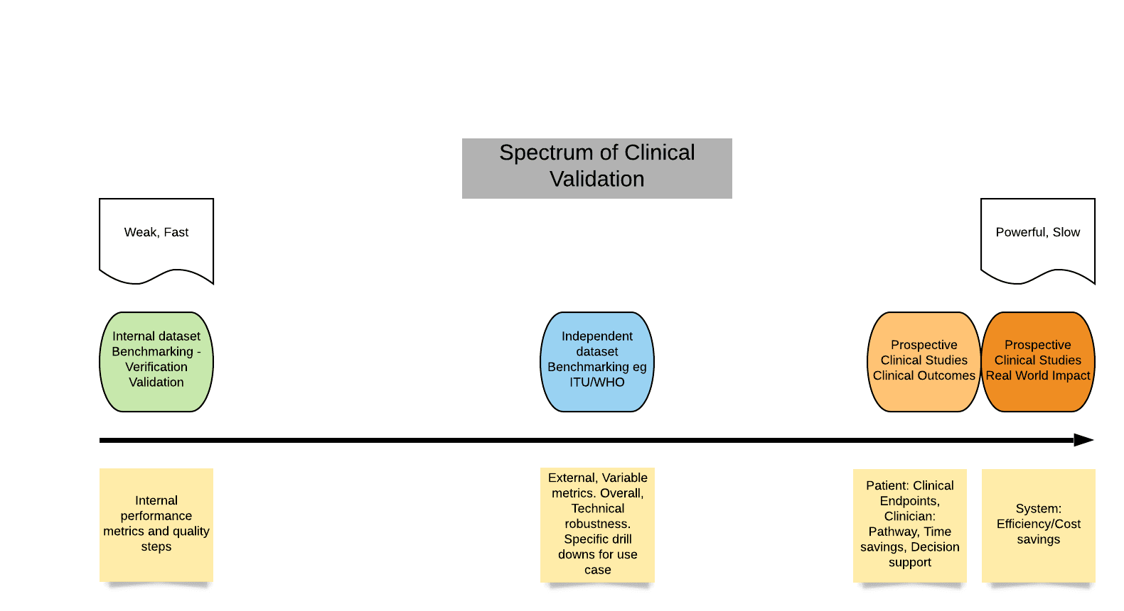
Spectrum of Clinical Evaluation
One possible approach

Slide 4
Specific issues
Phases of evaluation
Efficacy and comparative efficacy
Safety
Generalisability/Bias and Inclusiveness
Evaluation adaptive/learning models
Reporting of evaluation (following EQUATOR)
Clinically meaningful endpoints
Post deployment surveillance (overlap with regulation)
Specific considerations for low- and middle-income settings
Collaboration and engagement

Slide 5
Draw on current evaluation frameworks
EQUATOR
CONSORT AI and SPIRIT AI reporting guidelines
IMDRF SaMD: Clinical Evaluation
Strong examples: Digital health scorecard, Model facts labels

Slide 6
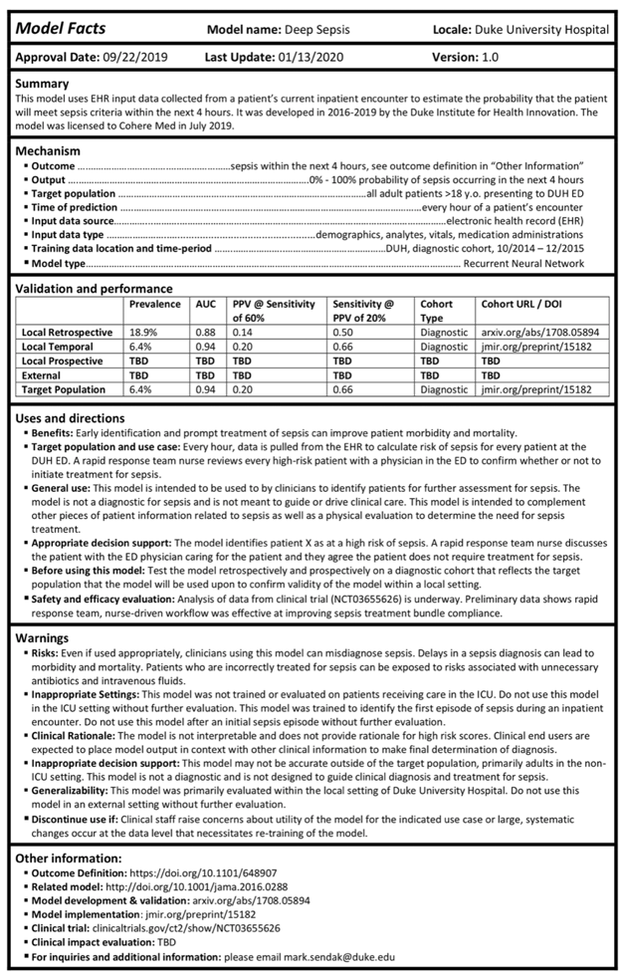
Model facts labels
Sendak, M.P., Gao, M., Brajer, N. et al. Presenting machine learning model information to clinical end users with model facts labels. npj Digit. Med. 3, 41 (2020)

Slide 7
Work to date
Update Working group on Clinical evaluation
ToRs
Deliverable 7.4 (version 2)
20 members by Sept. 2020
Workshop on Clinical Evaluation, 14 Oct 2-6 pm CEST

Slide 8
Next steps …
Online Workshop on
Clinical Evaluation
14 October 2020, 2-6 pm CEST
Register here: https://itu.zoom.us/meeting/register/tJMsdu2qrj4sHdFp-4N-RH4tmopJOPBL7hh3

Slide 9
… See you at the Clinical Evaluation Workshop 14 Oct ☺
Join us!
Co-chairs:
Naomi Lee, Lancet
Shubhanan Upadhyay, Ada Health GmbH
Eva Weicken, Fraunhofer HHI
Please contact: eva.weicken@hhi.fraunhofer.de

