Slide 1
FGAI4H-J-051
E-meeting, 30 September – 2 October 2020
Source: | Editors
Title: | DEL01: AI4H ethics considerations - Progress Review
Purpose: | Discussion
Contact: | Andreas Reis Ethics & Governance Unit Research for Health Department Division of the Chief Scientist World Health Organization | Email: reisa@who.int
Abstract: | This PPT contains a progress review of DEL01: AI4H ethics considerations.

Slide 2
Ethics & Governance of AI for Health: Update
Dr Andreas Reis, MD, MSc Co-Lead, Health Ethics & Governance Unit, WHO Geneva

Slide 3
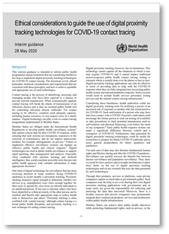
COVID-19
Ethical Considerations to Guide the Use of Digital Proximity Tracking Technologies for COVID-19 Contact Tracing
https://www.who.int/publications/i/item/WHO-2019-nCoV-Ethics_Contact_tracing_apps-2020.1

Slide 4
Developing Guidance for Ethics & Governance of AI for Health
Virtual meeting on role of big tech companies held in August
• Partial draft of WHO guidance on ethics & governance of AI completed
• Expert group plenary meeting on 7-8 September held
• 1st draft being finalized
• Looking for volunteers for external peer review (in November)

Slide 5
Developing Guidance for Ethics & Governance of AI for Health
Table of contents
1. Introduction
2. Describing artificial intelligence in health and medicines
3. Applications of artificial intelligence in health
4. Ethical challenges for the use of artificial intelligence in health care
5. Risks associated with the widespread adoption of AI for health
6. Existing governance frameworks that apply to AI in health
7. Key ethical principles for the use of AI in health
8. Liability regimes for AI in health
9. Elements of a governance framework for AI in health
10. Building an ethical approach in practice for AI in health
Annex: Checklists for ethical use and oversight of AI in health: Designers, MoH, health care providers

Slide 6
Thank you very much!

