Slide 1
FGAI4H-J-044-A01
E-meeting, 30 September – 2 October 2020
Source: | Editors
Title: | Updated DEL09 – Att.1: Presentation
Purpose: | Discussion | Information
Contact: | Manjeet Singh Chalga Scientist-C, ICMR, India | E-mail: manjeetchalga@gmail.com, chalgams.hq@icmr.gov.in
Abstract: | This PPT contains a presentation of J-044.

Slide 2
FG-AI4H-G-209
DEL-09 : AI4H Applications and Platforms
Manjeet Singh Chalga
Scientist-C, ICMR, India
+91-95827 76792
manjeetchalga@gmail.com, chalgams.hq@icmr.gov.in

Slide 3
Objectives:
to prepare the rules for development of AI tool for Health using Mobile Applications & Cloud Applications
to provide a forum for open communication among various stakeholders,
to discuss on technology, security and legal issues related to these AI tools
to coordinate the benchmarking process in collaboration with the Focus Group management and working groups.

Slide 4
Key features required for development of AI tool for Health using Mobile Application
Simple Registration
Minimal Introduction
Training Instructions
Simplified user interface
Functionality
Performance
Security Validation
Positive Discontinuation

Slide 5
Key features required for development of AI tool for Health using Mobile Application
PAS 277:2015 Health and wellness apps. Quality criteria across the life cycle. Code of practice
Good practice guidelines on health apps and smart devices (mobile health or mhealth)
Guiding Principles of Practice and Transparency for Mobile Health Solutions (CTA-2073)

Slide 6
Types of Mobile Application
Native App : The App that has been developed and distributed to run on a specific platform and updated via an app repository associated with that platform.
Web based App : Websites which are created to look like a native app but it actually run at a web browser software running on a mobile.
Hybrid App : These are the apps which are installed as a native app, however, their functionality is delivered from a web browser.

Slide 7
Types of Mobile Application for Health
Health Awareness Apps : mostly native or web based apps to give awareness about a particular disease.
Apps with associated medical devices : Apps associated with some diagnostic tools and designed to serve for a specific disease.
Apps for disease surveillance : There are disease specific standard questionnaires asked to know the prevalence of a disease or any problem relation to treatment seeking behaviour of the patients.

Slide 8
Designing of Apps for disease surveillance
Such Apps mostly contains repeated pattern of questionnaire.
Basic data types used for storing data in a server are character, varchar, numeric, float, date, datetime and logical.
Questionnaire consists of Questions with Text input, Radio button, Check Box, Date input, Time input and List Box.
One question may link to another question

Slide 9
Designing of Apps for disease surveillance
A mechanism is designed to laydown the complete questionnaire in a predefined format in Excel/ a simple database namely questionnaire_detail
Each row contains details about following :
Tablename
Fieldname
Text of Question
Type_of_field
Size_of_field
Type_of_question
Option_text
Option_code
Enable/Disable field
Page_no

Slide 10
Designing of Apps for disease surveillance
Tablename : cancer_survey
Fieldname : name_of_patient
Text of Question : What is the Name of Patient?
Type_of_field : varchar
Size_of_field : 50
Type_of_question : EditText
Option_text / Option_code : Not Applicable
Enable/Disable field : Nil
Page_no : 01

Slide 11
Designing of Apps for disease surveillance
Tablename : cancer_survey
Fieldname : gender_of_patient
Text of Question : Gender of Patient
Type_of_field : numeric Size_of_field : 11
Type_of_question : Radio Button
Option_text : Male Option_code : 1
Enable field : q11,12 Disable field : q13,14
Page_no : 01

Slide 12
Designing of Apps for disease surveillance
Tablename : cancer_survey
Fieldname : gender_of_patient
Text of Question : Gender of Patient
Type_of_field : numeric Size_of_field : 11
Type_of_question : Radio Button
Option_text : Female Option_code : 2
Enable field : q13,14 Disable field : q11,12
Page_no : 01

Slide 13
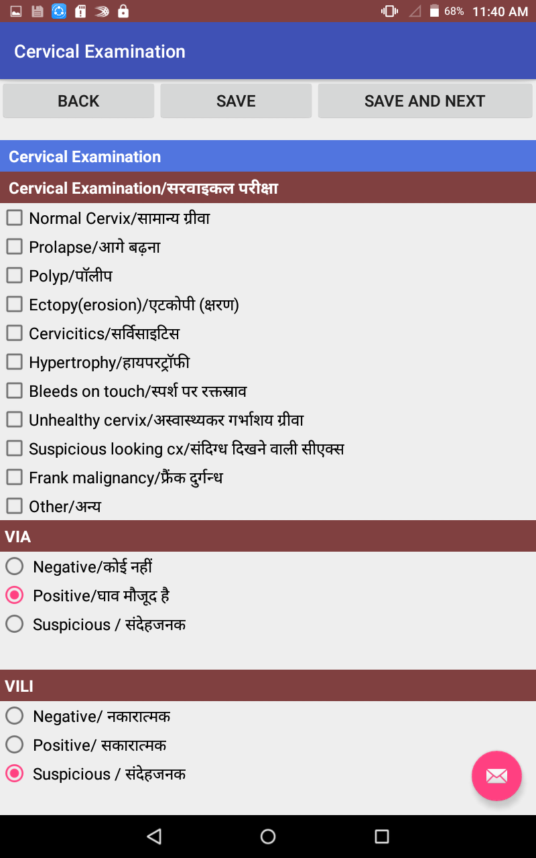
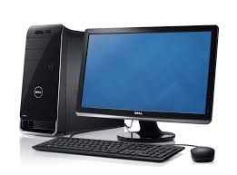
Designing of Apps for disease surveillance
Questionnaire_detail
Internet
Data Sync
Mobile Database
Database of Web Based Server
Server

Slide 14
Benefits of developing questionnaire_detail
Creation of tables in web based server and mobile app becomes easy.
Creates dynamic questionnaire in mobile App
Building data save query becomes easy.
Data checks can be placed automatically.
Data synchronization coding becomes small.
Table works as metadata during data analysis
Creates data view automatically
Graphical Analysis becomes easy
Most Important : Easily replicable

Slide 15
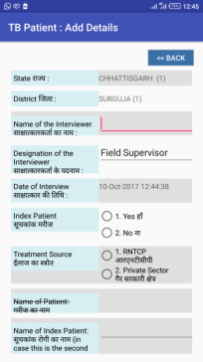
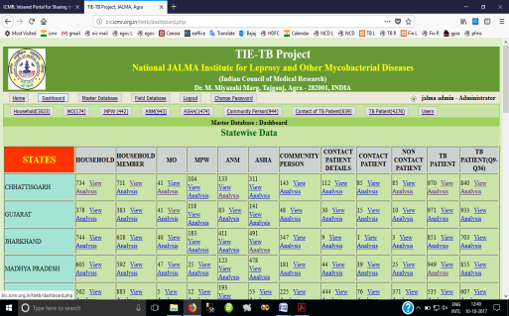
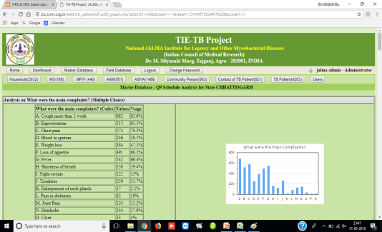
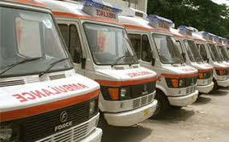
TieTB Project Flow Diagram
Mobile
App
Analyzed
Report
Present Status : Developed Mobile App and collected Data from Tribal Area from 19 Districts of 5 States Chhattisgarh, Gujarat, Jharkhand , MP & Rajasthan
Server at ICMR Headquarters
4500+ TB Patients
600+ Contacts Patients
900+ Community Persons
1400 ASHA workers
900+ ANMs
400+ MPWs
170+ Medical Officers
35 Mobile vans equipped with Digital X-ray and sputum microscopy services have been launched and providing services to TB Patients in Tribal Area

Slide 16
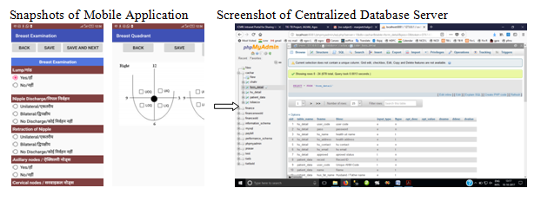
About 46000 population has been screened by 250+ health workers using Mobile Application under project “Screening and Early Detection of Cervical, Oral and Breast Cancer in Cachar, Assam”

Slide 17
About 10000 Tea Garden workers were screened by 20+ health workers using Mobile Application for Cancer and Non-Communicable Diseases
About 50000 population has been screened using Cloud Based Application for prevalence of fluorosis
About 50000 population has been screened for Salt and Sugar intake using Cloud Based Application. More than 3,00,000 schedules are filled

Slide 18
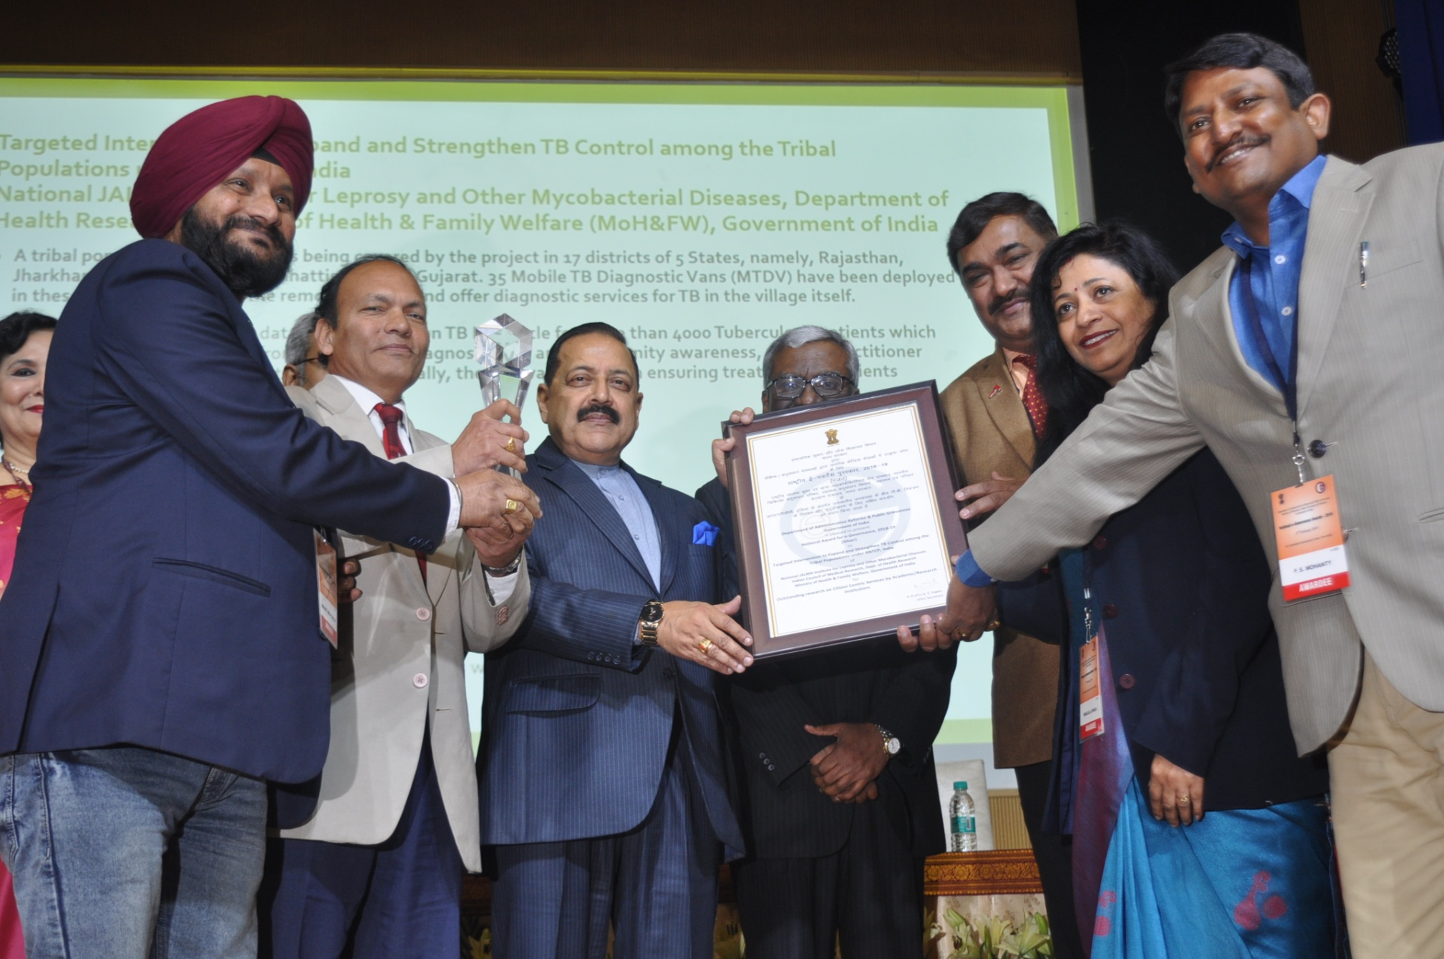
Received National Award for project on TB in Tribal Areas

Slide 19
Thank You

