Slide 1
FGAI4H-J-037-A01
E-meeting, 30 September – 2 October 2020
Source: | ETH Zurich
Title: | Practical challenges of artificial intelligence in healthcare: building the evaluation framework for organizations - Presentation
Purpose: | Discussion
Contact: | Agnieszka Sitarska Switzerland | Email: Sitarska.aga@gmail.com
Abstract: | This PPT contains a presentation of J-037.

Slide 2
Intro: Agnieszka Sitarska
Recent graduate of MAS Management, Technology and Economics at ETH Zurich
MAS Thesis: Practical challenges of AI in healthcare: building the evaluation framework for organizations
Aspiring venture capitalist with a passion for digital health
Venture Capital
Early stage technology ventures
Digital Health

Slide 3
Evaluation framework for AI-driven solutions for healthcare
The organization (business) perspective
Agnieszka Sitarska, MAS/MBA graduate
Zurich, 30.09.2020

Slide 4
Research question: what aspects should healthcare organizations consider when evaluating AI-driven tools and providers?
Pillar I Groundwork: Identify challenges of evaluating AI for healthcare in the recent literature → (backup slide)
Pillar II: Interviews with business practitioners
Represented profiles:
Data science, digital services, medical, innovation, technology investors, business development
Pillar III: Evaluation project
Selecting a provider of an AI-driven digital service
Screening (20 companies)
Preselection (top 5)
Comparison (top 3)
Synergy analysis (the winner)

Slide 5
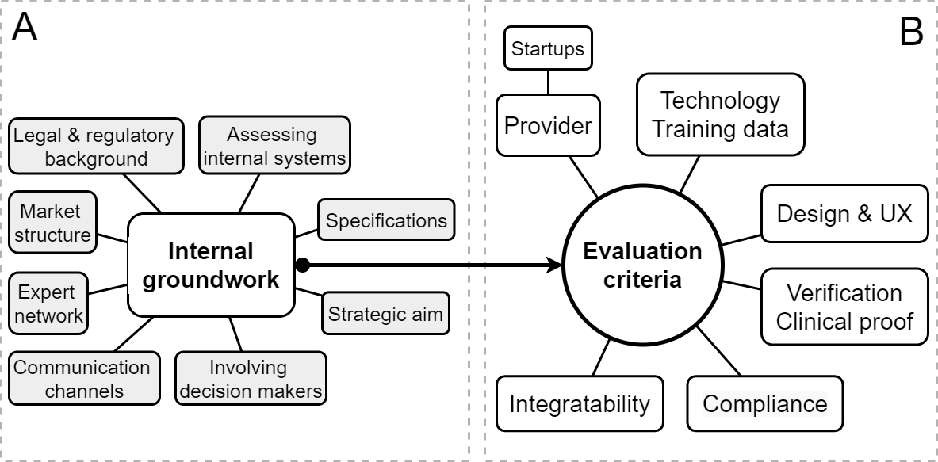
The final framework comprises internal (A) and external-facing aspects (B) of evaluation
Important phase at the very start!

Slide 6
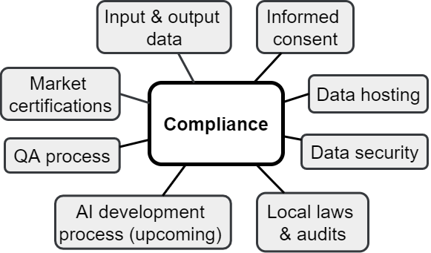
1/6: Compliance
Organizational departments involved in the evaluation:
Procurement
Regulatory Affairs
Legal

Slide 7
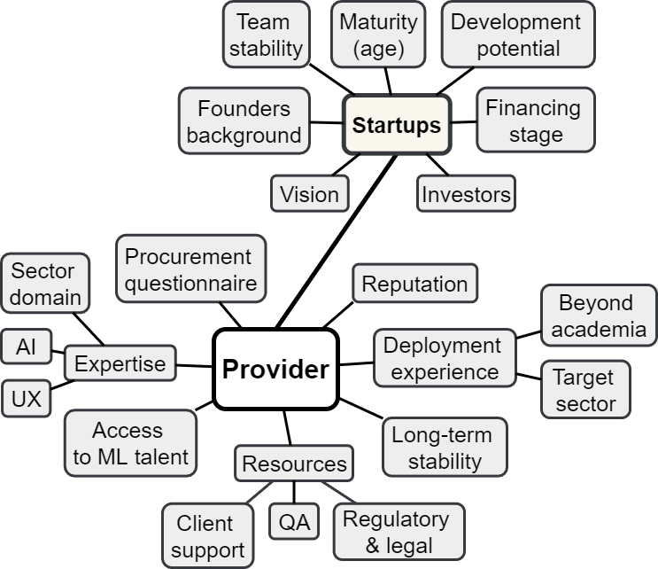
2/6: Capabilities of the provider
This cluster received the most attention from the interviewed business practitioners!
A few extra criteria to be considered for startup companies
Organizational departments involved in the evaluation:
Procurement
Data Science

Slide 8
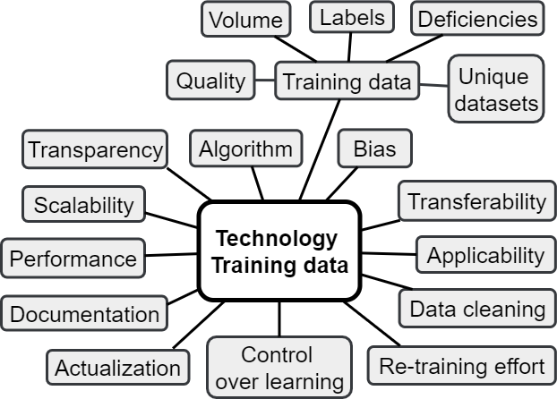
3/6: Technology and training data
Suitability to the defined use case is key!
The type of AI algorithm was not deemed important, as long as it is state-of.the-art
Organizational departments involved in the evaluation:
Data Science
IT

Slide 9
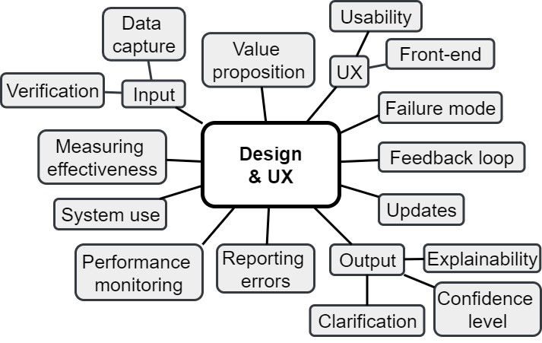
4/6: Design and User Experience (UX)
Solution design and user experience are key to the adoption and adherence
Interpretability features: specified confidence level, clarification of the output, rationale
Organizational departments involved in the evaluation:
Digital Services
IT

Slide 10
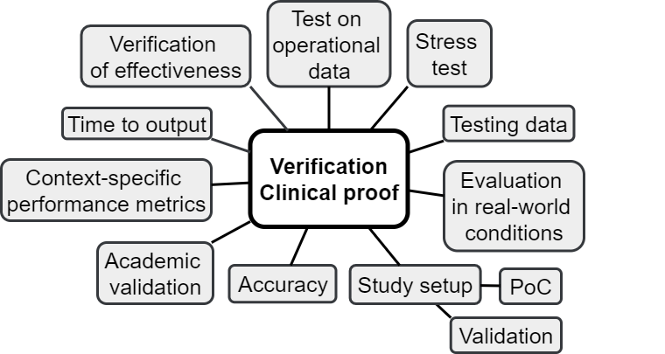
5/6: Verification and clinical proof
Testing data should be representative of the operational setting
Ground truth
Organizational departments involved in the evaluation:
Data Science
Medical/Clinical team

Slide 11
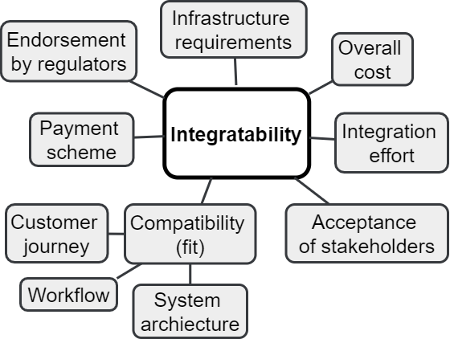
6/6: Integratability
The solution must be a good overall fit in:
IT infrastructure
User journey
Social context
Organizational departments involved in the evaluation:
Procurement
IT / Digital Services
Medical team

Slide 12
Let’s discuss!

Slide 13
Recent literature on the evaluation of AI for healthcare
Challen, R., Denny, J., Pitt, M., Gompels, L., Edwards, T., &amp; Tsaneva-Atanasova, K. (2019). Artificial intelligence, bias and clinical safety. BMJ Quality and Safety, 28(3), 231-237. BMJ Publishing Group
Magrabi, F., Ammenwerth, E., McNair, J., De Keizer, N., Hyppönen, H., Nykänen, P., . . . Georgiou, A. (2019). Artificial Intelligence in Clinical Decision Support: Challenges for Evaluating AI and Practical Implications. Yearbook of medical informatics, 28(1), 128-134. NLM (Medline).
Reddy, S., Allan, S., Coghlan, S., & Cooper, P. (2020, 3 1). A governance model for the application of AI in health care. Journal of the American Medical Informatics Association, 27(3), 491-497. Oxford University Press.
Topol, E. (2019, 1 1). High-performance medicine: the convergence of human and artificial intelligence. Nature Medicine, 25(1), 44-56. Nature Publishing Group.
Wiljer, D., & Hakim, Z. (2019, 12 1). Developing an Artificial Intelligence–Enabled Health Care Practice: Rewiring Health Care Professions for Better Care. Journal of Medical Imaging and Radiation Sciences, 50(4), S8-S14.
Yu, K., & Kohane, I. (2019, 3 1). Framing the challenges of artificial intelligence in medicine. 28(3), 238-241.
Yu, K., Beam, A., & Kohane, I. (2018, 10 1). Artificial intelligence in healthcare. Nature Biomedical Engineering, 2(10), 719-731. Nature Publishing Group.
(extra read about the existing evaluation frameworks in healthcare) Andargoli, S. R. (2017, 1 1). Health information systems evaluation frameworks: A systematic review. International Journal of Medical Informatics, 97, 195-209. Elsevier Ireland Ltd. - overview of the existing evaluation frameworks for Health Information Systems (HIS)

Slide 14
Challenges related to AI in healthcare emphasized in the literature
Performance metrics - abstract to the medical/operational context, variability in the implementation approaches - no easy way to compare the providers
Access to data - generally low availability, heterogeneity, fragmentation, adequacy of training data
Gap in regulations - rules applicable to HIS do not keep up with the newest solutions and technologies (AI4Health is there to address this challenge!)
Compliance and transparency - Medical device classification, post-market surveillance, data privacy, security and consent
Operationalization - changing quality over time, fit in the workflow
Social context - acceptance, understanding, adherence

