Slide 1

FGAI4H-J-031-A01
FGAI4H-J-032-A01
E-meeting, 30 September – 2 October 2020
Source: | Editors
Title: | Att.1: Presentation - Update onboarding document (J-031); Call for TG participation (J-032)
Purpose: | Discussion | Information
Contact: | Eva Weicken | E-mail: eva.weicken@hhi.fraunhofer.de
Abstract: | This PPT contains a summary concerning the following docs: Overview of the topic groups and TDDs (J-030) TDD-template: Proposed draft update (J-004) Update onboarding document (J-031), call for TG participation (J-032)

Slide 2
Update Onboarding document (J-031)
original Onboarding document‚ FGAI4H-G-107‘, guidance information for new members
Updates for the Onboarding document include:
  Update topic groups and working groups
  New section about deliverables & effective participation
  Updated figures
Update Call for topic group participation (J-032)
Updated list of topic groups

Slide 3
FGAI4H-J-030-A01
E-meeting, 30 September – 2 October 2020
Source: | Editors (E. Weicken, M. Kuglitsch)
Title: | Del.10 – Att.1: Presentation
Purpose: | Discussion | Information
Contact: | Eva Weicken | E-mail: eva.weicken@hhi.fraunhofer.de
Abstract: | This PPT contains a summary concerning the following docs: Overview of the topic groups and TDDs (J-030) TDD-template: Proposed draft update (J-004) Update Onboarding document (J-031), Call for TG participation (J-032)

Slide 4
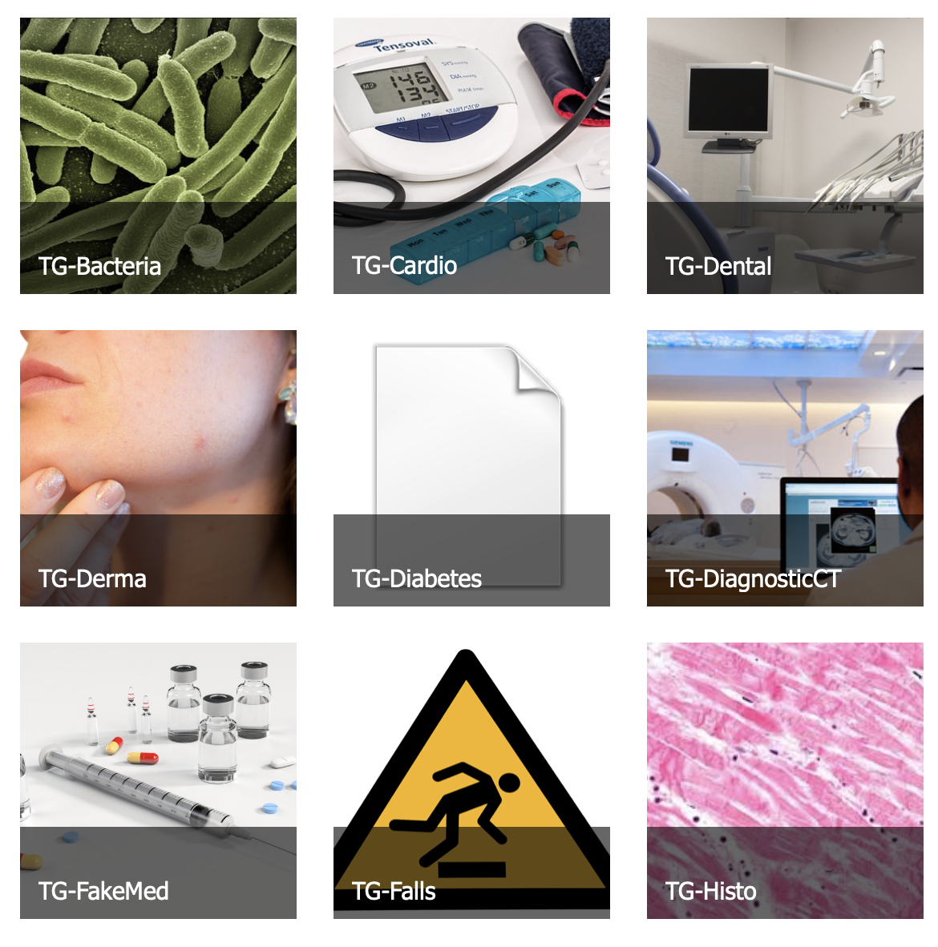
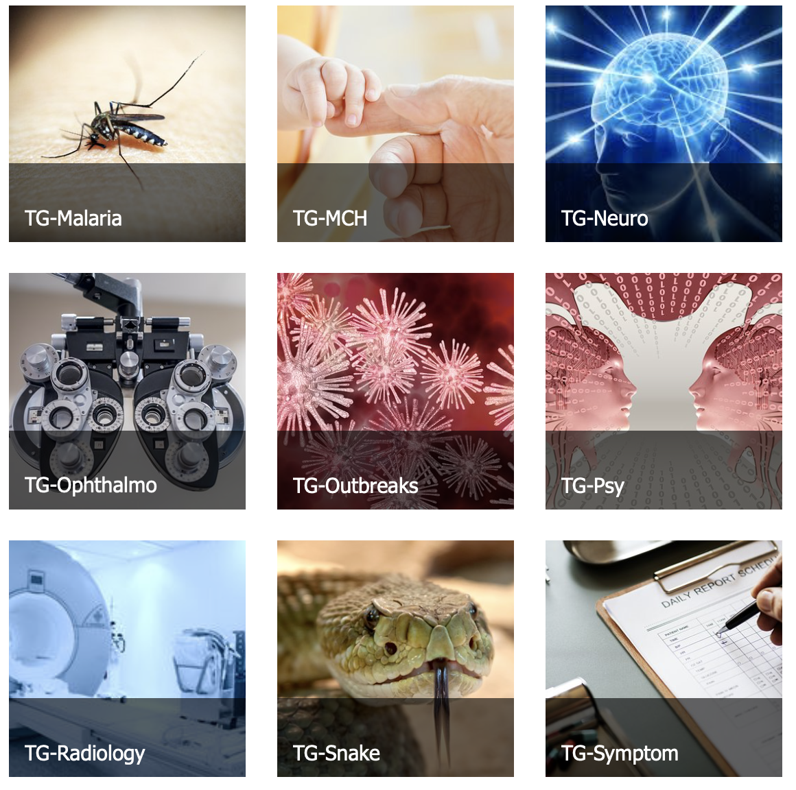


Topic groups by September 2020

Slide 5
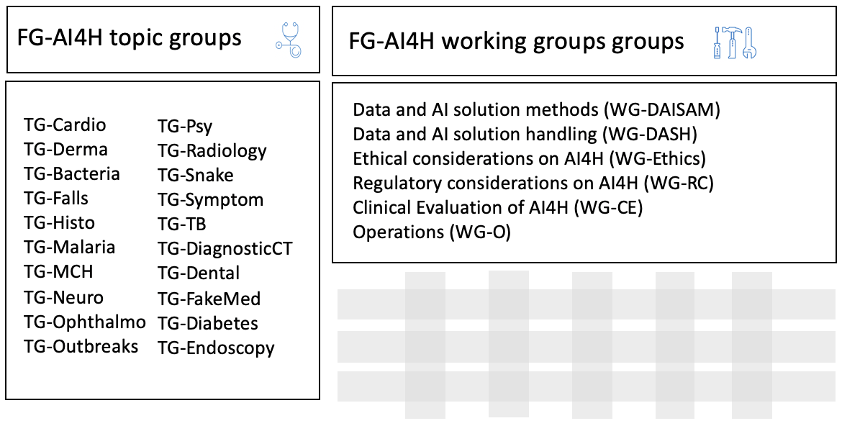
FGAI4H topic groups + working groups

Slide 6
Standardized benchmarking / Topic Description Document (TDD)
TDDs
=
Deliverables
No. 10.1 – 10.20

Slide 7
FGAI4H-J-004-A01
E-meeting, 30 September – 2 October 2020
Source: | Editors
Title: | Draft updated FG-AI4H TDD template – Att.1: Presentation
Purpose: | Discussion | Information
Contact: | Eva Weicken | E-mail: eva.weicken@hhi.fraunhofer.de
Abstract: | This PPT contains a summary concerning the following docs: Overview of the topic groups and TDDs (J-030) TDD-template: Proposed draft update (J-004) Update Onboarding document (J-031), Call for TG participation (J-032)

Slide 8
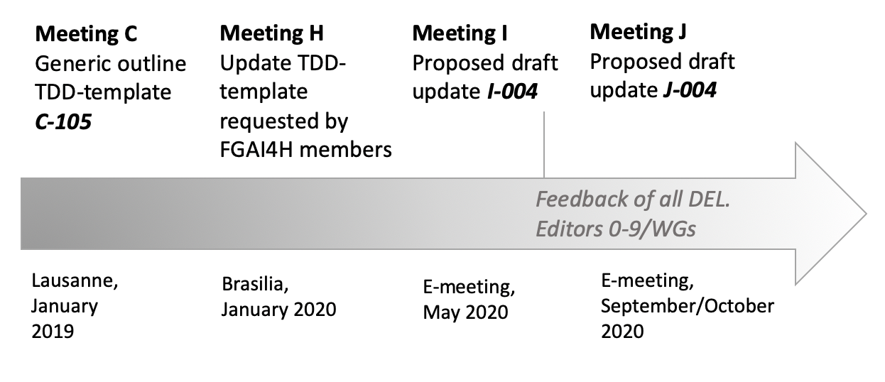
Update: TDD–template (J-004)
Motivation & development process
Editors: H. Hoffmann, E. Weicken, M. Wenzel

Slide 9
Update: TDD–template (J-004)
Why?
include all requirements of DEL 0-9, Common structure for all TDDs, facilitate review process
What‘s new?
Restructuring & amendment of several sections
Subtopics in TDD structure
Change notes & mentioning of contributors
Improved guidance, new design (e.g. colour legend)

Slide 10
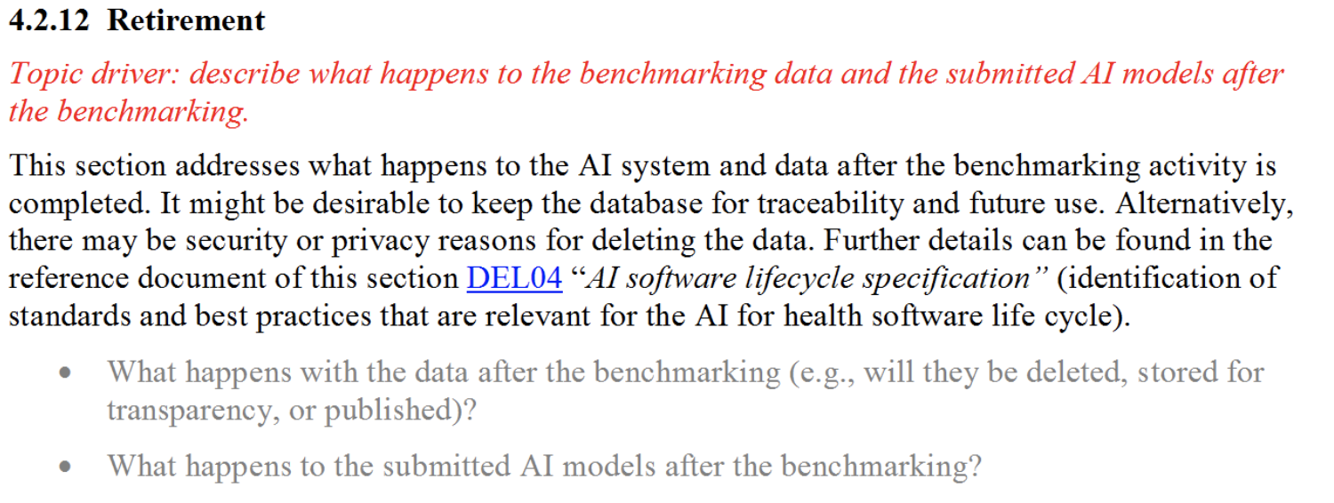
Update: TDD–template (J-004)
Introduction (FG-AI4H topic group, ethical, regulatory considerations)
Existing AI solutions
Existing work on benchmarking
Benchmarking (incl. benchmarking versions)
Discussion
e.g.:

Slide 11
Please provide feedback for the TDD-template update!
To: eva.weicken@hhi.fraunhofer.de
Contributors DEL 10, TDD-Template update, Onboarding document, CfTGP:
E. Weicken (Fraunhofer HHI), M. Kuglitsch (Fraunhofer HHI), H. Hoffmann (ADA),
M. Wenzel (Fraunhofer HHI), Simão Campos (ITU)

