Slide 1
FGAI4H-J-023-A03
E-meeting, 30 September – 2 October 2020
Source: | TG-Radiology Topic Driver
Title: | Att.3 – Presentation (TG-Radiology)
Purpose: | Discussion
Contact: | Darlington Akogo Topic Driver Founder, Executive Director minoHealth AI Labs | E-mail: darlington@gudra-studio.com
Abstract: | This PPT contains a presentation of J-023-A01.

Slide 2
Topic Group on AI for Radiology
Darlington Akogo Topic Driver
Founder, Executive Director
minoHealth AI Labs
darlington@gudra-studio.com

Slide 3
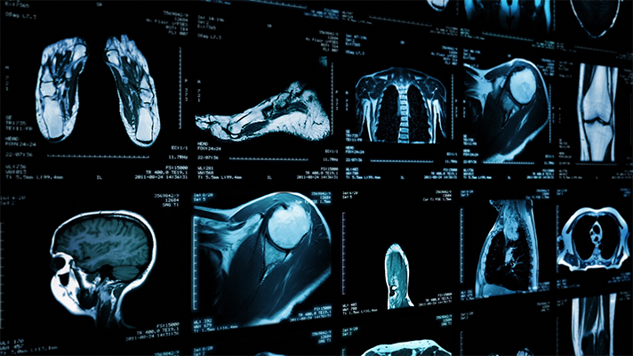
AI in Radiology - Overview
AI systems in radiology have achieved impressive results. They outperformed radiologists in some cases.
Challenge in properly testing AI radiological systems and ensuring they work in all edge and diverse cases radiologists encounter.
Study analysed 31,587 AI healthcare studies, only 69 studies provided enough data enabling calculation of test accuracy. Only 25 studies further did out-of-sample external validations. And further, only 14 of such studies compared the models’ performances to that of radiologists. (Liu et al., 2019)
Standardisation and benchmarking is required.

Slide 4
Objectives
TG-Radiology is dedicated to the development of global standards for the evaluation and benchmarking of AI radiological systems.
We are also collecting diverse data towards the assessment of AI radiological applications.

Slide 5
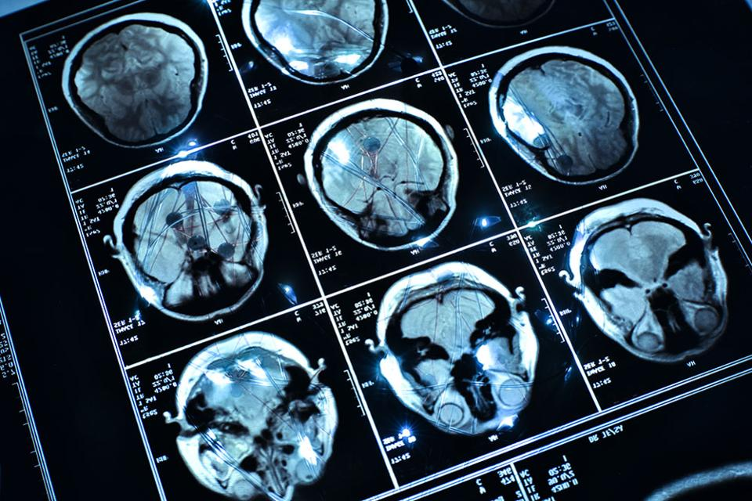
Timeline
21-24​ Jan 2020 - TG-Radiology was officially created at Meeting H, Brasilia
30 Jan - Call for Participants published
25 Feb - First Zoom meeting
26 Mar - First TDD submission (Radiograph-agnostic framework for AI Evaluation)
7-8 May - 9th FGAI4H Meeting (Use Cases & Existing Solutions)
Current - Updated TDD for ​​10th Meeting

Slide 6
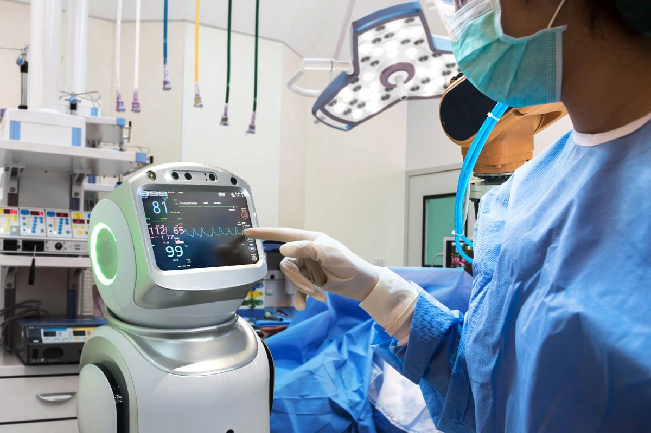
Participants
20 participants currently
From 5 continents; Africa (6), North America (5), South America (4), Europe (1), Asia (4)
11 organisations; AI providers (5), other digital health providers (2), health centers (3), universities (5)

Slide 7
Current Contributors to TDD (11 participants)
Vincent Appiah, minoHealth AI Labs, GUDRA Xavier Lewis-Palmer, minoHealth AI Labs, GUDRA Issah Abubakari Samori, minoHealth AI Labs, GUDRA Camilo Sotomayor, IA·TRad Chile & Clinical Hospital University of Chile Andrew Murchison, Oxford University Hospitals NHS Foundation Trust Benjamin Dabo Sarkodie, Euracare Advanced Diagnostic Center Alessandro Sabatelli, Braid.Health Daniel Hasegan, Braid.Health Pierre Padilla-Huamantinco, Universidad Peruana Cayetano Heredia Judy Wawira Gichoya, Emory University School of Medicine Saul Calderon Ramirez, De Montfort University (Metrics deliverables)

Slide 8
Topic Description Document
Topic Description Overview of Radiology, Challenges facing Radiology, Overview of AI in Radiology, Challenges Facing Overview AI in Radiology, Impact of Benchmarking
Precision Evaluation framework and platform A radiograph-agnostic benchmarking platform and framework
Existing AI Solutions & Use Case: 29 conditions, X-Ray/body part classification (56 parts), 3+ modalities Image Conversion Considerations & Guidelines: 3 approaches and their Advantages and Disadvantages

Slide 9
Metrics & Scores - Topic Description Document
17 metrics and scores (Pp. 18 - 22)
Threshold Metrics (12) Accuracy Metrics: classification accuracy, classification error, Patient Level Accuracy & Image Level Accuracy Sensitivity-Specificity Metrics: Sensitivity, Specificity, the geometric mean Precision-Recall Metrics: Precision, Recall, F-Measure, Fbeta-Measure Matthews Correlation Coefficient (MCC)
Ranking Metrics (2) ROC Curve, Precision-Recall Area Under Curve
Probability Metrics (3) Logarithmic loss or Cross-entropy, Brier Score, Brier Skill Score

Slide 10
Imaging Modalities - Topic Description Document
11 modalities (Pp. 10 - 16)
Description: Description of imaging modality Conditions: Conditions modalities are applied to Data structure: Data structure of images from modality AI Applications: How AI is being used with modality

Slide 11
Imaging Modalities - Topic Description Document
Conventional radiography (plain x-rays), Fluoroscopy, Angiography, Mammography, Computed Tomography (CT), Single-photon emission computed tomography (SPECT), Ultrasonography (US) and Doppler, Magnetic resonance Imaging (MRI), Nuclear Medicine Imaging, Positron emission tomography (PET), Interventional Radiology

Slide 12
Next Steps
Submit past works to journals and conferences
Metrics and Score: Generalizability, Robustness, Bias & Fairness, Uncertainty (metrics deliverable, WG-DAISAM) Segmentation, Object Detection, 3D Image Reconstruction
AI Input: Guidelines & Standards
AI Output: Guidelines & Standards
Ethical Considerations
Collaborate with WGs and deliverables
Explainability and Interpretability

