Slide 1
FGAI4H-J-021-A03
E-meeting, 30 September – 2 October 2020
Source: | TG-Symptom topic driver
Title: | Att.3 – Presentation (TG-Symptom)
Purpose: | Discussion | Information
Contact: | Henry Hoffmann | E-mail: henry.hoffmann@ada.com
Abstract: | This PPT summarizes the progress made by the topic group on AI-based symptom assessment since meeting I.

Slide 2
Meeting J Update for the
Topic Group “Symptom Assessment”
E-meeting, 30 September – 2 October 2020
Notes:
Hallo,
My name is Henry Hoffmann and it is now my pleasure to present you the update on AI-based symptom assessment benchmarkign on behalf of our Topic Group.

Slide 3
AI-based Symptom Assessment
What is the AI task this TG deals with?
Mobile/Web Applications – sometimes called ”Symptom Checkers” that
Allow users to enter (INPUT)
Patient information (age, sex, …)
Current presenting Complaints (symptoms, free texts )
To then engage in a dialog similar to a doctor collecting (INPUT)
Additional symptoms, findings, factors, attributes, (lab, imaging, genetics, …)
To finally provide the user with (OUTPUT)
Pre-Clinical Triage (emergency, see doctor today, self-care … )
Differential Diagnosis (disease A 93%, B 73% - e.g. in ICD10, SnomedCT)
Additional diagnostic tests to perform, treatment advice, explanations
Notes:
Symptom assessment – is about applications, sometimes called „symptom checkers“ that,
Allow users to enter some current symptom they want to get advice for, for instance some sharp abominal pain
To then engage in an AI based diagog, mimicing the doctor-patient conversation to collect further symptoms, factors, attributes …
To finally provide the user with some advice that might be
A pre-clinical triage saying if it is ok to stay at home or if it is important to see a doctor at the same day
Some systems also list some differential diagnoses that might be the underlying causes for the patients symptoms
And the systems might also give further advice for instance on further tests, treatment or just some general explanations

Slide 4
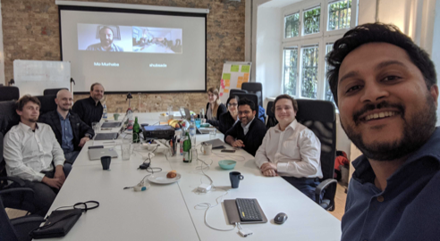
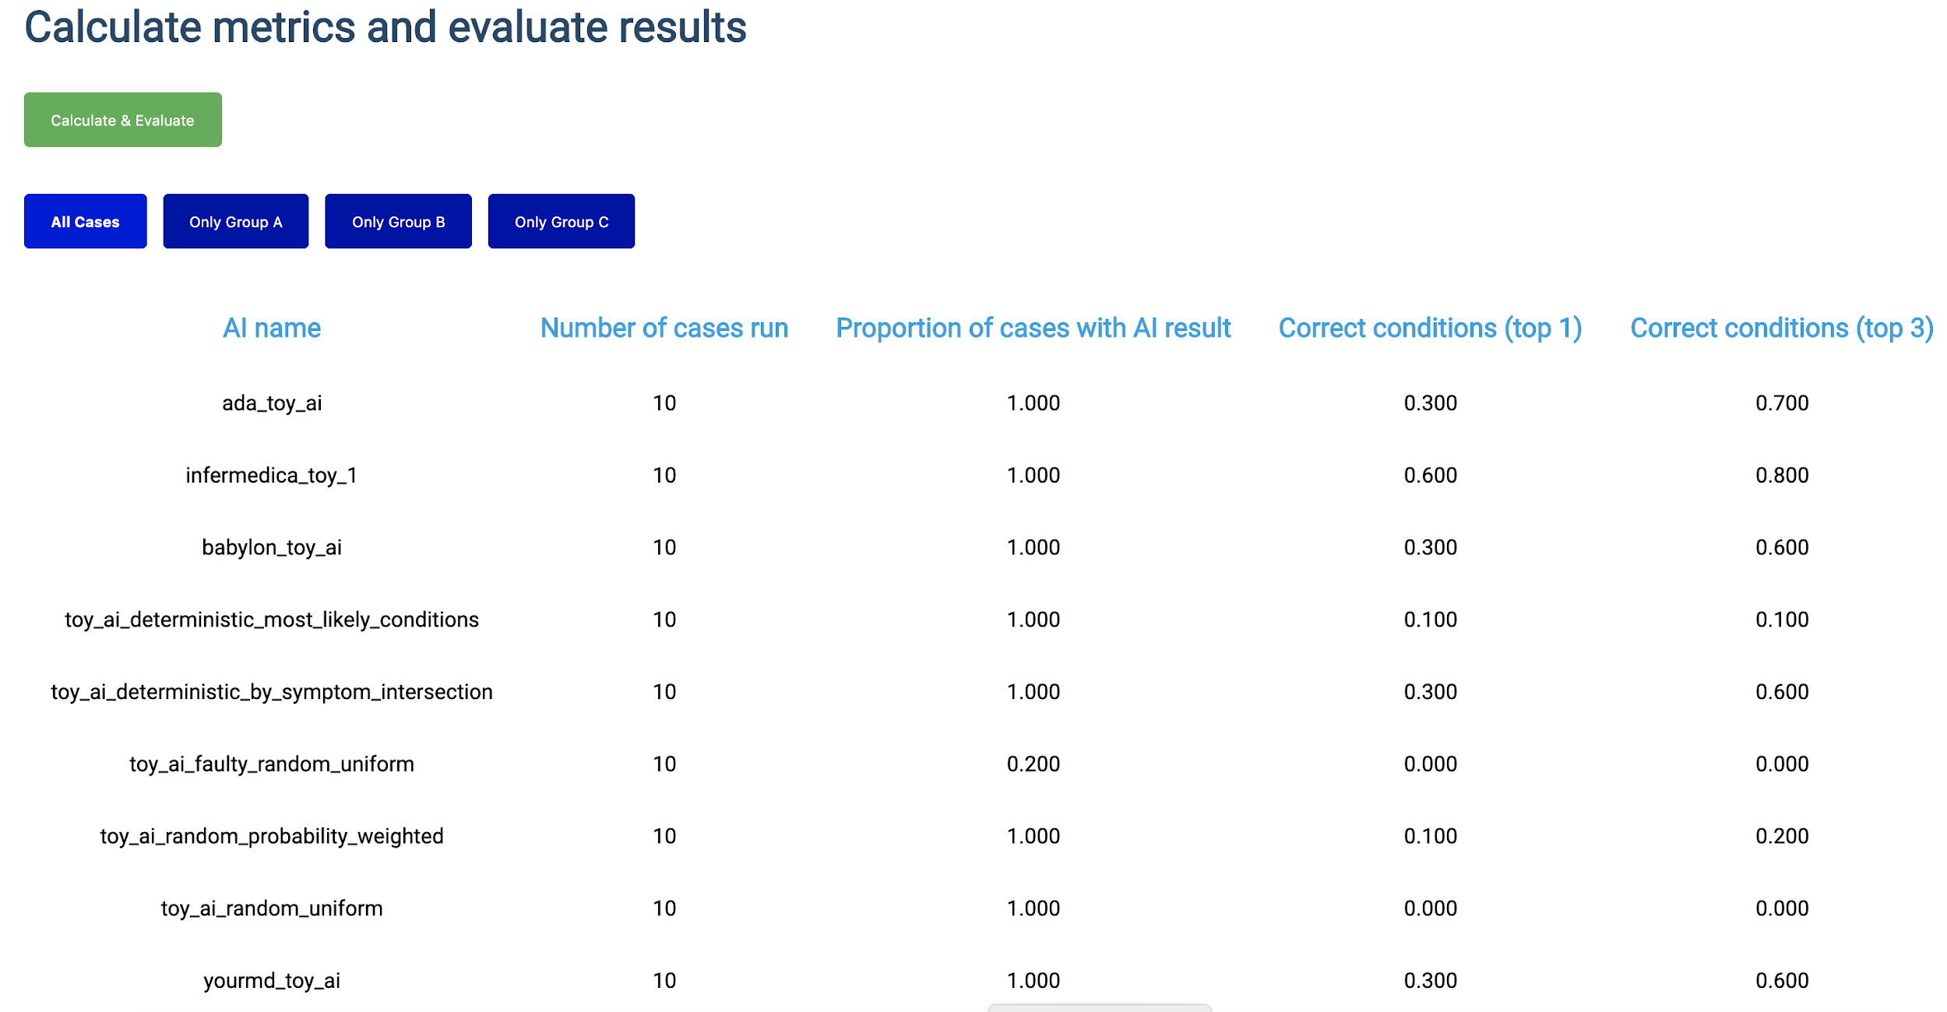
Journey & Approach
What happened so far?
Meeting A – Geneva, 25-27 September 2018
A-020: Towards a potential AI4H use case "diagnostic self-assessment apps"
Meeting C – Lausanne, 22-25 January 2019
Topic Group created
Approach:
MMVB 1.0 … MMVB N.0 → MVB
Meeting F – Zanzibar 2-5 September 2019
First benchmarking with toy AI & toy Data
Minimal Minimal viable Benchmarking
MMVB 1.0
Meeting G, H, I, J
Gradual increase of complexity by adding model details
Notes:
Such applications are use by millions of users worldwide
And if done right they can as some kind digital frontdoor to the health systems make the systems more efficient by navigating patients to the right solution at the right time
But, as most AI systems in the focus group there was no standardized benchmarking for such systems yet
An so, right from the beginning in Meeting A we worked on creating such benchmarking
In Meeting C then the current Topic Group was officially created and start its work
We following here a stepwise approach.
As you know there are many companies involved already having internal benchmarking, an so here it is more about agreeing on system that can benchmark all system
For this we need to create a whole new benchmarking system which is much easiert to do if everyone can see and work on all parts of the benchmarking software which is obviously not possible with the real production Ais
Also for debugging it is better to start with small toy model with only a few conditions and symptoms
The idea is then to increase the complexiy step by step, usually in workshops where we agree on the next level of complexity, until we are then ready for prime-time, benchmarking the real Ais with real data
So, we presented a first toy benchmarking at meeting F
And since then are in the phase of stepwise increasing the complexity

Slide 5
Status of the Topic Group
Overview
Topic Group Members:
Companies (15+2):
1DOC3, Ada, Babylon, Baidu, Barkibu, Buoy, Deepcare, EQL, Infermedica, Inspired Ideas, Isabel Healthcare, mfine, MyDoctor, Symptify, Visiba Care, xund.ai, Your.MD
Independent contributors (5+1):
Reza Jarral, Thomas Neumark, Muhammad Murhaba, Pritesh Mistry, Alejandro Osornio, Salman Razzaki
Sub-Topic Groups
Self-assessment
Clinical symptom assessment
fgai4htgsymptom@lists.itu.int 99 (16 more)
8 Online meetings since meeting I (All with minutes/protocols in SharePoint)
(additional bi-weekly tech syncs, clinical sub-group syncs, slack conversations)
Notes:
The Topic group has now 15 companies, with xund.ai recently joining thats one more than last time
Since last meeting Pritesh Mistry, Alejandro Osornio, Salman Razzaki and Yura Perov joined as individual contributors supporting the group, making it a total 6
We have 2 sub-topic groups
One on Self-assessment
and one on clinical symptom assesment
Currently both sub-topics work together on the first benchmarking
Once this is done we will split the workstreams to take care of the sub-topic details

Slide 6
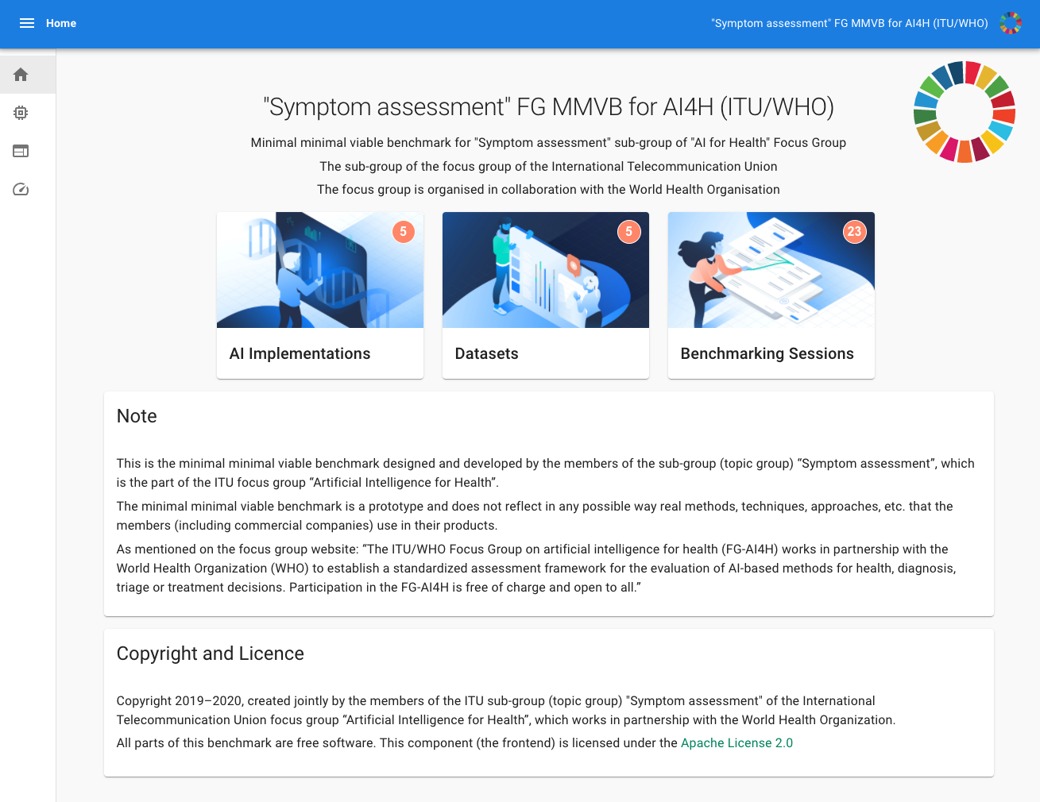
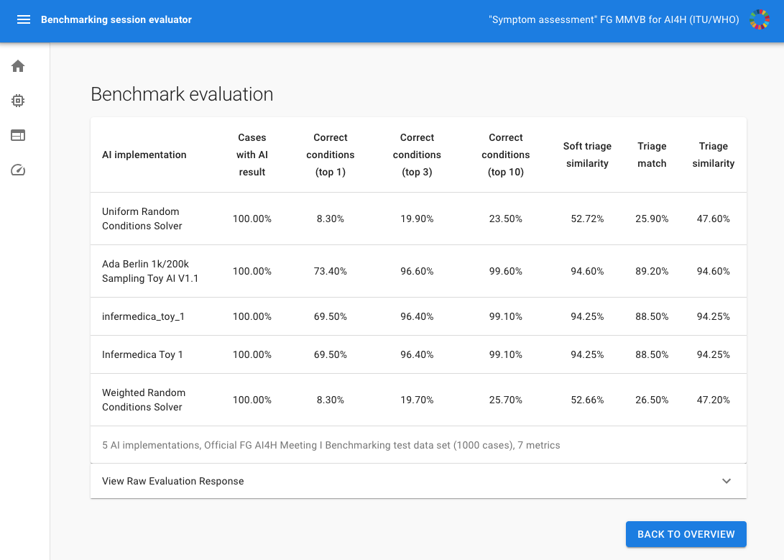
Status of the Topic Group
What we implemented since meeting I
Finished MMVB 2.2
Focus on implementing „Berlin Model“
Attributes + Factor distributions
Backend
Extended data structures + Frontend API
Extended benchmarking case synthesizer
Frontend
AI self-registration
Design & Usablity improvements
Toy Ais
Started implementation of new API interface + model by Topic Group members
Annotation Tool
Refactored into a separate tool
Extended to Berlin Model too
Notes:
The Topic group has now 15 companies, with xund.ai recently joining thats one more than last time
Since last meeting Pritesh Mistry, Alejandro Osornio, Salman Razzaki and Yura Perov joined as individual contributors supporting the group, making it a total 6
We have 2 sub-topic groups
One on Self-assessment
and one on clinical symptom assesment
Currently both sub-topics work together on the first benchmarking
Once this is done we will split the workstreams to take care of the sub-topic details

Slide 7
MMVB 2.2 Benchmarking
New start screen
Notes:
On the non-technical side we of couse also contined to work on the TDD
We documented there the latest work in the current benchmarking iteration,
We also integrated recent feedback from Baidu,
There was also some work done on the literature analysis and the ontology mapping, even though it was not in the TDD version from last week yet.
Noteworthy is that inside the group our doctors create some kind of clinical break-out group to work on the scores & metrics systems.
They have their own meeting stream and work on a corresponding document that will then feed into one of the next TDD version
The group was also incolved in some other focus group activities
So we contributed to the update of the TDD template
Worked with the clinical work group
Refined the ideas on focus group wide annotationt tool
And also supported with some focus group onboarding activities

Slide 8
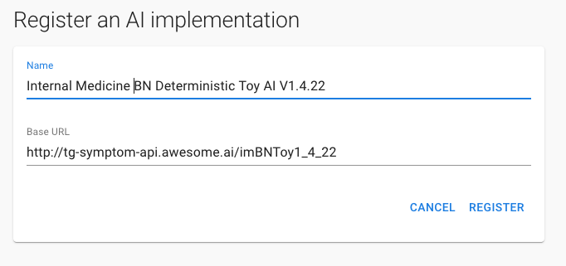
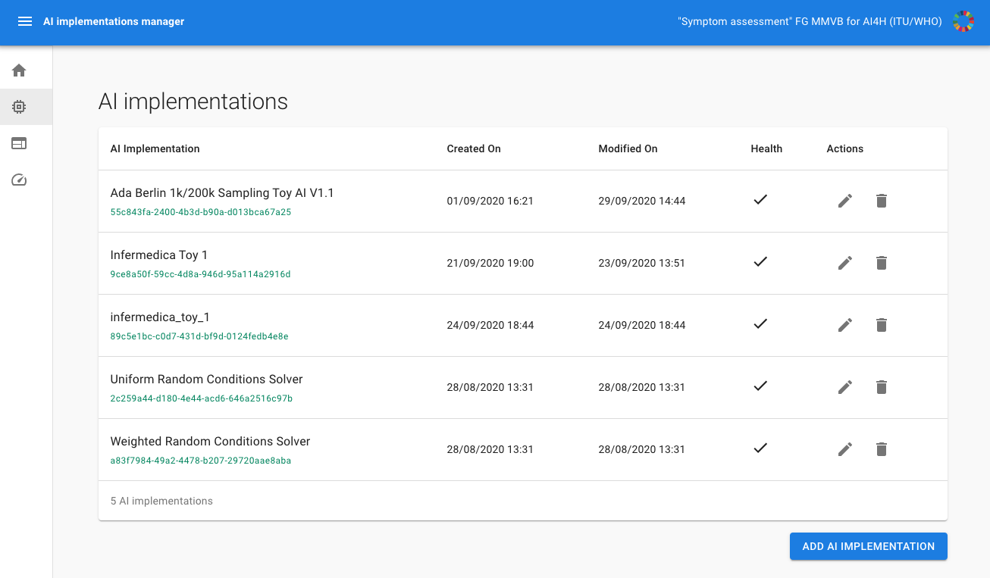
MMVB 2.2 Benchmarking
Self-registration of a new Toy AIs
Notes:
On the non-technical side we of couse also contined to work on the TDD
We documented there the latest work in the current benchmarking iteration,
We also integrated recent feedback from Baidu,
There was also some work done on the literature analysis and the ontology mapping, even though it was not in the TDD version from last week yet.
Noteworthy is that inside the group our doctors create some kind of clinical break-out group to work on the scores & metrics systems.
They have their own meeting stream and work on a corresponding document that will then feed into one of the next TDD version
The group was also incolved in some other focus group activities
So we contributed to the update of the TDD template
Worked with the clinical work group
Refined the ideas on focus group wide annotationt tool
And also supported with some focus group onboarding activities

Slide 9
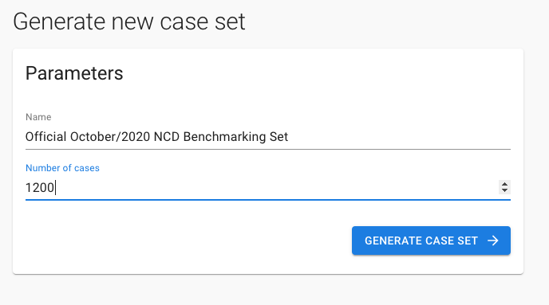
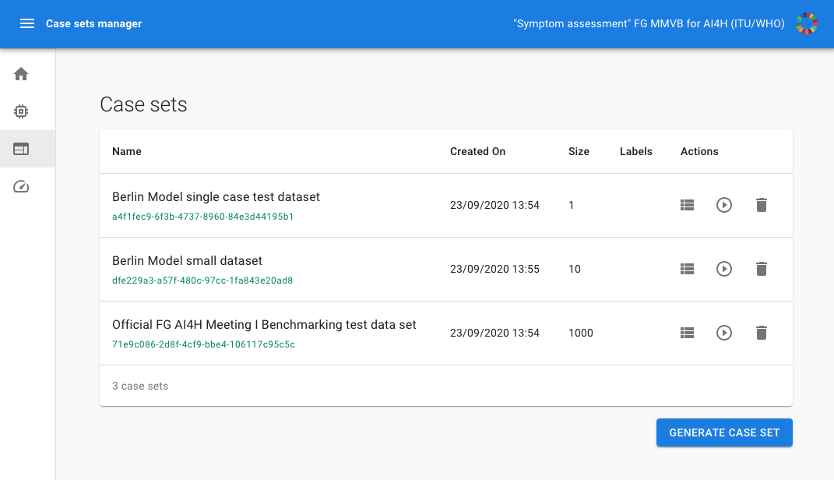
MMVB 2.2 Benchmarking
Generating new benchmarking case sets
Notes:
On the non-technical side we of couse also contined to work on the TDD
We documented there the latest work in the current benchmarking iteration,
We also integrated recent feedback from Baidu,
There was also some work done on the literature analysis and the ontology mapping, even though it was not in the TDD version from last week yet.
Noteworthy is that inside the group our doctors create some kind of clinical break-out group to work on the scores & metrics systems.
They have their own meeting stream and work on a corresponding document that will then feed into one of the next TDD version
The group was also incolved in some other focus group activities
So we contributed to the update of the TDD template
Worked with the clinical work group
Refined the ideas on focus group wide annotationt tool
And also supported with some focus group onboarding activities

Slide 10
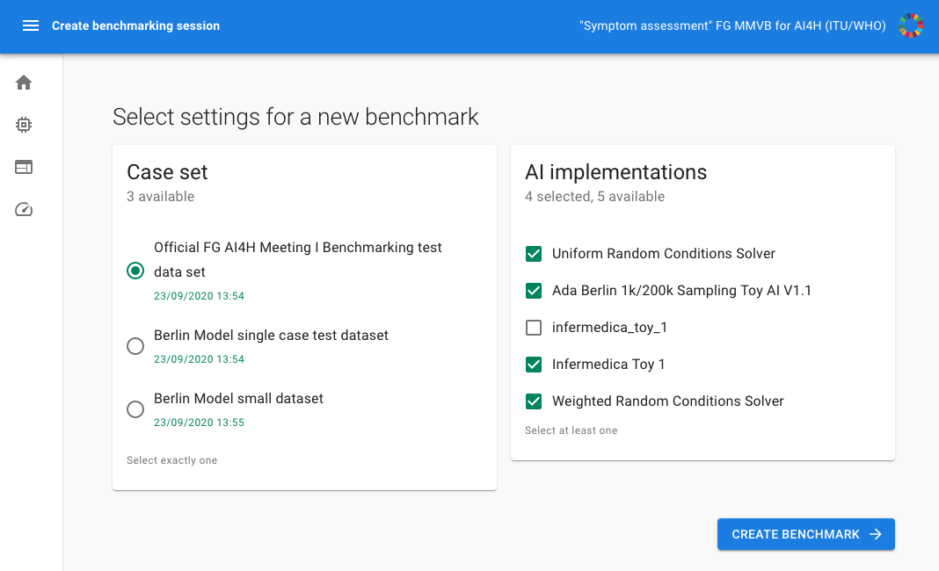
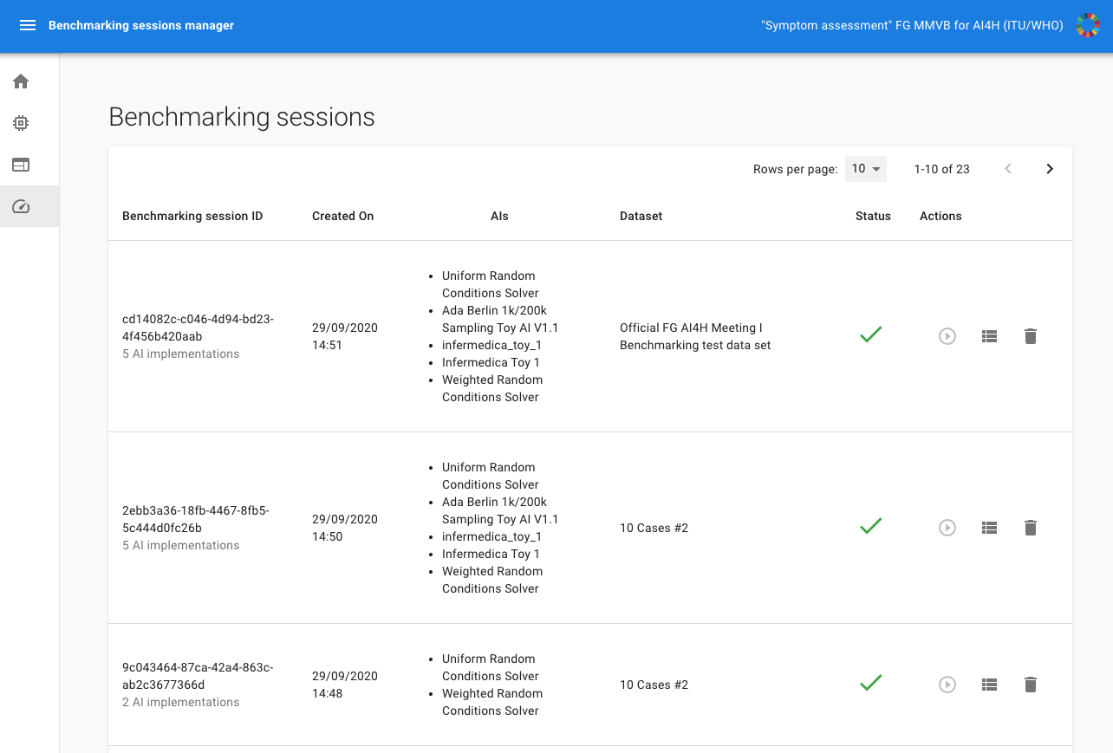
MMVB 2.2 Benchmarking
Creating a new benchmarking session
Notes:
On the non-technical side we of couse also contined to work on the TDD
We documented there the latest work in the current benchmarking iteration,
We also integrated recent feedback from Baidu,
There was also some work done on the literature analysis and the ontology mapping, even though it was not in the TDD version from last week yet.
Noteworthy is that inside the group our doctors create some kind of clinical break-out group to work on the scores & metrics systems.
They have their own meeting stream and work on a corresponding document that will then feed into one of the next TDD version
The group was also incolved in some other focus group activities
So we contributed to the update of the TDD template
Worked with the clinical work group
Refined the ideas on focus group wide annotationt tool
And also supported with some focus group onboarding activities

Slide 11
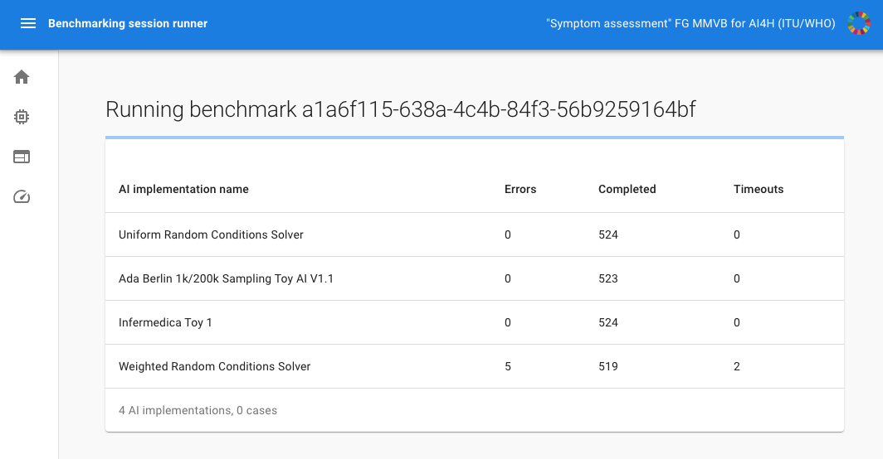
MMVB 2.2 Benchmarking
Running the benchmarking & results
Notes:
On the non-technical side we of couse also contined to work on the TDD
We documented there the latest work in the current benchmarking iteration,
We also integrated recent feedback from Baidu,
There was also some work done on the literature analysis and the ontology mapping, even though it was not in the TDD version from last week yet.
Noteworthy is that inside the group our doctors create some kind of clinical break-out group to work on the scores & metrics systems.
They have their own meeting stream and work on a corresponding document that will then feed into one of the next TDD version
The group was also incolved in some other focus group activities
So we contributed to the update of the TDD template
Worked with the clinical work group
Refined the ideas on focus group wide annotationt tool
And also supported with some focus group onboarding activities

Slide 12
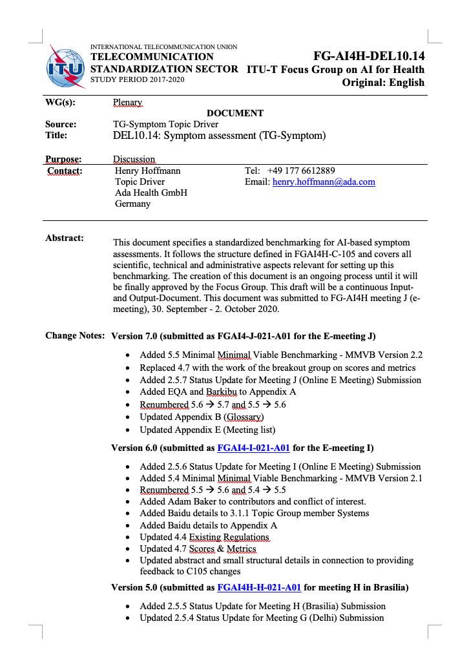
Status of the Non-Technical Work
The non-technical things we did
TDD work (99 pages)
Clinical Group output on scores & metrics merged (+15 pages)
Description of the finalization of MMVB 2.2
Outreach & FG Interaction
Contributed to the new TDD document template (FG-AI4H-J-004)
Contributed to the clinical validation working group (Shubhanan Upadhyay from the TG was confirmed as Co-Chair)
Contributed to the data annotation questionaire
(Contributed to the early Assessment Platform work)
Notes:
The Topic group has now 15 companies, with xund.ai recently joining thats one more than last time
Since last meeting Pritesh Mistry, Alejandro Osornio, Salman Razzaki and Yura Perov joined as individual contributors supporting the group, making it a total 6
We have 2 sub-topic groups
One on Self-assessment
and one on clinical symptom assesment
Currently both sub-topics work together on the first benchmarking
Once this is done we will split the workstreams to take care of the sub-topic details

Slide 13
Next Steps
What to focus on next
MMVB 3.0
Workshop with TG to
Agree on how to organize the definition of a full-scale condition & symptom space
AI and Data meta-data annotation system + Interactive drill down
(Authentication / Rights & Roles)
Implementing new model (frontend, backend, annotation tool)
TDD & Outreach
Aligning next steps with the Assessment Platform
Adoption of refined template structure
Align with Working Groups and Deliverables
E.g. Testing additional tools e.g. the Requirements Traceability Matrix
Notes:
The Topic group has now 15 companies, with xund.ai recently joining thats one more than last time
Since last meeting Pritesh Mistry, Alejandro Osornio, Salman Razzaki and Yura Perov joined as individual contributors supporting the group, making it a total 6
We have 2 sub-topic groups
One on Self-assessment
and one on clinical symptom assesment
Currently both sub-topics work together on the first benchmarking
Once this is done we will split the workstreams to take care of the sub-topic details

Slide 14
Thank you!
WHO/ITU FG AI4H TG Symptom Assessment
Meeting J Update
E-meeting, 30 September – 2 October 2020

