Slide 1
FGAI4H-J-010-A03
E-meeting, 30 September – 2 October 2020
Source: | TG-Dental Topic Driver
Title: | Att.3 – Presentation (TG-Dental)
Purpose: | Discussion
Contact: | Joachim Krois Falk Schwendicke Tarry Singh | E-mail: joachim.krois@charite.de E-mail: falk.schwendicke@charite.de E-mail: tarry.singh@deepkapha.ai
Abstract: | This presentation is given at the FG-AI4H e-meeting on Sep 30 to Oct 02 and contains background and overview of the TG-Dental activities and outputs since meeting I Introduction of Dr Robert Gaudin (Charité – Universitätsmedizin Berlin) and Dr Akhilanand Chaurasia (King George Medical University, Lucknow, India)

Slide 2
Meeting J TG-Dental Update
September 30 – October 02, 2020
Falk Schwendicke, Joachim Krois, Tarry Singh, Robert Gaudin and Akhilanand Chaurasia

Slide 3
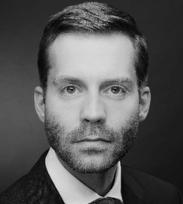
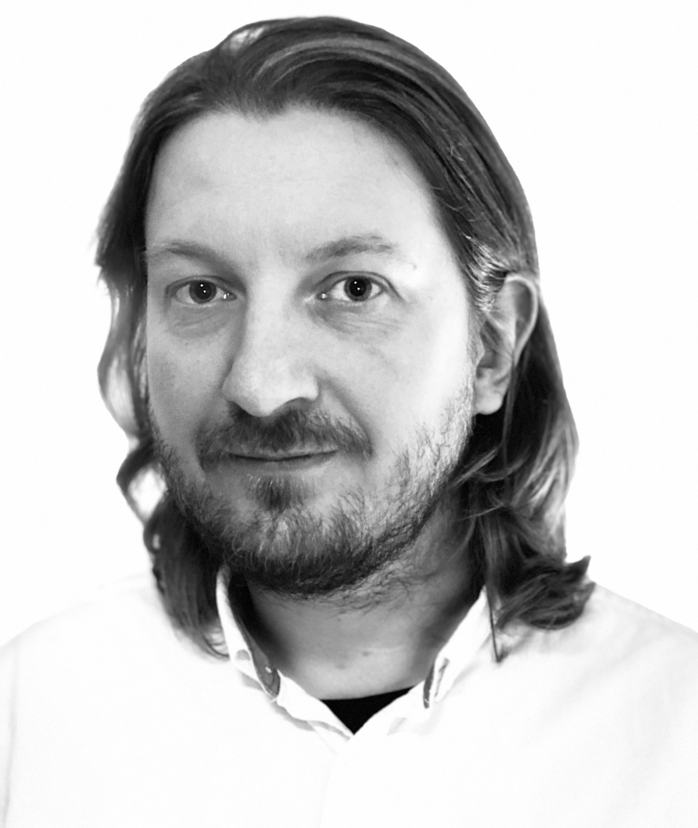
TG-Dental – Contributors
Prof Falk Schwendicke
Department of Oral Diagnostics, Digital Health and Health Services Research, Charité - Universitätsmedizin Berlin, Germany
.
Joachim Krois, PhD
Department of Oral Diagnostics, Digital Health and Health Services Research, Charité - Universitätsmedizin Berlin, Germany
.
Prof Jae-Hong Lee
Associate Professor, Department of Periodontology, Wonkwang University, College of Dentistry, Korea
.
Tarry Singh
CEO and AI Researcher, Entrepreneur deepkapha.ai, curae.ai & Real AI B.V., Netherlands.

Slide 4
TG-Dental - Topic group history
Meeting G (New Delhi, India)
-) Applied for new TG
Meeting H (Brasilia, Brazil)
-) First presentation and outline of AI-based systems in dentistry
Meeting I (remote)
New contributors: Tarry Singh (deepkapha), Prof Jae-Hong Lee (Wonkwang University, Korea)
Updates on TDD, in particular on section 2, AI4H Topic group
Review and gap analysis, set up of biweekly video calls, defined tools of communications

Slide 5
Activities since Meeting I
New contributors joined the TG-Dental
Dr. Robert Gaudin (Charite – Universitätsmedizin Berlin)
Dr. Akhilanand Chaurasia (King George Medical University, Lucknow, India)
Preparation of a manuscript on Artificial intelligence for dental image analysis: A Guide for Authors and Reviewers
Was shared for discussion with TG members
Goal is the publication in Journal of Dentistry, one of the most important journal in dental research
Updates on TDD, in particular on section 4.5, Metrics
Concept of computing the confusion matrix for dental image segmentation tasks

Slide 6
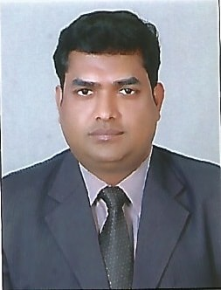
Introduction Dr Akhilanand Chaurasia
Dr. Akhilanand Chaurasia, a clinical consultant, academician and researcher at Department of Oral Medicine and Radiology, King George Medical University, Lucknow, India.
He has remarkable credit of contribution to academics by publishing more than 75 research papers, Books and Book chapters, peer reviewer of more than 50 international journals. He is editor in chief of 2 national journals, member of editorial board of 14 international journals and associate editor of 1 international journal.
His prime area of research is AI based dental imagery, Digital health and AI based diagnostics.

Slide 7
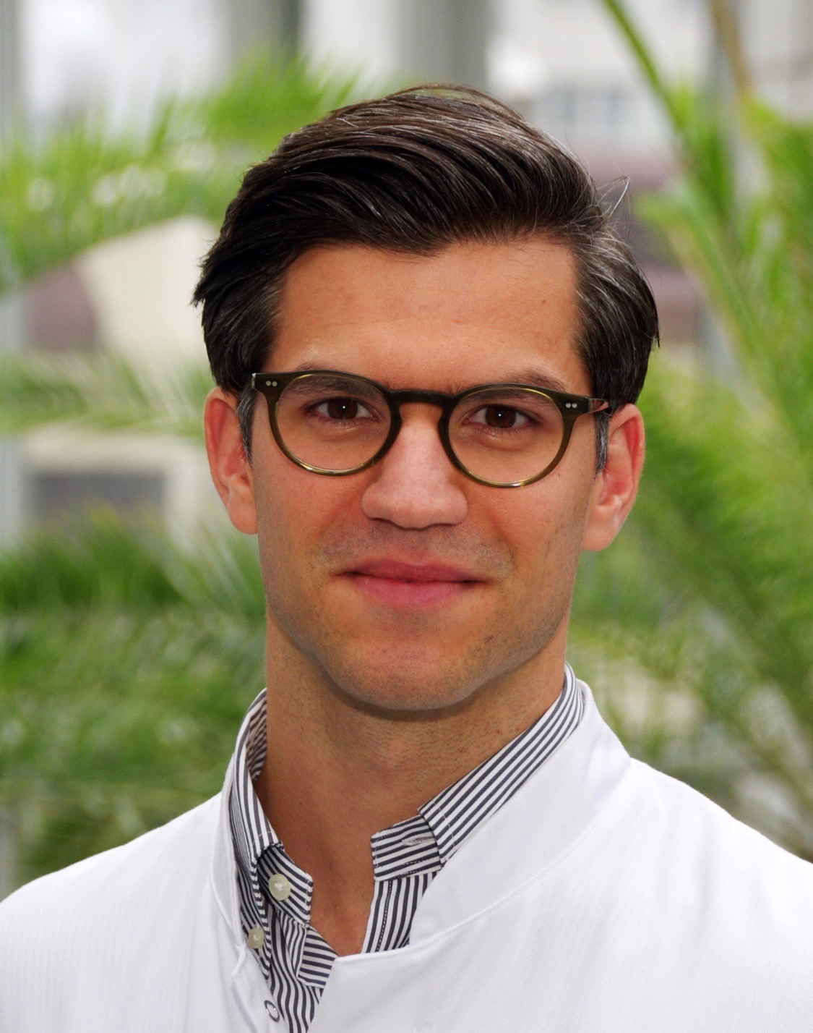
Introduction Dr Robert Gaudin, MD
- Medical doctor & and final year dental studies at Charité, Berlin
2015-2017 Research Fellow at Harvard Medical School, MGH
Since 2017 resident physician OMFS Department, Charité
2018- 2020 Fellow at the Laboratory for Innovation Science
at Harvard Business School
2018 Founder of VideaHealth a MIT startup for AI in medical imaging -> Accelerator DeltaV and Sandbox MIT
2020 Founder of DentalXrai a Charité startup for AI in medical imaging

Slide 8
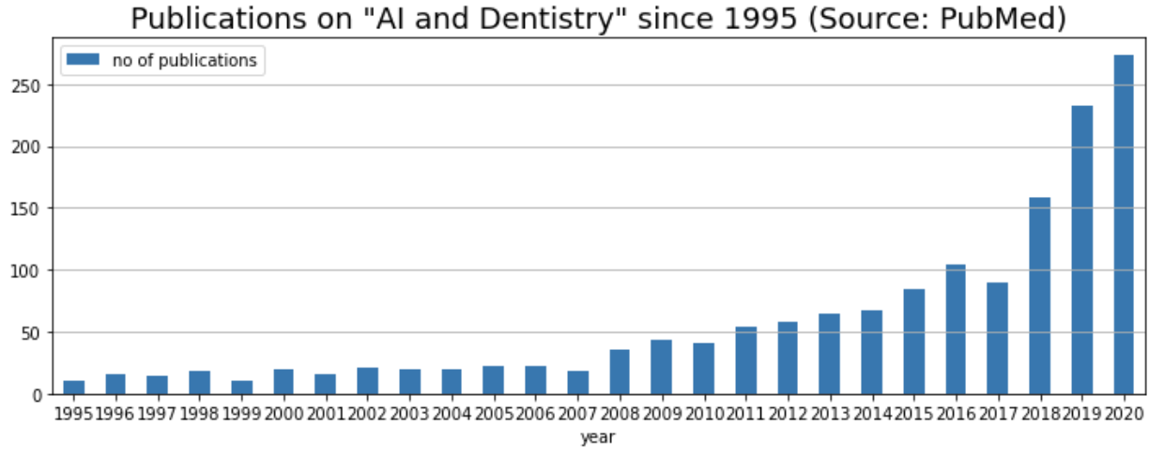
Artificial intelligence for dental image analysis: A Guide for Authors and Reviewers (FGAI4H-J-010-A04)

Slide 9
Artificial intelligence for dental image analysis: A Guide for Authors and Reviewers (FGAI4H-J-010-A04)
Objectives: The number of studies […] is growing fast. […] limitations in planning, conduct and reporting, […]. […] a non-authorative guide for authors and reviewers[…].
Methods: […] existing guidelines […] evidence-based research practice, […] derived on a discussion basis within the ITU/WHO focus group “Artificial Intelligence for Health (AI4H)”, and the topic group “Dental diagnostics and digital dentistry”, […].
Results: Thirty-one items on planning, conducting and reporting studies were devised. […]
Conclusion: Scientists, reviewers and editors should consider this guide when planning, conducting, reporting and evaluating studies on AI for dental image analysis.

Slide 10
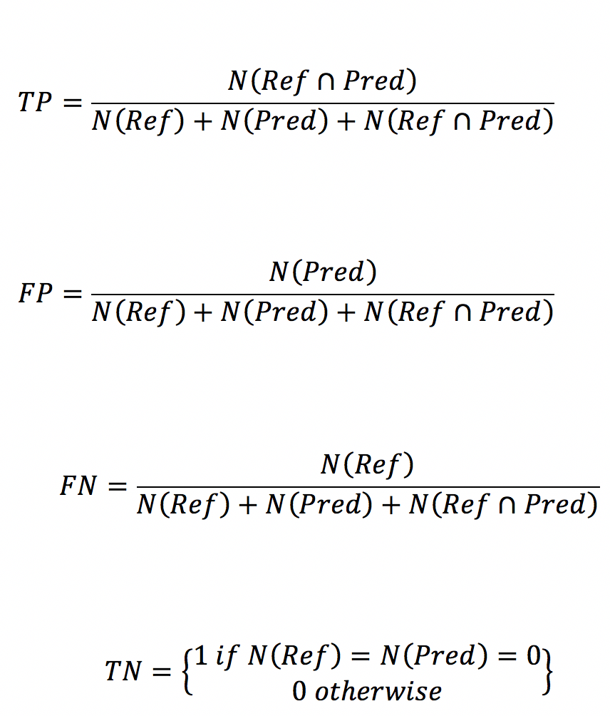
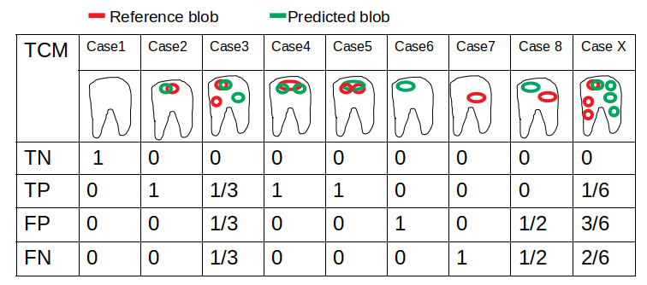
Confusion matrix for dental image segmentation tasks
Garcia-Cantu et al. 2020: Detecting caries lesions of different radiographic extension on bitewings using deep learning. Journal of Dentistry 100, 103425.

Slide 11
Outputs
TDD – Topic description document (FGAI4H-J-010-A01)
Call for Topic Group Participation “Dental Diagnostics and Digital Dentistry” (FGAI4H-I-010-A02)
Discussion paper “Artificial intelligence for dental image analysis: A Guide for Authors and Reviewers” (FGAI4H-J-010-A04)

Slide 12
Next steps
-) Further advance and discuss the TDD
-) Dissemination and publication of the manuscript on Artificial intelligence for dental image analysis: A Guide for Authors and Reviewers
-) Further analyses how to bridge the gap between reporting practices in dentistry (metrics on tooth level) and AI model outputs

Slide 13
Thank you!

