Slide 1
FG-AI4H-J-009-A03
E-meeting, 30 September – 2 October 2020
Source: | TG-DiagnosticCT Topic Driver
Title: | Att.3 – Presentation (TG-DiagnosticCT)
Purpose: | Discussion | Information
Contact: | Bingshu Chen | E-mail: cbingshu@infervision.com
Abstract: | This PPT contains updates on indicators for primary benchmarking metrics and future plans for further indicators and methods.

Slide 2
Purpose of the TG
Establish a standardized assessment framework for the evaluation of AI-based methods for medical applications
Propose a benchmark for AI in volumetric Chest CT which include data format, desired data for AI training and testing as well as AI performance evaluation methodologies.
Structure and Content
Include a general review of a specific area of Chest CT lung cancer detection
Relevant existing AI solutions
AI Input Data Structure and Output Data Structure
Test Data Labels
Score and Metrics : updated
Available Public Data and Undisclosed Test Data Set Collection
Reporting Methodology

Slide 3
Primary Benchmarking Metrics
Detected nodules by standalone AI system, were compared with pre-labelled nodules to determine the true positive nodules and false positive nodules, benchmarking metrics including nodule-based sensitivity, false positive rate, free-response ROC, location ROC, F-score, time spent reading the cases were calculated.
Nodule detection
Clinical Performance indicators by binary classification
Clinical Performance indicators by multi-class classification

Slide 4
Nodule detection
Nodule detection refers to positioning nodules based on radiological results. The indicators include:
Indicators | Explanation and formula
True positive rate | Detected nodule All nodules ^{×100%}
Average false positive number | False positioning number Radiological cases
FROC Curve | Vertical axis is true positive rate. Lateral axis is Average false positive number

Slide 5
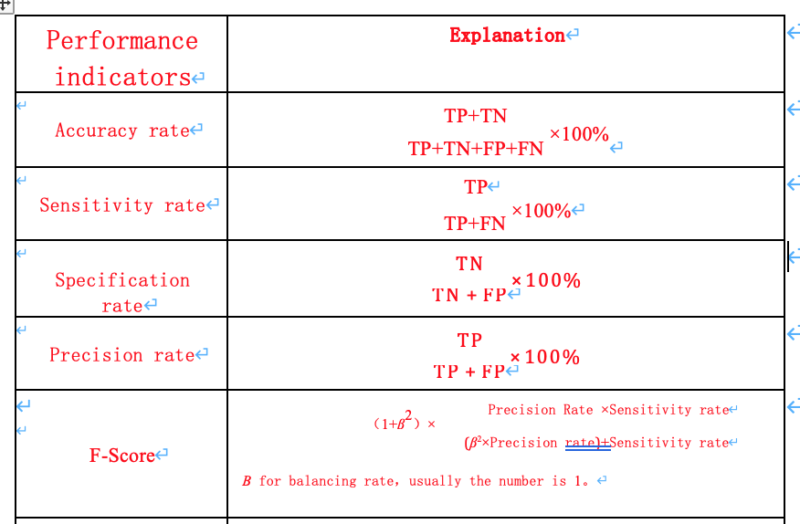
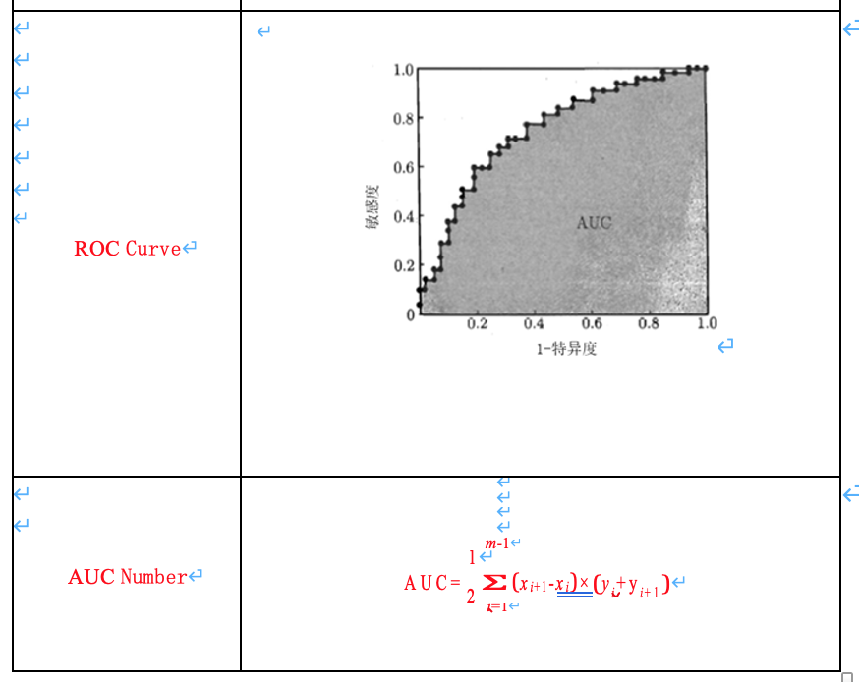
Clinical Performance indicators by binary classification

Slide 6
Clinical Performance indicators by multi-class classification
Multi-class classification including grading classification and comprehensive classification. Grading classification can transfer classification to sets of binary classification.
Comprehensive classification refers to indicators like KAPPA.
Future Plans
More discussion on different indicators and explanation
Nodule characterization indicators: size measurement, density, classification and malignancy
Other indicators, such as robustness, reproducibility and generalization

Slide 7
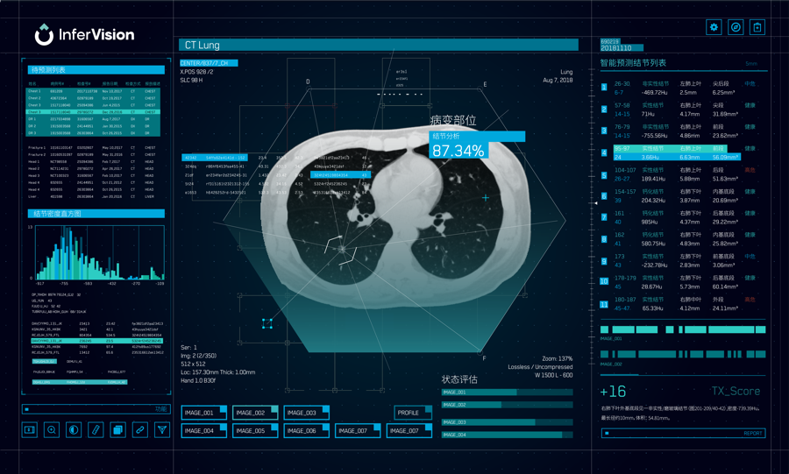
Thank You
cbingshu@infervision.com

