Slide 1
FGAI4H-I-042-A01
E-meeting, 7-8 May 2020
Source: | TG-Dental Topic Driver
Title: | FTG-Dental: Artificial intelligence for dental image analysis: A guide for authors and reviewers - Att.1: Presentation
Purpose: | Discussion
Contact: | Joachim Krois Falk Schwendicke | E-mail: joachim.krois@charite.de E-mail: falk.schwendicke@charite.de
Abstract: | This presentation is given at the FG-AI4H e-meeting on 07-08 May 2020 and contains: Background and aims Envisioned process Expected outcome

Slide 2
Meeting I TG-Dental: Artificial intelligence for dental image analysis: A guide for authors and reviewers
May 07-08, 2020
Falk Schwendicke, Joachim Krois

Slide 3
Background
Doubts as to the robustness, generalizability, transparency and replicability
In dentistry, and specifically, dental image analysis,
datasets are small, lacking robustness and stability
data generation process, data sources and annotation strategy poorly conducted and reported
choice of model, training and hyperparameter tuning as well as validation strategy not ideal or not reported
outcomes often focus on technical performance rather than relevant aspects beyond that
A wealth of studies performed and submitted for publication, all with these flaws: Research resources wasted, futile research spread and potentially harmful applications applied clinically

Slide 4
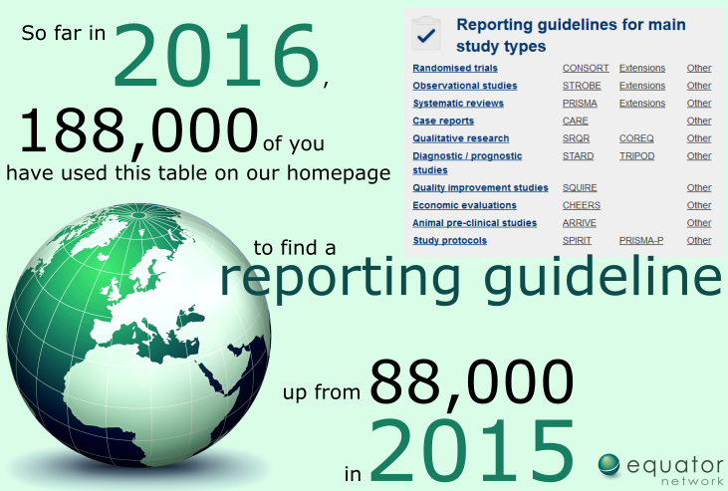
Aims
Guidance for authors, reviewers and editors to scrutinize when assessing their own or other researchers’ work needed
We plan to establish, discuss and approve a guidance document on how to conceive, conduct and report studies on AI in dental image analysis.
CONSORT
STROBE
STARD
TRIPOD RECORD
QUADAS-2

Slide 5
Envisioned process
existing reviews and guidance materials
principles of evidence-based research practice and reporting checklists
a set of guidance items will be defined by topic drivers and members of the TG Dental
Guidance document will be circulated and discussed among the focus group.
Structured consensus process tbd

Slide 6
Expected outcome
publication in Journal of Dentistry
narrow focus on dental image analysis and AI, additive to other guidance documents to come
NOT authorative and final, but a living document.

Slide 7
Next steps
Finalization of paper and checklist
Circulation among focus group
Discussion and agreement
Submission, dissemination, refinement

Slide 8
Thank you!

