Slide 1
FGAI4H-I-038-A01
E-meeting, 7-8 May 2020
Source: | Editors
Title: | Updated DEL02: Outline Describing Suggested Topics for the Regulatory Considerations on AI for Health Working Group (Draft: April 2020) - Att.1: Presentation
Purpose: | Discussion
Contact: | Khair ElZarrad, PhD, MPH (U.S. FDA) Naomi Lee, M.D. (Lancet, UK) | E-mail: Mohammed.ElZarrad@fda.hhs.gov E-mail: naomi.lee@lancet.com
Abstract: | This PPT contains the presentation of FGAI4H-I-038.

Slide 2
Working Group on Regulatory Considerations on AI for Health (WG-RC)
DEL02: Outline Describing Suggested Topics for Regulatory Considerations on AI for Health
Khair ElZarrad, PhD, MPH (U.S. FDA)
Naomi Lee, M.D. (Lancet, UK)

Slide 3
Purpose & Scope
A high-level overview of key regulatory considerations for the use of AI in healthcare and therapeutic development
A resource that can be considered by:
regulators who might be in the process of identifying approaches to manage and facilitate AI solutions
developers who are exploring AI solutions
other stakeholders
Not intended to be a guidance, regulation, or policy
Not a substitute for planned and/or ongoing efforts to develop frameworks

Slide 4
Purpose & Scope
Act as the point of contact between the FG and regulators:
Provide input on regulatory considerations for the FG to consider in their work. Enabling the FG to be up to date on regulatory processes, and align where possible.
To inform regulators about the work of the FG. Enabling regulators to use the work of the FG in their processes.

Slide 5
Topic Areas for Regulatory Considerations
Documentation and Transparency
Risk Management and Lifecycle Approach
Data Quality
Analytical and Clinical Validation
Engagement and Collaboration
Data Protection and Information Privacy
Note: these topic areas are not fully inclusive

Slide 6
Documentation and Transparency
Transparency and effective documentation are essential for AI solutions and systems that may be subject to regulatory review.
Prespecifying and documenting the development, validation, and piloting of AI solutions are important factors that will help establish trust and confidence and guard against biases and data dredging.
It is important for regulators to be able to trace back the development process and to have evidence and documentation of essential steps and decision points.
It is also important to note that systems used to track and document development processes and key decision points should be designed to protect against data manipulation and adversarial attacks, and to track and record access and any changes applied.

Slide 7
Risk Management and Lifecycle Approach
The controls and measures put in place to ensure that an AI solution functions as expected while minimizing any risk should be proportional to the risks that could be imposed if the AI solution were to malfunction.
2. Developers need to consider the intended use of the AI solution and the clinical context, if appropriate, to evaluate the level of risk.
SaMD IMDRF risk categorization

Slide 8
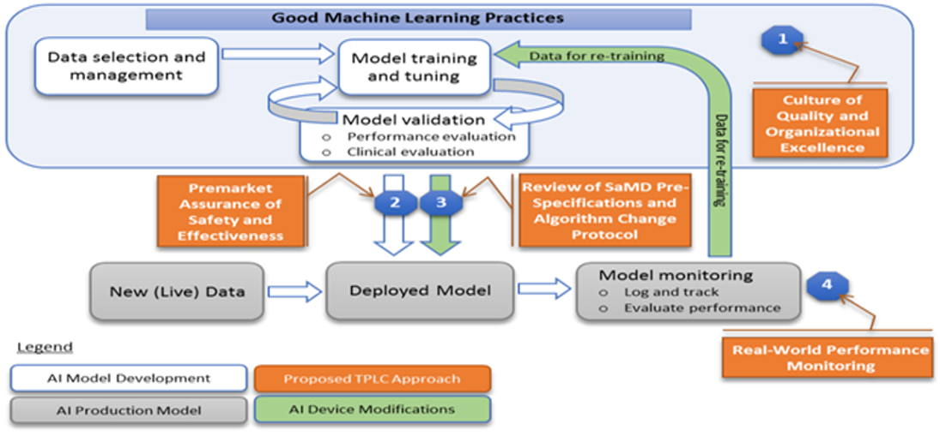
Total Product Lifecycle Approach
A lifecycle approach that involves good machine learning practices throughout the development and deployment of adaptive AI/ML solutions can facilitate continuous learning and product improvement while providing effective safeguards
Overlay of FDA’s TPLC approach on AI/ML workflow

Slide 9
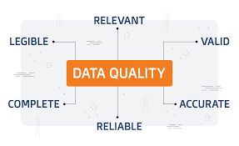
Data Quality
Harmonizing data from different sources, standards, and formats into a coherent dataset(s)for the purpose of its comprehensive analysis is especially challenging when using healthcare data.
Examples of factors that may affect the quality of health data include:
Bias
Missing values
Outliers
Errors
If data quality issues are identified early, the resulting possible harm could potentially be ameliorated with careful design or prompt troubleshooting.
To mitigate the unique data quality issues that arise in healthcare data and the associated risks, stakeholders should continue to work to create data ecosystems to facilitate the sharing of good-quality data sources.

Slide 10
Analytical and Clinical Validation
Developers can establish trust in their AI solution by performing well-documented technical and clinical validation steps throughout its lifecycle.
IMDRF description of clinical evaluation components

Slide 11
Collaboration and Engagement
Stakeholders
Establishing a common understanding of the technology, its implications, and regulatory considerations between stakeholders will support the responsible development of AI-related health tools and enhance clarity throughout the process.
Developers and Regulators
Developers may want to consider engaging with regulators early in the development process to address any critical issues that may have regulatory implications and to ensure that they are accurately accounting for the complexity of the clinical and public health contexts of the AI solution’s intended use.
Regulatory Agencies
Expand on current collaboration and ensure that AI is considered.

Slide 12
Data Protection and Information Privacy
More than forty countries have enacted data protection regulations or information privacy laws and many other countries are in the process of enacting such laws.
When developing an AI solution for therapeutic development or healthcare applications, early in the development process developers should consider gaining an understanding of applicable data protection regulations and information privacy laws, including special regulatory provisions related to sensitive data, such as genetic data.
Developers should be aware of the nuances of the different jurisdictions’ regulations and laws and consider documenting their data protection practices accordingly.

Slide 13
Considerations for Regulating and Assessing AI for Health in Low-Resource Settings
Fully understand the complexity of the healthcare needs in the specific setting.
Encourage dialogue between all stakeholders to assure that the development of the AI solution is responsive to the needs and specifics of the setting.
Identify and dedicate the needed resources to facilitate the development, testing, and deployment of the AI solution.
Determine the regulatory and governance needs to ensure that the AI solution is safe and effective.
Ensure effective communication and collaboration between stakeholders to facilitate all of the processes.

Slide 14
WG-RC Initial Meeting – May 4-5, 2020
Attendance: Over 60 participants from different stakeholder communities
Discussion of the proposed outline of the deliverable and topic areas for key regulatory considerations (which were reviewed in the previous slides)

Slide 15
Next steps– up to July, 2020
Subgroups will meet to discuss and develop different topic areas. They will meet at least twice before the next WG meeting.
Build on the initial outline document
Arrange a further meeting for all sub groups to talk further about the work of the FG
Next working group meeting in July

